Slide 1

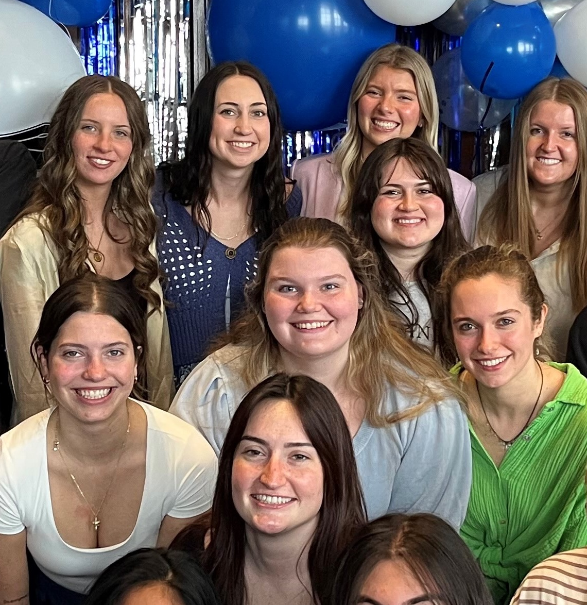
1. RECENT JOB/INTERNSHP OPENINGS | New week, new opportunities to learn and grow as an HTM professional. Check out the listings for jobs and internships!
2. GVSU TEACH-IN | The GVSU Teach-In: Lifelong Learning Toward Educational Equity and Action is a campus-wide opportunity that explores educational equity across disciplines. Join us November 10 on the Valley Campus and November 11 on the City Campus.
3 CAREER & INTERNSHIP FAIR 2026 | The GVSU Career & Internship Fair is on October 13, 2026 at the Devos Convention Center. CareerLab is hosting events leading up to the fair including the annual Suit Up shopping day at JC Penny on October 2nd.
4. HOMECOMING WEEK 2026 | Homecoming kicks off next week with events across campus, leading up to the Alumni Homecoming Tailgate and football game on Saturday, October 3. Wear your Laker gear, join the tailgate and be part of the celebration!
9.28.2026

Slide 2
New Internship and Employment Opportunities
Event Sales Coordinator
Main Event Entertainment - Grand Rapids, Michigan
Application Deadline: Until position(s) are filled--- December 1st, 2026
Posted: 9/24/26
Director of Dining Services
Kandle Dining Services - Independence , Kentucky
Application Deadline: 12/18/26
Posted: 9/18/26
Concierge Lounge Attendant
AHC Hospitality - Grand Rapids, Michigan
Application Deadline: 10/30/26
Posted: 9/2/26
Culinary / Kitchen Prep / Line Cook
Char+Barrel @ Hotel Rose - Rockford, Michigan
Application Deadline: ongoing
Posted: 9/2/26
1

Slide 3

GVSU TEACH-IN
The GVSU Teach-In: Lifelong Learning toward Educational Equity and Action is a campus-wide, student-centered learning experience dedicated to advancing educational equity across the university. Bringing together students, faculty, and staff, the Teach-In creates opportunities to explore how educational equity shapes teaching, learning, research, and practice across disciplines, including technology, healthcare, engineering, business, the arts, and beyond.
Join us November 10 on the Valley Campus and November 11 on the City Campus.
Faculty, staff, and students are invited to submit session proposals by October 11.
2

Slide 4
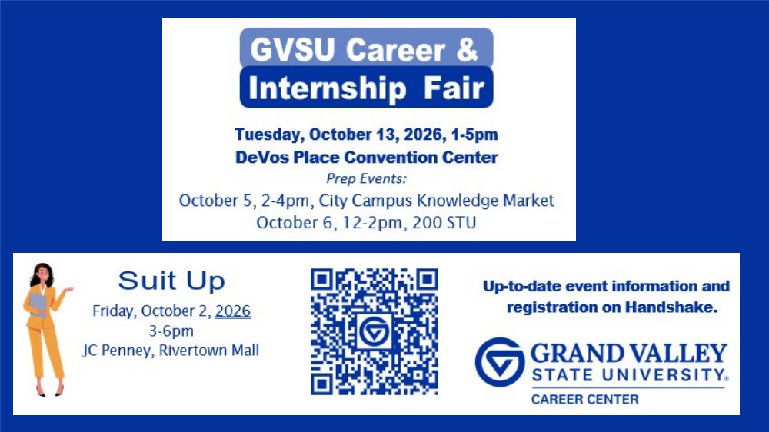
CAREER FAIR 2026
3

Slide 5
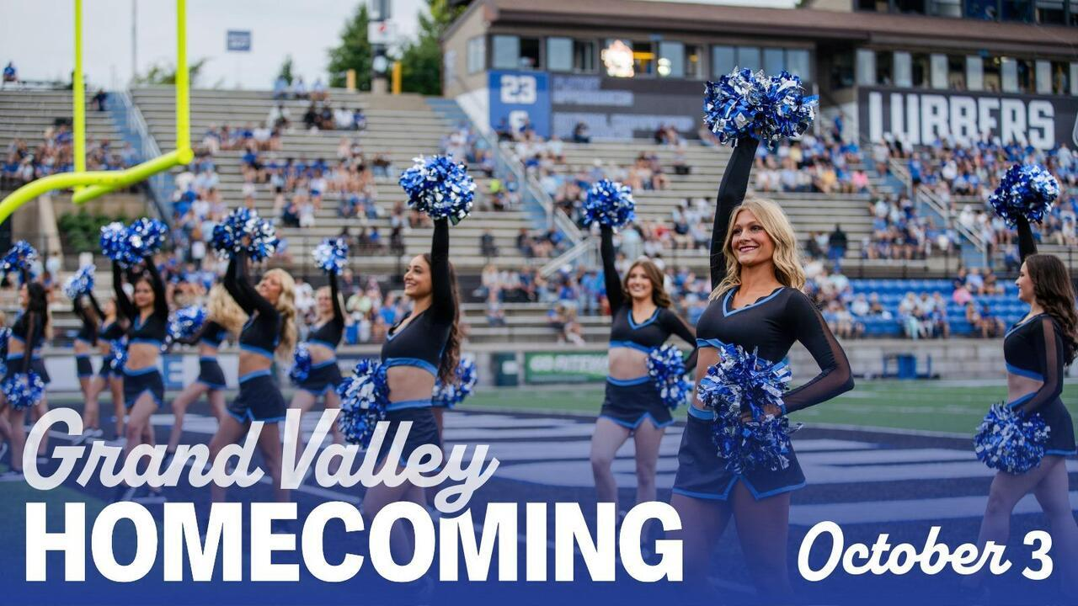
HOMECOMING WEEK
4
Homecoming kicks off next week with events across campus, leading up to the Alumni Homecoming Tailgate and football game on Saturday, October 3. Wear your Laker gear, join the tailgate, join the daily activities and be part of the celebration!
More information on Homecoming week

Slide 6



COMMUNITY EVENTS
Did you know that the world’s most attended public art event takes place in Grand Rapids, Michigan? Nearly one million people visit downtown Grand Rapids every fall for ArtPrize, an international art competition and cultural festival launched in 2009.
Start your tour of ArtPrize at the Clubhouse at 428 Bridge St NW where the concierge staff ready to help guide you through your ArtPrize experience.
ArtPrize runs now through October 3rd.

