Slide 1

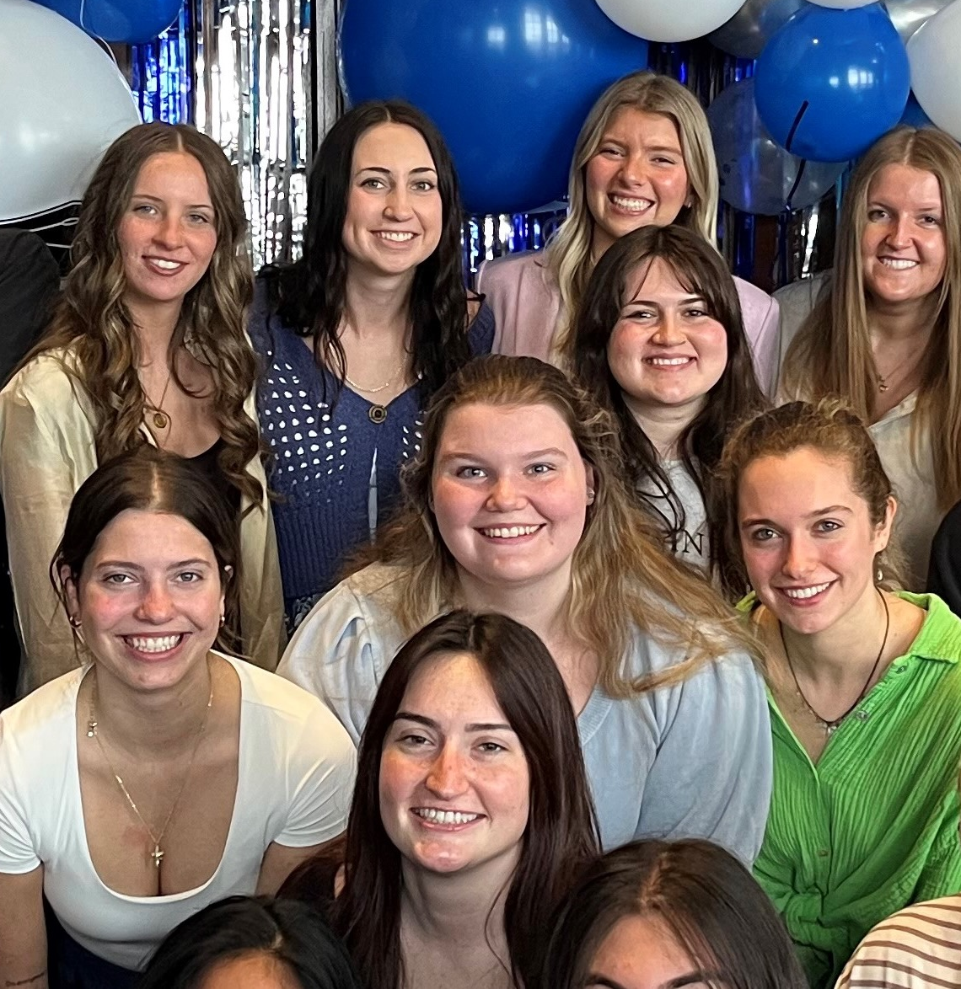
1. RECENT JOB/INTERNSHP OPENINGS | New week, new opportunities to learn and grow as an HTM professional. Check out the listings for jobs and internships!
2. HTM CLUB POPCORN DAY | The HTM Club is handing out free popcorn on Monday, Sept. 14 from 10:30 – 3:00 in the HTM student lounge. Come hangout out with other students between classes!
3 CAREER & INTERNSHIP FAIR 2026 | The GVSU Career & Internship Fair is on October 13, 2026 at the Devos Convention Center. CareerLab is hosting events leading up to the fair including the annual Suit Up shopping day at JC Penny on October 2nd.
4. STUDY ABROAD FAIR | Browse study abroad programs, meet students that have participated in the programs and talk to faculty program directors! Get answers to questions about program selection, funding, academics and more. September 23, 10 am – 3 Pm.
9.14.2026

Slide 2
New Internship and Employment Opportunities
Concierge Lounge Attendant
AHC Hospitality - Grand Rapids, Michigan
Application Deadline: 10/30/26
Posted: 9/2/26
Culinary / Kitchen Prep / Line Cook
Char+Barrel @ Hotel Rose - Rockford, Michigan
Application Deadline: ongoing
Posted: 9/2/26
Room Operations / Housekeeping
Hotel Rose - Rockford, Michigan
Application Deadline: Ongoing
Posted: 9/2/26
Front Office / Rooms Division Operations
Hotel Rose - Rockford, Michigan
Application Deadline: Ongoing
Posted: 9/2/26
1

Slide 3

POPCORN DAY
2

Slide 4
CAREER FAIR 2026
3

Slide 5

STUDY ABROAD FAIR
Start your adventure at the Study Abroad Fair - the GVSU Padnos Center for Global Experiences' biggest event of the year! Browse study abroad programs around the world! At this event, students are able to browse programs, talk to students that have studied abroad, and meet international students and program directors! Get answers to questions about SCHOLARSHIPS, academics, programs and more. Free food and refreshments!
Questions? Contact us!
studyabroad@gvsu.edu
616-331-3898
www.gvsu.edu/studyabroad
4

Slide 6



CAMPUS EVENTS
LAKER FAMILY WEEKEND
Friday, Sept. 18 - Sunday, Sept. 20, 2026
Laker families and supporters are invited to campus for a weekend full of events and activities including the popular Family Day football game.
www.gvsu.edu/familyweekend

