Slide 1
Understanding Posttraumatic Growth
Richard G. Tedeschi, Ph.D.
Bret A. Moore, Psy.D., ABPP

Slide 2
Executive Director, Boulder Crest Institute
Professor Emeritus, UNC-Charlotte
Developer of PTG concept with Lawrence Calhoun at UNC Charlotte
Author/Editor of several books on Trauma, Bereavement, and PTG
Clinical Psychologist in practice for 40 years
Background-Rich

Slide 3
▪ Deputy Director, Boulder Crest Institute
▪ Clinical and Prescribing Psychologist
▪ Former Active Duty Army Psychologist
▪ Veteran of Iraq War
▪ Faculty
∙University of Missouri
∙Adler University
∙Chicago School of Professional Psychology
∙Fairleigh Dickinson University
▪ Author/Editor
Background-Bret

Slide 4
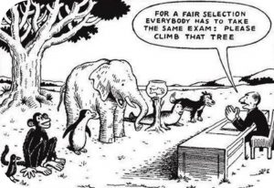
Trauma—the usual
Definition & Diagnosis: DSM
Treatment: Symptom focused
Outcomes: Symptom focused

Slide 5
DSM-5 Criteria
Criterion A: Stressor
The person was exposed to: death, threatened death, actual or threatened serious injury, or actual or threatened sexual violence (*changed in part because of service members and first responders).
Criterion B: Intrusion symptoms
Criterion C: Avoidance
Criterion D: Negative alterations in cognition and mood
Criterion E: Alterations in Arousal and Reactivity
*Intense fear, helplessness, and horror

Slide 6
Vulnerability & Resilience
Being exposed to traumatic events places one at somewhat increased risk for PTSD and other psychiatric disorders.
However, the majority of persons exposed even to the most catastrophic events tend not to develop stress related disorders.
Therefore we should speak of “potentially traumatic events” (Bonanno, 2012)

Slide 7
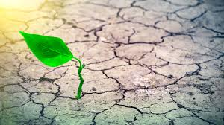
Trauma—not the usual
Understanding from the survivor’s point of view
“Expert Companionship”
Outcomes: Possibilities and Aspirations for Growth

Slide 8
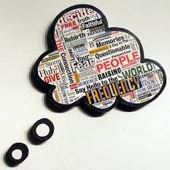
Trauma--Broadly defined
Threat to cognitive or psychological integrity-- a severe challenge to individuals’ past ways of understanding the world and their place in it, their personal identity.

Slide 9
Trauma & Cognition
    Challenging or shattering the assumptive world or core beliefs about
      benevolence
      safety
      predictability
      controllability
      vulnerability
      self-esteem
      morality (moral injury)

Slide 10
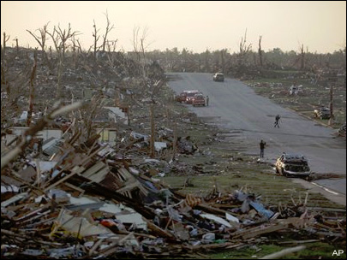
Reconstruction Needed

Slide 11
Trauma and narrative
Trauma is a turning point in the life narrative, the watershed event.
Events are traumatic when they disrupt the anticipated course of life or the plan people had for their lives.
If an event divides life into “before and after” it may be traumatic, and also, growth-enhancing.

Slide 12
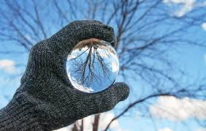
Posttraumatic Growth (PTG)
Posttraumatic Growth is both a process and an outcome: The experience of positive changes in oneself as a result of the struggle with traumatic events.
Changes are transformative and involve changes in perspective.

Slide 13
PTG Domains
Posttraumatic Growth domains are empirically derived.
New Possibilities
Relating to Others
Personal Strength
Appreciation of Life
Spiritual and Existential Change

Slide 14
Posttraumatic Growth History
PTG is not a new concept.
PTG is found in the wisdom literature of the great religions.
PTG examples are found in stories and literature across time and cultures.

Slide 15
Christianity and Suffering
“Suffering, on the other hand, tends to plow up the surface of our lives to uncover the depths that provide greater strength of purpose and accomplishment. Only deeply plowed earth can yield bountiful harvests.” (Graham, 1981, p. 27).

Slide 16
Buddhism and Suffering
The Noble Truths and suffering:
  Do not make it personal and react to it in a habitual way.
  Accept the suffering, embrace it rather than just react to it.
  When you have actually practiced with suffering - looking at it, accepting it, knowing it and letting it be the way it is – then suffering has been understood.

Slide 17
Existential Psychology and Suffering
Rollo May, Erich Fromm, Victor Frankl:
  Human condition or facts of existence: Suffering, guilt, and transitoriness.
  By engaging these, we can develop meaning in our living.
  Suffering doesn’t have to be mere suffering. It can produce individuation (not necessarily happiness).

Slide 18

Resilience vs. PTG
Resilience: “The ability to recover readily from illness, depression, adversity or the like.” The ability to regain shape.
Also, resistance to adversity.
Versus PTG: a new level of functioning and perspective--transformative responses to adversity.

Slide 19
Encounters with Posttraumatic Growth
You will hear examples if you listen.

Slide 20
A sailor whose legs were amputated in a shipboard accident
A lot more good things have happened to me since that accident that probably wouldn't have happened. I don't regret it. I don't wish it hadn't happened.

Slide 21
A soldier who lost his friend during a convoy
I struggled with Dave’s death for a long time. I still struggle with it. But I look at my daughter, my wife, my home…and I feel appreciative. I’m sad that he died, but because of his death I no longer take things for granted and I cherish so many things in my life. Dave gave this gift to me.

Slide 22
A Vietnam War Veteran
I have gained much more than I lost from being in Vietnam. The taste is sweeter. The flowers are more beautiful. The delights of this earth are more fully appreciated and enjoyed.

Slide 23
A bereaved mother
Before Justin’s death I often said that family was my priority. I think I believed that, but my actions didn’t always show it. Now, family is a priority in my heart, head, and in my actions. I am there for my other children and my husband. Not a day goes by that I don’t grieve for my beautiful boy, but not a day goes by that I don’t thank him for giving me perspective and making our family stronger. We all love each other deeper…and can love deeper…I love deeper because of him.

Slide 24
  “I am a more sensitive person, a more effective pastor, a more sympathetic counselor because of Aaron’s life and death than I would ever have been without it. And I would give up all those gains in a second if I could have my son back. If I could choose, I would forego all of the spiritual growth and depth which has come my way because of our experiences, and be what I was fifteen years ago, an average rabbi, an indifferent counselor, helping some people and unable to help others, and the father of a bright, happy boy. But I cannot choose.”
Rabbi Harold Kushner in Viorst, J. (1996) Necessary Losses. p. 295.

Slide 25
Posttraumatic Growth Research
Concepts, Measures, Data

Slide 26
Posttraumatic Growth Inventory—Expanded
Empirically derived domains:
  New Possibilities,
  Relating to Others,
  Personal Strength,
  Appreciation of Life,
  Spiritual & Existential Change.

Slide 27
Relating to Others
6. I more clearly see that I can count on people in times of trouble. (I)
8. I have a greater sense of closeness with others. (I)
9. I am more willing to express my emotions. (I)
15. I have more compassion for others. (I)
16. I put more effort into my relationships. (I)
20. I learned a great deal about how wonderful people are. (I)
21. I better accept needing others. (I)

Slide 28
New Possibilities
3. I developed new interests. (II)
7. I established a new path for my life. (II)
11. I am able to do better things with my life. (II)
14. New opportunities are available which wouldn't have been otherwise. (II)
17. I am more likely to try to change things which need changing. (II)

Slide 29
Personal Strength
4. I have a greater feeling of self-reliance. (III)
10. I know better that I can handle difficulties. (III)
12. I am better able to accept the way things work out. (III)
19. I discovered that I'm stronger than I thought I was. (III)

Slide 30
Spiritual & Existential Change
5. I have a better understanding of spiritual matters. (IV)
18. I have a stronger religious faith. (IV)
22.I have greater clarity about life’s meaning. (IV)
23.I feel better able to face questions about life and death. (IV)
24.I feel more connected with all of existence. (IV)
25.I have a greater sense of harmony with the world. (IV)

Slide 31
Appreciation of Life
1. I changed my priorities about what is important in life. (V)
2. I have a greater appreciation for the value of my own life. (V)
13. I can better appreciate each day. (V)

Slide 32
The Basics of PTG
Its not the trauma, it’s the struggle.
People first struggle to survive, not grow.
PTG and distress coexist.
PTG is reported across cultures.
There are various routes to growth.

Slide 33
Predictors of PTG
  Generally, studies indicate that severity is positively related to PTG, with an indication of a curvilinear relationship with more PTG related to moderate severity.
  Across life-span, late adolescents/young adults may report most PTG.
  Active coping, positive reinterpretation and acceptance coping tend to be related to PTG.

Slide 34
Predictors of PTG
  Deliberate rumination involves “searching for meaning” but also deliberately creating it by deciding what to believe and reconstructing the belief system in new design.
  Unhelpful responses to disclosure related to PTSD, helpful responses to disclosure related to PTG.
  Giving social support may be even more highly related to PTG than receiving social support.

Slide 35

BOULDER CREST

Slide 36
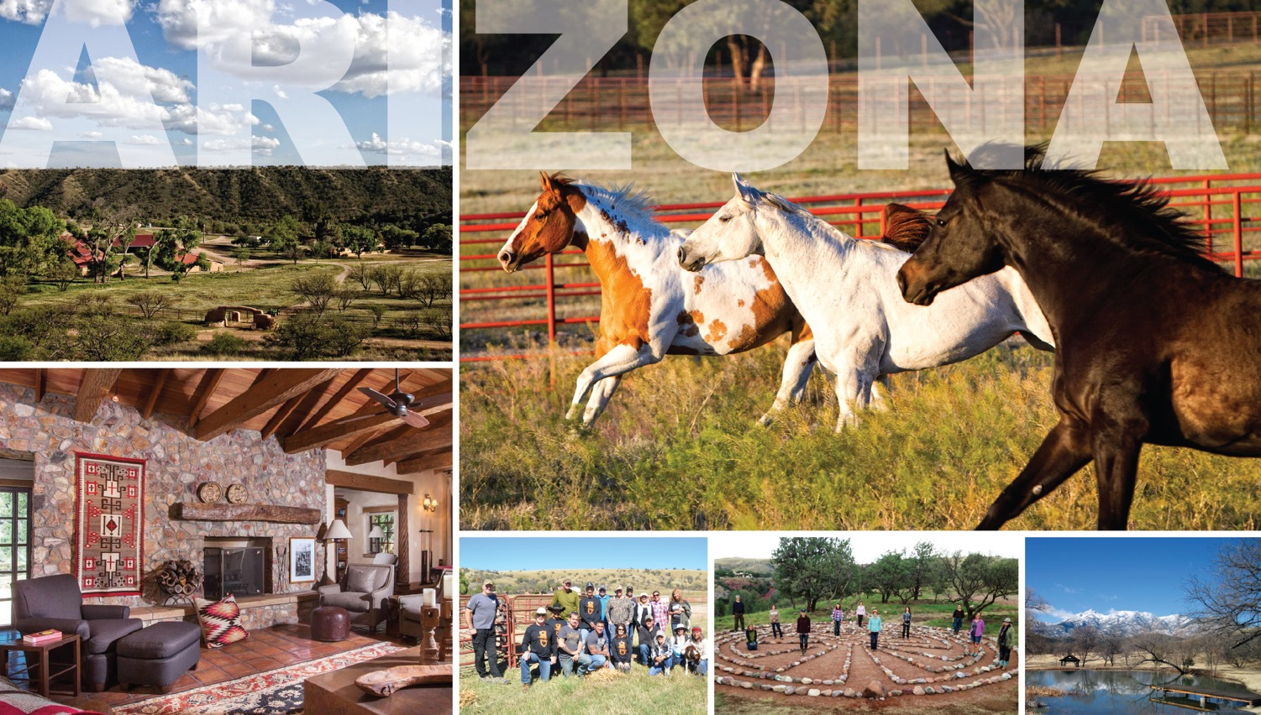
BOULDER CREST

Slide 37
Philosophy
▪ There is a sense of possibility for growth in the aftermath of trauma, not simply ongoing struggle with symptoms
▪ Paradigm shift of living with past experiences vs. extinguishing them
▪ Veterans see themselves as suffering not because of character defects, but because of what happened
▪ PTG model posits that in order to facilitate PTG, trauma survivors will benefit from expert companionship; the process is common and often occurs naturally
▪ Service/mission oriented

Slide 38
People
▪ Familiar with the military experience from their own service or from close connections with veterans
▪ They understand the PTG concept and do not focus on symptoms/dysfunction/deficits
▪ Use language consistent with a respectful and more familiar approach to veterans; minimal use of psychological terms/theories

Slide 39
Program
▪ Psychoeducation (physiological and psychological trauma; PTG)
▪ Emotion regulation training, including meditative techniques
▪ Constructive self-disclosure about trauma and life in the aftermath of trauma
▪ Narrative development that integrates perspectives on life before military service, military service, and the aftermath of deployment and service as the veteran returns home or separates
▪ Missions created to transmit learning about the value of life, living courageously, and other life lessons given to those in society who have not been exposed to these perspectives

Slide 40
Warrior PATHH
Measurement & Data Collection

Slide 41
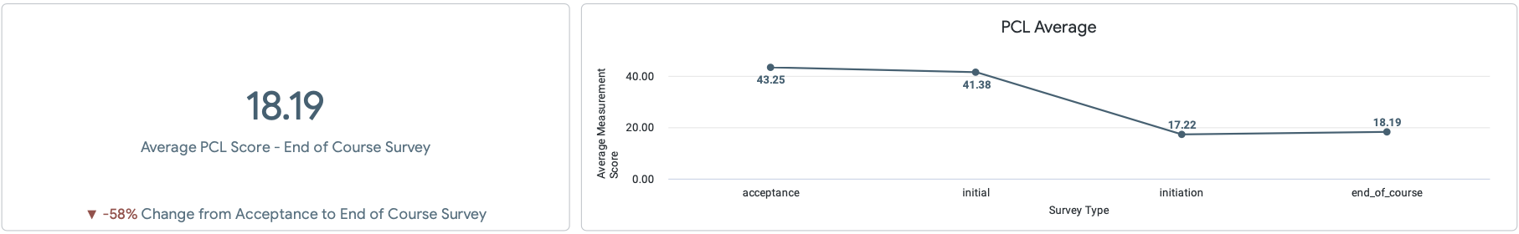
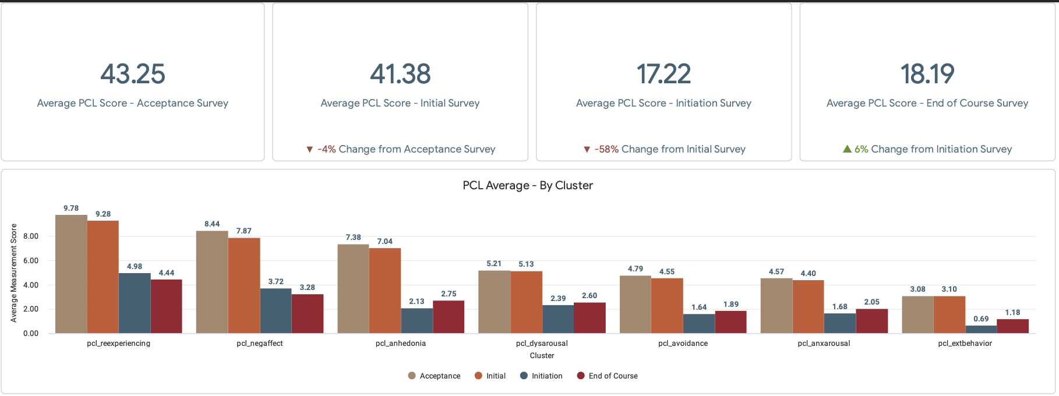
PCL
B

Slide 42
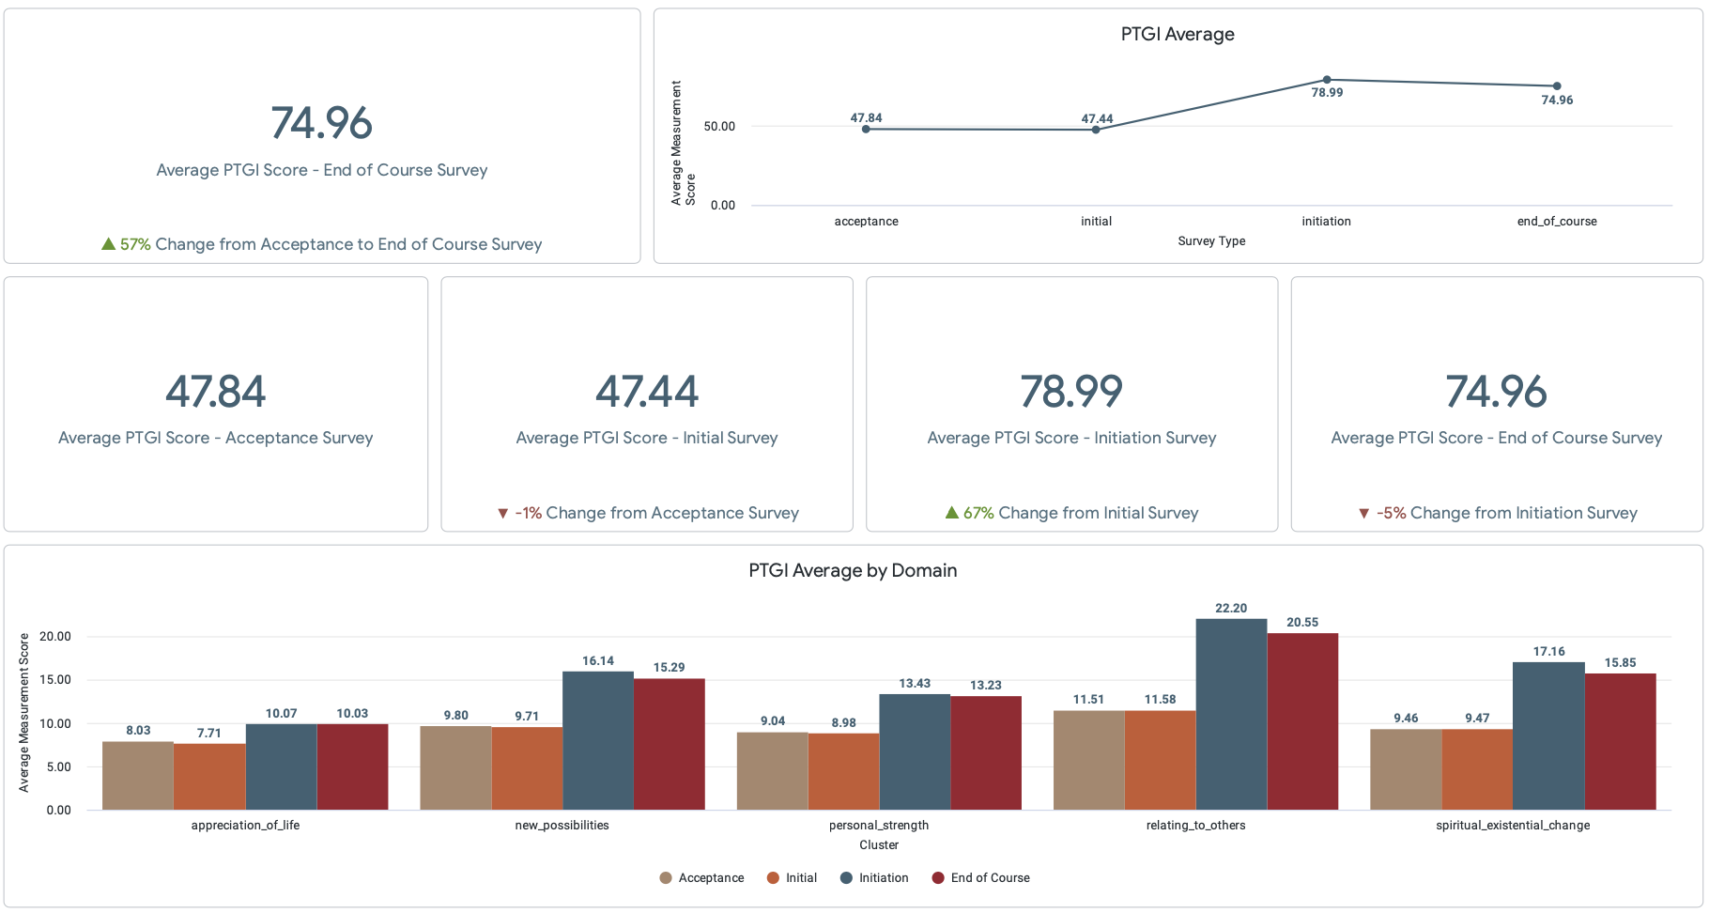
PTGI
B

Slide 43
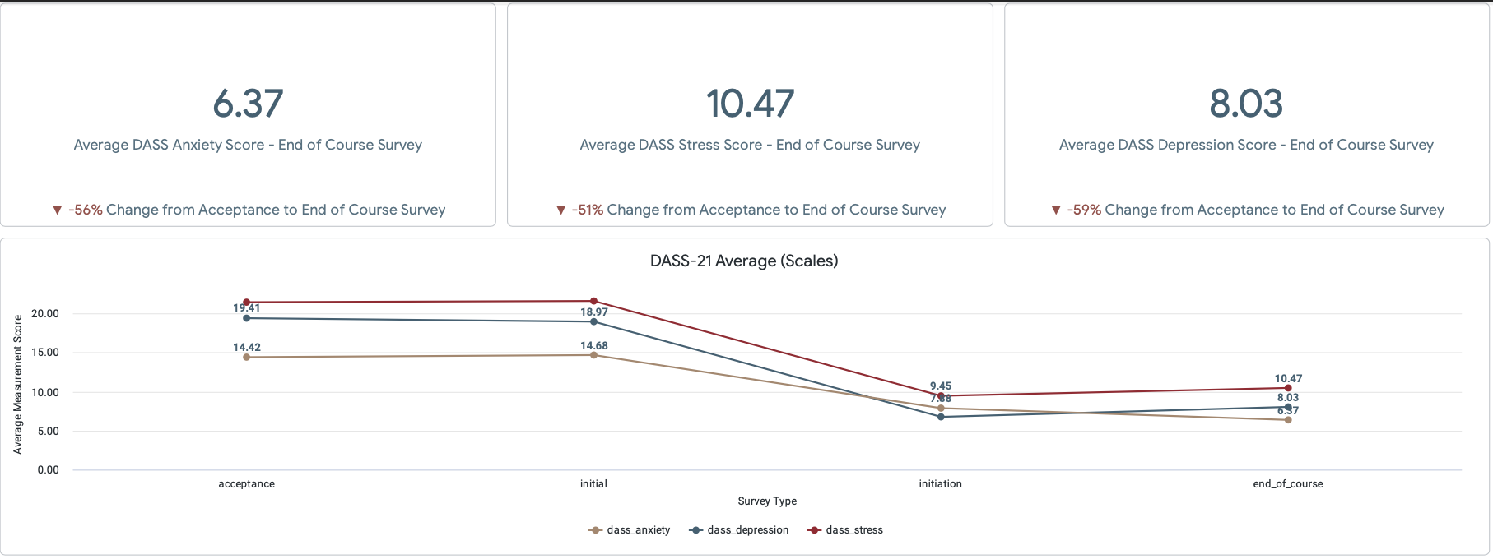
DASS - 21
B

Slide 44
Final Thoughts

Slide 45
Some Final Thoughts
No “time limits.”
It is a gradual process.
The assumption that a traumatized or grieving person is going to go though certain phases or stages in a predictable sequence is not helpful.
There may not be “closure.”
Those suffering loss continue to be attached.
Trauma survivors often must re-understand everything, and this can lead to Posttraumatic Growth.

Slide 46
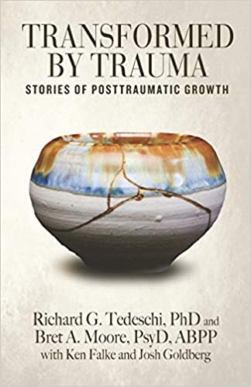
Transformed by Trauma

