Slide 1
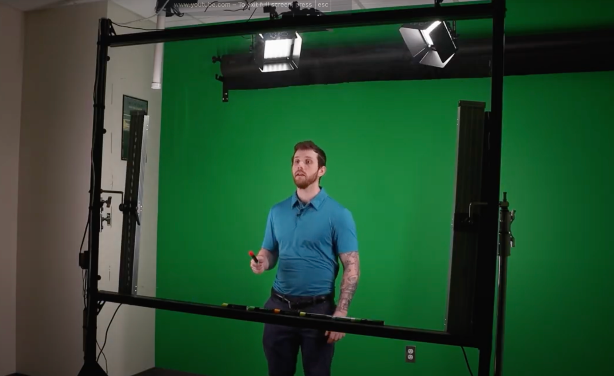
Lightboard Template
A guide to making a strong slide deck
for your Bridge recording

Slide 2
Keep text, images, and media content on one side of the screen
This allows enough room on the left for you to stand while recording
[ WHERE YOU STAND ]

Slide 3
Keep text, images, and media content on one side of the screen
This allows enough room on the right for you to stand while recording
[ WHERE YOU STAND ]

Slide 4




Follow these text rules:
Try to use at least size 18 font
Use colors + fonts that are easily readable
Position the text on the opposite side of the screen, where you won’t be standing
The software you use does not matter, as long as the slides are correct (Canva, Microsoft Powerpoint, Google Slides, Adobe Express, Keynote, etc).

Slide 5



Add Graphics + Images + Videos!
You can use a wide range of media types in your slides! Just make sure the graphics aren’t covering where you plan on standing!
Video
(embed it)
GIF
(import as image)
Image
(just drag and drop!)

