Slide 1
For the best experience in Collaborate Ultra:
Use Google Chrome
Make sure Chrome is up-to-date
Clear Chrome browser cache before entering a session
If you still have trouble, open the Session menu and Report an issue.

Slide 2
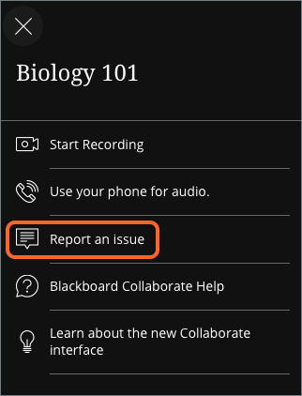
For the best experience in Collaborate Ultra:
Use Google Chrome
Make sure Chrome is up-to-date
Clear Chrome browser cache before entering a session
If you still have trouble, open the
Session menu and Report an issue.

