Slide 1
Revised Common Rule and Other Useful Updates
Office of Research Compliance and Integrity
January 2019

Slide 2

Agenda
Name Change
Revised Regulations
Other quick updates

Slide 3
Name Change!
HRRC: IRB:
Human Research Institutional
Review Committee Review Board
www.gvsu.edu/irb
Notes:
Our website address has changed.

Slide 4

Brief History
July 2011: OHRP issues ANPRM
September 2015: OHRP issues NPRM
January 2017: Final Rule published
January 21, 2019: Effective date & mandatory compliance date
Notes:
Why is this called the Common Rule? Because it has been adopted by 20 federal agencies, making this regulation “common” among these agencies. NOT ADOPTED BY THE FDA!!!
The most recent version of the Common Rule has been in place since 1991. After 20 years, it needed to be updated to reflect changes in research and technology: personalized medicine, CRISPR for gene editing, the internet, big data sets, wearable technology….
OHRP: Office of Human Research Protections, part of the federal Department of Health & Human Services
ANPRM: Advanced Notice of Proposed Rule Making
NPRM: Notice of Proposed Rule Making

Slide 5
Fundamental Changes
Focus resources on riskier research
Single IRB review for multi-site studies
Increase public transparency for federally funded research
Improve the consent process
Incorporate biospecimens into the regulations
Notes:
OHRP received feedback from researchers that IRB review was burdensome and took too long. For multi-site research, it could take years for the IRBs at all sites to complete their reviews, and all of these IRB reviews didn’t add substantially to participant protections. This led to delays and wasting federal money.
OHRP decided to use this feedback to make improvements:
IRBs should use their resources to focus on greater than minimal risk studies. More risk = more resources
To save time and money and to get research started in a timely manner, only 1 IRB will review multi-site research.
Public transparency: ICFs need to be posted on CT.gov
Improve consent process by requiring key information to be presented at the beginning of the ICF, and adding in some additional required statements
Biospecimens were not a large part of research back in 1991. This type of research has exploded in the last 15 years and the regulations needed to include more information on how these were to be handled.
We are not going to review every change, just those most likely to impact your research.

Slide 6
Definitions
Research: Definition clarified to exclude oral history, journalism, legal research, literary criticism, national security missions, public health surveillance
Clinical trial: Prospective assignment to an intervention to evaluate the effects on health-related outcomes
Benign Behavioral Intervention: Brief in duration, harmless, painless, not invasive or embarrassing
Notes:
Research: these were not previously considered to be research, but now the regulations specifically call them out to avoid confusion or misinterpretation.
Clinical trial: more about this later. Keep in mind that it is possible for exempt research to meet this definition. Includes both biomedical & behavioral health
Benign behavioral intervention: Examples: playing online games, solving puzzles under various noise conditions

Slide 7
Exempt Research
Exempt 2: Tests, surveys, interviews, observation of public behavior
  Can now include recording identifiable info that would have required expedited review
Exempt 3: Benign behavioral interventions
  If deception is involved, participants must agree to be deceived. Otherwise, will require expedited review
Exempt 4: Secondary research of data and biospecimens
  No longer has to be in existence at the time of IRB review
  If all data subject to HIPAA, can now be exempt
Notes:
Exempt 2: Used to say “information recorded in an identifiable format AND disclosure outside of research could harm participants” could not be exempt. Now says only one category needs to be true: 1) recorded information does not identify participants, 2) disclosure would not result in participant harm, or 3) if identifiable info is recorded, then limited IRB review is done.
Two new exempt categories 7 (storage) & 8 (use) have to do with broad consent for data and biospecimens. GVSU has elected not to implement these at this time due to the extensive infrastructure needs that are required for this. This is consistent with a majority of research institutions.

Slide 8
Limited IRB Review
Required under exempt categories 2 & 3: “There are appropriate provisions to protect the privacy of subjects and to maintain the confidentiality of the data.”
Review will be completed by the IRB chair or other IRB member.
Notes:
With the broadening of exempt 2 and the new exempt 3 category, an additional protection has been added: limited IRB review. An IRB member will verify that there are appropriate privacy and data protection measures in place to ensure the confidentiality of the collected information.
GVSU was already completing this assessment for exempt research, so this doesn’t represent a change in our process.

Slide 9
Continuing Review
“Continuing review is eliminated for all expedited studies, unless the reviewer explicitly justifies why CR would enhance the protection of research subjects.”
This will be documented in the approval letter.
Even though CR is not required, you must still submit changes to research, including personnel changes.
Strongly recommend closing the study when complete

Slide 10
Informed Consent
New templates on website: https://www.gvsu.edu/irb/
Minor updates to exempt template
Lots of changes to expedited/full board template!
  Key information box
  New statements about future research and sharing data with other researchers
  New statements regarding commercial profit, clinically relevant results and whole genome sequencing
Notes:
Please download the newest consent template from our website, as it has been revised to incorporate all the new requirements.

Slide 11
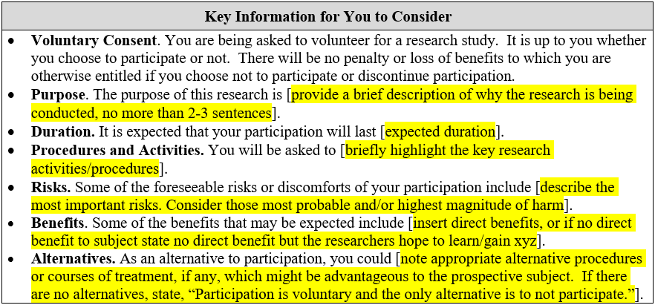
Consent: Key Information
Notes:
For non-exempt research, this box must be on the first page of the consent document. This box must fit entirely on page 1.
Remember, OHRP is trying to streamline the consent document. It wants key information up front, not buried on page 12 of a 25 page consent document. They also do not see the value in duplicating the same information.
Your research might need to include additional key information. For example, if participants will be required to purchase and download a specific app for the research, this should probably be included here. The IRB can determine that other information needs to be incorporated here as well.

Slide 12
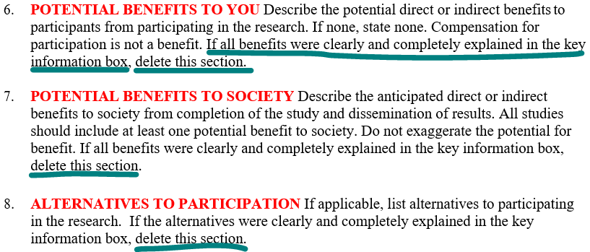
Consent: Key Information
Notes:
Good news: If everything in a section is explained in the key information box, it does not need to be repeated later in the document.

Slide 13
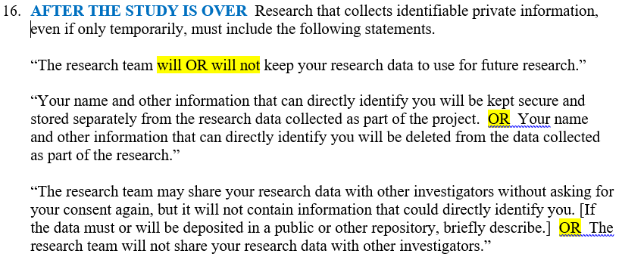
Consent: Future Research
Notes:
If you will be collecting identifiable private information, you must include this section in the consent document. For each paragraph, select the statement that represents your research. The goal is to be more transparent with participants about how their information will be used.

Slide 14
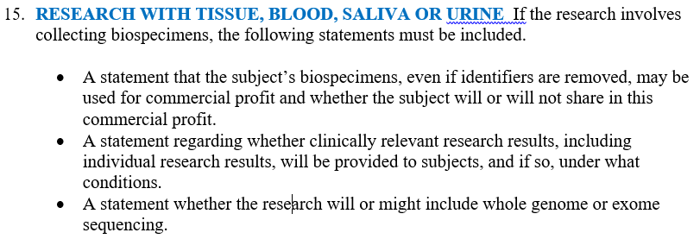
Consent: Biospecimens
Notes:
Please note that this section applies to all biospecimens, not just the ones listed here. I previously worked with a cystic fibrosis researcher who routinely collected sweat and phlegm from CF patients.
There is another section, further down in the consent document, that repeats the statement about whether or not clinically relevant research results will be shared with the participants. While this may seem like a mistake, it has been repeated on purpose as not all clinically relevant research results are derived from biospecimens. However, this statement only needs to appear once in the consent.

Slide 15
Clinical Trials
Clinical trial means a research study in which one or more human subjects are prospectively assigned to one or more interventions (which may be either placebo or other control) to evaluate the effects of the interventions on biomedical or behavioral health-related outcomes.
Notes:
So now we come back to clinical trials, and this expanded definition. Previously, this term was only defined by the FDA regulations. A few years ago, the NIH included this definition for any research they funded. We will assess every study to determine if it meets this definition as it is now part of the Common Rule.
This definition applies even if:
You are studying healthy participants
Your study does not have a comparison group
Your study is only designed to assess the pharmacokinetics, safety and/or maximum tolerated dose of an investigational drug
Your study is utilizing a behavioral intervention.
For example: A researcher is studying the effect of a text message intervention on the eating habits of healthy adults. Participants are randomized to either receive the texts or not, and they all have to complete a daily food diary. The goal is to determine if receiving text reminders about eating healthy foods impacts food choices. This meets the definition of a clinical trial. It would also require exempt review
https://grants.nih.gov/policy/clinical-trials/CT-Definition-Case-Studies_1.17.18.pdf

Slide 16
Clinical Trials
If the research is federally funded and meets this definition:
The consent form must be posted on www.clinicaltrials.gov.
Single IRB review
The consent form must include Certificate of Confidentiality language
All research personnel must complete Conflict of Interest training and Good Clinical Practice training
Research results must be posted on CT.gov within 1 year of study completion
Notes:
Additional requirements for federally funded clinical trials
All of these, plus other requirements! If your research falls into this category, we will work with you and your OSP contact to ensure compliance
The good news: If your research meets the definition of a clinical trial but is not federally funded, GVSU policy does not require you to do any of these things!

Slide 17
Transitioning Existing Research
Transitioning will be determined on a per-study basis
Generally, research will not be transitioned until enrollment and interventions are complete.
Transition will typically occur at the time of continuing review.
This will be documented in your approval letter.
Notes:
These new regulations and policies affect research approved on and after January 21, 2019. So what to do about ongoing research?
Why are we waiting until enrollment is complete to transition? Because once the study transitions, it must comply with all applicable parts of the revised Common Rule. If we wait until enrollment and interactions are complete, then the ICF will not need to be updated to comply, resulting in less work for you and us.

Slide 18
Other Useful Updates
IRBManager has been updated
GVSU policies have been updated
New COI disclosure process (Nov 2018)
Change from Epigeum to CITI (Jan 2019)
Personnel changes for exempt research (Jan 2019) [IRB Policy 1010]
Updated policy on reportable events (Jan 2019) [IRB Policy 1020]
Old emails being turned off: hrrc@gvsu.edu & rpp@gvsu.edu (Feb 2019)
Updated policy on data management (Soon?)
Notes:
While our policies have been updated, we will further refine them once we see how things are working out, and as additional federal guidance becomes available.

Slide 19
Questions?
Ben Vesper, Director, ORCI
Stacey Gardner, Research Compliance Specialist
(616) 331-3197
rci@gvsu.edu
www.gvsu.edu/rci
www.gvsu.edu/irb

