Slide 1
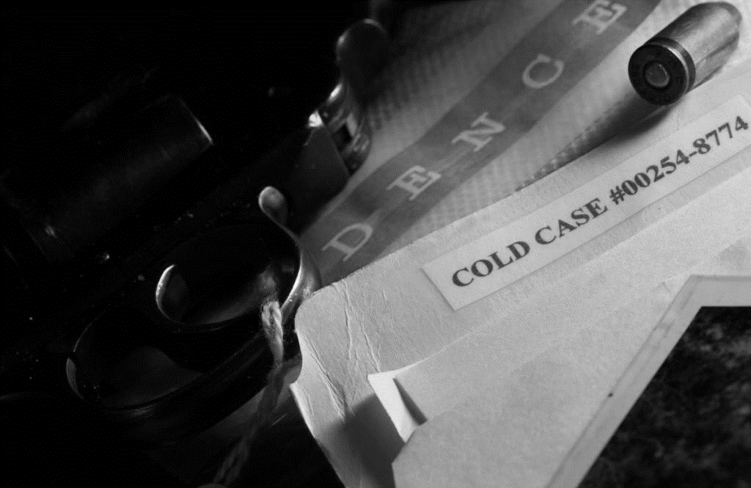
CJ 380: Cold Case Investigation
In partnership with Michigan State Police, the School of Criminology, Criminal Justice, and Legal Studies invites students (Junior or Senior status) to apply for this new and exciting opportunity to assist the Michigan State Police in working on real cold cases.
Students must commit to the class in both Fall 2023 and Winter 2024 semesters.
Requirements also include but are not limited to: Submitting an application, providing academic references, holding Junior or Senior status, 3.2 GPA, consenting to a background investigation, signing a confidentiality agreement, and being available on Tuesday evenings from 3 - 6pm
Don’t wait, class space is limited!
Application Deadline
Friday, April 28, 2023
Apply here!

