Slide 1
I AM
JUST ONE PERSON!
How to reconcile on time when it feels like you have no time.

Slide 3
AGENDA
SETTING
THE
FOUNDATION
WEEK
BY WEEK
STEPS
DEPARTMENT
CARDS
APPROVALS

Slide 4
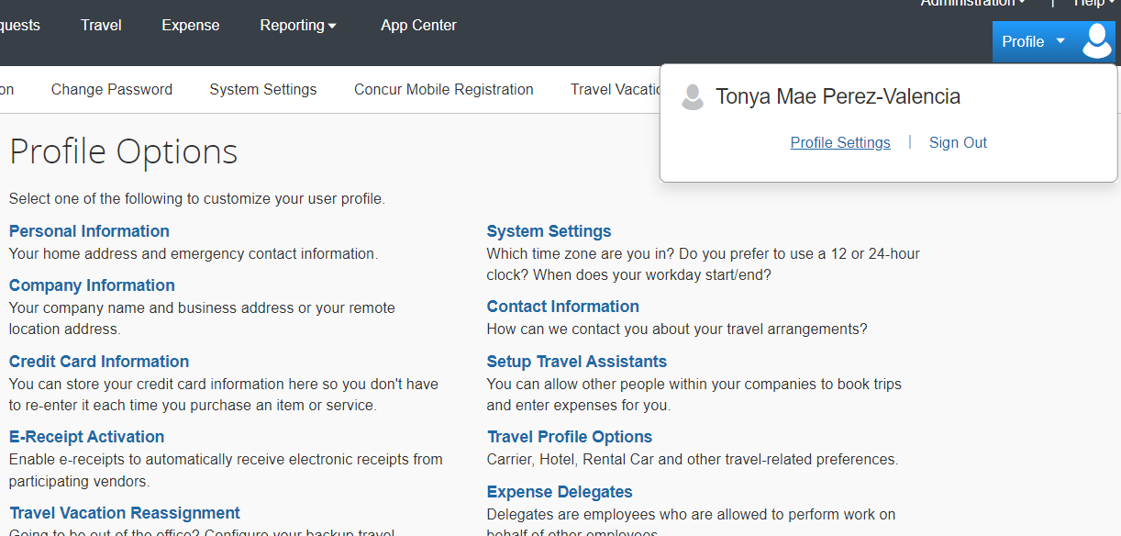
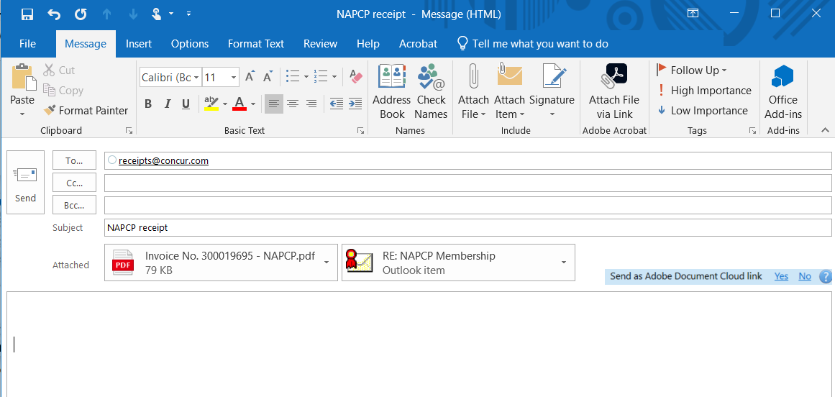
SETTING THE FOUNDATION
Obtain receipts at time of purchase
Tax exempt at time of purchase
Obtain necessary approvals ahead of time
Delegate when needed
Get receipts into Concur as soon as you get them
Put a reminder on your calendar
Weekly & on 25th of the month.

Slide 5
Create your expense report
Add any available expenses to the report
Upload your receipts to Concur
Edit/update all available expenses so you have no red warnings.
WEEK 1

Slide 6
Go back into your report you already created
Add any available expenses to the report
Upload your receipts to Concur
Edit/update all available expenses so you have no red warnings.
WEEK 2-3

Slide 7
Go back into your report you already created
Add any available expenses to the report
Upload your receipts to Concur
Edit/update all available expenses so you have no red warnings.
Submit for approval by last day of month.
TIP: Email your approver(s) if you know they won’t see the Concur notification
DAY 25
SUBMIT
EXPENSE
REPORT

Slide 8
DEPARTMENT CARDS
Use a transaction log in a shared L drive folder.
Have those who use the card upload their receipts to a folder on a shared L drive.

Slide 9
APPROVAL STAGE
Know who your approvers are
Communicate with your approvers
Make sure they are aware of the end of month deadline
Email them once you’ve submitted your expense report
Go back into Concur on last day of month to check that your approver has approved the report.

