Slide 1
Student Accounts Office

Slide 2
Billing Schedule – Fall 2026 Semester
Week of July 13th, 2026 – Bill emails are sent out
August 21st, 2026 – 1st semester due date
Payment in full or deferment plan enrollment required

Slide 3
Deferment Plan / Class Cancellation
August 21st, 2026
  25% of total amount owed + $40 non-refundable fee due by 5pm
Remaining Due Dates – 25% due each installment
  September 25th , 2026
  October 23rd , 2026
  November 13th, 2026
If payment not received by 5pm, December 12th, your classes will be dropped

Slide 4

Refunds / Late Fees
Refunds sent out the week of September 7th
Late fees of 1% per month assessed if following payment dates missed.
  September 25th, 2026
  October 23rd, 2026
  November 13th, 2026
Holds that prevent registration given to students with past due balances.

Slide 5

Payment Options
Online through MyBanner Account
  Electronic Check (no fee)
  Credit Card / Debit card (2.95% fee- domestic payments & 4.25% for international card payments)
  IFT
In Person at Student Assistance Center
  Check / Money order (no fee)
PayMyTuition (also accessible through MyBanner as well)

Slide 6
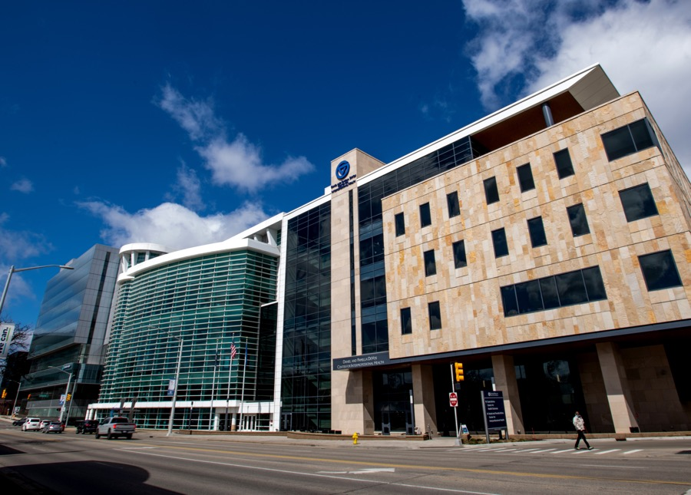
1042 Withholding – Tax implications
International students who are awarded grants or scholarships in an amount that exceeds the cost of tuition for the semester may be taxed on the amount of the overpayment- even if that overpayment covers other costs such as housing, meal plan, or GVSU Saves charges.
After the 75% add/drop period each semester, the charge for the tax amount is added to your student account balance.
If you have questions regarding this, please reach out to Brenda Sain in the payroll office at sainb@gvsu.edu

Slide 7
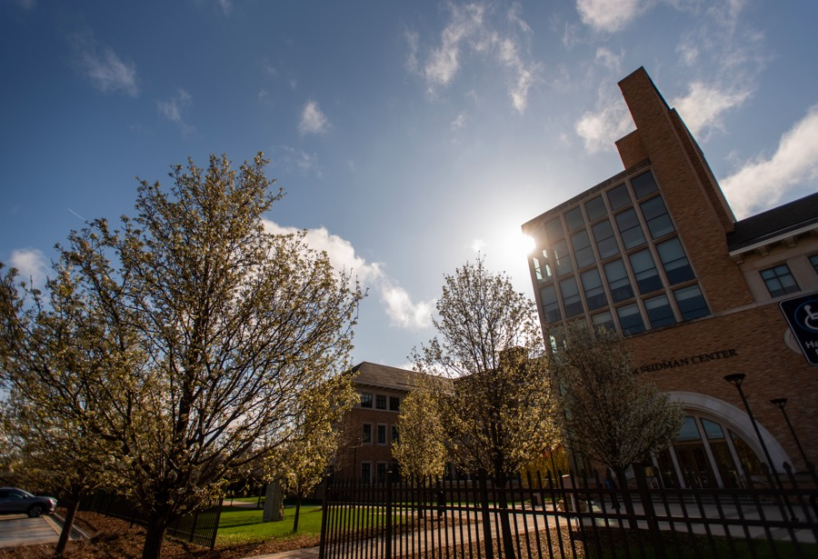
Contact information
Update your local address and phone number in MyBanner as soon as possible to ensure you receive all communications from the Student Accounts office
You can reach the Student Accounts office from at:
  studenta@gvsu.edu
  616-331-2209

