Slide 1

Budgeting

Slide 2
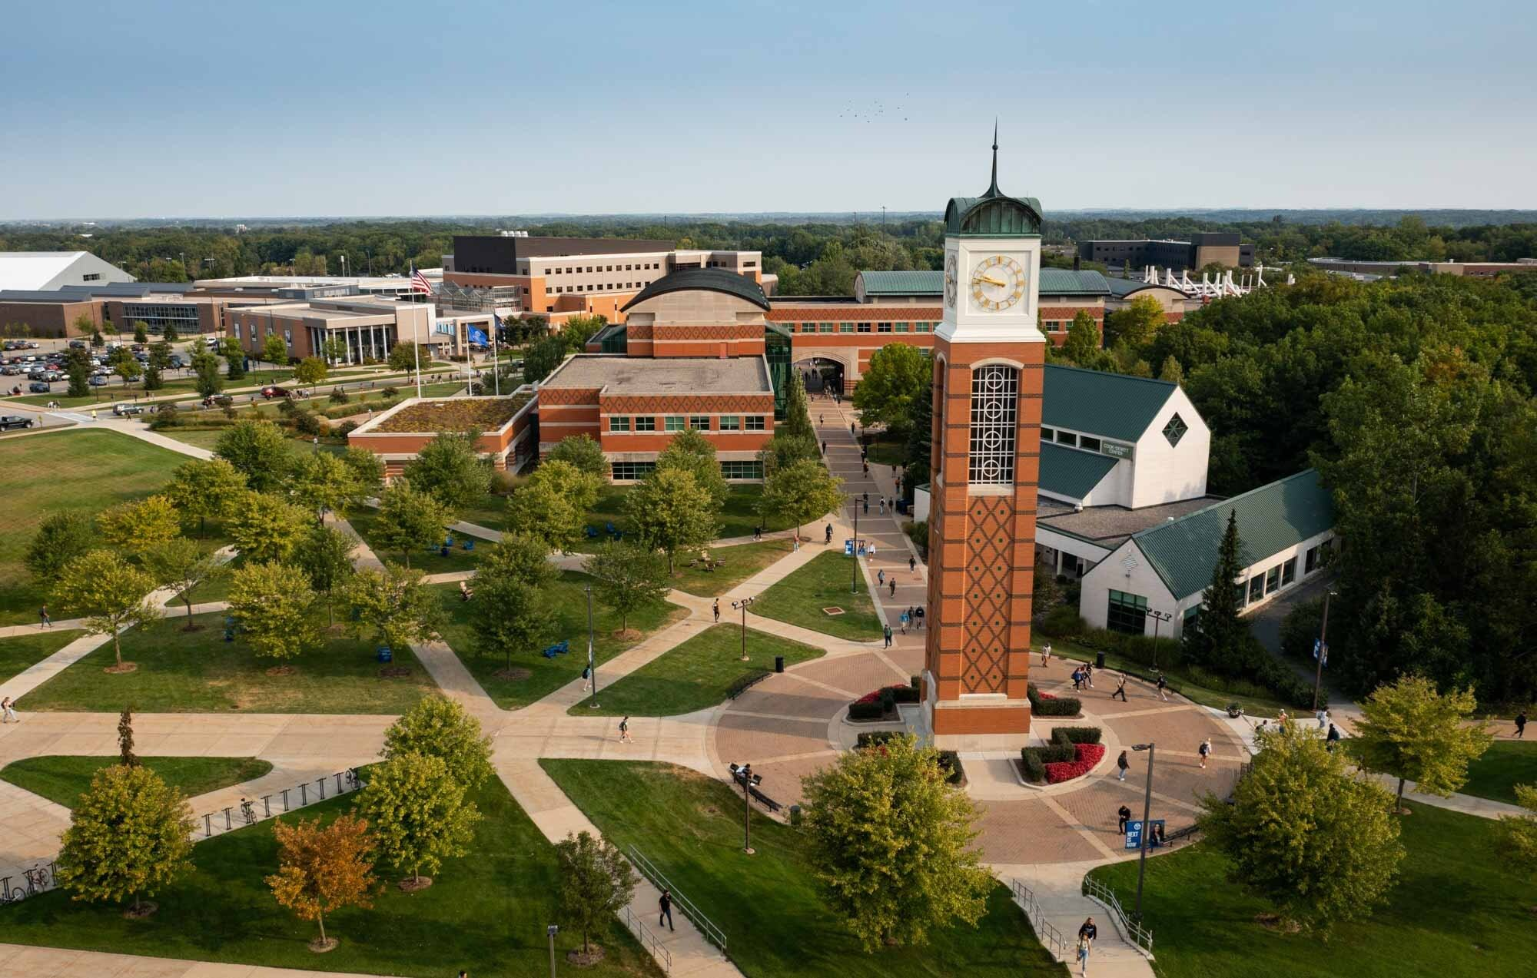
Who We Are
MoneySmart Lakers is a financial literacy program dedicated to educating students on essential financial skills.

Slide 3



Our Services
Budget/Spending Plans
Credit/Credit Reports
Wealth Building
Student Loan Exit Counseling
Notes:
Financial literacy is the possession of the set of skills and knowledge that allows an individual to make informed and effective decisions with all of their financial resources.

Slide 4
Understanding Your First-Year Finances
1. A guide to managing costs and planning for success at Grand Valley State University.
2. Importance of financial awareness in your first year
3. Overview: cost, income, budgeting, deadlines, planning, financing

Slide 5




Why Have a Budget?
CHOICE
You control your money, it does NOT control you. You get to choose where your money goes each month.
REDUCE SURPRISES
Plan out your expenses before you need your money
STRUCTURED SPENDING
Ensures you are not spending more than you are earning
REACH GOALS
Gives you the freedom to purse your dreams

Slide 6

Estimated Cost of Attendance at GVSU
Tuition & fees
On-campus housing & meal plan
Books, supplies, technology
Personal & transportation expenses
Total estimated annual cost
GVSU Financial Aid Office
Notes:
Explain that costs vary by housing, major, and lifestyle. Mention that official estimates are available from the GVSU Financial Aid Office.

Slide 7
Generating Income & Support for Your First Year
On-campus jobs or work-study through GVSU
Off-campus part-time work
Scholarships & grants
Family support or savings
Freelance/online work
Notes:
Encourage students to explore GVSU on-campus jobs early, apply for scholarships, and look for creative ways to supplement income.

Slide 8

Important Deadlines & To-Do Items
Scholarship application deadlines
Tuition payment plan sign-up
Housing & meal plan deadlines
Tax/banking documentation
Notes:
Stress the importance of tracking financial deadlines to avoid missed opportunities or late fees.

Slide 9
Banking & Financial Tools for GVSU Students
Set up checking/savings account
Use debit cards responsibly
Monitor spending with apps
Avoid overdraft & ATM fees
International banking tips
Notes:
Discuss how local banks or credit unions partner with GVSU and encourage responsible money management through apps and alerts.

Slide 10



Create Your Budget
Step 1
Step 2
Step 3
Step 4
Final
SUCCESS
START
Track Your Spending
Find your Income
Categorize Expenses
Adjust the Numbers
Follow the Plan
Record all your expenses over a period.
Create groups to separate needs from wants.
It’s your money, be realistic, yet firm.
Calculate your take-home pay.
Your income must be more than your expenses.

Slide 11

Building & Maintaining Your Student Budget
Track monthly income vs. expenses
Needs vs. wants
Use free budgeting tools
Adjust budget each semester
Build an emergency fund
Notes:
Explain that budgeting is an ongoing process. Suggest using tools provided by GVSU’s such as MSL and FinLit

Slide 12
Looking Ahead: Financing Your Degree at GVSU
Estimate total degree cost
Understand loan options
Meet with MoneySmart Lakers
Plan summer income
Build credit responsibly
Notes:
Encourage long-term financial planning and using GVSU resources to make smart financing decisions.

Slide 13
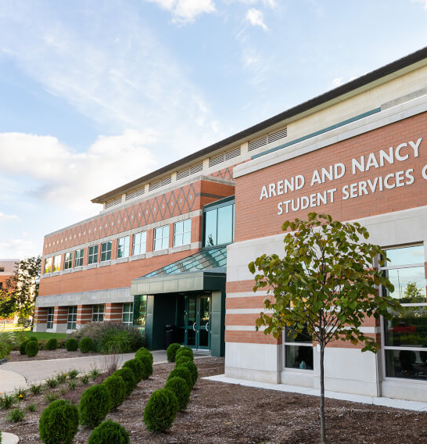
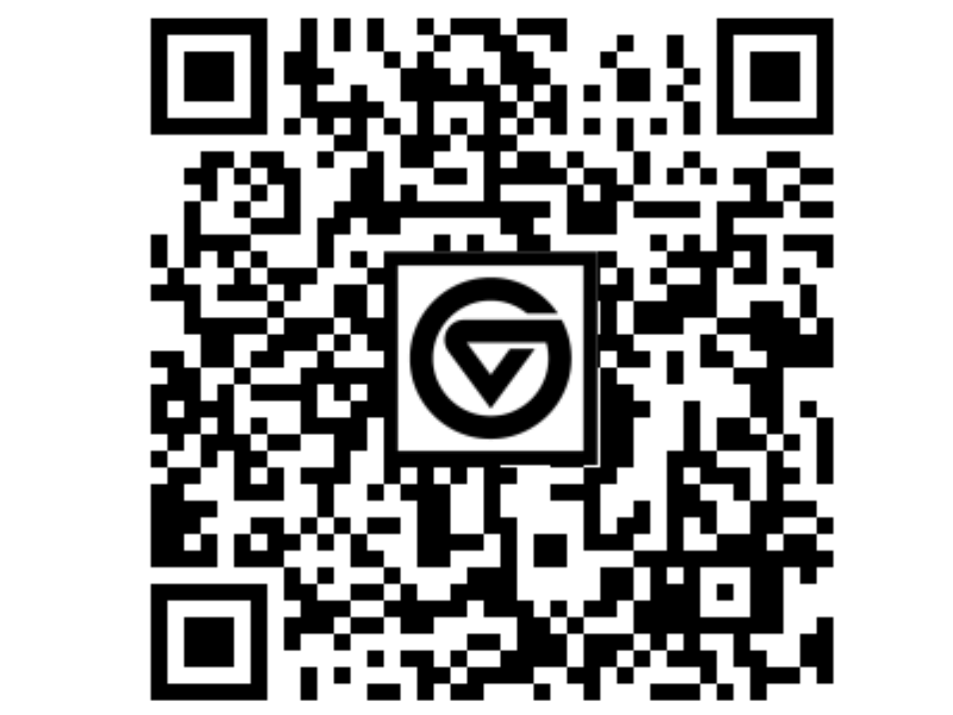
More Resources
www.gvsu.edu/moneysmart/
moneysmart@gvsu.edu
100 Student Services Building
STU 100
Office of Financial Aid & Scholarship
Scan to create a 1-on-1 appointment with us!
Notes:
Financial literacy is the possession of the set of skills and knowledge that allows an individual to make informed and effective decisions with all of their financial resources.

Slide 14
Thank You!

