Slide 1
Student Accounts Office

Slide 2
Billing Schedule – Winter 2023 Semester
November 18th, 2022 – Bills are sent out
December 16th, 2022 – 1st semester due date
January 6th, 2023 – Due Date for first semester international students
Payment in full or deferment plan enrollment required

Slide 3
Deferment Plan / Class Cancellation
January 6th, 2023
  25% of total amount owed + $40 non-refundable fee due by 5pm
Remaining Due Dates – 25% due each installment
  January 27th , 2023
  February 24th , 2023
  March 24th , 2023
If payment not received by 5pm, January 6th, your classes will be dropped

Slide 4

Refunds / Late Fees
Refunds sent out the week of January 20^{th.}
Late fees of 1% per month assessed if following payment dates missed.
  January 27th , 2023
  February 24th , 2023
  March 24th , 2023
Holds that prevent registration / transcript access given to students with past due balances.

Slide 5
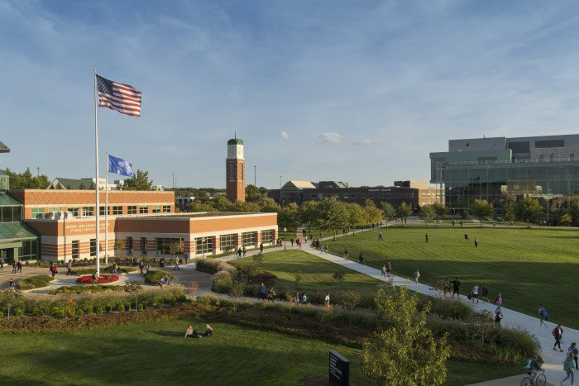
Payment Options
Online through MyBanner Account
  Electronic Check (no fee)
  Credit Card / Debit card (1% fee)
Phone Payment
  Credit Card / Debit card (1% fee)
In Person at Student Assistance Center
  Check / Money order (no fee)
GVSU Western Union / Convera Portal

Slide 6

1042 Withholding – Tax implications
International students who are awarded grants or scholarships in an amount that exceeds the cost of tuition for the semester may be taxed on the amount of the overpayment- even if that overpayment covers other costs such as housing, meal plan, or GVSU Saves charges.
Payroll will send a 1042-S form to you in March, and the charge for the tax amount is added to your student account balance.
If you have questions regarding this, please reach out to Brenda Sain in the payroll office at sainb@gvsu.edu

Slide 7
Contact information
Update your local address and phone number in MyBanner as soon as possible to ensure you receive all communications from the Student Accounts office
You can reach the Student Accounts office from at:
  studenta@gvsu.edu
  616-331-2209

Slide 8
Any Questions?

