Slide 1

The General Education Program prepares students for informed citizenship, leading to responsible participation in local, national, and global communities.

Slide 2
FOUNDATIONS [100-200 Level]
…the major areas of human thought and endeavor. These courses present the academic disciplines as different ways of looking at the world, introduce you to the varied methods used to create knowledge, and acquaint you with major questions and principles of the field.
Arts
Historical Analysis
Mathematical Sciences
Physical Sciences
Life Sciences
Philosophy and Literature
Social and Behavioral Sciences (2 courses from 2 different prefixes)
Writing
Faculty must teach 2-3 Knowledge and 2 Skills outcomes

Slide 3
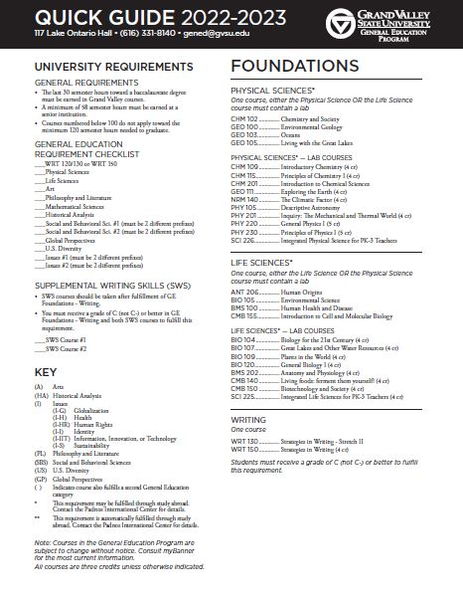
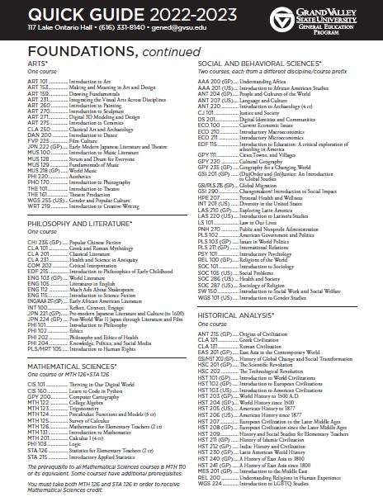
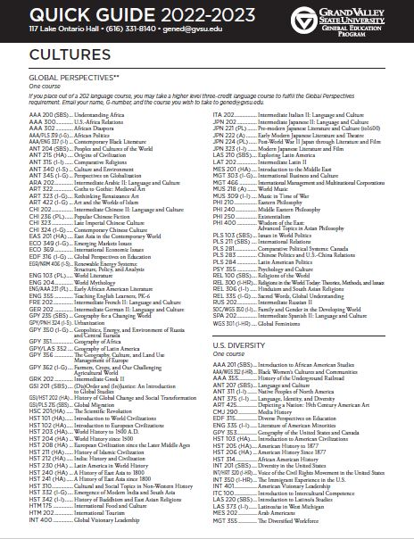
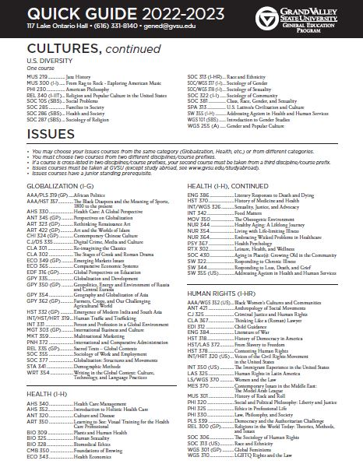
Each GE Category has 1-3 Knowledge outcomes
Each GE Category has 2-3 Skills outcomes

Slide 4
CULTURES [100-400 level]
…recognize yourself as a cultural being, and to understand the diverse ways in which people organize life and perceive the world. It enhances your ability to live and work intelligently, responsibly, and cooperatively in a multicultural nation and an interdependent world.
Global Perspectives
U.S. Diversity
Faculty must teach 2 Knowledge and 2 Skills outcomes

Slide 5
ISSUES [300-400 level]
…integrate learning and co-curricular experiences to build connections between prior understanding and new learning. Issues courses are problem-solving courses that encourage cross-disciplinary collaboration within each class. They also develop your understanding of some of the most compelling issues of our time: globalization, health, human rights, identity, sustainability, and the connected topics of information, innovation, or technology.
2 Issues courses
Faculty must teach 1 Knowledge and 3 Skills outcomes
Issues are the unique aspect of our GE Program – the point is teaching the skills of collaboration, problem solving and integration – at the upper division level

Slide 6

Double-dipping
Courses can double-dip – be in 2 GE categories
  Foundations + Cultures
  Issues + Cultures
Courses cannot
  Be in 2 GE Foundations
  Double-dip between Foundations and Issues
You are responsible to TEACH and ASSESS Knowledge and Skills outcomes in BOTH categories if the course is in 2 categories.

Slide 7
Read the category description for your course (see the GE Handbook at www.gvsu.edu/gened
EXAMPLE-Foundations - Philosophy and Literature
Literary and philosophical works represent an ongoing conversation about the fundamental ideas and values that shape cultures and civilization. To participate fully in this conversation requires knowledge, both of those works that are recognized as defining the history of the conversation and of works that offer original or critical additions to it in the present. Through the study of great works of philosophy and literature, you will come to understand more clearly your own response to the world and to the ideas that give it form and comprehensibility.
Courses in this category introduce you to the interpretation of a significant body of literary or philosophical work and assist you in the careful reading, discussion, and analysis of primary texts.

Slide 8
2. Determine how you will teach the Knowledge student learning outcomes
Example from Philosophy and Literature (see your syllabus attachments)
Explain principles and questions that define philosophy or literature and its contributions to human knowledge and civilization.
Explain the relationship between the works discussed, the cultures in which they were created, and the human concerns they illuminate.
Analyze and interpret one or more primary texts as a major portion of course content.
You have to teach ALL of the Knowledge outcomes

Slide 9
3. Determine how you will teach the Skills student learning outcomes for your course
Read the definition of the Skill and the objectives associated with it.
  You have to teach ALL of the objectives.
All of the Skills must be taught and assessed regardless of the course modality (online, hybrid, face to face).

Slide 10
General Education teaches the Knowledge and Skills society wants.

Slide 11
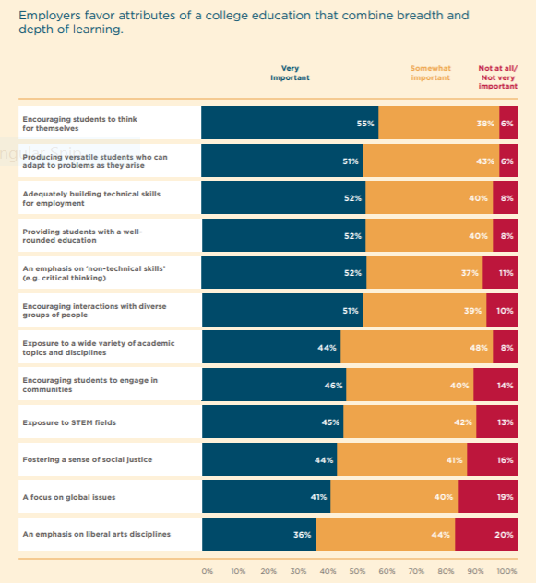
Specific to GE
Specific to GE
Source: How College Contributes to Workforce Success: Employer Views on What Matters Most, AAC&U, 2021
Specific to GE

Slide 12
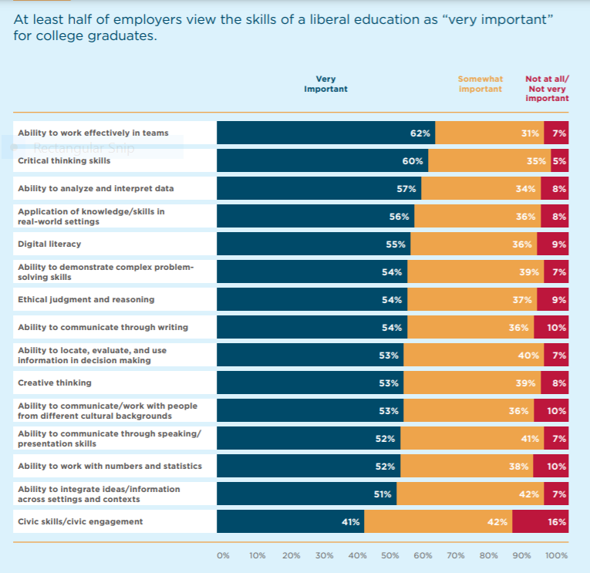
GE (and University)
Student
Learning
Outcomes
We don’t have:
Digital literacy
Creative thinking
Civic skills

Slide 13
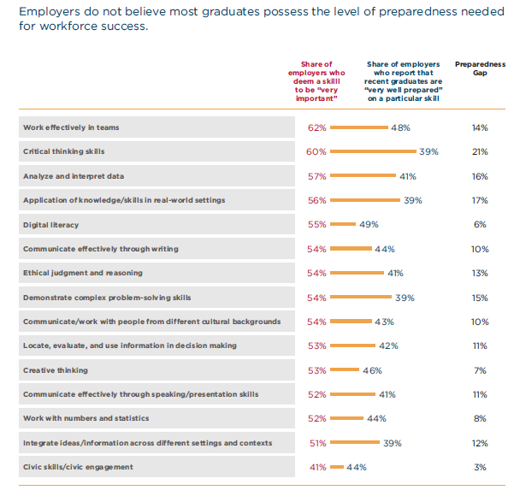

Slide 14
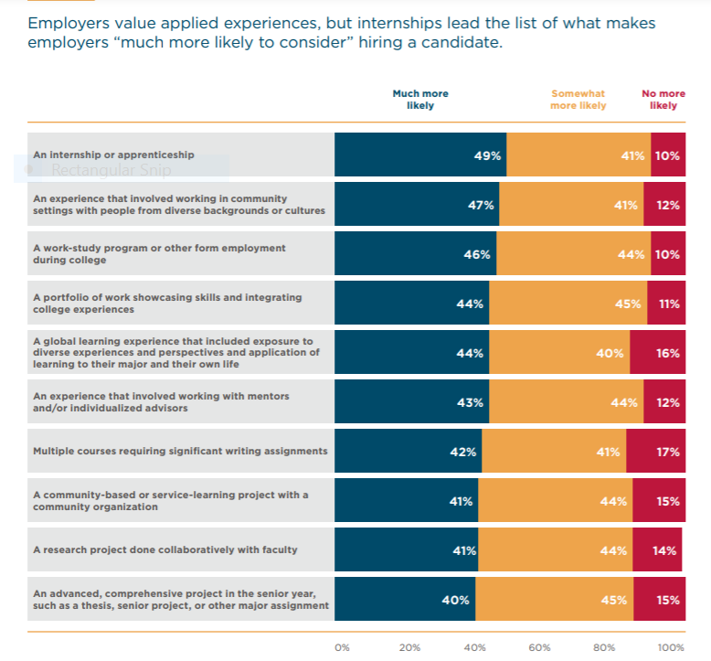
Majors provide
SWS (and the major)
Majors provide

