Slide 1
E-Board Officer Election and Transitions
Presented by:
Phillip Brzezinski
Elijah Fosu

Slide 2
Overview
01. Leadership Recruitment
02. The Election Process
03. Transition Period
04. Activity
05. Questions

Slide 3
Learning Outcomes
E-board members will be able to identify two ways that they can create interest in leadership positions among members in their org.
E-board members will understand how to hold an e-board election for their student organization
E-board members will be able to identify at least three ways that they can improve the officer transition process for their organization

Slide 4
Leadership Recruitment
Part 1

Slide 5
Creating Interest in Leadership
Providing Leadership Opportunities
Fields interest among org members
Can provide a head start on the leadership transition process
Org members can learn about important resources available to them

Slide 6
Example Leadership Opportunities
Leading an organization meeting
Taking charge in planning an event
Working with new org members
Mentorship and/or
shadowing

Slide 7
The Election Process
Part 2

Slide 8
Nominations
Campaigning
Refer to your organization’s constitution for eligibility requirements (if there are any)
Give members time to consider decision to run
Everyone should have equal time
Should take place over the course of several meetings

Slide 9
Uphold Ethical Standards
Candidates should be disqualified if they partake in unethical practices
i.e. bribery, intimidation
Contact your advisor and/or the RSO team for assistance, if needed

Slide 10
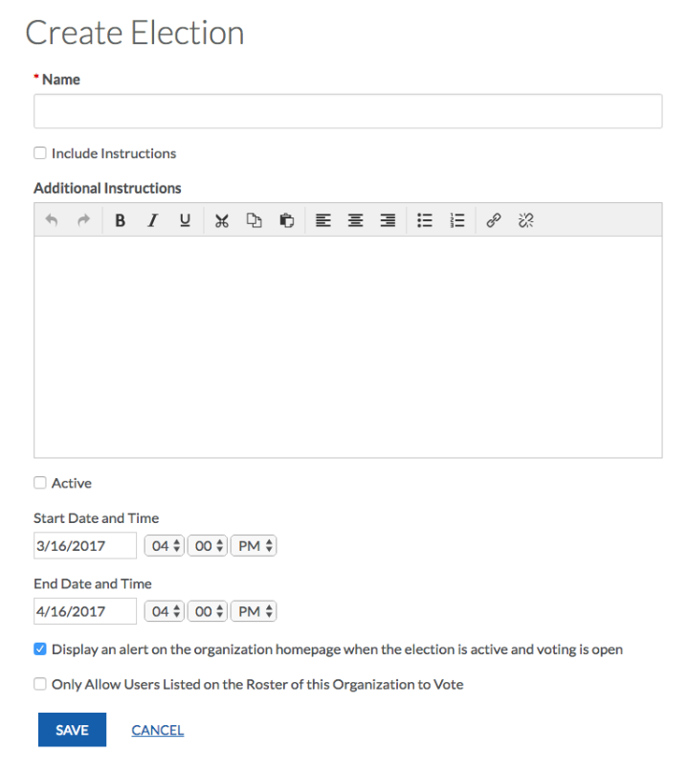
Voting
Ways to Hold an Election
In Person
Make sure that votes are kept confidential
Separate nominees from voters
Google Forms or LakerLink
Accessible
Easy to set up
LakerLink has start and stop times

Slide 11
Voting
Things to Keep in Mind
Keep votes confidential
Designate an org member to oversee the election
Should not be running for a position
Minimal contact with candidates
Have multiple people tally the votes
Mitigates bias
Can include org advisor

Slide 12
The Transition Period
Part 3

Slide 13
Communication & Setting Expectations
Plan Meetings With Newly Elected E-Board Members
Outline Expectations for the Next Year
Identify Important Dates/Deadlines
Be Okay With Change

Slide 14
Record Keeping
Compile any records of relevant organization info
Should include: Event planning docs, organization bank account info (if applicable), meeting minutes.
Make it accessible (i.e. Google Docs)
Start a precedent moving forward

Slide 15
Getting Connected
Introduce new e-board members to people important to the operations of your organization
Organization advisor
Relevant Campus Departments
OSL staff
Any external partners

Slide 16
Activity
Part 4

Slide 17
Write Down…
5 things that you had found to be helpful when you stepped into your e-board position
5 things that you either wish was done to make the transition process easier or challenges that you encountered during the process
5 things that you can do to make the leadership process easier moving forward

Slide 18
Questions
Part 5

Slide 19
E-Board Officer Election and Transitions
Presented by:
Phillip Brzezinski
Elijah Fosu

Slide 20
Overview
01. Leadership Recruitment
02. The Election Process
03. Transition Period
04. Activity
05. Questions

Slide 21
Learning Outcomes
E-board members will be able to identify two ways that they can create interest in leadership positions among members in their org.
E-board members will understand how to hold an e-board election for their student organization
E-board members will be able to identify at least three ways that they can improve the officer transition process for their organization

Slide 22
Leadership Recruitment
Part 1

Slide 23
Creating Interest in Leadership
Providing Leadership Opportunities
Fields interest among org members
Can provide a head start on the leadership transition process
Org members can learn about important resources available to them

Slide 24
Example Leadership Opportunities
Leading an organization meeting
Taking charge in planning an event
Working with new org members
Mentorship and/or
shadowing

Slide 25
The Election Process
Part 2

Slide 26
Nominations
Campaigning
Refer to your organization’s constitution for eligibility requirements (if there are any)
Give members time to consider decision to run
Everyone should have equal time
Should take place over the course of several meetings

Slide 27
Uphold Ethical Standards
Candidates should be disqualified if they partake in unethical practices
i.e. bribery, intimidation
Contact your advisor and/or the RSO team for assistance, if needed

Slide 28
Voting
Ways to Hold an Election
In Person
Make sure that votes are kept confidential
Separate nominees from voters
Google Forms or LakerLink
Accessible
Easy to set up
LakerLink has start and stop times

Slide 29
Voting
Things to Keep in Mind
Keep votes confidential
Designate an org member to oversee the election
Should not be running for a position
Minimal contact with candidates
Have multiple people tally the votes
Mitigates bias
Can include org advisor

Slide 30
The Transition Period
Part 3

Slide 31
Communication & Setting Expectations
Plan Meetings With Newly Elected E-Board Members
Outline Expectations for the Next Year
Identify Important Dates/Deadlines
Be Okay With Change

Slide 32
Record Keeping
Compile any records of relevant organization info
Should include: Event planning docs, organization bank account info (if applicable), meeting minutes.
Make it accessible (i.e. Google Docs)
Start a precedent moving forward

Slide 33
Getting Connected
Introduce new e-board members to people important to the operations of your organization
Organization advisor
Relevant Campus Departments
OSL staff
Any external partners

Slide 34
Activity
Part 4

Slide 35
Write Down…
5 things that you had found to be helpful when you stepped into your e-board position
5 things that you either wish was done to make the transition process easier or challenges that you encountered during the process
5 things that you can do to make the leadership process easier moving forward

Slide 36
Questions
Part 5

Slide 37
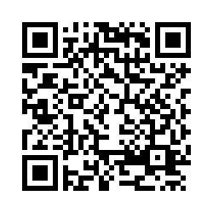
Complete this survey for attendance credit
https://gvsu.co1.qualtrics.com/jfe/form/SV_22ZSEULwToK8Xcy

