Slide 1
WELCOME
United Way Campaign
2018 Captains Training
Campaign Dates: October 1-12
Campaign dates: October 1-12

Slide 2
GVSU Civic Action Plan
SUSTAINABLE PARTNERSHIPS
We empower our students, faculty, staff, and community partners to co-create mutually respectful partnerships in pursuit of a just, equitable, and sustainable future for communities beyond the campus—nearby and around the world.
- Commitments from the 30th Anniversary Action Statement
Notes:
Tom Haas

Slide 3
GVSU Civic Action Plan
PLACE-BASED INSTITUTION
We embrace our responsibilities as place based institutions, contributing to the health and strength of our communities—economically, socially, environmentally, educationally, and politically.
- Commitments from the 30th Anniversary Action Statement
Notes:
Tom Haas

Slide 4
GVSU Civic Action Plan
SOCIAL AND ECONOMIC EQUITY
We harness the capacity of our institutions—through research, teaching, partnerships, and institutional practice—to challenge the prevailing social and economic inequalities that threaten our democratic future.
- Commitments from the 30th Anniversary Action Statement
Notes:
Tom Haas

Slide 5
Campaign Team 2018
Lindsay Ellis and David Bair—Co-chairs
Brian Van Doeselaar—Treasurer
Cheryl Kotecki—Administrative coordinator
Nate Hoekstra—Communications
Barbie Young—Campaign support
Travis Gibbons—Heart of West Michigan United Way
Patrick Moran—Greater Ottawa Country United Way
Notes:
David

Slide 6
2017 Campaign Statistics
Faculty/staff response rate
2016 72%
2017 72%
Faculty/staff giving rate
2016 45.9%
2017 45.4%
Total dollars
2016 $159,462.56
2017 $165,245.60
Notes:
Brian

Slide 15
Running a Successful Campaign
At your table, please discuss:
What motivates you to give to the United Way? What motivates your colleagues?
What obstacles or concerns keep people from giving?
How have captains at your table been successful getting a high response rate in the past?
What resources might help you get more responses?
Notes:
David Bair—Write answers on 3 pieces of paper at your table
Responding to Concerns & Objections:
• Objections are not personal
Giving is a personal matter and people may have strong feelings about the organizations they support.
• Objections are often based on incorrect information.
Listen carefully, or ask questions, to identify the real issue(s) before you respond.
a) I can’t afford it = can’t afford now, other priorities, or can afford.
To the group - What questions could you ask in this situation???
Help the individual connect with impact of the contribution by making it personal:
“Are you aware of any family, friends, or students who have needed to rely on human services within your community?”
b) I prefer to choose which organizations I wish to support.
To the group - What questions could you ask in this situation???
Help the individual understand that the United Way selects agencies that are effective and fit within the identified areas of supporting Education, Income, and Health in their own community:
“Did you know that you can designate which United Way agency receives your gift?”
• Be an empathetic listener.
Acknowledge that you heard and understand the concern... This does not mean you agree,
but that you care about the individual.
• Set and maintain the tone.
Anticipate common questions… Responding to objections with information, stats or a meaningful question can help. These situations often become your opportunity to offer information about the many ways United Way helps people.
• It is OK if you don’t know the answers.
Let those with questions know you’ll get back to them with the answer - or direct to gvsu.edu/unitedway
• Remember, our role is to educate - not to be coercive…
The most responsive donors are those who have the opportunity to become informed and involved. The United Way offers many opportunities for involvement.
United Way is committed to maintaining and modeling the highest ethical standards. They believe in providing
leadership and programming that is effective, transparent, compassionate, and inclusive.

Slide 16
Campaign Captain Basics
Distribute pledge information
Confirm the list of faculty/staff is correct
Communicate campaign dates and encourage 100% response within unit
Ensure confidentiality
Testify to your reasons for giving
Follow up with faculty/staff to achieve 100% response rate
Send envelopes to Brian
Notes:
Brian

Slide 17
Incentives (Let’s Have Some Fun)
Gifts from Amway, Cascade Engineering, Wolverine Worldwide, Fifth Third Bank, SpartanNash, Bissell...
Drawing among all who return envelopes by October 12.
Drawing among all captains whose units reach 100% participation
Drawing among captains who celebrate together at President’s Breakfast

Slide 18
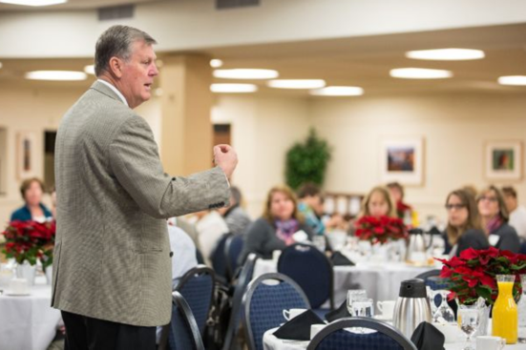
Captains Thank You Breakfast
with President Haas
Tuesday, December 11, 8 a.m.
2204 Kirkhof Center, Allendale Campus
Notes:
Lindsay:
We know that the captains are the key to the success of the campaign. Because of your support, United Way is able to create opportunities for a better life for all in West Michigan.
This year, we are going to draw an incentive gift ($100 gift card) for a captain who achieves 100% participation by October 16th. Please join us for the THANK YOU breakfast for the opportunity to win other great door prizes for those who attend. Contributors include:
Amway
Bissell
Fifth Third Bank
GE Aviation
Steelcase
Wolverine Worldwide

Slide 19
Help is nearby…
Forum/GVNow articles
Website: www.gvsu.edu/unitedway
Contact anyone on the team!
Lindsay Ellis - Co-chair
David Bair – Co-chair
Brian Van Doeselaar - Treasurer
Cheryl Kotecki - Administrative Coordinator
Nate Hoekstra - Communications
Barbie Young – Campaign Support
Notes:
Why can’t I just give to an agency directly?
You can, but the pooling of money allows for United Way to assess community needs and steer dollars to where they are needed most.
It also allows United Way to put money toward fixing core problems – not just surface issues.
Many non-profits do not have the overheard or infrastructure to

