Slide 1
Michigan Department of Community Health
Medicaid Overview
Healthy Michigan Plan Update
March 16, 2015
DRAFT
Jackie Prokop, RN, MHA
Director, Medicaid Program Policy Division

Slide 2
Overview of ACA Impact on Medicaid
Presentation overview:
  Medicaid Program Overview
  The Healthy Michigan Plan
  New eligibility methodology – Modified Adjusted Gross Income (MAGI)
  Health Homes Update

Slide 3
Medicaid Program
Michigan Medicaid is an entitlement program that started as a result of Title XIX of the Social Security Act in 1965.
The Michigan Medicaid program is a cooperative venture jointly funded by the Centers for Medicare and Medicaid Services (CMS).
  Administer by the states individuals and families with low-incomes and resources.

Slide 4
Medicaid vs CHIP Program Funding
Medicaid is an entitlement and does not have a cap on enrollment or on funding.
  Current Medicaid match is 65.54 %
Children's Health Insurance Program (CHIP) is administered under a program allotment.
  This is called Title XXI.
  Current CHIP match is 75.88%

Slide 5
Medicaid Covered Populations Title XIX
Pregnant Women
Children under age 21
Aged, Blind, Disabled
Parents or Caretaker Relatives
Emergency Services Only – non-citizens
“Spend down”
Healthy Michigan Plan 133% of the FPL
Other special populations

Slide 6
Medicaid Eligibility
Pregnant women and children income is reviewed.
Elderly and disabled look at income and assets.
Low-income family (LIF) – look at assets and income.
Healthy Michigan Plan – income only
Breast and Cervical Cancer Prevention and Treatment (BCCPT)
  income only up to 250% of the FPL
Plan First – income only
Eligibility determined by Department of Human Services (DHS).

Slide 7
100% of the Federal Poverty Level
Income | Family Composition
$11,770 | For an Individual
$15,930 | For a Family of 2
$20,090 | For a Family of 3
$24,250 | For a Family of 4
$28,410 | For a Family of 5
$32,570 | For a Family of 6
$36,730 | For a Family of 7
$40,890 | For a Family of 8

Slide 8
Review of Assets
The following are considered assets eligible for review:
  Bank savings
  Stocks, bonds, etc.
  House (more than $500,000)
  Prepaid funeral arrangements
  Trusts
  Life insurance (only for disabled)
  Other
  Limits for program are generally $2,000 to $3,000

Slide 9
Citizenship and Residency
Must meet U.S. citizenship requirements
  Used to be self declared, now with the Deficit Reduction Act of 2005, must prove citizenship
  Match federal files
  Must meet Michigan Residency
    Self-attestation

Slide 10

Medicaid Eligibility for Children
Newborns
Healthy kids infants under age 1
Healthy kids infants over age 1
Healthy kids pregnant women
Other Healthy kids
Foster care
Low-income family
Ward of the state
Disabled children
Children’s waiver
Children with serious emotional disturbances
Notes:
Does not include CSHCS, WIC

Slide 11
Quick Facts
Pay for roughly 50% of all pregnancies in Michigan.
Provide coverage to roughly 45% of all kids in the state (this includes Medicaid and MIChild).
Case load is approaching 2.2 million people in the state being covered by Medicaid.

Slide 12

Medicaid Consumers
55% are Children
22% are Aged or Disabled
Notes:
Data from FY13, if asked.
T:\Presentations\Budget Hearings\FY16 Medicaid\Expenditures and Eligibles by Group FY13

Slide 13
Medicaid Costs
60% for Aged or Disabled
24% for Children
Notes:
Data from FY13, if asked.
T:\Presentations\Budget Hearings\FY16 Medicaid\Expenditures and Eligibles by Group FY13

Slide 14
Medicaid Delivery System
Notes:
Data from FY15, if asked.
Raw Data: T:\Presentations\Budget Hearings\FY16 Medicaid\FY15 Medicaid delivery system (from Dennis)
Chart: T:\Presentations\Budget Hearings\FY16 Medicaid\Other FY16 Charts

Slide 15
Significant Improvement in Incentivized Quality Measures
Michigan Medicaid Managed Care currently ranks above the National Healthcare Effectiveness Data and Information Set (HEDIS®) 50th percentile for all of the measures below and improvements continue to be made.
Notes:
T:\Presentations\Budget Hearings\FY16 Medicaid\Other FY16 Charts

Slide 16
Medicaid Health Plan Rebid
New contract effective January 1, 2016
  5-year contract with three one-year options
Procurement will focus on four pillars:
    Population health management
    Value-focused payment
    Integration of care
    Structural transformation
Each pillar is supported by Heath Information Technology and an overarching Quality Strategy

Slide 17
Medicaid Health Plan Rebid
Major changes:
  Governor’s Prosperity Regions will be used
  Bidders will be required to cover all counties in a region
  Pay for value (rather than volume)
  Greater emphasis on shared information and care coordination
  Carved-out pharmacy benefits

Slide 18
Medicaid Cost Sharing
No deductibles (unless a person is a spend down beneficiary)
No premiums
Co-pays - $1 to $3 co-payment for office visits or pharmacy and a $50 hospital co-pay
  Children and pregnant women exempt
  Co-pays for preventive care and family planning services are exempt

Slide 19
Other Population Specific Services
Early and Periodic, Screening, Diagnosis and Treatment (EPSDT) for youth under age 21
Family planning services and supplies
Maternal Infant Health Program (MIHP)

Slide 20
Population Specific Programs
Breast and Cervical Cancer Prevention and Treatment (BCCPT)
Freedom to Work
Plan First Family Planning Waiver
CHIP Funded Programs
  Maternity Outpatient Medical Services (MOMS)
  MIChild

Slide 21
Breast and Cervical Cancer Prevention and Treatment
BCCPT
  For women ages 18-64 with diagnosis of cervical cancer, or ages 40-64 for breast cancer.
  250% of the federal poverty level.
  Must be diagnosed by a public health designated provider or a Title X clinic.
  Guided by the Centers for Disease Control and Prevention.

Slide 22
Family Planning Waiver Program
Waivers allow states to cover new populations
Family Planning Waiver “Plan First!”
Needs assessment
  PRAMS data shows 64% of Medicaid births are unintended,
    25% are unwanted
  Medicaid pays for roughly 40-46% of all Michigan births
  Covers women ages 19-44 years up to 185% of the FPL
  Covers family planning services only
  30,000 enrolled, but looking to end the program.

Slide 23

Maternity Outpatient Medical Services (MOMS)
  Program for pregnant women who are not eligible for Medicaid or their Medicaid eligibility pending.
    Up to 195% of the FPL
  Women are not U.S. citizens.
  Children born are citizens and are Medicaid eligible at birth.
  Migrant workers residing in Michigan.
  CHIP funds to care for unborn child.

Slide 24
Medicaid Long Term Supports and Services
Nearly one in five of Michigan’s elderly or disabled citizens receives health care from Medicaid.
Over 100,000 Medicaid beneficiaries receive long term supports and services over the course of a year.
Nursing Facility
  Skilled nursing care services
Program for All Inclusive Care for the Elderly (PACE)
  Acute and long term care services provided through a community center
MI Choice
  Wide ranging home and community-based supports and transition services
Home Help
  In-home Personal Care Services

Slide 25

CHIP Program - MIChild
  Covers all children up to 212% of the FPL who are not Medicaid eligible
  Premiums $10 per family (Native Americans exempt)
  Roughly 37,000 enrolled
  Michigan has a 3% uninsured rate for children under 18 years of age. Lowest rate of all of the states.

Slide 26

Healthy Kids Dental Program
Provide Dental care through our fee-for-service program.
Provide dental care through Delta Dental in all but two counties in Michigan.
  Looking to add remaining two counties for fiscal year 2016 up to age nine.
  Only covers children up to 21 years of age.

Slide 27
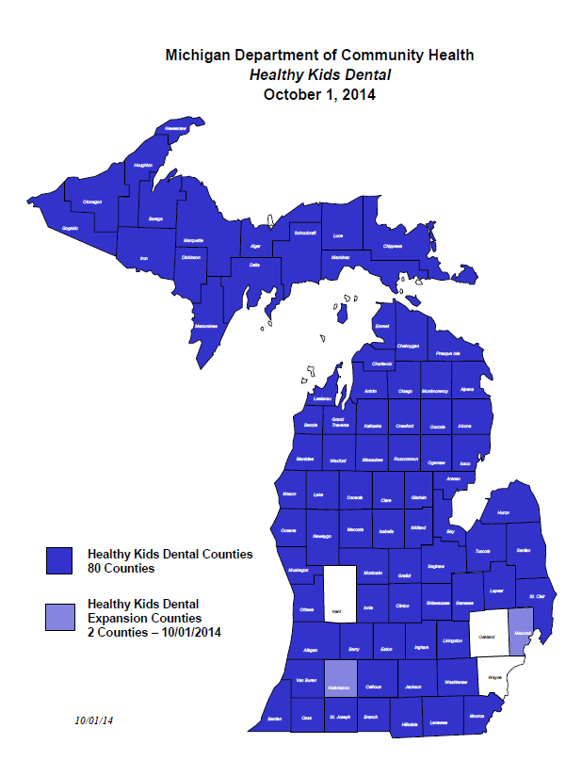

Slide 28
Healthy Michigan Plan
Unique cost-sharing
Healthy behaviors
Health Risk Assessment
MI Health Account
Started April 1, 2014

Slide 29
Federal Law and State Law
Affordable Care Act (ACA) authorizes Medicaid to expand by covering a new eligibility category.
Funding must be appropriated by State.
House Bill 4714
Public Act 107 of 2013 was signed into law by Governor Snyder September 16, 2013.
This is called the Healthy Michigan Plan.

Slide 30
Implementation Timeframe
Public Act 107 0f 2013 did not have an immediate effect.
Cannot implement prior to 90 days after the end of legislative session.
This is roughly around the April 1, 2014 timeframe.

Slide 31
Federal Waiver
State law requires certain cost-sharing requirements (co-pays and contributions).
Some of these requirements are not stated in federal regulation.
Need a waiver amendment to implement what is in state law.
  Amended our current Adult Benefits waiver.
Waiver Amendment was submitted 11-8-2013. Approved December 30, 2013.

Slide 32
Federal Funding
Federal government will pay 100% of the program cost for the first three years.
Will decrease federal match to 90% by 2020.
  Current Medicaid Match is about 65.54%
  CHIP is 75.88%

Slide 33
Impact on Low Income Citizens
Provides Health Insurance Coverage for Low Income Citizens
Dramatic Reduction in Uninsured in Michigan
Primary Care Is Available
Medicaid Coverage Improves Health Status
Improves Employability
Anticipated that up to 400,000 – 500,000 people could be eligible for the Healthy Michigan Plan – we are over the target.

Slide 34
Federal Eligibility Parameters
Includes people ages 19-64
Not receiving or eligible for Medicare
Not eligible for current Medicaid program
Not pregnant at the time of application
Covers up to 133% of the federal poverty level (5% disregard = 138%)
No asset test
Must meet other federal requirements

Slide 35
Healthy Michigan Plan Enrollment
Notes:
T:\Presentations\Budget Hearings\FY16 Medicaid\Other FY16 Charts

Slide 36
Eligibility for Healthy Michigan Plan and Current Medicaid

Slide 37
Covered Services
Benefit coverage must be based on federal benchmark coverage and include the 10 essential health care services.
Ambulatory patient services
Emergency Services
Hospitalization
Maternity and newborn care
Mental Health and substance use disorder services, including behavioral health treatment
Prescription drugs
Rehabilitative and habilitative services and devices
Laboratory services
Preventive and wellness services and chronic disease management; and
Pediatric services, including oral and vision care.
Other, Dental, vision,

Slide 38
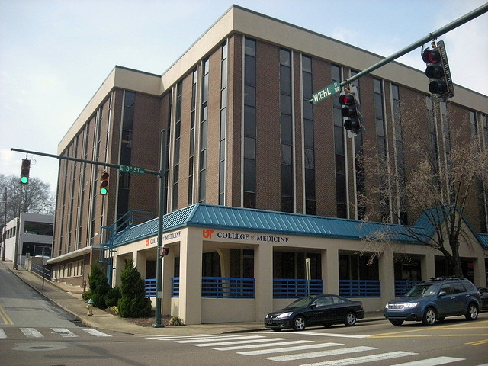
Service Delivery System
Healthy Michigan beneficiaries will enroll into the one of the current Medicaid Health Plans.
Current Medicaid populations that are exempt or voluntary from managed care will remain exempt or voluntary.
Will use the current Prepaid Inpatient Health Plan (PIHP) system of care.

Slide 39
MI Health Account
Required by Public Act 107 of 2013
Cost-sharing
  Average co-pays
  Contribution of 2% annual income for beneficiaries with income between 100%-133% of the FPL.
Account will provide information on health care services cost and utilization.
Will show cost of services and amount of contribution in account.
Quarterly statements

Slide 40
MI Health Account
Healthy Behaviors
Health risk assessment form completed
If beneficiary engages in healthy behavior can have reduction in cost-sharing.
Goal is to have beneficiary more involved in health care decisions and improve health outcomes.

Slide 41
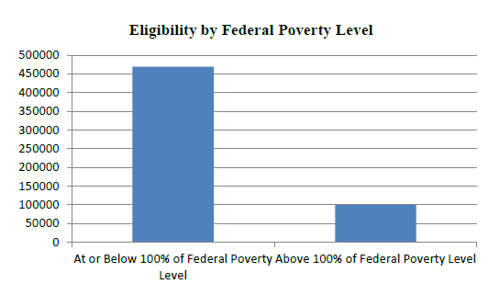
Eligibility by FPL

Slide 42
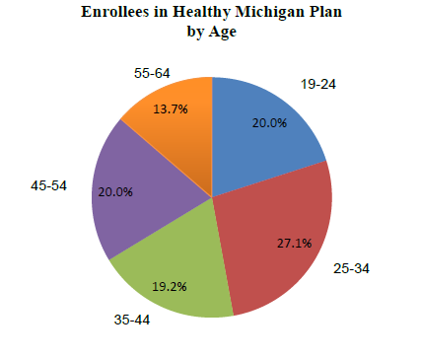
Age Distribution

Slide 43
Healthy Behaviors Incentive Programs
All health plans have an incentive for providers who complete and return the Health Risk Assessment form for their Healthy Michigan Plan patients.
Each health plan designed their own provider incentive, these incentives vary by plan.
  Online course on the Health Risk Assessment for providers is available at:
  www.michigan.gov/healthymichiganplan

Slide 44
Aligning Co-Pays with High Value Services
Visits related to these conditions will have no copay in 2014 |  | Drugs related to these categories will have no copay in 2014
Alcohol Use Disorder | Heart Failure | Behavioral Healthy/Substance Abuse
Asthma | HIV | Chronic Cardiovascular Disease
Chronic Kidney Disease | Hyperlipidemia | Chronic Pulmonary Disease
Depression | Obesity | Obesity
Diabetes Mellitus | Schizophrenia | HIV
Stroke/Transient Ischemic Attack | Substance Use Disorder | Diabetes
Tobacco Use Disorder | Hypertension | Smoking Cessation
Ischemic Heart Disease
Chronic Obstructive Pulmonary Disease and Bronchiectasis | DVT (while on anticoagulation)/ PE (chronic anticoagulation)

Slide 45
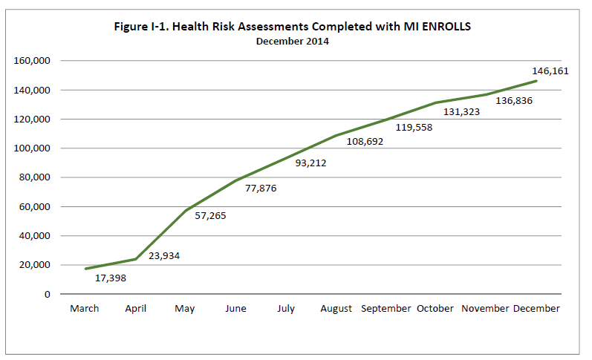
HRA Data

Slide 46
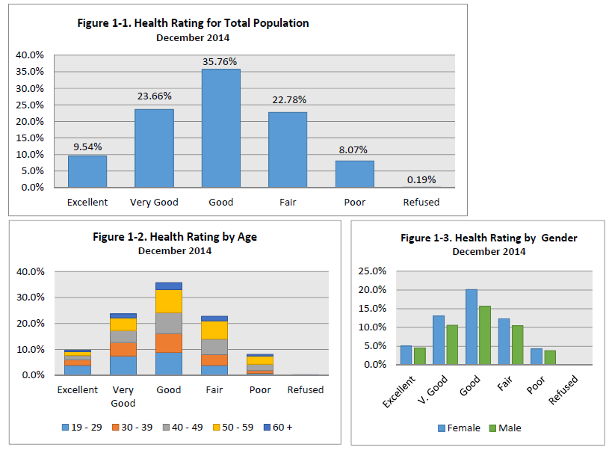
Health Rating

Slide 47
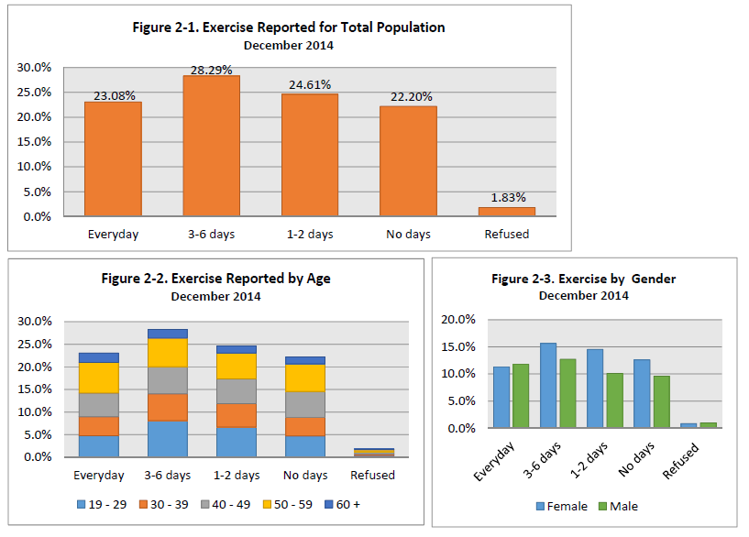
Reported Exercise

Slide 48
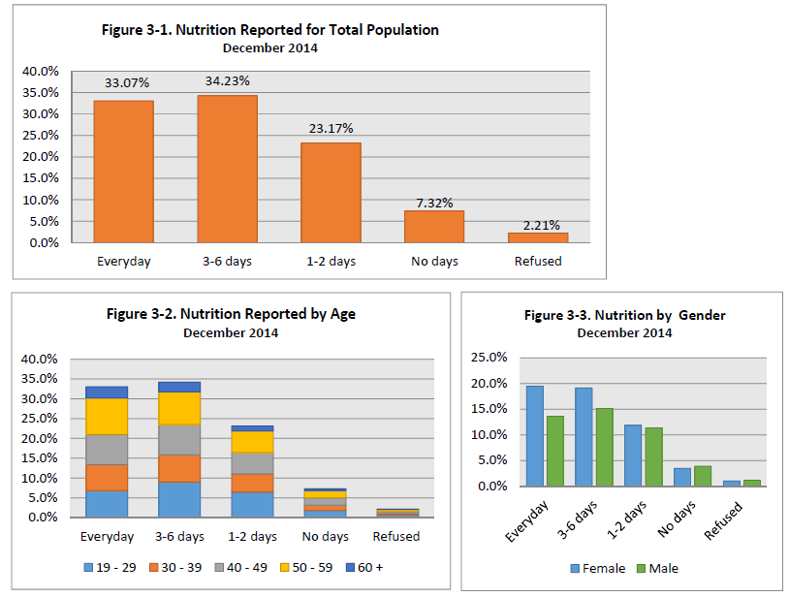
Reported Nutrition

Slide 49
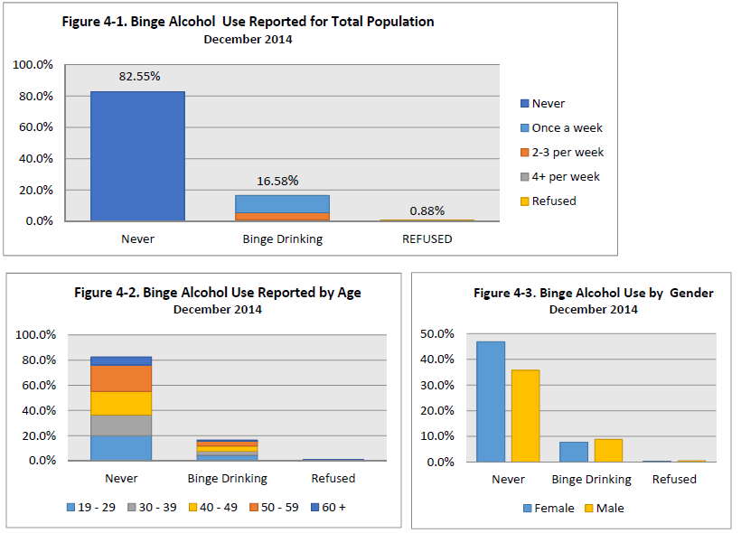
Binge Drinking

Slide 50
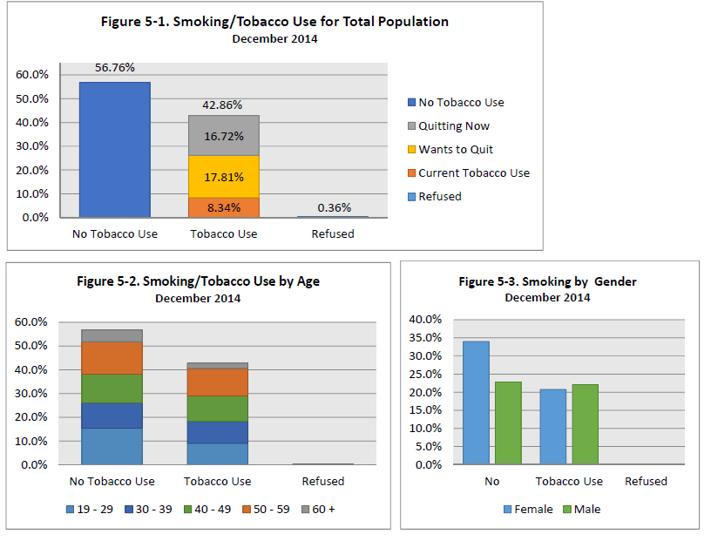
Smoking

Slide 51
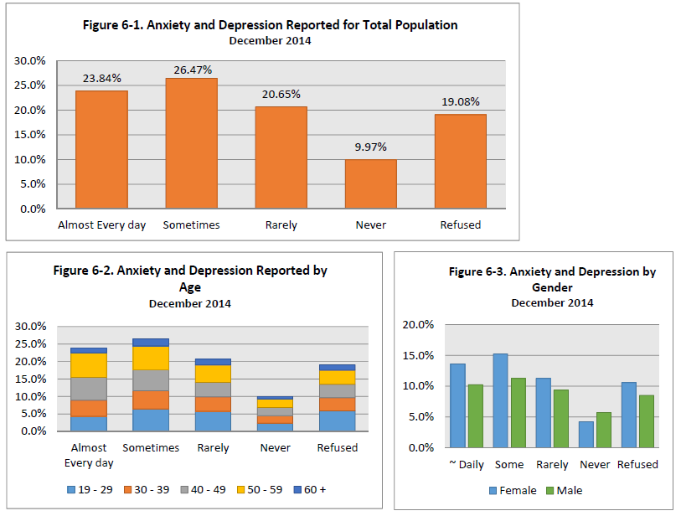
Anxiety Reported

Slide 52
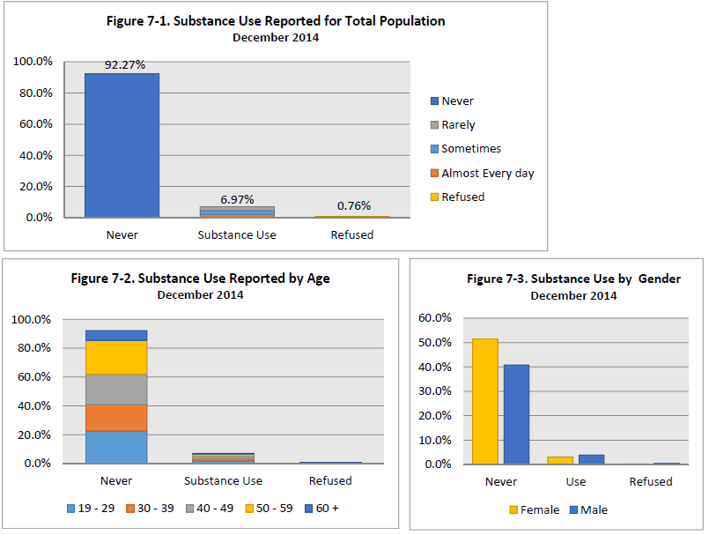
Substance Use

Slide 53
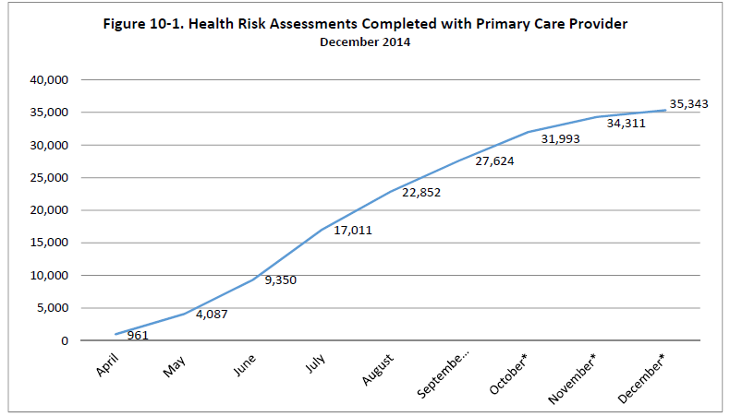
HRA completed in Physician Office

Slide 54
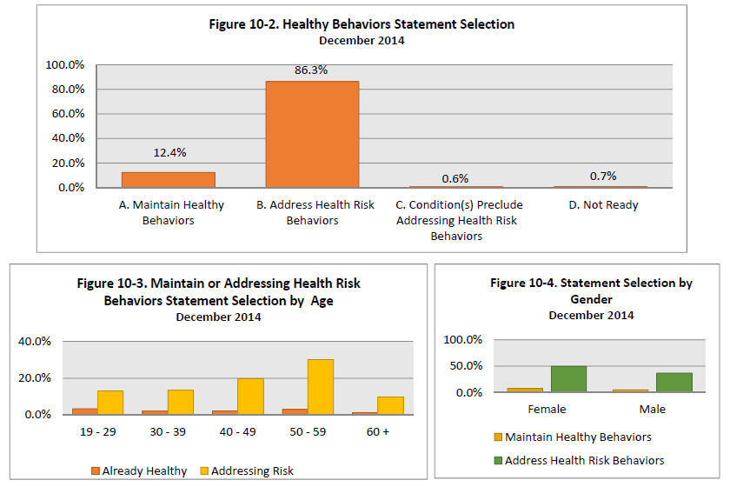
Healthy Behaviors

Slide 55
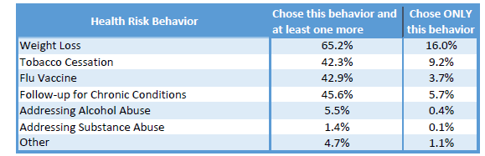
Healthy Behavior Selection

Slide 56
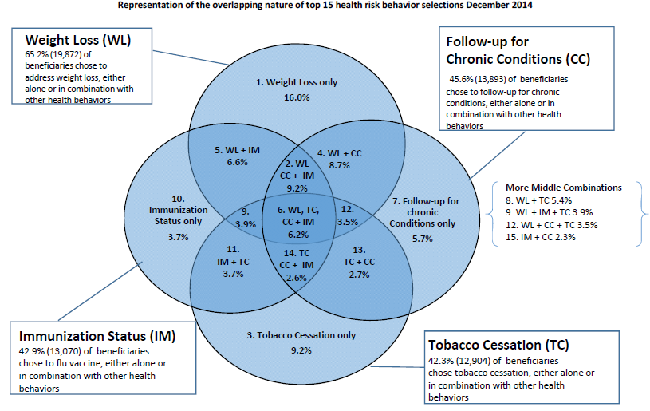

Slide 57
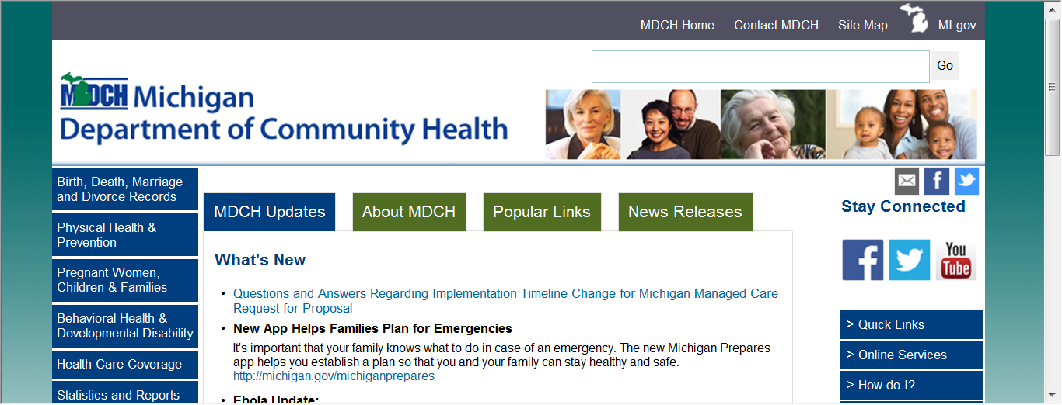
Health Risk Assessment Information
The HRA is on the MDCH website at:
www.michigan/mdch
Health Care Coverage > Healthy Michigan

Slide 58
Modified Adjusted Gross Income (MAGI)
New eligibility determination methodology for Medicaid (excludes disabled population)
Uses a single streamlined application
Provides for no wrong door for application
  Online
  In person
  Telephone
Standardizes the calculation of income with consistent formula
Relies on electronic data matching to the greatest extent possible
Removes asset test

Slide 59
Information Sources for the Healthy Michigan Plan
For Providers:
DCH Website - www.michigan.gov/healthymichiganplan
    Healthy Michigan Plan policy, amendments posted
    Healthy Michigan Handbook, brochures posted
    Health Risk Assessment, monthly reports and Online Provider Training
    Chronic Conditions list
Email: healthymichiganplan@michigan.gov
For Beneficiaries:
Beneficiary Website - www. HealthyMichiganPlan.org
    Eligibility information and Link to www.Michigan.gov/MiBridges
    Cost sharing information
    Beneficiary questions about their MI Health Account statement or payments should be directed to call the Beneficiary Help Line at
    1-800-642-3195 (TTY: 1-866-501-5656)

Slide 60
Apply for the Healthy Michigan Plan
Encourage applicants to apply online using MiBridges
www.mibridges.michigan.gov
DCH 1426 Paper Application is available online and at DHS Offices

Slide 61
Information Sources
New toll-free numbers for MAGI related activities.
MI healthcare helpline is 855-789-5610.
The phone application assistance helpline is 855-276-4627.
Call-line information will be updated when the Healthy Michigan Plan is implemented.

Slide 62
Affordable Care Act Major Changes
Healthy Michigan Plan
Primary care rate increase for 2013 and 2014.
Pharmacy Rebates
Tobacco Cessation
Not paying providers out of the US.
Section 2703 Health Homes

Slide 63
Health Homes
Several Health Homes projects underway
Michigan Primary Care Transformation project.
Seriously Mentally Ill project.
Federal Qualified Health Centers health home model.
MI Health Link

Slide 64
Integrated Care – MI Health Link
Three year demonstration with Center for Medicare and Medicaid Services for people dually eligible for Medicare and Medicaid
  Seeks to improve quality and access to care for residents by aligning Medicare and Medicaid services, rules, and funding
Seven Integrated Care Organizations selected to implement across four regions:
  Upper Peninsula
  Southwest (eight counties)
  Macomb County
  Wayne County
Program launched—March 1, 2015
Notes:
Governor Snyder was the 3rd governor who attempted to do this—first successfully.
Add Enrollee Number as of Presentation to Steve’s notes

Slide 66
Questions?
Jackie Prokop, Director
  Program Policy Division
  Prokopj@michigan.gov
  517-335-5104

