Slide 1
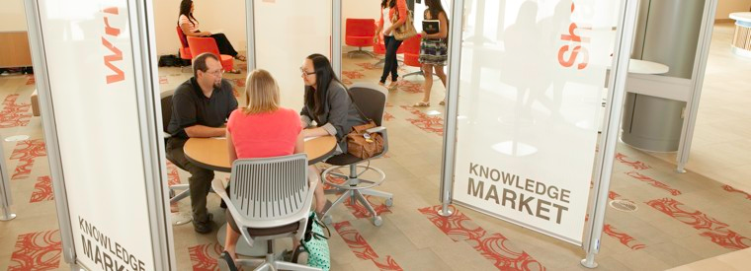
The Knowledge Market
Research, Writing, and Presentation Support for Students

Slide 2
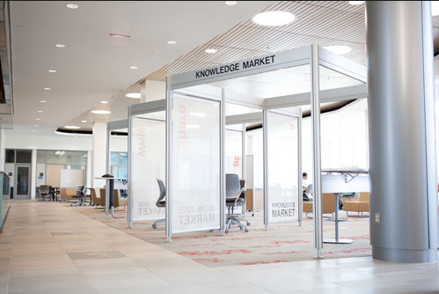
The Knowledge Market is…
One space with collaborating services
The University Libraries
The Fred Meijer Center for Writing and Michigan Authors
The Speech Lab
Centered around student needs and academic theory
Conveniently located services at multiple campuses
Specifically designed for collaboration, productivity, and learning
Comfortable and flexible atmosphere
Peer-to-peer consultations for academic support

Slide 3
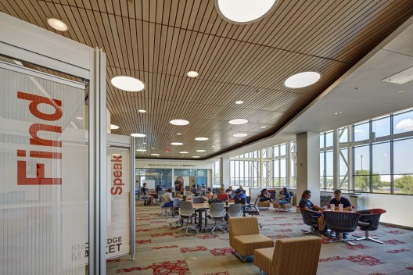
What Can I Find at the Knowledge Market?
Students find Research Assistance
“Students seeking an engaging, focused conversation about assignments requiring research can meet with research consultants”
Students experience a Collaborative Exchange for their Writing
“Student writers seeking feedback at any stage of their writing process can collaborate with a peer writing consultant”
Speakers develop Confident, Successful Presentations
“There are consultants to support all students in all aspects of speaking, in all disciplines from liberal arts to hard sciences”

Slide 4
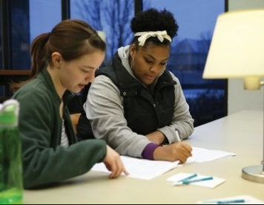
What is Peer Consulting?
The Knowledge Market provides students with an opportunity to work on research, writing, or presenting in the University
Students get to work with peers, who have been specifically trained in a specialty
Peer consultants can help with…
Brainstorming and developing topics
Learning new, more efficient strategies for completing work
Developing and organizing thoughts into a workable format
Practicing and improving library research, writing, and speech skills
Getting feedback on work in progress

Slide 5
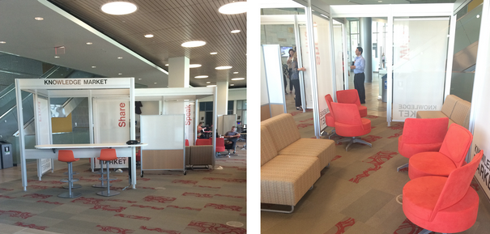
How Does It Work?
Just Drop In
Students can drop by any of our three locations and receive help in any way from any of the three services
Drop-in consultations last for 30 minutes (first come, first serve), and provide one-on-one or small group assistance for undergraduate and/or graduate students
Make an Appointment
Students can schedule appointments with specific services ahead of time by calling or by scheduling on their own time online
The Consultation
Students will work with a trained Peer Consultant, who specializes in Research, Writing, or Speech
Peer Consultants are highly-trained fellow students who can help improve your skills in any discipline
The ides behind a Peer Consultation is to receive collaborative support
It is not a “drop off” service. Students, instead, will engage in a meaningful conversation about their projects

Slide 6
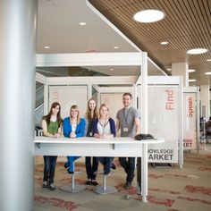
Who Are the Consultants?
Students, just like you!
Consultants are hired within the University.
They come from many different majors
All services hire students who demonstrate an ability to know how to talk about subjects beyond their own field of study
They have a passion for helping other students
Since Peer Consulting relies on communication, consultants must show a desire to support their fellow students
They are trained in an effective tutoring philosophy
All consultants go through intensive training when they first get hired
All consultants attend “continued professional development” opportunities throughout their entire career
Consultants sometimes attend Academic Conferences to stay informed or share their own insights about the field of consulting

Slide 7
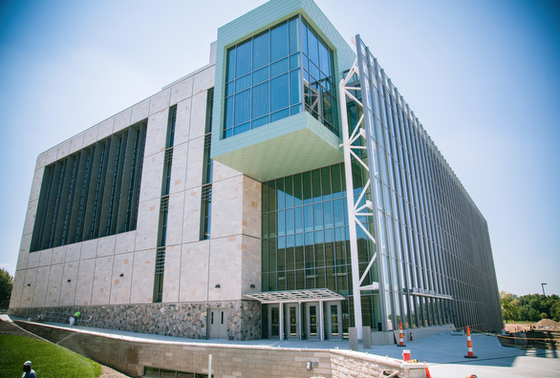
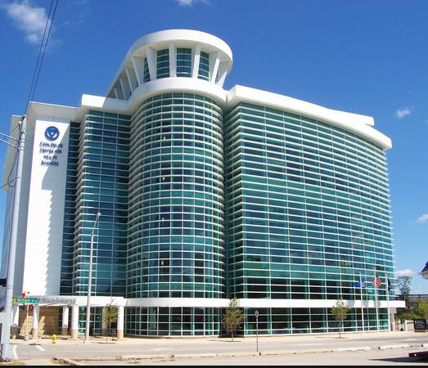
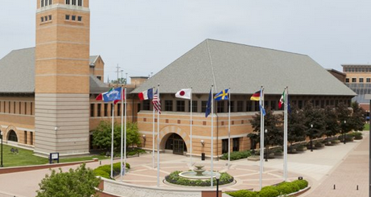
Where is the Knowledge Market?
Allendale
On the Main Level of the Mary Idema Pew Library
Research and Speech: Sun-Thu 4pm-11pm
Writing: Sun-Thu 6pm-11pm
CHS
The Frey Foundation Learning Center
Research: Mon-Thu 10am-3pm
Writing: Tue-Wed 10am-2pm
Speech: Mon & Wed 10am-1pm
Pew Campus
Down the hall from the Steelcase Library in Devos A
Research and Writing: Mon-Thu 2pm-7pm
Speech: Mon & Wed 5pm-7pm; Tue & Thu 2pm-7pm

Slide 8
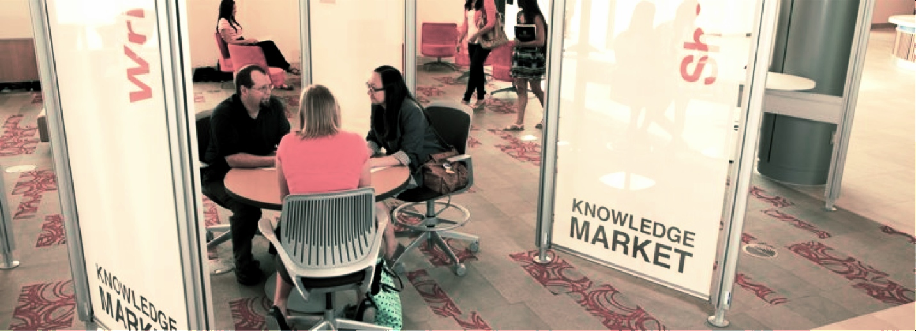
Questions?
For more information, feel free to visit: www.gvsu.edu/library & click on “Knowledge Market”

