Slide 1
Consulting Posters
Helping students design, revise, and refine effective posters

Slide 2
Consider this…
Developing Language:

Slide 3
What’s going on?
Developing Language:
Text Hierarchy
Central Image
“White” Space
Informative Images
Movement
Color
Columns
Notes:
Your opinion and explanation for this poster might depend on these features. Posters employ many features that are meant to be both aesthetically pleasing and functional.

Slide 4
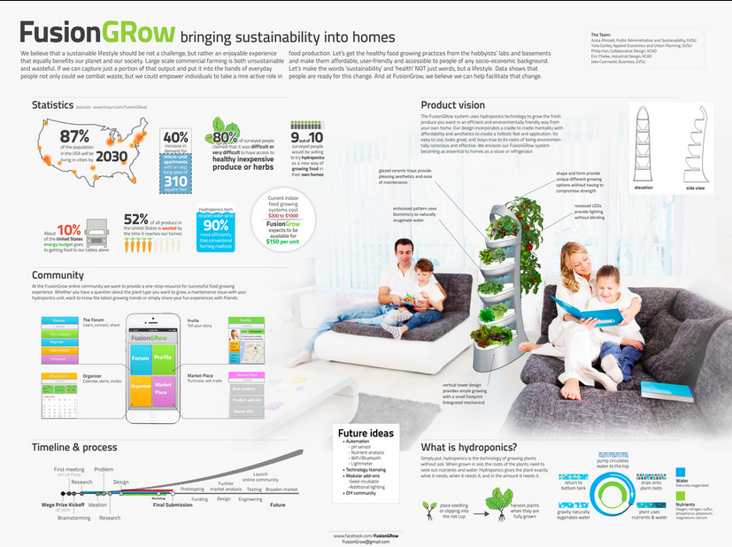
Consider these…
Developing Language:
Example 1:
What do you see?
What do you focus on first?
Where does your eye go?
How does it feel?
Do you like it? Why?
What works?
Notes:
Take a look at this poster, and give feedback to a hypothetical student. Consider the questions on the left.

Slide 5
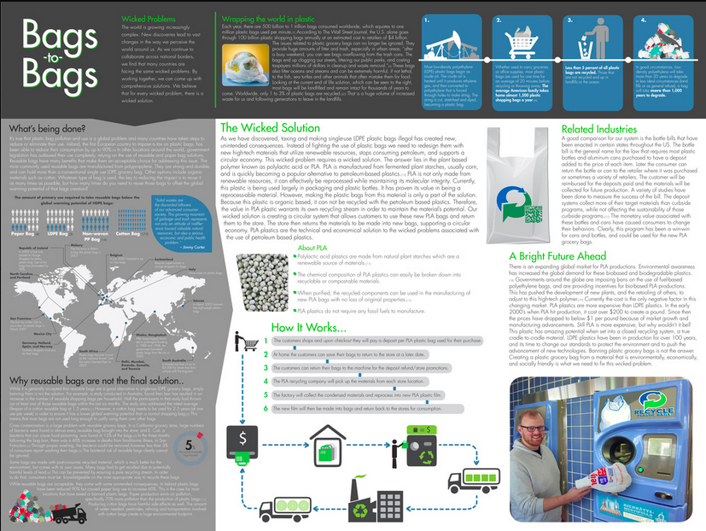
Consider these…
Developing Language:
Example 2:
What do you see?
What do you focus on first?
Where does your eye go?
How does it feel?
Do you like it? Why?
What works?
Notes:
Take a look at this poster, and give feedback to a hypothetical student. Consider the questions on the left.

Slide 6
Here’s what’s going on:
Developing Language:
Example 1:
Example 2:
One central image
Circular movement
White space
Black on White
Thematic color palate
Faces
Catchy title
Column layout
Informational images
White on Gray
Color palate
Thorough
Notes:
Here are some features that exist among each poster.

Slide 7
What should we know?
Developing Language:
Planning
Keep it simple
Information hierarchy
Think visually
Developing a Layout
Important goes first
Text hierarchy
The 40% “rule”
Avoid boxes and lines
Group items together
Audience & Purpose

Slide 8
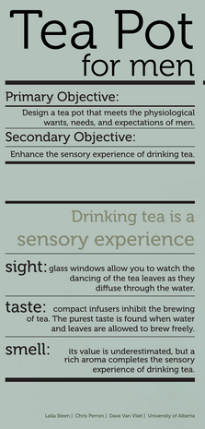
What should we know?
Developing Language:
Elegance, Style, and Tone
Selecting Fonts & Using Text
Common serif fonts for body texts
Stick to three fonts
Upper & lower case letters
The 5 ft. away rule
Black on white
Notes:
Continued…

Slide 9
What should we know?
Developing Language:
Elegance, Style, and Tone
Choosing & Using Color
Color scheme
Subtle backgrounds
Avoid bright colors
Avoid warm colors
Notes:
Continued…

Slide 10
What should we know?
Developing Language:
Elegance, Style, and Tone
Using Images
Meaningful & high quality
Edit images
Titles & captions
Label maps & charts
The 5 ft. away rule
Movement

Slide 11
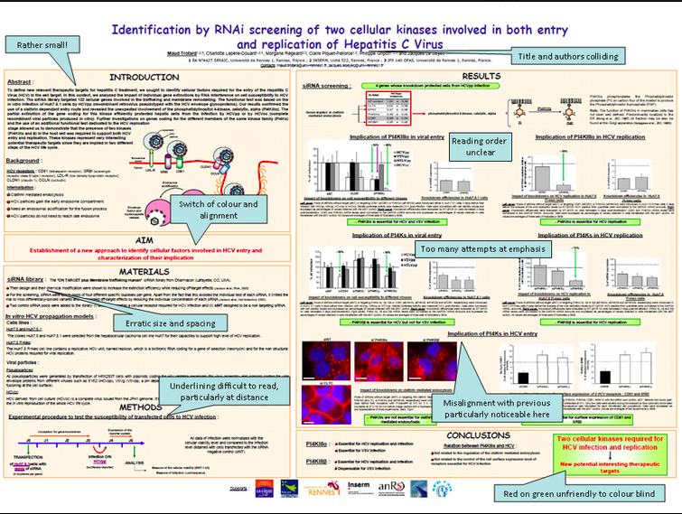
What not to do:
Developing Language:
No underlying grid
Underlining, bolding, & summary
Boxes
Font
Unbalanced
Devalued real estate
Color palate

Slide 12
How can we help?
Context and Consulting:
Respond as a genuine audience
But always know your “because”
Ask questions
Help them think about their decisions
Notes:
Remember this: your opinion is important, but not necessarily true. Try to rely on your non-directive skills in order to make the student aware of what they’re doing with the poster.

Slide 13
What counts?
Context and Consulting:
Field/Discipline
Business Presentations
Scholarship Presentations
Science Reports
Others?
Assignment
Advertisement
Persuasion
Informational
Branding
Others?

Slide 14
Discussion:
Context and Consulting:
“But what if everyone puts their information in boxes?”
“I don’t know what’s normal in my field.”

Slide 15
Quick Tips:
Context and Consulting:
Don’t Read Your Poster
It is a tool
Always face your audience
Stay credible
Engage Viewers
Verbally and nonverbally
Speak clearly, stay natural,
maintain eye contact
Keep it simple
Don’t Try to Cover Everything
It’s a summary
Manage your time
Consider revising

Slide 16
Quick Tips:
Context and Consulting:
Question & Answer Session
Know what you do and don’t know
Match your answer to the question
Complex – complex
Simple – simple
Always tell the truth
Manage the Crowd
Acclimate to volume
Speak up
Look for interest
Be Prepared
Manage your stress
Practice and time yourself
Arrive early

Slide 17
Ask yourself…
Context and Consulting:
STUDENTS’ NEEDS TRUMP ALL
“Does the poster help me understand?”
“Is it aesthetically pleasing? Does that matter?”
“Is it accurate/clear?”

Slide 18
You know this…
RELATE TO OTHER ASSIGNMENTS
Papers have paragraphs…
Essays use transitions and structure…
Titles, Headings, & Subheadings
Structure and organization is meant to help…

Slide 19
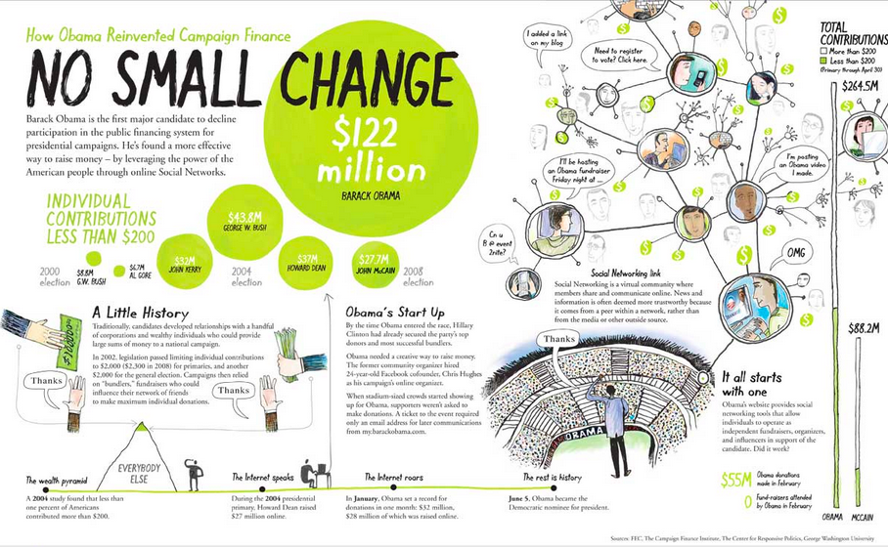
Time to Practice:

Slide 20
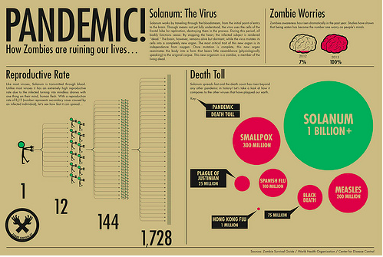
Time to Practice:

Slide 21
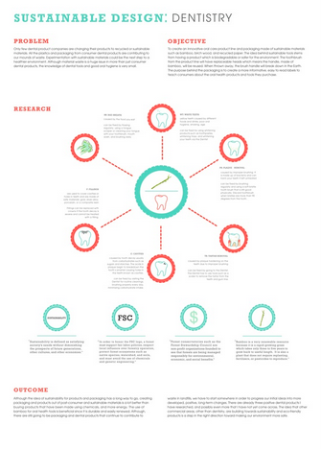
Time to Practice:

Slide 22
Time to Practice:

Slide 23
Time to Practice:

Slide 24
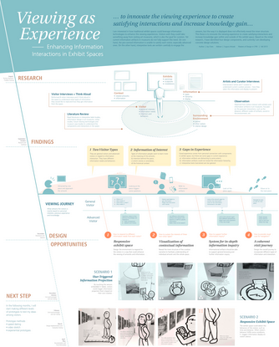
Posters Communicate
A poster presents information to an audience in an engaging, efficient, and aesthetically pleasing way

