Slide 1
Tom Burns, Special Agent
Drug Enforcement Administration
Department of Justice

Slide 3
The Prescription Painkiller Epidemic
Nearly 15,000 people die every year of drug overdoses involving prescription painkillers (CDC 2015).
More people die from prescription painkillers than from heroin and cocaine combined (CDC 2015).
Drug overdose was the leading cause of injury death in 2015 – it caused more deaths than motor vehicle traffic accidents. (CDC 2015)

Slide 4
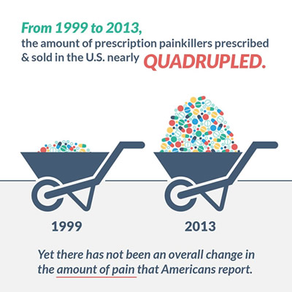

Slide 5
Drug Overdoses Have Increased 137 % Since 2000 Opioid Overdoses Have Increased 200% Since 2000

Slide 6
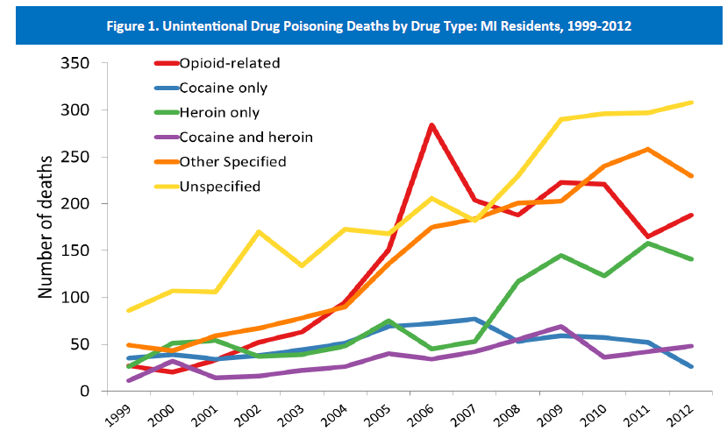
Overdoses in Michigan More Than Tripled from 1999 – 2012
Notes:
Notice two highest are unspecified. Major problem in Michigan. Also note correlation between prescription drugs and heroin.

Slide 7
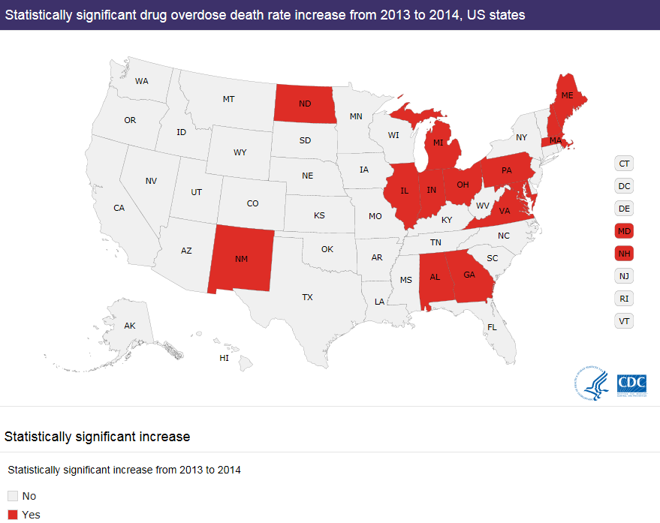
Michigan’s Drug Overdose Rate Continues to Climb, Increasing 14% From 2013 to 2014

Slide 8
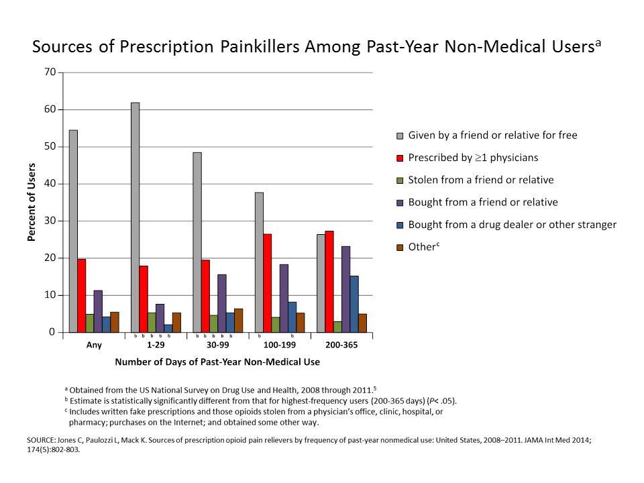

Slide 9
Many Legit Scripts Are Ultimately Abused
Prescribers wrote nearly 250 million opioid painkiller prescriptions in 2013 – enough for every adult in the United States
Although of most of these painkillers were prescribed for a medical purpose, many end up in the hands of people who abused or misused them

Slide 10
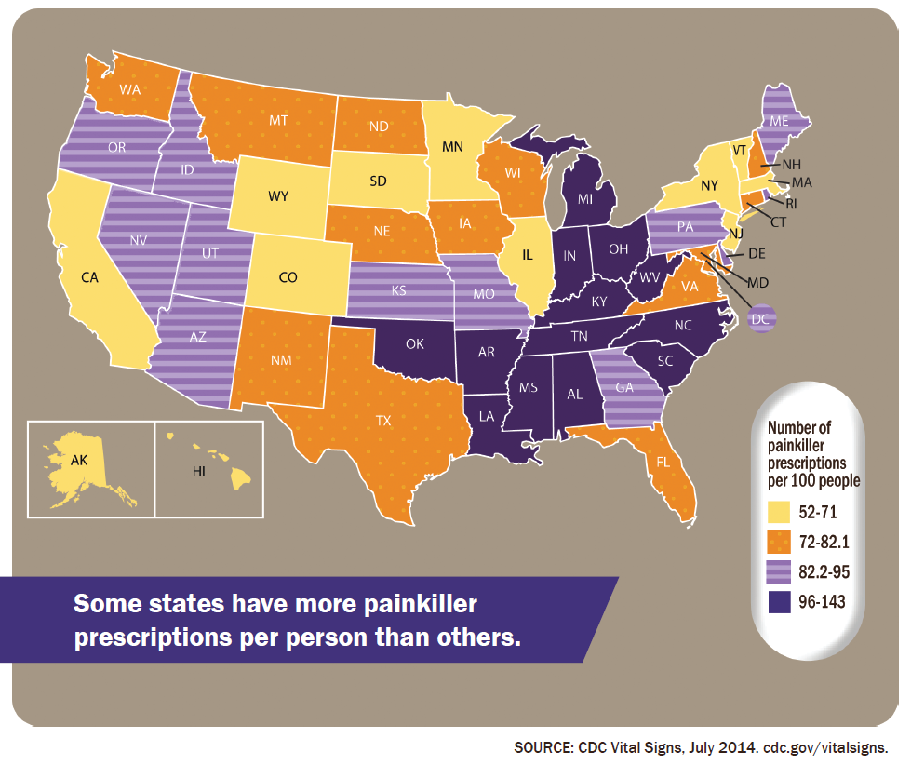
The Consequence: We are in “Bad Company”

Slide 11
More than one script for every Michigan resident

Slide 12
It Took Years, But The Medical Profession Has Acknowledged Its Role October 2015 JAMA Editorial
“Prescribing of opioid[s] . . . appears to be a main factor in the majority of nonmedical use . . . Prescribers are, directly or indirectly, the source of most misused opioids.”
“Little evidence for long-term benefit from opioid therapy for most types of chronic pain.”

Slide 13
October 2015 JAMA Editorial
For long-term opioid users, “25% became nonmedical users, and 10% develop features suggestive of addiction.”
Recommends both use of prescription drug monitoring programs (MAPS) and “reducing the number of new opioid initiates.”

Slide 14
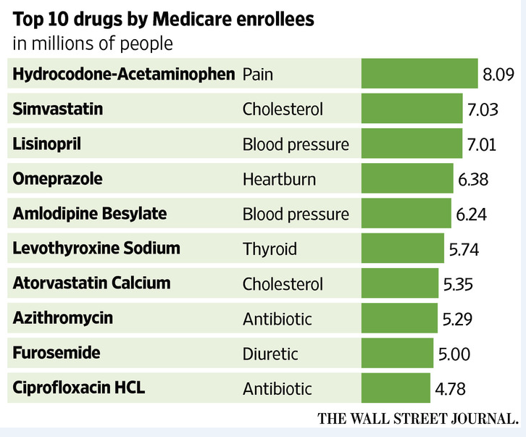
Hydrocodone – The Most Prescribed Drug In America

Slide 15
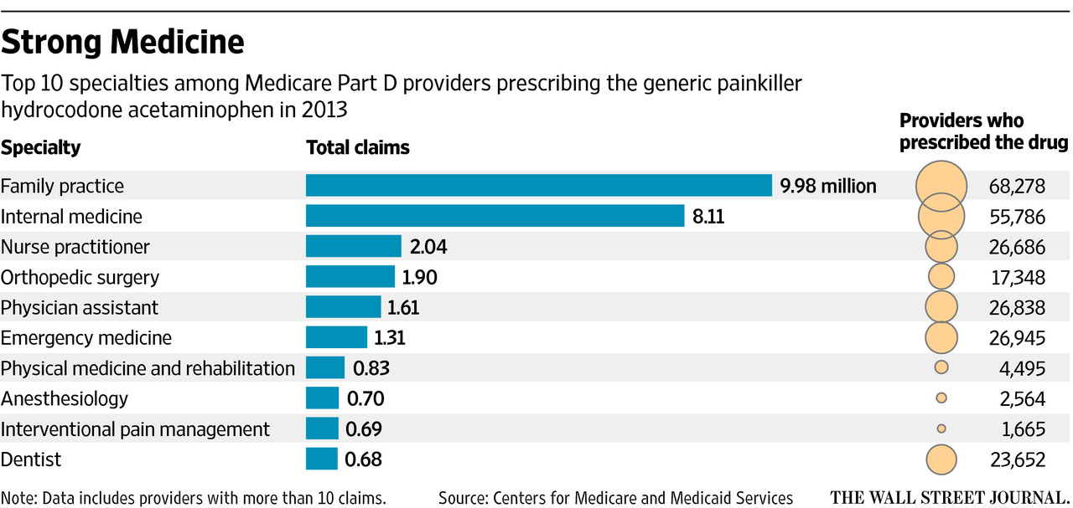
Family Practice and Internal Medicine Doctors Issued More than Half of All Hydrocodone Prescriptions In 2013

Slide 16
Prescription Drugs Are The Gateway to Heroin Abuse

Slide 17
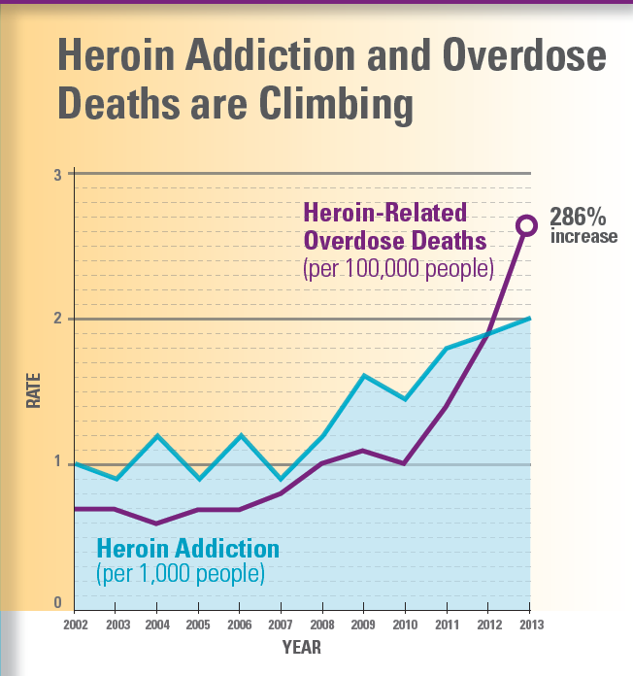

Slide 18
Michigan Heroin Overdose Deaths Have Tripled
1999-2002:
271 deaths
Source:
2010-2012
728 deaths

Slide 19
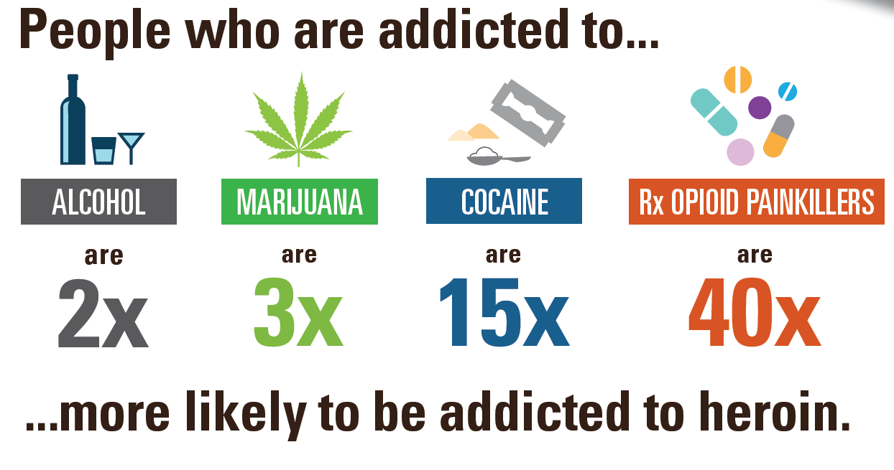
Prescription Drugs Are The Gateway to Heroin Abuse

Slide 20
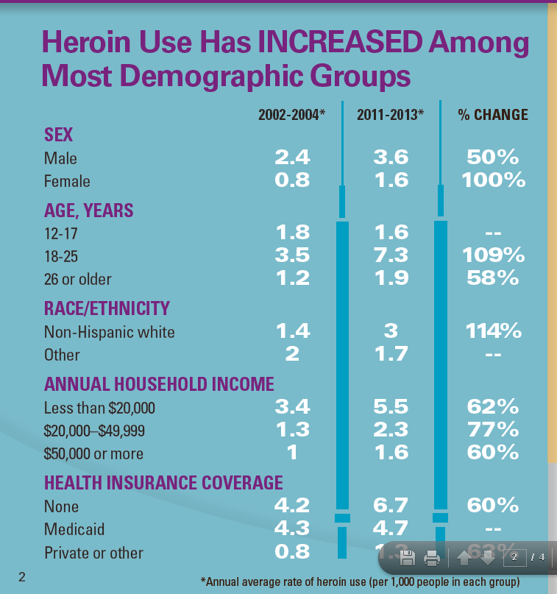

Slide 21
DEA 360 Strategy
(1) coordinated Law Enforcement actions against drug cartels and heroin traffickers in specific communities;
(2) Diversion Control enforcement actions against DEA registrants operating outside the law and long-term engagement with pharmaceutical drug manufacturers, wholesalers, pharmacies, and practitioners; and
(3) Community Outreach through local partnerships that empower communities to take back affected neighborhoods after enforcement actions and prevent the same problems from cropping up again.

