Slide 1
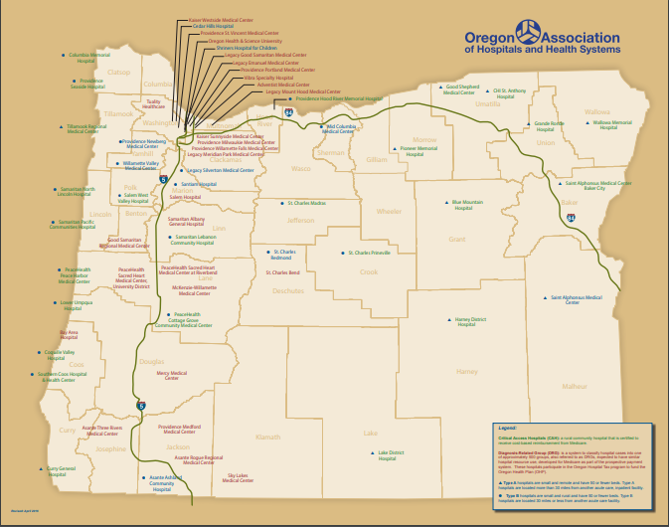
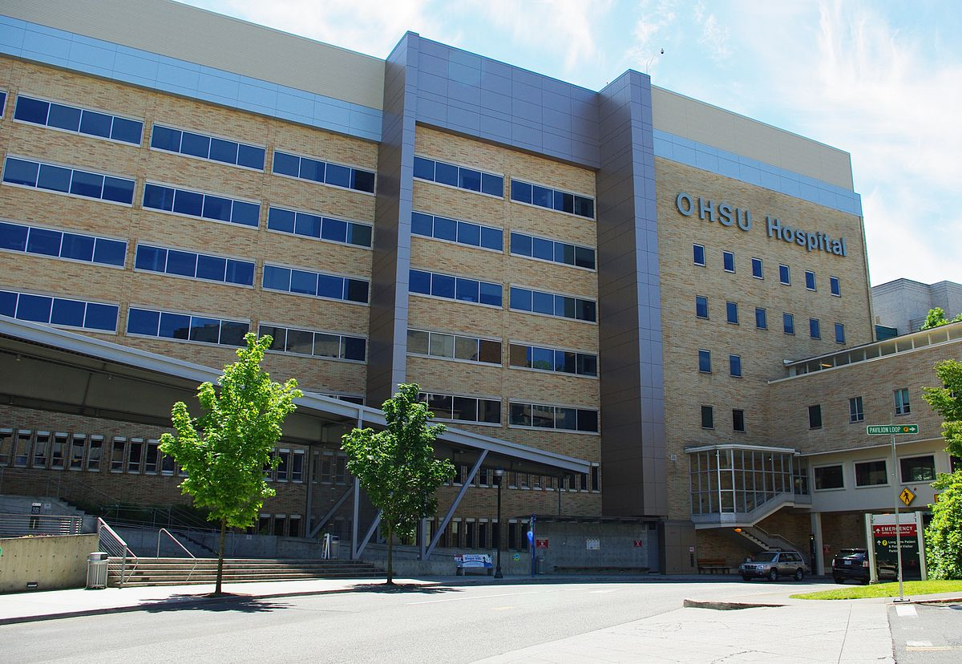
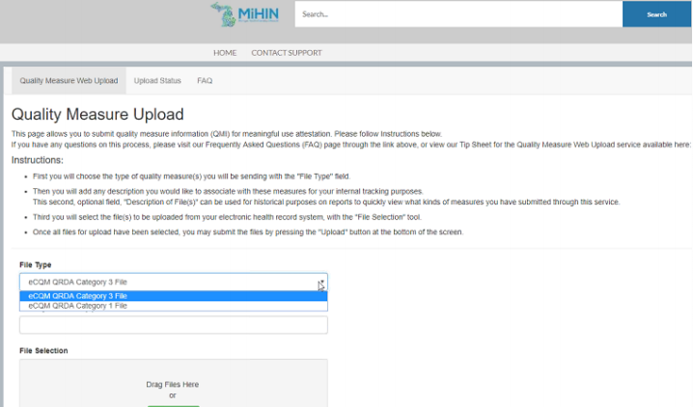
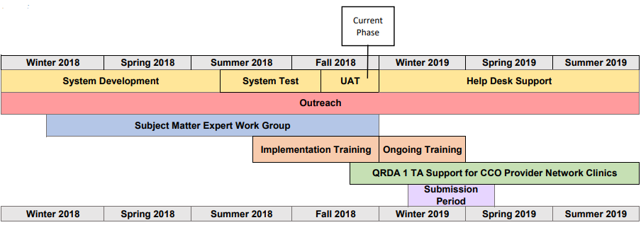
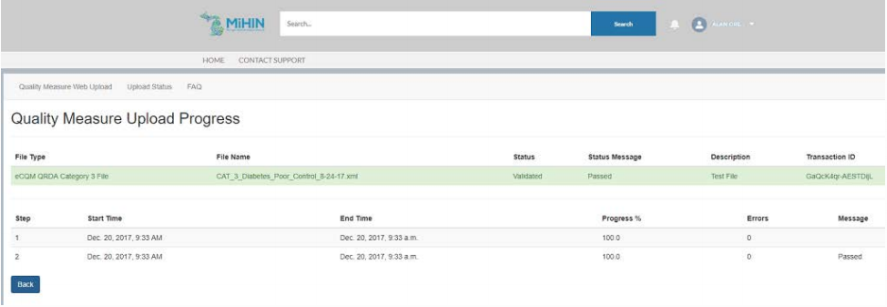
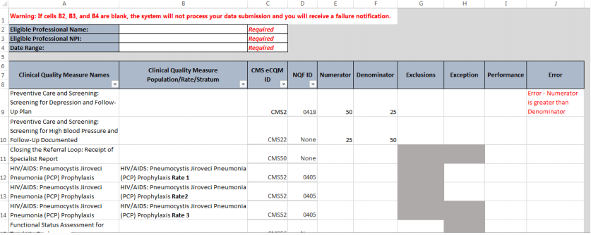
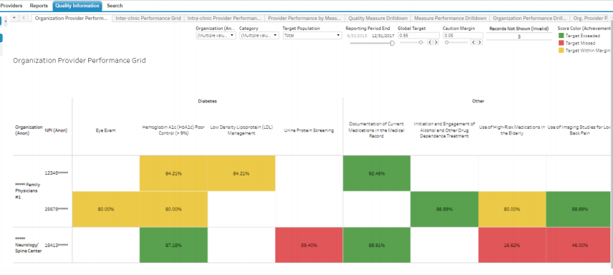
Oregon
Clinical Quality Metric Registry
MiHIN Internship
Health Informatics and Bioinformatics
Grand Valley State University
Jacob Bourgeois
Fig. 1 Map of major Oregon Hospitals
Fig. 4 Oregon Health and Science University Hospital
Introduction
The Michigan Health Information Network (MiHIN) was selected as the primary vendor by the Oregon Health Authority (OHA) to implement a Clinical Quality Metric Registry (CQMR) in the state of Oregon.
The CQMR will collect, aggregate, and provide clinical quality metrics data to support quality reporting programs in the state of Oregon. The ability for health care providers and organizations, as well as OHA, to gather and analyze data is a key component to evaluating system performance, improving patient outcomes and reducing costs for Oregonians.
Why is CQMR needed
Clinical quality measures are a way to assess the care that patients receive. With the increasing adoption of electronic health records (EHRs), Oregon has new opportunities to measure and improve the quality of care.
Using EHR data supports measuring outcomes—for example, measuring whether a diabetic patient’s blood sugar levels are controlled rather than simply measuring whether the patient’s blood sugar levels were tested. The CQMR will enable more efficient collection and use of this important quality data.
Currently, Oregon has no standard, automated capacity for the collection, storage, or aggregation of clinical quality metrics. The CQMR will fill this gap.
It will align with national standards for the collection and calculation of quality measures. To support providers with different levels of technical capacity, the CQMR will offer several secure options for data submission.
How the CQMR will be used
The CQMR will be used for collecting and validating data, calculating measure results for comparison to established benchmarks, and supplying data for analytics. It will comply with privacy and security standards and best practices.
The registry will allow health care organizations to review local, regional, and state data to help inform decision-making and measure how they and others are doing to help improve patient care and reduce system costs. It will provide information that can be used to evaluate systems and processes to determine if changes can be made to help meet goals.
Initially, the CQMR will support two programs:
Coordinated care organization (CCO) incentive measures
Oregon Medicaid EHR Incentive Program
OHA’s incentive-based model pays CCOs for improved health outcomes and accountability, not for the number of services provided. CCOs receive incentives for meeting benchmarks and improvement targets on certain metrics, including a subset of EHR-based clinical measures.
Medicaid providers who participate in the EHR Incentive Program (also known as Meaningful Use) report annually on quality measures.
Timeline for development
Implementation started in late 2017.
User acceptance testing began on November 13, 2018.
Go-live date sometime in late 2018
My Role in Project
In preparation of System Testing and UAT, I created all of the test data used by testers in the CQMR system. This included data for both quality programs and consisted of various file types in accordance to strict Centers for Medicare & Medicaid Services standards:
QRDA CAT 1 files (xml)
QRDA CAT 3 files (xml)
MEHRIP Excel files (xlxs)
CCO flat files (csv)
During System Testing, I participated in daily scrums and communicated with testers over defects and system bugs they were experiencing. I then presented these finding with software developers and business analyst to find solutions and correct deficiencies in the system.
Fig. 2 Select which quality file format to upload (QRDA Category 1, 3 or Excel)
Fig. 6 Oregon Clinical Quality Metrics Registry Program High Level Schedule
Fig. 3 Review audit log for one quality file validation
Fig. 7 MEHRIP Excel file template
Fig. 4 Organization provider performance grid

