Slide 1

Laboratory Safety: Chemical Hygiene Plan and Hazards in the Laboratory
Grand Valley State University
Training Section 1 of 3

Slide 2
Part 1: Academic and Research Safety at GVSU
GVSU committed to providing a safe work environment for the health and well-being of its employees and students. We have developed a Lab Safety program to support that commitment. In addition to health and safety, the goals of this program include:
  Prepare Students for “Real World” Expectations
  Comply with State and Federal Regulations
  Protect the Integrity of University Research & Maintain Grant Eligibility
  Control Financial Losses & Legal Liability
  Become a Leader Among Our Peers in Providing a Safe Environment for Faculty, Students, and Researchers

Slide 3
Environmental, Health & Safety Programs for
Academics and Research
GVSU Supports the following EH&S programs for students and faculty:
  Chemical Hygiene and Lab Safety
  Biological Safety
  Radiation Safety
  Field Study/Experiential Learning Safety
  Art & Design Safety
  Machine Shop Safety for Sciences and Engineering
  Laser Safety
  Animal Care and Use
  Human Research Review
Other University Departments for EH&S include
  Facilities Safety
  Health Compliance
  Legal Compliance and Risk Management
  Office of Sustainability Practices

Slide 4
Lab Safety Regulations
  The US Occupational Safety and Health Administration (OSHA) has developed regulations for the safe use of chemicals in labs and workplaces. This training is intended to comply with the following OSHA regulations:
Hazard Communication Standard | Hazardous Work in Labs
Addresses the informational needs of employers and workers with regard to chemicals. | Specific rules for employees involved in the lab use of hazardous chemicals
Safety Data Sheets | Develop a Chemical Hygiene Plan
Chemical Labelling | Monitor employees’ chemical exposure
Train employees | Train employees

Slide 5
Chemical Hygiene Plan
The Chemical Hygiene Plan is a written program developed and implemented by GVSU which sets forth procedures, equipment, personal protective equipment and work practices that are capable of protecting employees from the health hazards presented by hazardous chemicals used. The contents of GVSU’s plan includes:
  Scope, Roles & Responsibilities and General Information
  Training Requirements
  Standard Operating Procedures for Working With Chemicals
  Chemical Handling & Storage Requirements
  Laboratory Facility Requirements
  Hazardous Waste Management Plan
  Control Measures and Safety Equipment
  Emergency Response & Medical Procedures
  GVSU’s CHP can be found at www.gvsu.edu/labsafety.

Slide 6
PART 2: SAFETY HAZARDS IN THE LAB

Slide 7
Routes of Entry
Skin contact with certain chemicals can damage skin or allow absorption of chemicals into the blood
Chemical contact with eyes can result in painful injury or loss of vision
Inhalation of vapors, gasses, particles, and aerosols into lungs causing localized effects or absorption into bloodstream
Ingestion through contaminated food or beverages, touching mouth, or swallowing inhaled particles
Injection via skin puncture can occur from handling animals, or accidents with syringe needles, pipettes, broken glassware, or other contaminated sharp objects

Slide 8
Laboratory Safety: Identifying Hazards and Assessing Risks
Grand Valley State University
Training Section 2 of 3

Slide 9
Assessing Hazards and Reducing Risks
Safe work practices result from a continuous, proactive process of anticipating and identifying hazards, then designing, implementing, and evaluating risk-reduction practices.
A Job Hazard Analysis is a method for studying and identifying hazards associated with work processes. An effective job hazard analysis will:
  Identify hazards and potential injuries associated with each step of the work process
  Develop solutions that will eliminate, minimize, and prevent hazards

Slide 10

Equipment and Environmental Hazards
Equipment and environmental hazards are often more apparent than chemical hazards. For instance:
  Ovens and Bunsen burners present a burning hazard
  Sharp objects present a cutting hazard
  Machines with moving parts present a pinching or crushing hazard
  Hiking presents a slip and fall hazard

Slide 11
Equipment and Environmental Hazards
Sources of hazards information:
  Equipment manuals
  Warning labels and signage
  Standard Operating Procedures
  For field studies, consult GVSU’s Risk Reduction for Experiential Learning Website: http://www.gvsu.edu/clas/riskreduction/

Slide 12
Chemical Hazards
Students and employees of GVSU have the right to know the properties and potential safety and health hazards of substances to which they may be exposed. Such knowledge is essential to reducing the risk of illness and injury. This program is commonly referred to as the University’s Hazard Communication Program.
Goals of Hazard Communication:
  To help you reduce the risks involved in working with hazardous materials
  To transmit vital information to about real and potential hazards of substances in the work place
  To reduce the incidence and cost of illness and injury resulting from hazardous substances
  To encourage a reduction in the volume and toxicity of hazardous substances

Slide 13
Components of GHS Hazard Communication System
Hazard Classification
  Provides specific criteria for classification of health and physical hazards.
Labels
  Chemical manufacturers will provide a label that includes a signal word, pictogram, and hazard statement for each hazard class and category. In addition, precautionary statements must also be provided.
Safety Data Sheets (SDS)
  Formerly known as MSDS, has a specified 16-section format.

Slide 14
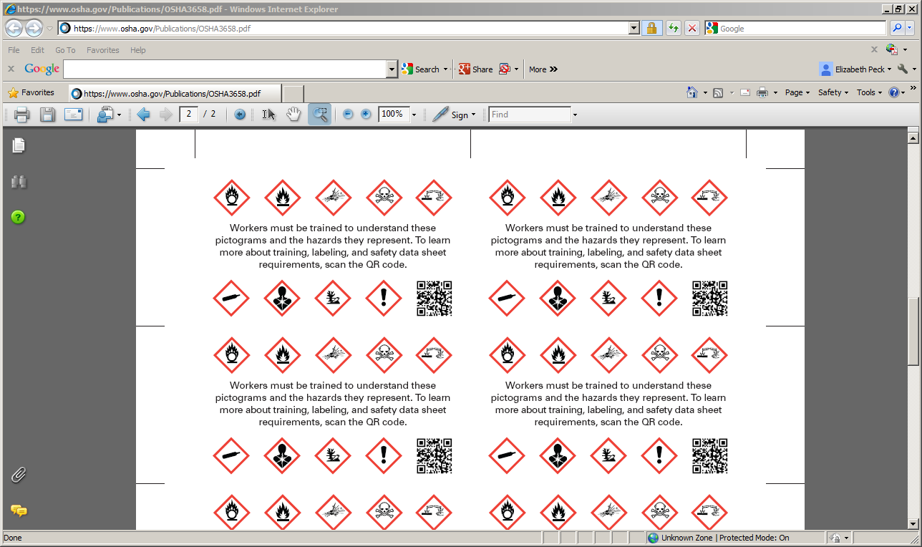
Hazard Classification:
Pictograms
OSHA has designated hazard classifications and designed pictograms associated with each hazard. The hazard classifications are ranked on a scale from 1- 4, with 1 being higher hazard and 4 being a lower hazard (note that his is the opposite of NFPA & HMIS rakings). Each pictogram is in a red diamond with a black hazard symbol in a white background. It is important to become familiar with these pictograms.

Slide 15
Labeling:
Requirements
All hazardous chemical containers are required to be labeled with the chemical name and hazard warnings. The original manufacturers label should be kept in-tact until the bottle has been emptied. When the chemical is transferred to a secondary container, including bottles, flasks, vials, etc., it must be clearly labeled with their contents and warnings.
All labels must contain:
  Product identification (same as it appears on the SDS)
  Signal word
  Pictogram
  Hazard statement(s)
  Precautionary statement(s)
  Name, address, and phone number of the chemical manufacturer, distributer

Slide 16
Labeling:
Signal Word
“Danger” and “Warning” are the only two signal words. They indicate the relative level of severity of hazard, “Danger” being more severe than “Warning.”
There will be only one signal word per label, no matter how many hazards a chemical may have.
  If one hazard warrants a “Danger” signal word, but another warrants a “Warning” signal word, then only “Danger” will appear on the label.

Slide 17
Labeling:
Hazard Statement(s)
Describe the nature of the hazard(s) of a chemical and the degree of hazard (where appropriate). All applicable hazard statements will appear on the label and will be combined when necessary to reduce redundancy. There are standardized hazard statements for all chemicals, ensuring that the same statement will show up for the same hazards, regardless of the chemical or who produces it.
As an example, Acetonitrile will have:
  Highly flammable liquid and vapor
  Harmful if swallowed
  Harmful in contact with skin
  Causes serious eye irritation
  Harmful if inhaled

Slide 18
Labeling:
Precautionary Statement(s)
A phrase that describes recommended measures that should be taken to minimize or prevent adverse effects resulting form exposure to a hazardous chemical or improper storage or handling.
As an example, Acetonitrile will have:
  Keep away from heat/sparks/open flames/hot surfaces – no smoking
  Wear protective gloves/protective clothing/eye protection/face protection
  IF ON SKIN (or hair): Remove/Take off immediately all contaminated clothing. Rinse skin with water/shower.

Slide 19
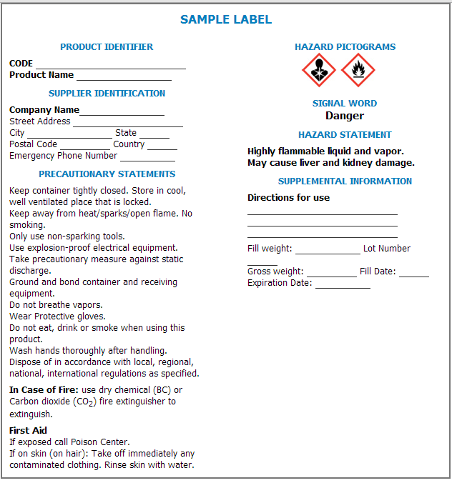
Labeling:
Sample Label

Slide 20
Safety Data Sheets (SDS)
Chemical manufacturers are required to provide GVSU with a Safety Data Sheet (SDS) for each chemical we purchase. GVSU must make those SDS’s available to the entire campus community.
  (note that the terms SDS and MSDS are often used interchangeably. OSHA regulations now define them as SDS’s, but many will still refer to them as MSDS’s, including many of GVSU’s websites)
Each laboratory must maintain an inventory of chemicals and SDS’s for each chemical. SDS’s for GVSU’s lab chemicals can be found online at: www.gvsu.edu/labsafety or http://csims.clas.gvsu.edu/MSDS.php
All SDSs will have a consistent 16-section format.

Slide 21
Safety Data Sheets (SDS)
Section 1 – Identification
Section 2 – Hazard(s) identification
Section 3 – Composition/Information on Ingredients
Section 4 – First-aid Measures
Section 5 – Fire-fighting Measures
Section 6 – Accidental Release Measures
Section 7 – Handling and Storage
Section 8 – Exposure Controls / Personal Protection
Section 9 – Physical and Chemical Properties
Section 10 – Stability and Reactivity
Section 11 – Toxicological Information
Section 12 – Ecological Information
Section 13 – Disposal Consideration
Section 14 – Transport Information
Section 15 – Regulatory Information
Section 16 – Other information including date of preparation of last revision

Slide 22
Laboratory Safety: Protecting Yourself and Reducing Risks
Grand Valley State University
Training Section 3 of 3

Slide 23
Standard Operating Procedures (SOP)
Standard Operating Procedures instruct students and employees on how a particular procedure or function is performed in order to work efficiently and safely.
  Be able to recognize critical points in a procedure
Recommended for specific lab functions (spill response, working alone, transferring materials, etc), as well as routine, repetitive, and unique operations as well.
Standard operating procedures can be found at www.gvsu.edu/labsafety

Slide 24
Substitution for Less Hazardous Chemicals
If a chemical can be substituted for a safer chemical alternative, it is recommended that the safer chemical is used.

Slide 25

Personal Protective Equipment (PPE)
Proper PPE should be appropriate for the type of work being done. You are responsible for taking the necessary precautions to protect yourself.
As a minimum, everyone must be covered from shoulders to knees, but more protection may be needed depending on the lab.

Slide 26
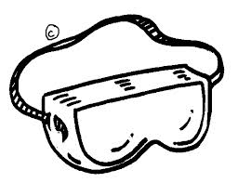
PPE: Eyes and Face
Eye and face protection are available to all employees or visitors to laboratories where chemicals are used or stored.
These include:
  Safety goggles or glasses
  Face shields

Slide 27

PPE: Skin and Body
Skin and body protection involves the use of protective clothing to protect individuals from chemical exposure
These include:
  Lab coats
  Gloves
  Closed-toe shoes
  Long pants

Slide 28
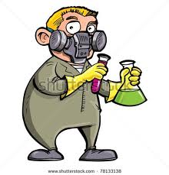
PPE: Respiratory and Hearing
In situations where hazardous chemicals may be inhaled, respiratory protection is necessary
In situations where hearing may be damaged, it is necessary to wear proper ear protection

Slide 29
Engineering Controls
Controlling exposure by modifying or reducing the quantity of contaminants released

Slide 30
Engineering Controls: Ventilation
Chemical fume hood, snorkel, downdraft, and Biosafety cabinets
  Proper use
    Local ventilation systems must be used properly according to the manufacturer’s recommendations
    Never work with hazardous chemicals if the required vent system is not working properly
    Ductless ventilation may be an option to conventional local exhaust hoods (i.e. portable fume hood)
Biosafety cabinets
  GVSU has Class II Biosafety Cabinets which provide personal, environmental, and product protection.
  Since air is pulled in from the room, filtered prior to flowing over the product, and then passed through a certified HEPA filter before re-entering the room, it will protect both the user and the product.
  The filter does not remove volatile chemicals and will not substitute as a chemical fume food.

Slide 31
Engineering Controls: Chemical Storage Cabinets
All flammable chemicals should be stored in a flammable storage cabinet (Yellow).
All corrosive chemicals should be stored in a corrosive storage cabinet (blue).
The cabinets under hoods will not be a specific color, but they will be labeled with the type of storage cabinet it is.

Slide 32

Engineering Controls:
Safety Shields
Safety shields must be used for protection against possible explosions or uncontrolled reactions.
Must be shielded on all sides.

Slide 33
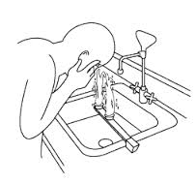
Safety Equipment
Safety showers
  Provide an immediate water drench for splashes of hazardous chemicals
Eyewash facilities
  Required in all laboratories where injurious or corrosive chemicals are used or stored

Slide 34
Emergency Response:
Medical Emergency
If immediate first aid is needed for an injury or illness, dial 911
  Only trained individuals should respond to an injury or illness or administer first aid
For chemicals on skin, eyes, or clothing, flush with water for at least 15 minutes. Consult SDS for chemical specific instructions or call 911
For skin contact with infectious agents, wash with soap and water for at least 1 minute. If skin is punctured, wash and dial 911
For ingestion or symptoms of inhalation, consult the SDS and dial 911 or poison control
Complete injury form

Slide 35
Emergency Response:
Fire
You are not required to fight fires.
Faculty and staff may choose to use fire extinguishers or other means to extinguish small fires.
Major Fires
  Pull alarm
  Evacuate & close the door behind you
  Notify responders or public safety of the nature of the fire

Slide 36
Emergency Response:
Chemical Spills
Small chemical spills
  Assess the hazard and ability to properly clean up
  Use appropriate PPE and follow cleanup and disposal procedures outlined on SDS.
  For biological hazards, identify proper disinfection procedures.
  If you are unsure, contact the Lab Supervisor or Lab Safety Office
Larger chemical spills
  If fire or health hazard exist, call 911
  If they do not present a fire or health hazard, contact public safety or building security.
Labs using chemicals and biological hazards with greater risk should develop a spill response plan and spill kits should be available.

Slide 37
Waste Disposal
Each lab has a designated space to collect waste.
Waste containing no hazardous material must be kept in receptacles labeled “Broken Glass”
Chemical waste is to be collected in containers labeled “Hazardous Waste”, the category of hazard, the specific chemical or reagent, and the date
  Although it is recommended waste is reagent/chemical specific, reagents/chemicals may be mixed if they are of the same category.
Use separate waste containers for metal, glass, and plastic sharps. Collect sharps that are contaminated with biohazardous material in rigid, leak proof, puncture resistant containers labeled with biohazard.
More information on waste disposal can be found at http://www.gvsu.edu/labsafety/hazardous-waste-88.htm

Slide 38
General Lab Safety Rules
Review SDS’s for chemicals and understand the chemical hazards, safe use and handing, and responsible procedures.
Familiarize yourself with emergency equipment (alarms, extinguishers, showers, eyewash, evacuation routes).
Be aware of unsafe conditions and notify as appropriate.
Avoid direct contact with any hazardous chemical.
If you are working alone, be sure to obtain approval from the lab supervisor and follow the protocols.

Slide 39
General Lab Safety Rules Continued
Wash hands thoroughly with soap and water after handling chemicals or biological materials.
No eating, drinking, or smoking in the lab.
Do not mouth pipette.
Do not use refrigerators or microwave ovens that have been used with chemicals for food storage or prep.
Keep work areas clean and uncluttered.
Dispose of hazardous waste as described in GVSU’s Hazardous Waste Management Plan.

Slide 40
General Lab Safety Rules Continued
Do not block exits, access to emergency equipment (eyewash, shower, first aid, etc), or controls. Do not use hallways or stairwells for storage.
Follow proper safety precautions for cylinders.
Label all containers with its contents.
When transporting hazardous materials outside the laboratory, use a bottle carrier or a cart with raised edges
Operations should not be left unattended unless they are failsafe. If an operation is left unattended, leave contact information.
Lab supervisors should maintain a current and comprehensive chemical inventory of all chemicals in their lab along with SDS’s available and accessible.

Slide 41
Lab Specific Safety
Safety Training is not complete without a review of hazards specific to the lab space or research project. Consult your Lab Supervisor, Principle Investigator, or the Lab Safety Specialist.
Areas to consider:
  Chemical Hazards
  Biological Hazards
  Physical Hazards
  Electrical Hazards
  Radiation Hazards
  General lab procedures and specific housekeeping tasks

Slide 42
Our Goal: A Culture Of Safety
Institutional Culture: A reflection of the actions, behaviors, and attitudes of an organization.
“Safety is important, and it’s everyone’s responsibility”
How?
  Strong Leadership & Personal Accountability
  Planning and Controlling Work Activity
  Continuous Learning/Questioning Attitude
  Positive, Respectful Work Environment

Slide 43
Questions
If you have any questions regarding lab safety please contact Jim Seufert, Laboratory Safety Specialist:
  seufertj@gvsu.edu
  616-331-8628
  322a Padnos

