Slide 1
Announcements
Week of September 20, 2021

Slide 2
Nervous about attending the GVSU Virtual Career & Internship Fair?
Never attended a virtual fair before? Not sure what to expect? Join GVSU Career Center staff as we go over the Handshake Virtual Fair platform and provide tips on how to best prepare for the upcoming career fair.
Monday, September 27 | 12:00 p.m. – 1:00 p.m. | Zoom Registration is required. RSVP for this event
Contact: GVSU Career Center I 616-331-3311 I careers@gvsu.edu

Slide 3
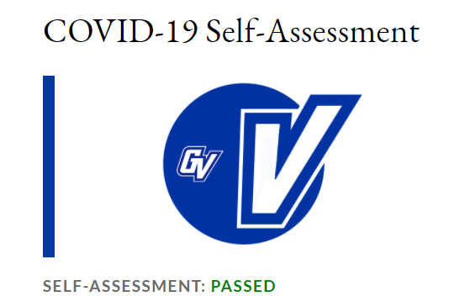
PLEASE COMPLETE YOUR DAILY SELF-ASSESSMENT EVERY. DAY.
Please do this today, whether vaccinated or not, and remember to continue to fill out the online self-assessment each day you are on campus.
www.gvsu.edu/hro/selfassessment-login.htm

Slide 4
Roosevelt Park Ministries Newsletter Internship Description Fall 2021, Spring/Summer 2022
The primary task of this position is to create a quarterly newsletter that represents Roosevelt Park Ministries to its potential donors. The goal of this newsletter is to promote Roosevelt Park Ministries to previous supporters through the use of anecdotes, data, and other related material. This internship is heavily dependent on being able to work with templates and to have a posture of curiosity for Roosevelt Park Ministries and our mission. This is an unpaid internship. Expect to work about 10 hours a week.
Full internship descriptions, qualifications, and how to apply can be found on Handshake.

Slide 5
SAVE THE DATE!
Explore various career fields and meet with employers looking to hire for internships, part-time and full-time opportunities in a virtual environment!
Sign up for 1:1 meetings in Handshake with representatives to introduce yourself and express interest in a position. These are on a first-come, first-served basis!
During the fair, join group meetings with employers to ask questions, learn more about the organization, opportunities, and various career paths.
Career Explorers – explore various career paths and build your professional networks by meeting with employers interested in engaging with you.
Do this all from the comfort of your room! No lines, no travel, no parking hassle!

Slide 6
Career Fairs, whether in-person or virtual, can be quite nerve-wracking. Preparation is key!
Join the Career Center for a session on crafting your virtual introduction/elevator pitch. Taking a few minutes to craft your story—where you started, where you are now, where you want to go—will serve as a foundation for conversations. Attendees will have the chance to practice their crafted pitch with professionals who can give great advice to help improve their networking skills, all in a low-key environment!
Tuesday, September 28 | 11:30 a.m. – 1:00 p.m. | Zoom Registration is required. | RSVP for this event

Slide 7
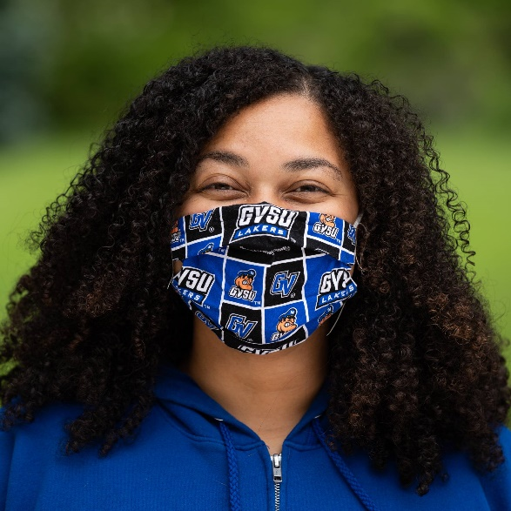
Be safe, and make good choices, Lakers!

Slide 8
Roosevelt Park Ministries Bilingual Administrative Intern/Volunteer Fall 2021,Winter/Spring 2022
This position requires a responsible and personable individual to provide holistic support for residents of the Roosevelt Park Ministries neighborhood and surrounding area through giving a warm welcome, answering phones, and translating basic documents, and giving out information about the services/programs offered at RPM. Roosevelt Park Ministries is a non-profit organization located in the Roosevelt Park area of Grand Rapids. This opportunity will allow the student to utilize both Spanish and English skills. The internship requires 8-10 hours per week for 12-15 weeks or more, and days and hours can be negotiated. The internship is unpaid.
Full internship descriptions, qualifications, and how to apply can be found on Handshake.

Slide 9
Applying for jobs, grad school, attending a career fair, etc.? Stop in to the CareerLab to get your resume reviewed, no appointment needed! Locations are in both Allendale and Downtown, as well as both in-person and virtual appointment options.
CareerLab Hours:
(In-Person) Mon-Fri 11am-4pm
(Virtual) Mon-Thu 4pm-7pm

Slide 10
Public, Nonprofit, and Health Administration
Main Office Hours:
Monday – Friday, 8am – 5pm
Phone Number: (616) 331-6575
Location: 288C DeVos
www.gvsu.edu/pnha
Please call or e-mail with any questions!
Please call the CECI Advising Center if you need to schedule an advising appointment. 616.331.6890

