Slide 1
Announcements
Week of November 15, 2021

Slide 2
Sustainability Showcase website

Slide 3
myScholarships
Scholarship applications are now being accepted for the 2022-2023 academic year via myScholarships!
Scholarships available specifically for GVSU PNHA students:
Henry H. and Juanita Dungey Endowed Scholarship
Valerie P. Eggert Distinguished Scholarship in Philanthropy
Joyce Hecht Philanthropy Scholarship
Kurt F. Kimball Scholarship Endowment
Don and Mille Wagner Scholarship in Memory of Caprice R. Wagner
Maribeth Wardrop Leaders in Philanthropy Scholarship
Michael F. Young Memorial Scholarship
Start you myScholarships application TODAY!

Slide 4
Your participation in a GVSU Age Friendly Readiness Assessment Focus Group will help us to identify how students and older adults perceive, experience, and think about aspects of the GVSU community and GVSU experience that can help or hinder age friendliness.
Focus Group Sessions (all via Zoom):
Wednesday, November 17
5:30 p.m. – 7:00 p.m.
Friday, November 19
2:00 p.m. – 3:30 p.m.
Monday, November 22
12:00 p.m. – 1:30 p.m.
3:00 p.m. – 4:30 p.m.
REGISTER HERE

Slide 5
The 2022 Richard J. Stull Student Essay Competition is underway!
The American College of Healthcare Executives is pleased to sponsor the annual Richard J. Stull Student Essay Competition in Healthcare Management. The purpose of the competition is to stimulate and demonstrate the ability of future healthcare executives to identify and describe important issues and developments in their chosen profession.
Essays must be received at ACHE by close of business on Monday, December 6, 2021.
For complete rules and details, including eligibility requirements, visit ache.org/StullEssayComp

Slide 6
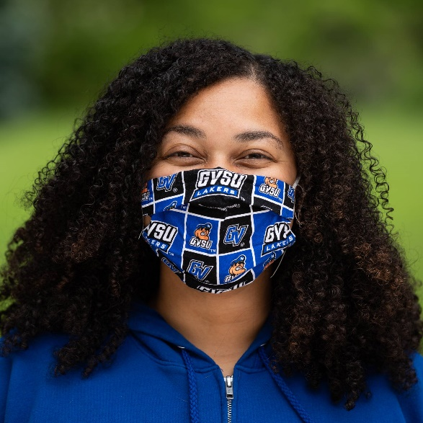
Be safe, and make good choices, Lakers!

Slide 7
Become a CECI Mentor OR Mentee!
Visit the CECI website for full position description and requirements.

Slide 8
NOODLES & NETWORKING
FOR NONPROFIT PROFESSIONALS
GVSU's Nonprofit Professionals Graduate Student Organization (NPGSO) and the Young Nonprofit Professionals Network of Grand Rapids (YNPN-GR) are thrilled to put on this fun networking event for nonprofit professionals.
The event will take place in the private dining room at Palio Grand Rapids. Attendees are expected to purchase their own food and beverages.
Come and meet other nonprofit professionals, celebrate the end of the semester, and maybe make a new friend!
December 7, 2021
6:00 - 8:00 p.m.
Palio Grand Rapids
Register here to attend!

Slide 9
Important Student Resources
Be in the know! During your time at GVSU, we want to make sure that you get any and all the assistance you may need to have a successful college career. Get to know the various resources available for you to utilize right here on campus, many of which are available to you AT NO COST.
Available resources include: Academics, Academic Support, Belonging and Campus Climate, Campus Safety, Finances, Wellness
Check out all of the resources available to you here: www.gvsu.edu/studentservices/student-resources-29.htm

Slide 10
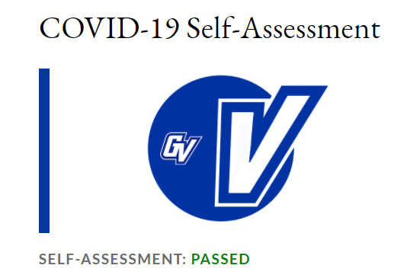
PLEASE COMPLETE YOUR DAILY SELF-ASSESSMENT EVERY. DAY.
Please do this today, whether vaccinated or not, and remember to continue to fill out the online self-assessment each day you are on campus.
www.gvsu.edu/hro/selfassessment-login.htm

Slide 11
Public, Nonprofit, and Health Administration
Main Office Hours:
Monday – Friday, 8am – 5pm
Phone Number: (616) 331-6575
Location: 288C DeVos
www.gvsu.edu/pnha
Please call or e-mail with any questions!
Please call the CECI Advising Center if you need to schedule an advising appointment. 616.331.6890

