Slide 1
UNDERSTANDING TITLE IX & CIVIL RIGHTS PROCESSES AT GVSU 2024

Slide 2

SESSION DESCRIPTION
The presentation provides an overview of the Title IX and Civil Rights processes at GVSU. Attendees will gain an understanding of what types of issues the office handles, what happens once a report is made and what options an impacted party has for resolution. This session aims to address misconceptions about the reporting & resolution process.

Slide 3

AGENDA
INTRODUCTIONS
OVERVIEW OF REPORT TYPES WE RECEIVE AND RESPOND TO
MISCONCEPTIONS ABOUT CIVIL RIGHTS AND TITLE IX PROCESSES
CASE STUDY DISCUSSION
SUBMIT A TEST REPORT TO MAXIENT DATABASE INTAKE MEETING WITH TITLE IX
POSSIBLE OUTCOMES OF CASE STUDIES

Slide 4


LEARNING OUTCOMES
Participants will be able to:
Understand the types of incidents that the Office of Civil Rights and Title IX handles
Understand what happens once a report is made, supportive measures and resolution pathways
Understand options for formal and informal resolution of a
complaint

Slide 5
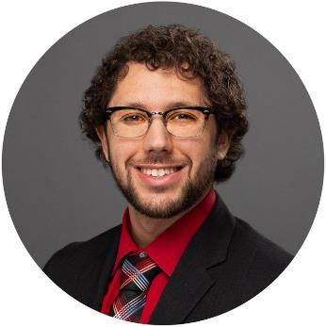
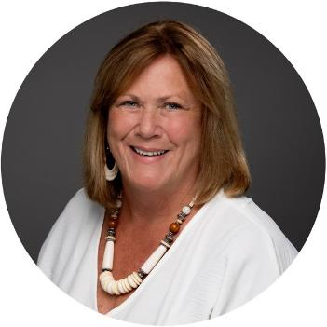


INTRODUCTIONS
Cameron Jones
Kathleen VanderVeen
MJ Creutz
Stacy Piasecki
Associate Vice President, Acting Title IX Coordinator, & Deputy Chief Inclusion and Equity Officer
Assistant Director: Office of Civil Rights and Title IX and Deputy Title IX Coordinator
Lead Civil Rights Investigator & Deputy Title IX Coordinator
Civil Rights Specialist
www. gvsu. edu/ t i t leix

Slide 6
CONTENT WARNING
Topics related to sexual misconduct/assault, intimate partner violence, stalking, and age discrimination.

Slide 7


OVERVIEW OF REPORT TYPES WE RECEIVE AND RESPOND TO
Sexual Harassment
Unwelcome conduct based on sex, sexual orientation, gender identity, and/or pregnancy.
Sexual Assault
Unwelcome sexual intercourse/fondling, incest, statutory rape (16 yr.)
Domestic Violence
Physical violence or threat of violence committed by a current or former spouse, intimate partner, co-parent, or person you’ve lived with.
Dating Violence
Physical violence or threat of violence committed by a current or former romantic or intimate partner.
Stalking
Engaging in a course of conduct involving repeated or continuing harassment of another person that would cause a reasonable person to fear for their safety or the safety of others or suffer substantial emotional distress.

Slide 8
OVERVIEW OF REPORT TYPES WE RECEIVE AND RESPOND TO CONT.
Discriminatory Harassment may include unwelcome conduct based on an individual’s or group’s, race, color, national origin, age, disability, familial status, height, weight, marital status, political affiliation, veteran status, military status, genetic information, or any other legally protected characteristic that interferes with performance, limits participation in University activities, or creates an intimidating, hostile, or objectively offensive environment when viewed from the perspective of both the individual and a reasonable person in the same situation.
Discriminatory harassment includes, but is not limited to, the following types of conduct when such conduct is based an individual’s or group’s protected characteristic:
Verbal abuse, slurs, derogatory comments or insults about, directed at or made in the presence of an individual or group.
Display or circulation of documents or pictures that are objectively offensive or degrading.
Physical contact or threatening language or behavior.
Damage to, trespass on, or theft of property.

Slide 9

MISCONCEPTIONS ABOUT CIVIL RIGHTS AND TITLE IX PROCESSES
“WHAT WE DO”
We keep your information as private as possible, within policy and process;
We work with you to evaluate your care and support needs;
Discuss your options under university policy;
Empower you to obtain the care and support you need

Slide 10
MISCONCEPTIONS ABOUT CIVIL RIGHTS AND TITLE IX PROCESSES
“WHAT WE DON’T DO”
Require you to take action in any direction
Notify accused party/ies that you’ve reported to our office Start investigating immediately
Find the perfect solution or outcome for any party involved
While our office responds to reported harm with support, empathy, and understanding, it’s never wholly possible for us to heal impact of an incident
“sweep things under the rug”
Policy/procedure driven responses, formal language in outreach letters

Slide 11


CASE STUDY DISCUSSION
Case study content is related to sexual misconduct, intimate partner violence, stalking, and age discrimination.
Please take care as your participate and/or leave the space as needed.

Slide 12
CASE STUDY DISCUSSION
Dating/Domestic Violence
You arrive home from a day of classes and see a message from your friend Matt who is dating Garrett, his roommate in South Apartments. Matt goes on to tell you that he is going to have to drop out of GVSU as a whole, and that he doesn’t know what to do because he and Garrett got into a fight and it became physical. Matt has a large scratch on his face that drew blood and bruises all over his arms. Matt told you that this has happened two times previously and the violent behavior is escalating and he is starting to feel scared for his safety.
Consider this as you plan your next steps:
What could you SAY that might be helpful in this situation? What could you DO that might be helpful?
What would NOT be helpful to SAY or DO?
What does this bring up for you? Consider what fears, automatic thoughts, biases/assumptions, or personal experiences are evoked.

Slide 13
CASE STUDY DISCUSSION
Sexual Assault
Megan is your partner in a group project in anthropology class. Megan typically participates in class discussions and seems pretty outgoing. You notice that Megan has stopped participating in class discussions and has not been available for group work after class for the past three weeks. You talk with Megan privately after class to ask if everything is ok. She becomes emotional but won’t look at you and tells you she’s fine and rushes out and leaves. Later that night Megan emails you to apologize and let you know that she was raped by another GVSU student over Winter break and doesn’t know what to do.
What could you SAY that might be helpful in this situation? What could you DO that might be helpful?
What would NOT be helpful to SAY or DO? Mandatory reporting?

Slide 14
CASE STUDY DISCUSSION
Stalking
Sam is your lab partner in Bio 120. It’s the 6th week in the semester, and Sam has come late to two labs in a row. You check in with Sam during lab and ask if there’s something going on. Sam asks if the two of you can speak privately so you go to get coffee after class. Sam confides that an ex partner has been messaging them non-stop, showing up outside their apartment and around campus where Sam is at. The ex has told Sam they want them back and won’t stop messaging them and following them until they agree to take them back.
Consider the following questions:
What could you SAY that might be helpful in this situation? What could you DO that might be helpful?
What would NOT be helpful to SAY or DO?

Slide 15
CASE STUDY DISCUSSION
Discriminatory Harassment
Jackson is your coworker in the tutoring center. A student he tutors has been referring to him as “Grandpa Jack” because he returned to GVSU to earn his bachelors degree at the age of 32. Jackson has asked that the student stop referring to him as “Grandpa Jack” and the student dismissed his request by saying, “It’s just a joke.” Now, the student’s friend Taylor stopped by the tutoring center to specifically request “Grandpa Jack” as a tutor because she “thinks he is wise due to his old age”. Jackson already feels uneasy returning to college as a “non traditional” student after taking so much time off and these incidents are causing him stress in his workplace.
Consider the following questions:
What could you SAY that might be helpful in this situation? What could you DO that might be helpful?
What would NOT be helpful to SAY or DO?

Slide 16


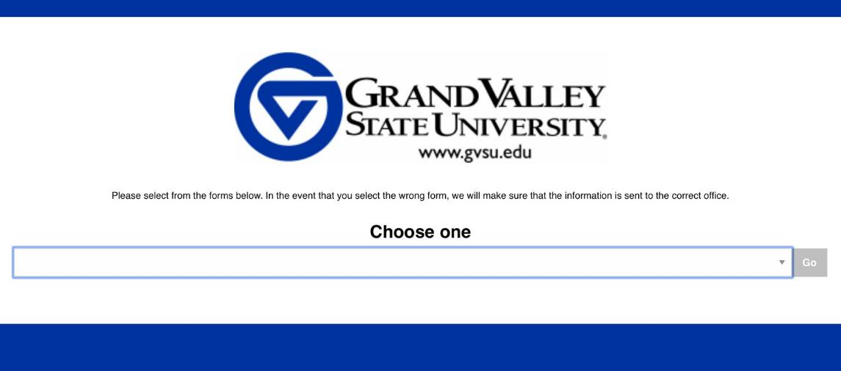
Submit a test report:
https://cm.maxient.com/reporting.php?GrandValley

Slide 17
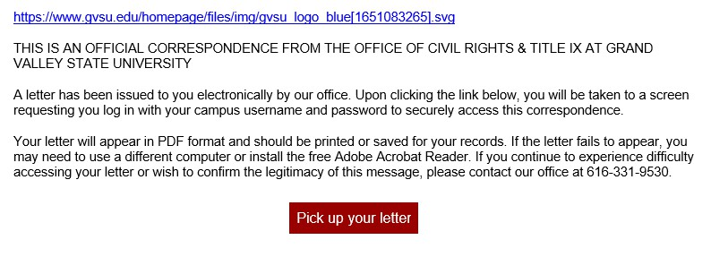

WHAT TO EXPECT AFTER SUBMITTING A REPORT
Does it look like fishing? Yes. Is it fishing? No.
What does it give access to? Support resources and information on pathways for resolution.

Slide 18


INTAKE MEETING WITH TITLE IX
Person who has submitted a report (on their own behalf or for someone else) receives a confirmation email;
Complainant (alleged harmed party) receives an outreach email from MJ or Stacy which includes resources;
Complainant has the opportunity to meet with a member of the Title IX team for intake- resource sharing, options for resolution;
Submitting a report does not initiate action by the Title IX office nor does it require that a complainant takes additional action. It is possible and okay to submit a report for record keeping and do nothing.

Slide 19



POSSIBLE OUTCOMES OF CASE STUDIES
Sexual Assault: Supportive measures only
Dating/Domestic violence: Formal complaint for investigation
Stalking: Remedial response, educational conversation, no contact order issued by Title IX
Age discrimination: Remedial response, collaboration with tutoring center for educational conversation

Slide 20
Participants should now be able to:
Understand the types of incidents that the Office of Civil Rights and Title IX handles
Understand what happens once a report is made and the agency of the impacted party
LEARNING OUTCOMES
Understand options for formal and informal resolution of a complaint
Questions?

Slide 21







616-331-9530
titleix@gvsu.edu Office: Zumberge 4015
THANK YOU
www.gvsu.edu/titleix

