Slide 1

OFFICE OF CIVIL RIGHTS AND TITLE IX POOL MEMBER TRAINING
2024

Slide 2
AGENDA
  Why do we need a pool to support Title IX?
  Requirement of Impartiality
  What is Title IX?
  Definitions of Title IX Sexual Harassment and Sexual Misconduct

Slide 3

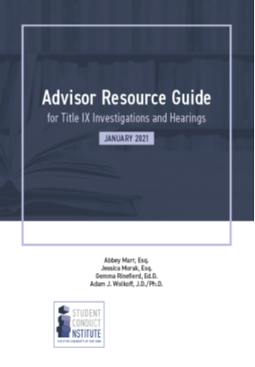

TRAINING MATERIALS

Slide 4
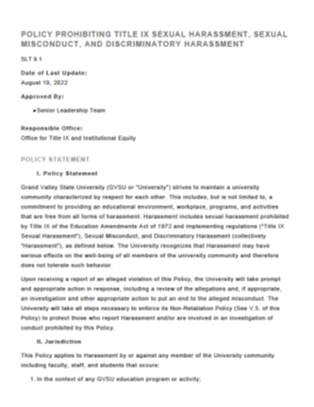
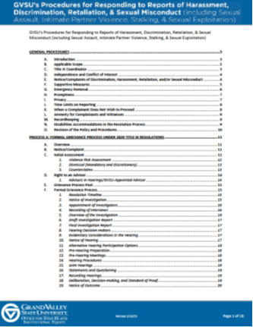
TRAINING MATERIALS

Slide 5
REQUIREMENT FOR IMPARTIALITY
Section 106.45(b)(1)(iii)
The grievance process must require that any individual designated by the recipient as Title IX Coordinator, investigator, decision maker, or facilitator of informal resolution not to have a conflict of interest or bias:
  For or against complainants or respondents generally
OR
  An individual complainant or respondent (this does not apply to advisors).

Slide 6
REQUIREMENT FOR IMPARTIALITY
Section 106.45(b)(1)(iii)
Requires that officials in Title IX proceedings act:
  Impartially, including avoiding prejudgment of the facts at issue (this does not apply to advisors).
Identify and avoid any conflict of interest, and bias.
Training material may not rely on sex stereotypes and must promote impartial investigations and adjudications of formal complaints of sexual harassment.

Slide 7
WHAT IS TITLE IX?
No person in the United States shall, on the basis of sex, be excluded from participation in, be denied the benefits of, or be subjected to discrimination under any education program or activity receiving Federal financial assistance.

Slide 8
TITLE IX JURISDICTIONAL REQUIREMENTS
An allegation will fall within Title IX when it involves:
1. Conduct that would constitute sexual harassment, sexual assault, domestic violence, dating violence, and/or stalking (if proven) as defined by GVSU policy and:
A. Occurs in the United States;
B. Occurs in an education program or activity (where GVSU controls the context of the incident);
C. Involves a complainant who is participating in or attempting to participate in GVSU’s educational programs or activities at the time of filing the complaint; and
D. Involves a respondent over whom GVSU has substantial control (as a student or employee).

Slide 9
Title IX Sexual Harassment is unwelcome conduct on the basis of sex, sexual orientation, gender identity and/or pregnancy that satisfies one or more of the following:
A. Quid Pro Quo Harassment: An employee or agent of GVSU conditioning the provision of an aid, benefit, or service on an individual’s participation in unwelcome sexual conduct.
B. Unwelcome conduct determined by a reasonable person to be so severe, pervasive, and objectively offensive that it effectively denies a person equal access to the University’s education program or activity.
TITLE IX SEXUAL HARASSMENT

Slide 10
C. Sexual assault: Any forcible or non-forcible sex act proscribed by law. “Forcible sexual assault” includes sexual intercourse and fondling without consent. “Non-forcible sexual assault” includes incest and statutory rape.
i. “Sexual intercourse” includes oral, anal, and vaginal intercourse or penetration, to any degree, with any part of the body or other object.
ii. “Fondling” is defined as touching of the genitals, buttocks, and/or breasts of another person for the purpose of sexual gratification, without consent.
iii.“Incest” is defined as sexual intercourse between persons who are related to each other within the degrees wherein marriage is prohibited by law.
iv. “Statutory rape” is nonforcible sexual intercourse with a person who is under the statutory age of consent according to Michigan law.
TITLE IX SEXUAL HARASSMENT

Slide 11
D. Dating violence: Physical violence or the threat of physical violence committed by a person who is or has been in a social relationship of a romantic or intimate nature with an individual, and the existence of such a relationship shall be determined based on factors such as the length and type of relationship, and frequency of interaction between the persons involved.
E. Domestic violence: Physical violence or the threat of physical violence committed by a current or former spouse or intimate partner of an individual, by a person with whom the individual shares a child in common, by a person who is cohabitating with or has cohabitated with the individual as a spouse or intimate party, by a person similarly situated to a spouse of the individual under applicable domestic or family violence laws.
TITLE IX SEXUAL HARASSMENT

Slide 12
F. Stalking: Knowingly or intentionally engaging in a course of conduct involving repeated or continuing harassment of another person that would cause a reasonable person to fear for their safety or the safety of others or suffer substantial emotional distress.
G. Only conduct that meets the definition of Title IX Sexual Harassment, that occurs in a University education program or activity, and that occurs against a person in the United States constitutes Title IX Sexual Harassment.
An “education program or activity” includes locations, events, or circumstances over which the University exercised substantial control over both the Respondent and the context in which the alleged sexual harassment occurs, including on campus or on property owned or controlled by the University, at University-sponsored events, or in buildings owned or controlled by a student organization that is officially recognized by the University.
TITLE IX SEXUAL HARASSMENT

Slide 13
Quid Pro Quo: An RA documents a resident for possession of marijuana in the residence halls. The RA invites the resident to their room with an offer to engage in sexual activity to discuss what it would take for the RA not to have to submit this report.
Hostile Environment: A student was overheard having sex within the residence halls. A group of residents began imitating the sounds they made during their sexual encounter. The complainant, their friends, and an RA have all asked the students to stop, but they have continued. The student no longer feels comfortable attending hall programs or being in common spaces within the residence hall.
SEXUAL HARASSMENT
EXAMPLE

Slide 14
SEXUAL ASSAULT EXAMPLE
Sexual Contact: A student reported that they woke up to their roommate in bed with them, naked and touching their own genitals. The student reported that they pretended to be asleep, but then their roommate began touching their genital area over their shorts too.
Sexual Intercourse: A student reports that they went to a big party and had more to drink than they planned…

Slide 15
DATING VIOLENCE (INTIMATE PARTNER VIOLENCE)
A student reports that they broke up with their significant other two weeks ago. The student stated that towards the end of the relationship, their partner had engaged in increasingly controlling behavior, and that the partner repeatedly raised their voice during arguments.
The student reported that after the relationship ended, their partner told them that “they would regret ending things”, and that their partner then put their fist through the wall of their apartment.

Slide 16
STALKING
A student reported that they matched with someone on Tinder and had gone on one date. The student reported that the date did not go well, and that they did not plan to go on a second date. The student reports that the person they matched with has continued to message them via the app, even creating a new profile to continue to message them after their first profile was blocked. The student reports that they recently found a note on their windshield after class. The student reports that they are afraid to be on campus by themselves, and that they are afraid to use Tinder for fear of being contacted by this person again.

Slide 17
We define discrimination as differential treatment on the basis of a protected characteristic noted above, that disadvantages an individual or group in university activities such as admissions, employment, athletics, housing, or access to facilities. Discrimination may also be demonstrated by showing that a facially neutral policy or practice had a disproportionate impact or effect on individuals with a protected characteristic.
DISCRIMINATION
Notes:
- In procedures doc
- Citing Eliot Larson and IIV- used to be group of folks between title ix specialists and title IIV

Slide 18
Some examples of conduct that may constitute prohibited discrimination may include, but are not limited to:
i. Denying a person access to an educational program based on a protected characteristic as noted above;
ii. Denying raises, benefits, or promotions on the basis of a protected characteristic as noted above;
iii. Preventing any person from using GVSU facilities or services because of a protected characteristic as noted above;
iv. Instigating or allowing an environment that is unwelcoming or hostile based on a protected characteristic as noted above.
DISCRIMINATION

Slide 19
DISCRIMINATORY HARASSMENT
Discriminatory Harassment may include unwelcome conduct based on an individual’s or group’s, race, color, national origin, age, disability, familial status, height, weight, marital status, political affiliation, veteran status, military status, genetic information, or any other legally protected characteristic that interferes with performance, limits participation in University activities, or creates an intimidating, hostile, or objectively offensive environment when viewed from the perspective of both the individual and a reasonable person in the same situation.

Slide 20
DISCRIMINATORY HARASSMENT
A. Discriminatory harassment includes, but is not limited to, the following types of conduct when such conduct is based an individual’s or group’s protected characteristic:
i. Verbal abuse, slurs, derogatory comments or insults about, directed at or made in the presence of an individual or group.
ii. Display or circulation of documents or pictures that are objectively offensive or degrading.
iii. Physical contact or threatening language or behavior.
iv. Damage to, trespass on, or theft of property.

Slide 21
WHAT TO EXPECT AS A MEMBER OF OUR POOL
When a request for a formal investigation is received, an email will be sent out to our pool members asking if they are available to assist.
Investigators will assist in conducting interviews with complainant(s), respondent(s) and witnesses.
Advisors can be brought into the process during the interview phase if the party wishes, but must be present for the hearing.
Hearing panelists will typically attend a pre-hearing meeting, the hearing and a post hearing meeting to deliberate
Notes:
- Taking all cases and these outreaches will be my responsibility
- Me talk about outreach for advisor and panelists
- Stacy reaches out to co-investigators and I do panelists and advisors
- Send out ask when stacy shares with me the draft investigation report
- hearing schedule within 10 business days from when final investigation report is sent to parties
- Jackie schedules hearings/doodle/Hypatia sends docs and what not

Slide 22
UNDERSTANDING THE PROCESS
Regardless of whether an incident falls under Title IX or University policy, a letter is emailed to the impacted party with an offer to meet, discuss support and resources.
If the impacted party (Complainant) meets with our office they will be provided options for resolution, both formal and informal.

Slide 23




PURPOSE OF THE HEARING
Review and Assess Evidence
Make Findings of Fact
Determine Responsibility/Findings of Responsibility
Determine Sanction and Remedy
Notes:
- my process explaining intake and support and resolution process, purpose of hearing logistically and process of hearing possibly personally

Slide 24

SERVING AS A CO-INVESTIGATOR
  Co-Investigators serve as factfinders in Title IX/Civil Rights investigation by interviewing Complainants, Respondents, and Witnesses on alleged violations of GVSU’s Policy Prohibiting Harassment, Discrimination, Retaliation, & Sexual Misconduct.
As a co-Investigator you:
  Compile and organize the information received during an investigation to aid in the creation of the preliminary report.
  Must be impartial, neutral and unbiased.
  Must be able to effectively communicate in oral and written form.
  Must be able to analyze complex information and synthesize relevant details
  Must attend an annual training provided by our office
Notes:
- best practice keeping notes from investigative interviews

Slide 25
SERVING AS AN ADVISOR
Case/Hearing Advisors serve as a support to students, faculty, and/or staff engaged as complainants or respondents in Title IX cases. This individual accompanies participants to meetings, interviews, and their administrative hearing, as needed.
Advisors are responsible for:
  Providing support and university resource information to students, faculty, or staff who are complainants or respondents in Title IX/University policy proceedings.
  Conducting cross-examination during hearings
  Post hearing support and appeal if desired

Slide 26
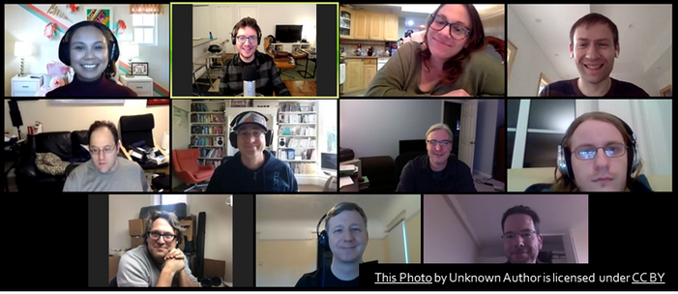
SERVING AS A HEARING PANELIST
Hearing Panelists serve as support for the Hearing Chair for Title IX Hearings. Each Hearing panel will consist of at least (2) trained administrators. The Hearing Panel reviews the Title IX Investigative Report, evidence gathered throughout the investigation, and attends the scheduled Hearing. During the Hearing, the panelist will listen to verbal testimony of witnesses and parties to a case. This includes direct examination and cross examination between the parties, through each party’s hearing advisor.
Hearings are held via ZOOM.

Slide 27
SERVING AS A HEARING PANELIST
As a Hearing Panelist, you must:
  Be neutral, independent, impartial, objective and must not have a conflict of interest that would result in a biased process or decision.
  Maintain significant familiarity with GVSU Policies and Procedures, particularly related to hearings.
  Be able to analyze complex information and synthesize relevant details into a determination regarding violations of the Title IX Sexual Harassment Policy or applicable policy.

Slide 28
SERVING AS A HEARING PANELIST
  Following the hearing, the hearing panel will deliberate in a closed door session.
  Hearing panelists can only rely on whatever evidence is available through the investigation and hearing in making their determination of responsibility.
  Preponderance of the evidence standard is used in decision making.
  Hearing panelists are responsible for determining responsibility, and sanctions (if found responsible).
  A majority vote is required to determine a finding.

Slide 29
ADVISORS TIME COMMITMENT
The amount of time you spend as an advisor will vary from case to case. Here are some things you can expect and how long they usually taken when in the role of an advisor:
  Review the investigative report and evidence (1-3 hours)
  Plan on, at a minimum, meeting with the party you are advising prior to the hearing to go over the details of the report (2 hours)
  There will be a pre-hearing conference with the Hearing Chair that you and the party you represent will attend (1-1.5 hours)
  You will attend the hearing (3-8 hours)
  Depending on the outcome, you may need to assist in filing an appeal (1-2 hours)

Slide 30
HEARING PANELIST’S TIME COMMITMENT
The amount of time you spend as a hearing panelist will vary from case to case. Here are some things you can expect and how long they usually taken when in the role of a hearing panelist:
  Review the investigative report and evidence (1-3 hours)
  Creating relevant questions to present to the Hearing Chair after reviewing the investigative report and evidence (2 hours)
  There will be a pre-hearing conference with the Hearing Chair that you will attend (1-1.5 hours)
  You will attend the hearing (3-8 hours)
  Post-hearing deliberation meeting with the Hearing Chair (1-2 hours)

Slide 31
PREPONDERANCE OF THE EVIDENCE STANDARD
Under this standard, individuals are presumed not to have engaged in the alleged conduct unless a "preponderance of the evidence" supports a finding that the conduct occurred. This "preponderance of the evidence" standard requires that the evidence supporting each finding be more convincing than the evidence offered in opposition to it.
50 plus a feather

Slide 32
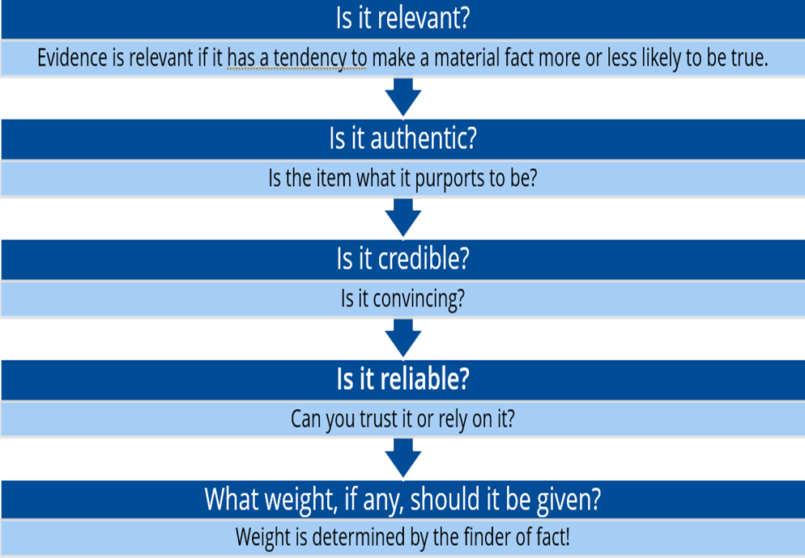
EVALUATING THE EVIDENCE

Slide 33
It is important that you take measures to promote your own self-care after helping someone deal with sexual and relationship violence, stalking, sexual harassment, and gender-based discrimination. witnessing an assault or hearing the details may arouse vicarious trauma and feelings such as anger, fear, outrage, or depression in you. These incidents may also trigger memories of your own traumatic experiences, inciting a variety of physical or psychological stress responses.
SELF CARE FOR SUPPORT PERSONS

Slide 34
Exposure to an event or events that creates a real or perceived threat to life, safety, or sense of well being and bodily integrity
May result from war, natural disasters, severely distressing events
When the brain senses a threat, releases hormones or chemicals throughout the body to help react to the threat and/or trauma
The brain does not distinguish between “types” of sexual assault
Interprets stranger or acquaintance equally as threats to survival.
The brain also does not typically differentiate between an actual threat and a perceived or subjective threat
Sometimes also a function of prior experiences, rather than the immediate situation
UNDERSTANDING TRAUMA
@2023 ATIXA Association of Title IX Administrators

Slide 35
Memory is formed in two steps:
  Encoding: organizing sensory information coming into the brain.
  Consolidation: grouping into memories and storing the stimulus.
Trauma can interfere with the encoding and/or the consolidation of memory
May create fragmented memories
Recall can be slower and more difficult
Alcohol may interfere further with memory
However, sensory information (smell, sound, etc.), may still function properly.
TRAUMA AND MEMORY
@2023 ATIXA Association of Title IX Administrators

Slide 36
  Expecting a complainant to give a linear account in the days after an incident, or having been triggered, is not always realistic.
  Memory fragmentation can occur.
  Having “inconsistent” memory, pausing, and stumbling to provide an account are not outside the bounds of what one could expect from a person who has experienced trauma.
  A non-linear account, with jumping around and scattered memories is not uncommon.
  Be patient during the interview and allow time.
TRAUMA AND MEMORY
@2023 ATIXA Association of Title IX Administrators

Slide 37
  However, while trauma may help explain issues that impact credibility, it typically does NOT excuse them.
  An assessment of credibility must focus on issues such as the reliability, consistency, and believability of the parties.
  If, for example, a party’s account is inconsistent or variable, lacking in detail, or has material memory gaps, it typically lacks credibility.
  An understanding of trauma and its impact will provide insight as to why some credibility deficits exist, but a trauma-informed understanding should not materially impact a credibility assessment.
TRAUMA AND MEMORY
@2023 ATIXA Association of Title IX Administrators
Notes:
Payment spiell

