Slide 1
Three Act Tasks
Chelsea Ridge, Math Coordinator
GVSU Regional Math and Science Center

Slide 2
Agenda
NCTM Teaching Practices
3 Act Task
Share and Debrief
Paper Video
Lunch
Enhancing Traditional Tasks
Work time

Slide 3
NCTM Teaching and Learning Survey
Take the survey on your own
When your table is done, discuss some of the most thought-provoking portions of the survey
Be prepared to share two highlights from your discussion

Slide 4
Beliefs about teaching and learning mathematics
What do you notice about the Beliefs and the survey?
Discuss in your small groups
Be prepared to share

Slide 5
Mathematics Teaching Practices
Please read the 8 Mathematics Teaching Practices
Identify which ones you highlight when you are teaching a 3 Act Task
Share at your table

Slide 6
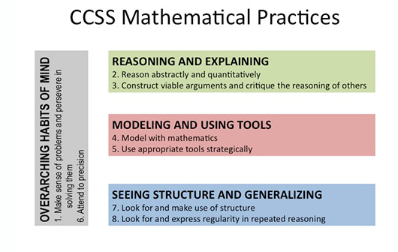
Compare and Contrast
Mathematics Teaching practices
Standards for student mathematical practice
Establish mathematics goals to focus learning.
Implement tasks that promote reasoning a problem solving.
Use and connect mathematical representations.
Facilitate meaningful mathematical discourse.
Pose purposeful questions.
Build procedural fluency from conceptual understandings.
Support productive struggle in learning mathematics.
Elicit and use of evidence of student thinking.

Slide 7
Here we go!!!!
https://tapintoteenminds.com/3act-math/mowing-the-lawn/#task

Slide 8
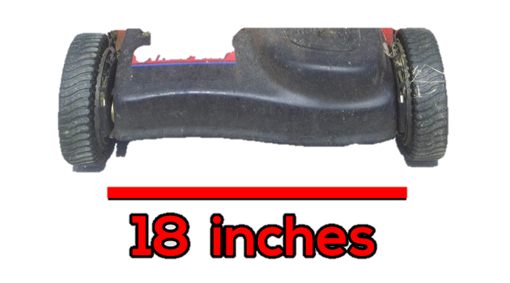
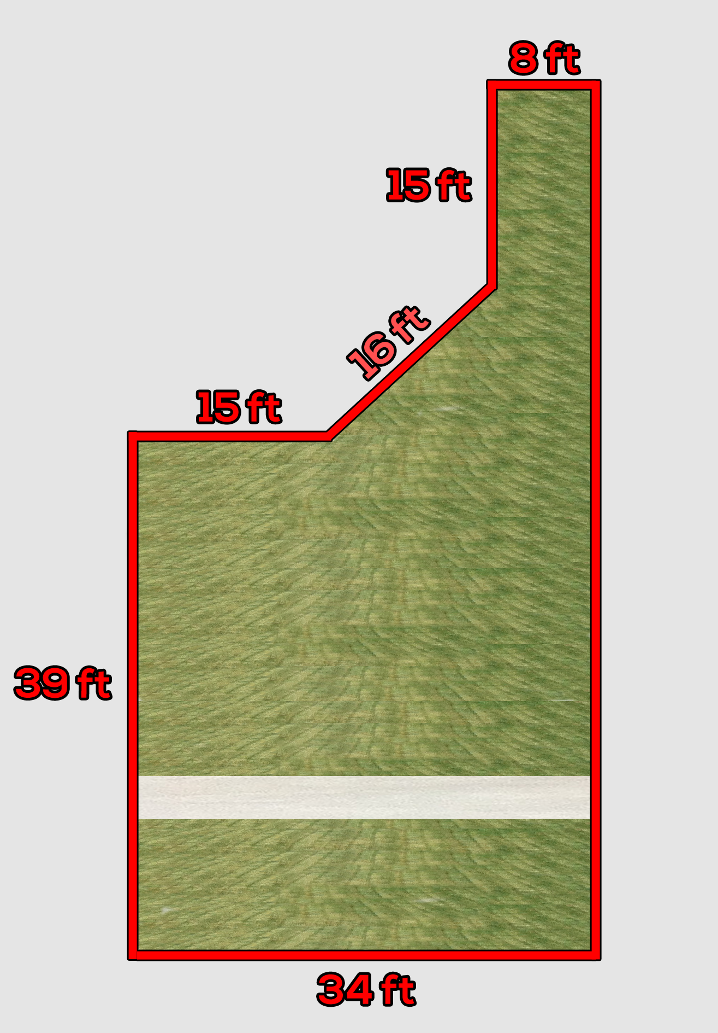
Act 2

Slide 9
ACT 3

Slide 10

Break

Slide 11
Debrief
Do you think this a rich task?
What did you like about it?
What do you think could be improved?
What do you think are key points to facilitating this 3 Acts Task?

Slide 12
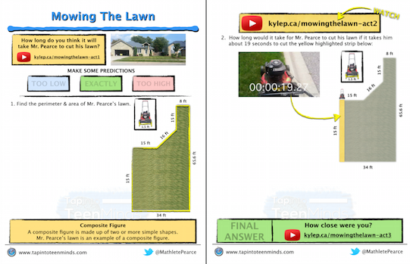
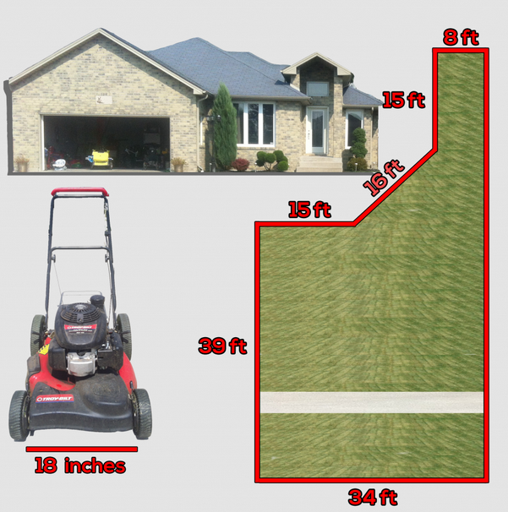

Compare Worksheets
What are the positives?
What are the drawbacks?
Which is more appropriate for
your students?

Slide 13
Sharing your Classroom Work
Turn in Lesson Plan, paper or email to ridgec@gvsu.edu
Include in some blank space:
  One thing you are most pleased with through your experience.
  One thing that was most challenging.

Slide 14
Lesson Sharing Preparation
  Prepare a display:
  Share videos
    Laptop carts are available so people can view
  Question that you were hoping for/what was actually provided by students
  Share student work
  Highlights of your experience
  Area of growth for next time
  Advice to anyone who may run this again

Slide 15
Gallery Walk
Visit at least 4 displays
Provide feedback on things you notice using a sticky note

Slide 16
Paper Slide Show
https://www.youtube.com/watch?v=Ayu9nV8z8-Y
https://www.youtube.com/watch?v=Qf6L1PTG3p4
Create a paper slide show video
No more than 30 seconds long! (60 seconds max)
Necessary information on either:
  3 Act Tasks
  CCSS-M Modeling

Slide 17


Lunch

Slide 18
Integrating Modeling into High School Curriculum
Read the introduction pg. 374 & 376
Highlight anything important that you notice
When table is done reading, share as a group

Slide 19
Jigsaw
Read your assigned section (1, 2, 3, or 4)
Discuss with your group:
  How did they change from the initial problem?
  What are the benefits of this change?
  What are the challenges?

Slide 20
Jigsaw
Resort into groups so each group has someone that read section 1, 2, 3, and 4.
Share out your section to the other groups

Slide 21
Return to your original seats
Read the final section on pg. 378
What do you think about the article?
Is this do-able in your classroom?
At what grade should this process be encouraged?

Slide 22
Break

Slide 23
Time for Innovation
Complete your Paper Slide Video
Plan to share with your colleagues
Plan additional Three Act Tasks to use throughout the rest of your year

Slide 24
Taking Back to your District
What format would be feasible for you to bring this back to your district?
What highlights would be necessary to share?
What activities would you include in your session?
Be prepared to share
What makes a rich task?
What is a Three Act Task?
Intellectual Need
Missing the Promise of Modeling
Mini Paper videos
Other…

Slide 25
Complete the Evaluation
Thank you for coming to the workshop and I look forward to seeing you at our future events!

Slide 26
Through Provoking Video
https://www.youtube.com/watch?v=zDZFcDGpL4U

