Slide 1
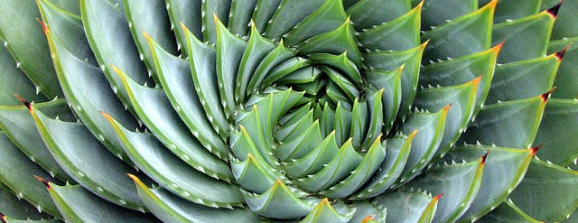
Orchestrating Mathematical Discussions
Welcome to Day 1!
Please take 2 dot stickers and place one on each line to represent your class.
October 7, 2014

Slide 2
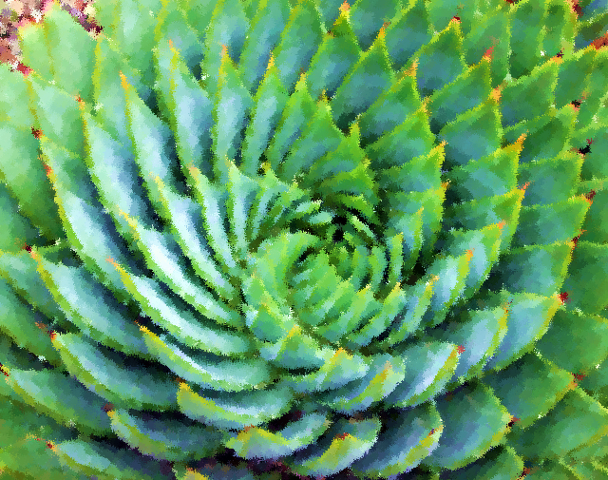
Orchestrating Mathematical Discussions
October 7, 2014

Slide 3
Welcome
Introductions
  Karen Meyers, Director
  Chelsea Ridge, Math Coordinator
Workshop Information
  Grant Funding
  SCECHs
  Document Cameras
  Substitute Reimbursement Forms
  Payment Options

Slide 4
5 Practices for Orchestrating Productive Mathematics Discussions
by Margaret S. Smith, Mary K. (Kay) Stein

Slide 5
5 Practices introduction
  Activity 1: Successful of Superficial? Discussion in David Crane’s Classroom
    Read pages 2-4, silently with the Active Engagement 0.1 guideline in mind:
      As you read the Case of David Crane, identify instances of student authorship of ideas and approaches, as well as instances of holding students accountable to the discipline.
    Once all at your table have read the case study, share the instances that you found.
      What were some strengths of David Crane’s approach?
      What were some weaknesses?

Slide 6
5 Practices introduction
  Activity 2: Analyzing the Case of David Crane
    Read pages 5 & 6 silently with the following questions in mind:
      What might be an appropriate learning goal for a lesson that features the Leaves and Caterpillars task?
      How might the discussion have unfolded differently in Mr. Crane’s classroom with this goal in place?
    Once all at your table have read the analysis, discuss your answers to the above questions AND discuss which of the student work on page 4 you would have shared with the whole class and in what order.

Slide 7
5 Practices
Chapter 1
  Activity 1: The Five Practices
    Divide participants into 5 groups
    All read page 7 and the top of page 8.
    Then each group will read their assigned practice in the following format: (Text rendering)
      Read through section silently – as a block. One read through to understand the “gist” of the section.

Slide 8
5 Practices
Chapter 1 (con’t)
  Re-read the section (silently) and this time:
      Pick out one sentence that speaks to you from the section.
      Pick out one phrase that speaks to you from the section.
      Pick out one word that represents the section for you.
  When all in your group have read and picked their items then:
      Share around the group with each person reading ONLY their sentence; then ONLY their phrase; and then ONLY their word. ..(without any comment).
      Then as a table discuss the commonalities in what you saw in the passage and your understanding of that “practice”.

Slide 9
5 Practices
Chapter 1 (con’t)
Based on your discussion, be prepared to share out a brief summary of your section to the whole group with your highlights.

Slide 10
5 Practices
Introduction revisited
  Activity 2: Summary & Sharing
    Revisit the student work on page 4 and discuss the “best” way to sequence the student work.

Slide 11
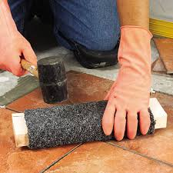
Tiling a Patio:
Anticipating
Student
Responses
Notes:
Participants will now apply the “Anticipating Student Response” practice to the “TILING ACTIVITY (Fig.3.1)” (SBAC-like)

Slide 12
Tiling a Patio
For 5 minutes, independently
Work through the activity
Find as many distinct solution pathways as possible
Begin Anticipating Student Responses.
Record your thinking.
Notes:
Teachers first do task independently and attend to the practice of Anticipating Student Responses.

Slide 13
Tiling a Patio
Now, with your table:
Debrief each person’s work
Discuss possible student misconceptions, and
Prepare a summary.
Notes:
The table group then debriefs each persons work focused on possible student misconceptions. The table group then prepares a summary for sharing with whole group.

Slide 14
Tiling a Patio – Activity Debrief
What strategies did you anticipate?
What misconceptions did you anticipate?
How would you respond to those misconceptions?
How can you gather information for Anticipating?
Notes:
Facilitator debriefs process using summary work focused on anticipating
• Debrief the activity - What were positives (what was helpful)? What were challenges? Did anyone come up with other ideas you didn’t think of? How did working with others at your table help with this?
• Have the teachers list what they did for anticipating/monitoring and put on poster paper then During lunch they discuss at their tables ideas to anticipate/monitor.

Slide 15

BREAK

Slide 16
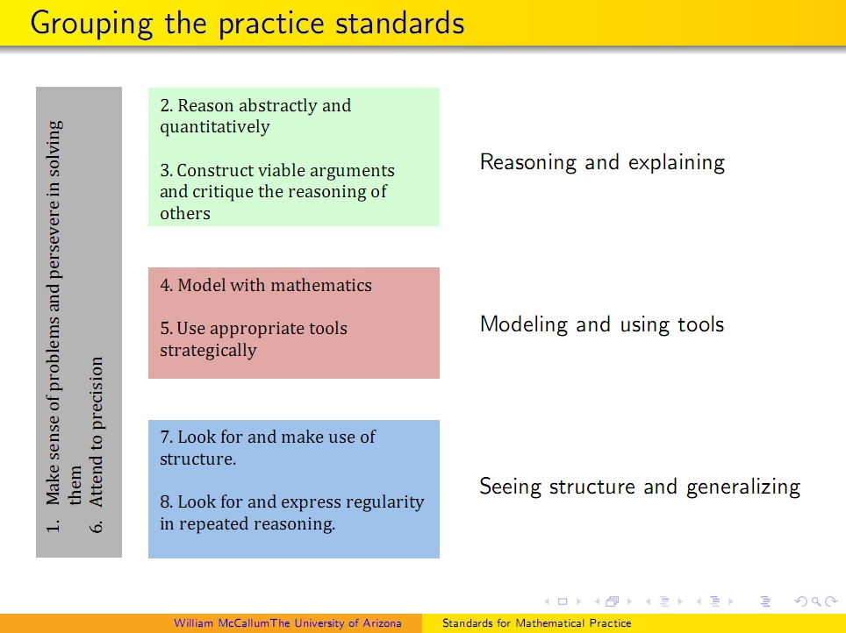
Mathematical Practice Standards
Consider the grouped practice standards with the traditional list.
Discuss at your table the
similarities and differences.
Do you agree with the groupings?
Why or Why not?
Which standards are currently
most effectively incorporated into
your classes?
Why?

Slide 17
Anticipating and Monitoring
What are the three branches of Anticipating?
What is the connection between Anticipating and Monitoring?

Slide 18
Dan Meyer’s Penny Task
Complete the activity as students.
We will be monitoring your work.

Slide 19
Dan Meyer’s Penny Task
Dan Meyer Penny Task

Slide 20
Dan Meyer’s Penny Task
Anticipate Misconceptions, Discuss Monitoring
What misconceptions do you think students might have with this problem?
How would you monitor?
What are you monitoring for?
Are there specific student responses/misconceptions you are looking for?

Slide 21
Dan Meyer’s Penny Task
Response to Misconceptions
How will you respond to the misconceptions that you anticipate?
What questions will you ask to promote discussion between small groups while students are working?
What will you save for the large group during/after students share their work?

Slide 22
LUNCH

Slide 23
Practice 0 & Cognitive Demand
Task Sorting
At your tables, please discuss what a ‘rich task’ is to you?
Sort the cards from ‘most rich’ to ‘least rich.’
Make a list of characteristics of a rich and cognitively demanding task.
Be prepared to share!

Slide 24
Cognitive Demand
Read through the levels of cognitive demand found on pg. 16.
When completed, look at the way you sorted your task. Would you make any changes to your arrangement now?

Slide 25
Important Questions to Ask
What are the key conceptual ideas in the lesson?
What misconceptions might students have about these concepts?
What are the important questions to ask?
Could students figure out a procedure instead of just being told?
Are there constraints that can be added to illuminate a concept?
Are there places to open up the problem to allow for multiple solution paths?
Are there anticipated mistakes that students are likely to make? Can analyzing student solutions be helpful in making those ideas a part of the discussion?

Slide 26
Tasks to Consider
Tasks that have the potential for:
Providing opportunities for discussion about concepts and/or procedures
Highlighting key conceptual ideas
Illuminate student conceptions and misconceptions

Slide 27
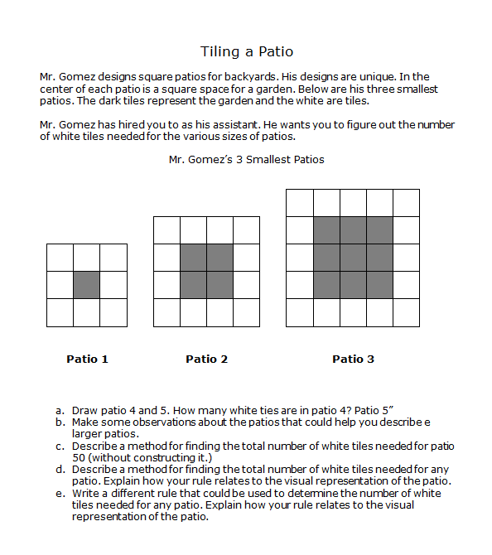
How could we increase the cognitive demand of this task?

Slide 28



BREAK

Slide 29

Select a Task Work Time
Work in groups by content area. Cross district groups work well to share ideas!
Find a NEW Task that no one has ever attempted in their classrooms that you can teach before our next session on November 13.
Attempt the task and ANTICIPATE student responses. (Remember multiple solution pathways)
Use resources online or resources you brought to pick a rich and cognitively demanding task

Slide 30
Sticky Notes!
Hang up the Poster with your task
Walk around the room and look at the other tables tasks
Write Suggestions on the sticky notes for ways they can improve their task / make it richer / increase cognitive demand

Slide 31
Reflection - On Your Notecard
POMS (Point of Most Significance)
  On Front Side
  From the day, please write the point of most significance, or the concept that covered that was most important to you.
POMC
  On the Back Side
  Please write the point of most confusion, muddiest or, or still most unclear concept covered today.
  Thank You!

Slide 32
Thank you!
Remember: Teach your task and return with student work.
Next session: Thursday, November 13!
Have a wonderful day!

Slide 33
Examples of Easy Changes to Increase Cognitive Demand
Thoughtful Constraints
  Focus Students on a particular issue
Students Create Procedures
  Procedures more meaningful to the student – helps with a more general understanding
  Why does the procedure actually work the way it does?

Slide 34
Examples of Easy Changes to Increase Cognitive Demand
Analyzing Other Students’ Work
  Can give students a starting point to discuss their thinking.
  Can make explicit measurement concepts explicit through justifying whether the method is valid or not.
  Important to show both correct and incorrect methods
Opening Up a Problem
  Not all scaffolding is productive.
  Provides multiple pathways
  Can create more “what if” questions

Slide 35
Examples of Easy Changes to Increase Cognitive Demand
Multiple Solution Pathways
  Students can find many ways to solve the problems.
  Different solutions also provide opportunities for different conceptual knowledge to be made explicit during discussions.

