Slide 1
Orchestrating Mathematical Discussion
Session 2- Please sit with your Content groups from last session.

Slide 2
Welcome
Please pick up your document camera form, if ordered.
Remember your SUBSTITUTE REIMBURSEMENT FORM is due next session.
That’s Me!!!

Slide 3
Sharing Tasks
Please include on your poster:
  Lesson/Task Description
  What did you anticipate?
  Monitoring Tool
  What did you actually see?
  What changes would you make if you were to run the activity again?

Slide 4

Best Size Task
Do the task yourself as a student.
Then discuss at your table the different ways you approached the problem.
Be prepared to share your method.

Slide 5
Best Size Task
What misconceptions do you think students might have with this problem?
How would you monitor? What are you monitoring for?
Are there specific student responses/misconceptions you would look for?

Slide 6
Best Size Task
How will you respond to the misconceptions that you anticipate?
What questions would you ask to promote discussion between the small groups while students are working and the large group doing/after students share their work?

Slide 7

BREAK

Slide 8
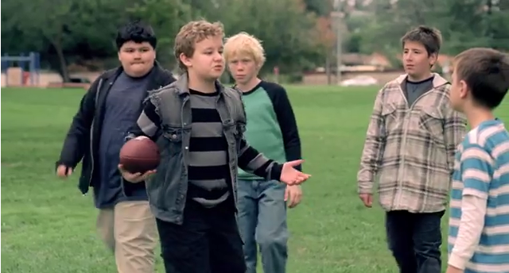
http://www.youtube.com/watch?v=XWbJK7eY51o
http://www.youtube.com/watch?v=54LLsKXpZyk

Slide 9
Selecting and Sequencing
Guided Highlighting
  Please Read pg. 43 – 46
  Highlight the important characteristics of the selecting and sequencing process.
When your table is done reading, please share what you highlighted.

Slide 10
Selecting and Sequencing
Please read pages 47 – 49
Discuss with your group:
  What did Mr. Bannister do well ?
  What areas could Mr. Bannister change to improve?

Slide 11

What should we keep in mind when SELECTING and SEQUENCING?

Slide 12
What is the mathematical goal of the task?
The Can Problem in your class or a class you could see it being useful

Slide 13
How has each student approached the task?

Slide 14
How would you SELECT and SEQUENCE the work?

Slide 15
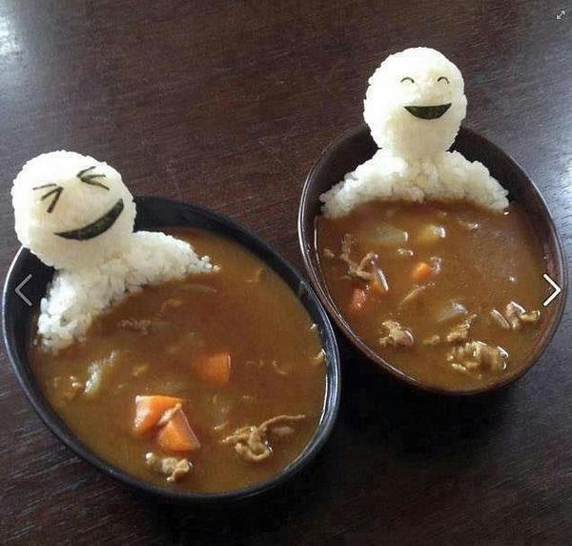
LUNCH
Please move to
sit in your
school groups.

Slide 16

The Art of Questioning

Slide 17
As you read pp. 62 & 63
How can questioning deepen
student comprehension?
Do all questions deepen
student understanding?

Slide 18

Bungee Jump Video
What other questions
could you ask?
What questions
are asked?
Notes:
Click on video to view to view the video online

Slide 19
Bungee Jump Video
Based on the Math Talk Learning Community Rubric, at what level of questioning would you place this classroom?
Bungee Jump Video
Notes:
Click on the background to view to view the video online, choose video 5 from the list

Slide 20
Bungee Jump Video
Make some questions that you would ask to the class based on the ASCD Handout.
Bungee Jump Video
Notes:
Click on the background to view to view the video online, choose video 5 from the list

Slide 21
Discussing Talk Moves
RESOURCES:
Checklist: Goals for Productive Discussions and Nine Talk Moves & Talk Move Map
  (Same handout / front to back)
5 Practices: pages 69-73
TASK:
Review your question list from the Bungee Jump Video identifying questions asked that could be considered talk moves.
Categorize those questions using the Talk Moves Checklist
Be prepared to share examples found with the whole group.

Slide 22
Discussing Talk Moves
WARNING SIGNS!
Read and reflect on the article “Warning Signs! Recognize three common instructional moves that are generally followed by taking over children’s thinking.”

Slide 23
Connecting Questioning to the Mathematics Practices
RESOURCES:
Standards of Student Practice in Mathematics Proficiency Matrix
Engagement Strategies
From mathleadership.com
  Developed by Dr. Don S. Balka, former middle school and high school mathematics teacher, professor emeritus in the Mathematics Department at Saint Mary’s College, Notre Dame, Indiana.
  Dr. Ted Hull
  Ruth Harbin Miles

Slide 24
Connecting Questioning to the Mathematics Practices
TASK:
Review the Standards of Student Practice in the mathematics Proficiency Matrix
  For each of the practices, highlight the cell on the grid that best describes where your students are in developing that practice (Initial, Intermediate, or Advanced).
  Then, revisit practices 1a, 1b, 3a, and 3b. For one or more of these four practices, indicate, in a different highlighter color, where you would like your students to be at the end of the year.
Turn to a partner(s) and discuss:
  What practice you chose and why.
  What steps you hope to take to facilitate student growth in this area.

Slide 25

BREAK

Slide 26

Lesson Planning
Plan a lesson for a topic you will teach between now and session 3.
With your group, anticipate student misconceptions and responses.
Think about what questions you will intentionally ask.
How would you select and sequence the anticipated student work?

Slide 27
Evaluation – Look Back
Please Look Back
Take a note card and reflect on at least two topics you learned/know more about now and how, which aspects of the workshop, helped you to enhance your knowledge.
What I Learned… | How I Learned it…
1. 2.

Slide 28

Next Session is Friday, December 12, 2014, Same time, Same Place
BRING YOUR SUBSTITUTE REIMBURSEMENT FORM SIGNED BY YOUR PRINCIPAL

