Slide 1
MAISD
October 27, 2015
Effective, engaging
methods for
writing in Science
Wireless ID: Montcalm_Guest
User Name: ADMGUEST
Password: Welcome2MAISD

Slide 2
Welcome Back!
Housekeeping
Agenda
Sub-reimbursement forms
SCECH’s

Slide 3
LOOKING AT OUR WORK
Tuning Protocol:
In your table groups
Describe the Strategy & Implementation (Presenting Teacher) / 3 minutes
Ask Clarifying Questions (Group) / 2 minutes
Warm & Cool Feedback (Group) / 1 minute
Reflection (Presenting Teacher) / 1 minute
Notes:
Walk participants through the process involved in looking at their work. The “Tuning Protocol” suggested here is from HS-MASS I. Other protocols that you know/have used before are equally valid.
Ask participants to form table groups. You may have these groups based either on content area or of mixed ccontent area.
Each teacher is afforded opportunity to share their lesson and student work within the following guidelines:
The presenting teacher describes the writing strategy and how is was implemented in the classroom (4 minutes
Teachers in the group ask clarifying questions and presenting teacher maya respond (3 minutes)
Teachers in the group then provide warm and cool feedback. Presenting teacher may NOT respond (3 minutes.
Presenting teacher reflects on lesson based on feedback (2 minutes)

Slide 4
Climbing the Pyramid
Or…Helping Student Evaluate Science News Sources
NBC News – Al Roker

Slide 5
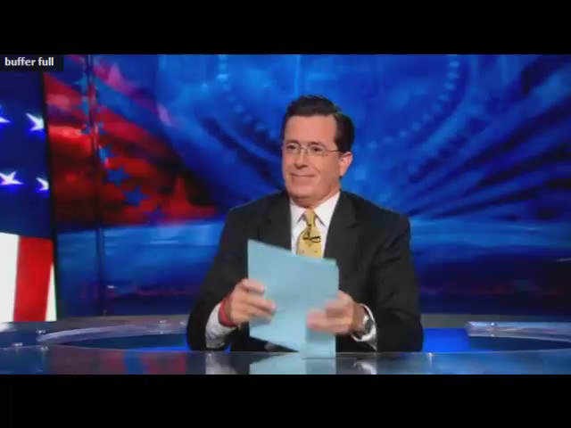
THE COLBERT REPORT
  Where did Colbert get his information?
  How do you know whether the news report is accurate?
  Do you trust the news source?

Slide 6
Source Quality Pyramid
Use the source cards to build your own source-card pyramid.
Read the description of each source and decide where to place it.
Lower-quality sources go toward the bottom and higher-quality sources go toward the top.
All spaces must be filled.

Slide 7
Source Quality Pyramid (con’t)
Once all the pyramids are complete, walk around the room and view other group’s pyramids.
Discuss how your pyramids are alike and/or different?
Did groups agree on the most reliable source? Why or why not?

Slide 8
Science in the Media
Source Assessment Checklist
  Using your “Source Quality Pyramid” as a guide, try and identify the source of each media quote.
  Once you make a decision, discuss with your group and underline parts of the text that helped you make your decisions.
  While reading each source, use the check boxes below each quote to help you.

Slide 9
BREAK

Slide 10
Definition of Digital Writing
Compositions created with, and oftentimes for reading or viewing on, a computer or other device that is connected to the internet.
Digital writing is not simply a matter of learning about and integrating new digital tools into an unchanged repertoire of writing processes, practices, skill and habits of mind. It is about the dramatics changes in the ecology of writing and communication and, indeed, what it means to write—to create and compose and share.

Slide 11
Purpose of Digital Writing
Equipping students to work across and within contemporary networked spaces, and to write ina range of genres and diversity of modes to audiences local and widespread, will serve students in their higher education experiences and in the workplaces of the future.

Slide 12
Components of Digital Ecology
The physical space for digital writing
The ethical, legal , and policy environments for digital writing
Online environments for digital writing

Slide 13
Digital Writing Environments
Using the collaborative document, Online Environments for Digital Writing, share your experiences regarding these venues.
Please add to the list with sites you have used.

Slide 14
SAT

Slide 15
Geysers vary widely: some may discharge ----, whereas others may have only a brief explosive eruption and then remain ----------- for hours or days.
violently…….dangerous
continuously…..quiescent
spontaneously……..unpredictable
regularly……….active
faintly…..imperceptible

Slide 16
Whether substances are medicines or poisons often depends on dosages, for substances that are ------- in small doses, can be --------- in large.
useless……..effective
mild ………benign
curative……toxic
harmful……..fatal
beneficial ……….. miraculous

Slide 17
Nightjars possess a camouflage perhaps unparalleled in the bird world; by day they roost hidden in shady woods, so ----- with their surroundings that they are nearly impossible to --.
vexed….dislodge
blended…….discern
harmonized……..interrupt
impatient…….distinguish
integrated….classify

Slide 18
SAT Critical Reading Section
Answers Difficulty Level
17. E 4
18. A 2
19. D 5
20. C 3
21. E 5
22. E 3
23. E 4
24. B 4

Slide 19
LUNCH

Slide 20
VOCABULARY PITFALLS: Challenges and Pitfalls
Using the Google Doc, Science Vocabulary Pitfalls, add examples of words that fit the descriptions.

Slide 21
IMPROVING LAB REPORTS
AND RESEARCH PAPERS
HWLS – Pages 15-23
Science Teacher – Laboratory Notebooks in the Science Classroom (pp. 38-42) and
Writing Better Lab Reports (pp.43-48)
Notes:
This activity addresses the more summative assessment strategies from all four documents shown above.
You will not be able to include each of these documents. Select those resources which best meet the needs/interests of your participants. In handing out the NSTA journal, be sure to note that NSTA donated 500 copies to our workshop FREE.

Slide 22
USING THE 4 A STRATEGY
Select one of the recommended resources (see previous slide)
Read individually, recording your reactions on the 4A handout
  Assumptions
  Agreement
  Argument
  Aspiration
Notes:
Participants may be assigned the same article by table group with each table reading a different article. Or Participants could be paired up in trios with each reading a different article.

Slide 23
DO A JIGSAW
Share your reactions based on your 4 A worksheet
Notes:
If all teachers at a given table have read the same article, ask them to discuss the article; record their group notes in each of the 4As and report out to the whole group.
If in trios, each teacher could share with other members of the small group about the article he/she read
Either method of Jigsawing is effective

Slide 24
MORE ABOUT SCIENCE JOURNALS
Interactive Journals
Using Science Notebooks in Elementary School & Middle Schools / Michael P.Klentschy
Any other resources to share?

Slide 25
BREAK

Slide 26
WRITING & FORMATIVE ASSESSMENT
Book: Science Formative Assessment: 75 Practical Strategies for Linking Assessment, Instruction, and Learning
Strategy: Guided Highlighting
  Read silently pages 1 – 3 (may want to reference pg. 42-44. On this first read, do NOT highlight or mark text in any way.
  Read assigned passage a second time. This time highlight
    What is the teachers’ role in Formative Assessment?
    What is the student’s role in Formative Assessment?

Slide 27
When your table is done reading, please share what you highlighted.
NOW, review the list of FACTs
  Find one FACT that you might use in your classroom yet this week.
  Share that FACT with an elbow partner.

Slide 28
MANAGING THE PAPERWORK LOAD
OR
How to add more writing assignments and cut the paperwork load at the same time
Notes:
A COMMON CONCERN HELD BY TEACHERS CONSIDERING EMPLOYING WRITING IN THEIR CLASSROOM
SOME READING AND HEARING FROM EXPERIENCED TEACHERS CAN ALLEVIATE THIS CONCERN

Slide 29
PAPERWORK BRAINSTORM
Brainstorm (as table groups) ways to help manage the paperwork in a classroom where there is more writing
If you need to “prime the pump”, refer to HWLS (pp. 23-26)
Record your group’s ideas on the chart paper
Indicate your top three ideas
Join the circle to share your group’s ideas
Notes:
The purpose of this activity is to have participants share ideas about how to manage workload.
In table groups, have them brainstorm (with the help of the strategies are referenced in HWLS – pages 23 -26) ways to help manage the paperwork in a classroom where there is more writing.
Have them list their top three ideas on the white board.
Share out with whole group using white boards as follows:
If space allows have the whole group come together in a circle (with groups sitting together).
One person in each group will have the white board “propped” against their knees with the writing facing the center of the circle.
In turn, have each group share their suggestions.
If space does not allow for circle format, have groups share from where they are at using the white board.

Slide 30
Evaluation
Complete Double Likkert Evaluation
Thank you! Drive home safely!

