Slide 1
Exploratory Student Tips
Read about what tips and resources former exploratory students have utilized to find their best fit at GV!

Slide 2
Q1 - What major did you declare?
What major did you declare?
Criminal Justice
Political Science
PCKET, Educational Studies
Business
Political Science
Wildlife Biology
Fisheries and Aquatic Sciences
Advertising and Public Relations
writing
Biology
Psychology

Slide 3
Q1 - What major did you declare?
What major did you declare?
Marketing
Wildlife biology
Advertising and Public Relations
Political science
Advertising and Public Relations
Human Resource Management
Criminal Justice
Spanish
Social work
Environment and sustainability
Geology

Slide 4
Q1 - What major did you declare?
What major did you declare?
Information Technology
Communication
General Business
English education
Psychology
Business General
psych
psychology
Art Education
social work
Wildlife Biology

Slide 5
Q1 - What major did you declare?
What major did you declare?
Psychology
Illustration
Art Education
Integrated science enducation secondary
General Business
Exercise Science
Art Education
Communication studies
Graphic design
Geology
Geology

Slide 6
Q1 - What major did you declare?
What major did you declare?
Clinical Exercise Science
Allied Health
Art Education
Studio Art
Political science
Psychology
Geology
Nursing
Criminal justice
Biomedical Sciences
recreational therapy

Slide 7
Q1 - What major did you declare?
What major did you declare?
Biology
Anthropology
Art Education
Geology
Criminal Justice
Diagnostic medical Sonography
communication sciences and disorders
Studio art
Philosophy

Slide 8
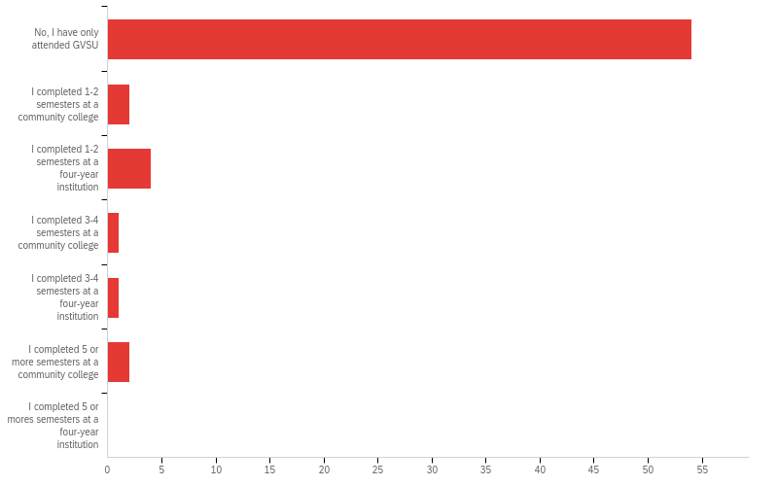
Q3 - Were you a transfer student to GVSU?

Slide 9
Q3 - Were you a transfer student to GVSU?
# | Field | Minimum | Maximum | Mean | Std Deviation | Variance | Count
1 | Were you a transfer student to GVSU? | 1.00 | 6.00 | 1.42 | 1.13 | 1.28 | 64

Slide 10
Q3 - Were you a transfer student to GVSU?
# | Answer | % | Count
1 | No, I have only attended GVSU | 84.38% | 54
2 | I completed 1-2 semesters at a community college | 3.13% | 2
3 | I completed 1-2 semesters at a four-year institution | 6.25% | 4
4 | I completed 3-4 semesters at a community college | 1.56% | 1
5 | I completed 3-4 semesters at a four-year institution | 1.56% | 1
6 | I completed 5 or more semesters at a community college | 3.13% | 2

Slide 11
Q3 - Were you a transfer student to GVSU?
# | Answer | % | Count
7 | I completed 5 or mores semesters at a four-year institution | 0.00% | 0
 | Total | 100% | 64

Slide 12
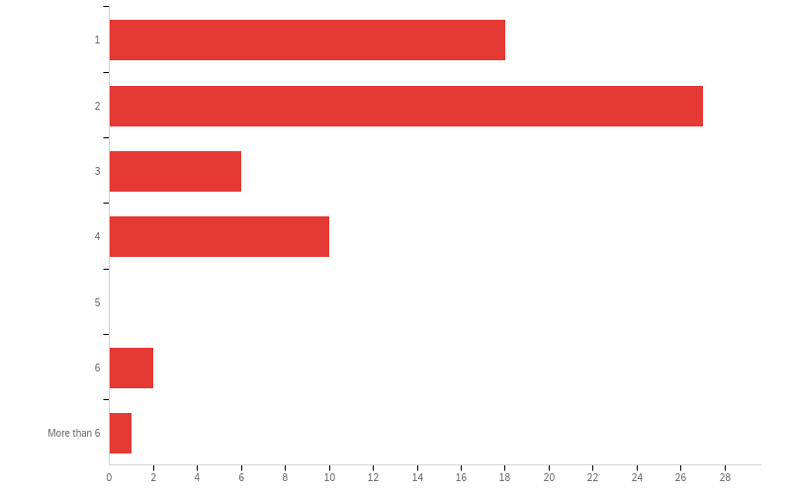
Q2 - How many semesters have you been enrolled at GVSU?

Slide 13
Q2 - How many semesters have you been enrolled at GVSU?
# | Field | Minimum | Maximum | Mean | Std Deviation | Variance | Count
1 | How many semesters have you been enrolled at GVSU? | 1.00 | 7.00 | 2.33 | 1.34 | 1.78 | 64

Slide 14
Q2 - How many semesters have you been enrolled at GVSU?
# | Answer | % | Count
1 | 1 | 28.13% | 18
2 | 2 | 42.19% | 27
3 | 3 | 9.38% | 6
4 | 4 | 15.63% | 10
5 | 5 | 0.00% | 0
6 | 6 | 3.13% | 2
7 | More than 6 | 1.56% | 1
 | Total | 100% | 64

Slide 15
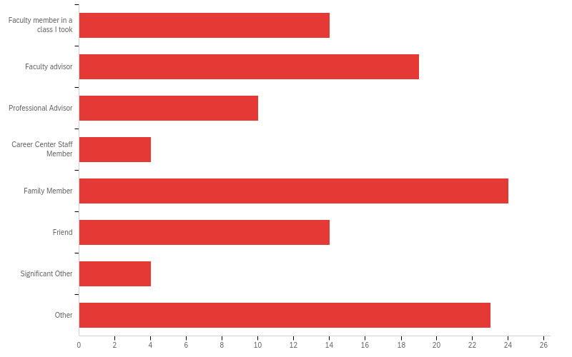
Q4 - Who helped you decide on your major? Select all that apply.

Slide 16
Q4 - Who helped you decide on your major? Select all that apply.
# | Answer | % | Count
1 | Faculty member in a class I took | 12.50% | 14
2 | Faculty advisor | 16.96% | 19
3 | Professional Advisor | 8.93% | 10
4 | Career Center Staff Member | 3.57% | 4
5 | Family Member | 21.43% | 24
6 | Friend | 12.50% | 14
7 | Significant Other | 3.57% | 4
8 | Other | 20.54% | 23
 | Total | 100% | 112

Slide 17
Q4 - Who helped you decide on your major? Select all that apply.
Q4_8_TEXT - Other
Other - Text
Myself
Handshake App
Myself
Delta Sigma Pi
myself
I took classes of majors I was considering but after taking the classes decided I didn’t want to do them anymore
That was my major at my last college
Professor Galen: took his psych course and declared afterwards
I already knew what I wanted to major in, I just couldnt declare it due to technical difficulties in the art program while the curriculum was under construction
Myself

Slide 18
Q4 - Who helped you decide on your major? Select all that apply.
Q4_8_TEXT - Other
Other - Text
That was my major at my last college
myself
Teachers in Highschool, as well as a camping trip I took with Geology students and professors when I was still Undecided for my major.
I knew what I wanted to do just didn't know how to get there.
Myself
My own research, and some classes made me narrow down my major.
No one
By faculty advisor, I'm referring to my academic advisor
Me
Students and Geology Staff
CJSA club

Slide 19
Q4 - Who helped you decide on your major? Select all that apply.
Q4_8_TEXT - Other
Other - Text
research

Slide 20
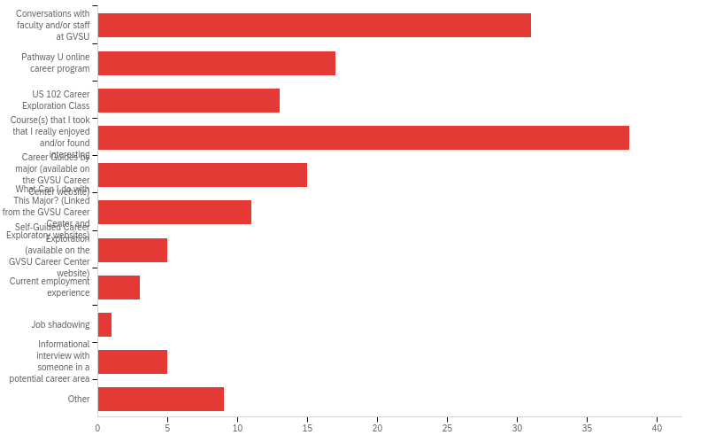
Q5 - What resources did you use in determining the best major for you (select all that apply)

Slide 21
Q5 - What resources did you use in determining the best major for you (select all that apply)
# | Answer | % | Count
1 | Conversations with faculty and/or staff at GVSU | 20.95% | 31
2 | Pathway U online career program | 11.49% | 17
3 | US 102 Career Exploration Class | 8.78% | 13
4 | Course(s) that I took that I really enjoyed and/or found interesting | 25.68% | 38
5 | Career Guides by major (available on the GVSU Career Center website) | 10.14% | 15
6 | What Can I do with This Major? (Linked from the GVSU Career Center and Exploratory websites) | 7.43% | 11

Slide 22
Q5 - What resources did you use in determining the best major for you (select all that apply)
# | Answer | % | Count
7 | Self-Guided Career Exploration (available on the GVSU Career Center website) | 3.38% | 5
8 | Current employment experience | 2.03% | 3
9 | Job shadowing | 0.68% | 1
10 | Informational interview with someone in a potential career area | 3.38% | 5
11 | Other | 6.08% | 9
 | Total | 100% | 148

Slide 23
Q5 - What resources did you use in determining the best major for you (select all that apply)
Q5_11_TEXT - Other
Other - Text
GVSU Majors page
Delta Sigma Pi
I've always wanted this major
Take your time!
I was this major at another school I was just waiting to add more to my portfolio before applying
doing my own research
Highschool classes.
Social media
Conversations with Students

Slide 24
Q6 - What is one piece of advice you would give a fellow GVSU student who is exploring majors?
What is one piece of advice you would give a fellow GVSU student who is exploring majors?
you’ll figure it out! Keep on taking those gen Ed’s and it would definitely help you decide on what you do or don’t want to do!
take an intro level class for a major you’re interested in 1st semester freshman year
If you are undecided, take General Studies first
Don't stress because you will end up where you need to be, but also make sure you take your future and responsibility into your own hands.
It is ok to not know what you want to do. Find the broad thing your passionate about and break it down from there.
Take your time
You don't need to decide right away. I felt that choosing a major would make me feel more put together and gave me something I felt I was working towards.
Seek out advice and talk to people, as they're good source of guidance.
Don't be shy, utilize your resources. Even if they don't set you on a completely straight path, they will be helpful in exploring your options and narrowing them down.

Slide 25
Q6 - What is one piece of advice you would give a fellow GVSU student who is exploring majors?
What is one piece of advice you would give a fellow GVSU student who is exploring majors?
Study Hard
Take time to explore all the fields that interest you.
Think about what you truly want to spend the rest of your life doing.
Take your time
Weigh your options and don’t let others make a decision for you.
Take all sorts of classes. Wide variety!
Take as many of the basic classes for that major that you’re interested in to help figure out if you would actually like them or not
IDK
Find things that you enjoy doing in every day life, can't hurt to major in its field
It's ok not to know what you want to do, don't let anyone pressure you into choosing a major if your not reason

Slide 26
Q6 - What is one piece of advice you would give a fellow GVSU student who is exploring majors?
What is one piece of advice you would give a fellow GVSU student who is exploring majors?
Just keep trying to find one that suits you. Try not to give up right away the worse that could happen is you get a degree in something else.
It’s ok to take the time to explore your options, take lots of classes in a wide variety of fields and consider what jobs might look like when you’re degree is finished, not just what classes are interesting.
Be patient.
Declare as soon as you can
Do research
If you truly can’t decide, it may be helpful to get experience in different fields to see if you can narrow down what field you would truly like to work in.
Try to find an individual in the field to talk to; your classes may not totally resemble your career. In addition, go to the advisors! They are the most helpful individuals I've met on campus.
Find something that doesn't make you miserable, then track down how to make a career out of it

Slide 27
Q6 - What is one piece of advice you would give a fellow GVSU student who is exploring majors?
What is one piece of advice you would give a fellow GVSU student who is exploring majors?
Choose something that you enjoy, not for money.
Don’t wait too long because a major still takes courses to graduate. Meet individually with departments for them to tell you about their majors to try to sell you on it.
Choosing a major doesn't mean your stuck with it. If you dont like your major then go and explore other options.. "Be free"
Make sure you Gen eds are done right away
take your time.
Do what you want to do, not what your parents want you to do.
Find what you're slightly interested in, and talk to people within that major, whether it be students or professors. Look for opportunities and events to bond with them and learn more about the program as a whole.
Take classes you have an interest in and let that help you decide.

Slide 28
Q6 - What is one piece of advice you would give a fellow GVSU student who is exploring majors?
What is one piece of advice you would give a fellow GVSU student who is exploring majors?
Take your time!
Take your time
It’s okay to not know what you want to go into right away, explore courses you find interesting and go from there
Take your time, be patient with it
Talk to your advisor.
Meet with your academic advisor!!
look into all paths that can be taken from each major
Take classes that interest you that you could see yourself enjoying as a future career.
Talk to the professors, take opportunities to meet people, and talk to your peers about why they chose their major.
Take the time to ask questions you may have about a career you are interested in.

