Slide 1

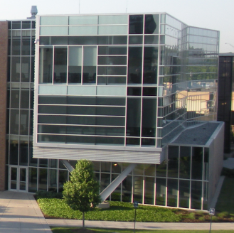
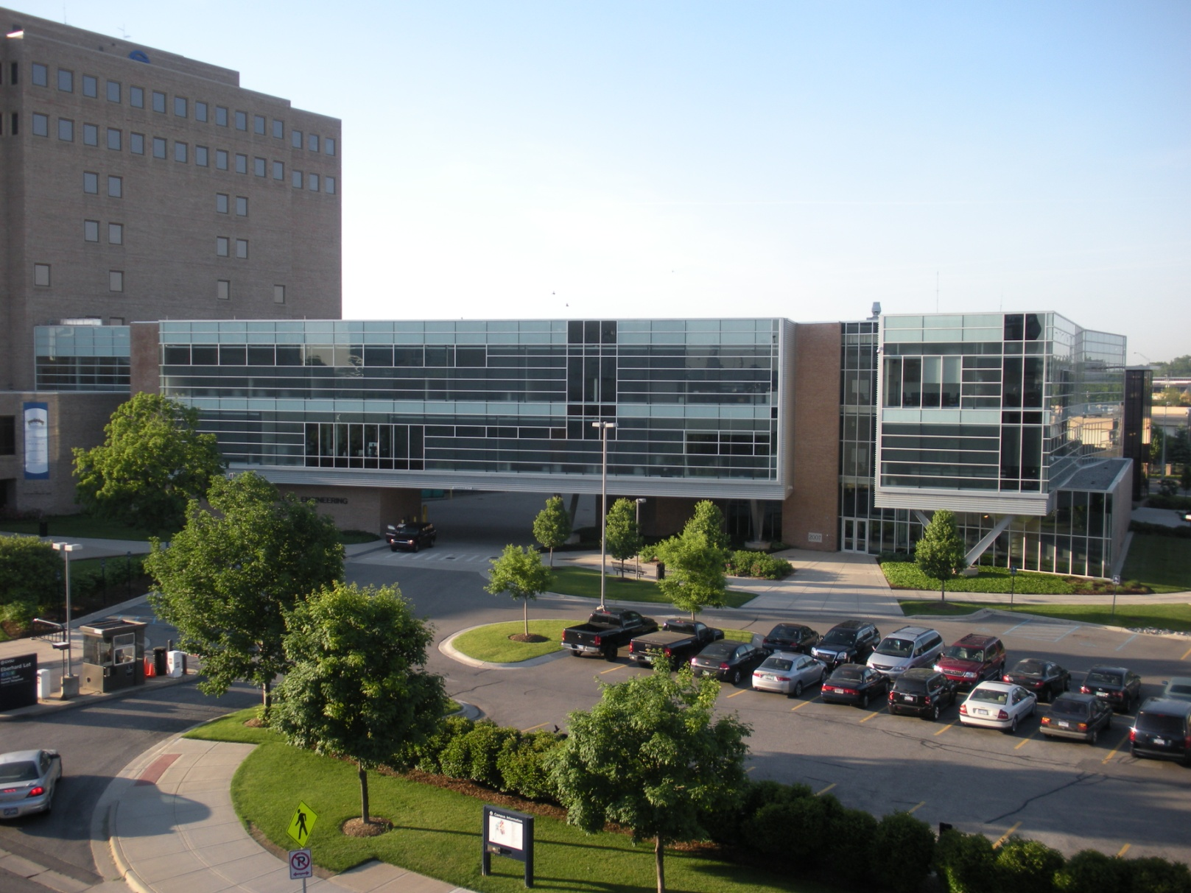
Engineering Co-op Program
Overview
SEYMOUR & ESTHER PADNOS
COLLEGE OF ENGINEERING & COMPUTING

Slide 2
School of Engineering (SoE)
Began in 1987
ABET Accredited
Undergraduate Majors (B.S.E.):
- Computer, Electrical, Mechanical, Product Design & Manufacturing, Interdisciplinary, and Bio-Medical (Minor)
Graduate Programs (M.S.E.):
  - Electrical & Computer, Manufacturing Operations, Mechanical, Product Design & Manufacturing, and Bio-Medical
Mandatory Co-op
Secondary Admission
SEYMOUR & ESTHER PADNOS
COLLEGE OF ENGINEERING & COMPUTING

Slide 3
SoE Secondary Admission
Foundational courses completed:
  Calculus sequence (4X), Physics (2X), Chemistry, Engineering Design/Build including CAD/CAM & Computer Programming (2x), Engineering Laboratory work including Statistics and Writing, Statics & Solid Mechanics, Materials Science, Digital Systems, Circuit Analysis, and Co-op Preparation
  Minimum GPA of 2.7 and grade of 2.0 (“C”) in each foundational course
Practice interview feedback
Essay – “Why I Want to Become an Engineer”
SEYMOUR & ESTHER PADNOS
COLLEGE OF ENGINEERING & COMPUTING

Slide 4
SoE Co-op Program Model
Fall Winter Spring/Summer
(Sept - Dec) (Jan - April) (May - Aug)
1st Year: Foundational Foundational Open
Courses Courses
2nd Year: Foundational * Foundational ** Co-op I
Courses Courses
3rd Year: Program Courses Co-op II Program Courses
4th Year: Co-op III Program Courses Program Courses Senior Project
* Provisional promotion, early January
** Secondary admission to SoE, May
SEYMOUR & ESTHER PADNOS
COLLEGE OF ENGINEERING & COMPUTING

Slide 5
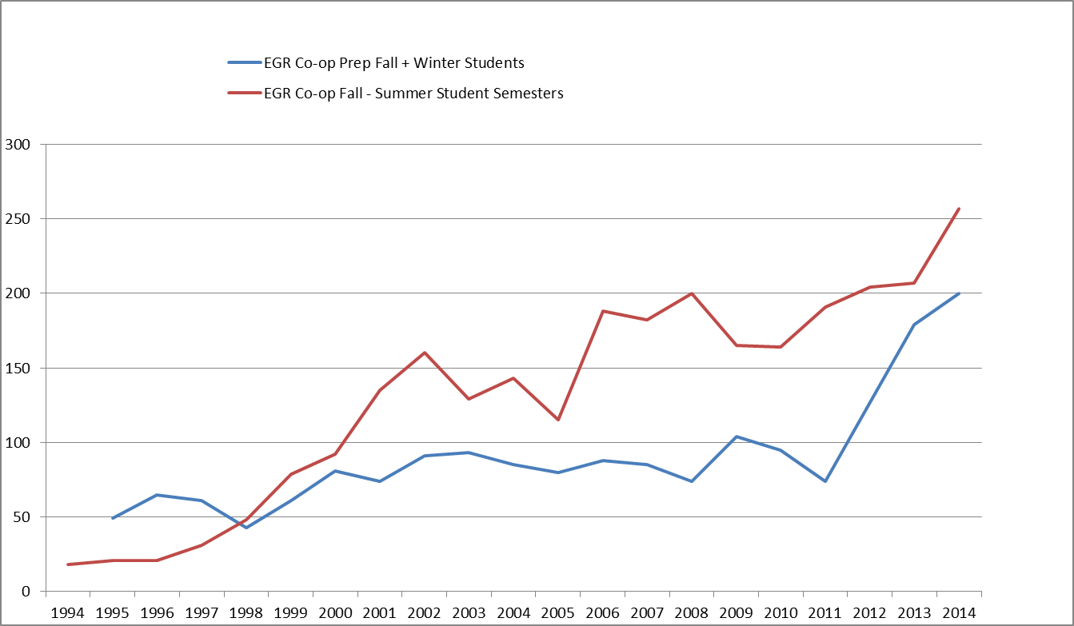
Co-op Growth (1994 – 2014)
SEYMOUR & ESTHER PADNOS
COLLEGE OF ENGINEERING & COMPUTING

Slide 6
SoE Co-op Program
Admitted to SoE
Co-op during junior and senior years
Alternating semesters
Summer semester start
One full-time year of work
Students working all semesters
  (not just summers)
May work anywhere
(domestic and international)
SEYMOUR & ESTHER PADNOS
COLLEGE OF ENGINEERING & COMPUTING

Slide 7
Co-op Program – Key Dates
Oct 21: GVSU Fall Career Fair/
  Pre-approval by SoE (>3.2 GPA)
Nov 11 – 14: Practice Interviews
Dec 31: LakerJobs Co-op postings
Jan 9: Approval by SoE
Jan 14: Co-op Recruiting Fair
Anytime: Interviews/provisional offers
SEYMOUR & ESTHER PADNOS
COLLEGE OF ENGINEERING & COMPUTING

Slide 8
Co-op Program Expectations
Student
  Good attitude and hard work
  Written/web homework and weekly journal
Company
  Degreed engineers supervise and mentor student
  Progressively responsible engineering work
Faculty
  Support/assess each student, every semester
All
  Evaluations
  Three semesters with the same company which can include both domestic and international assignments
SEYMOUR & ESTHER PADNOS
COLLEGE OF ENGINEERING & COMPUTING

Slide 9
SoE Co-op Keys to Success
Develop aggressive learning goals with the student
Provide responsible, challenging work related to the above goals
Progressively grow the student from “apprentice” to “entry-level” engineer
SEYMOUR & ESTHER PADNOS
COLLEGE OF ENGINEERING & COMPUTING

Slide 10
SoE Co-op Contacts
Tom Demmon
Associate Director – Career Center
  (616) 331-6708 demmont@gvsu.edu
Dr. Chris Plouff
Interim Director/Co-op Chair – School of Engineering
  (616) 331-6750 plouffc@gvsu.edu
SEYMOUR & ESTHER PADNOS
COLLEGE OF ENGINEERING & COMPUTING

Slide 11

School of Engineering
Industrially conscious
Engineering education that works for
  West Michigan
  Michigan
  United States
  World
SEYMOUR & ESTHER PADNOS
COLLEGE OF ENGINEERING & COMPUTING

