Slide 1

Name(s) & Positions
[Date]

Slide 2
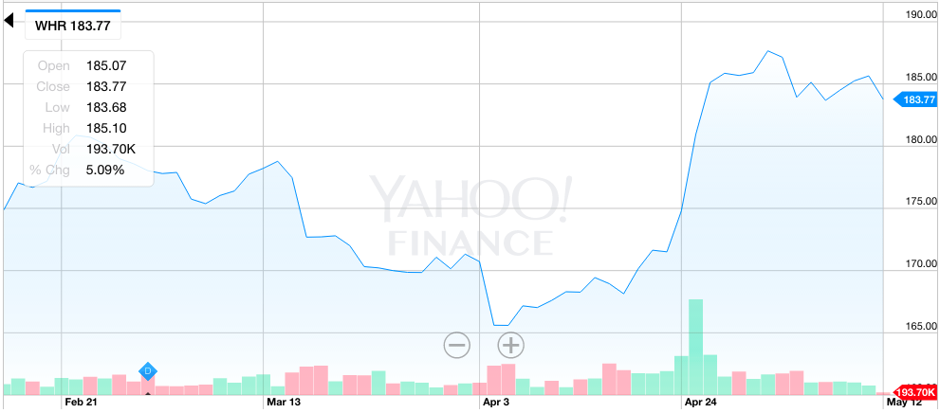
PITCH SUMMARY
BUY WHR
[Delete this for pitch] Use Yahoo Finance 3-month interactive chart
Transaction Details
BUY ___ Shares @ $__.__ /sh
Total Value = $
Price Target = $

Slide 3
SWOT ANALYSIS
WHR
S
Strengths
Fill in
W
Weaknesses
Fill in
O
Opportunities
Fill in
T
Threats
Fill in

Slide 4
INVESTMENT THESIS
WHR
Input key reasons as to why this is a viable investment opportunity, including key supporting evidence and strategy

Slide 5
MAIN TITLE HEADER
SUBTITLE HEADER
Slide for supporting content (i.e. financials, analyst estimates, breakthroughs, article support, etc.)

Slide 6
MAIN TITLE HEADER
SUBTITLE HEADER
Slide for supporting content (i.e. financials, analyst estimates, breakthroughs, article support, etc.)

Slide 7
CONCLUSION
BUY WHR
Reiterate transaction details, investment strategy, and any other conclusive details

