Slide 2
SLIDE LAYOUT OPTIONS
Home > “New Slide” dropdown arrow
Home > “Layout” dropdown next to New Slide (near “Reset” and “Section”)

Slide 3

LOOKING FOR DIFFERENT PHOTOS?
University Communications provides a wide range of communication services to the university, including photography. Please visit https://www.gvsu.edu/ucomm/ for more information.

Slide 4
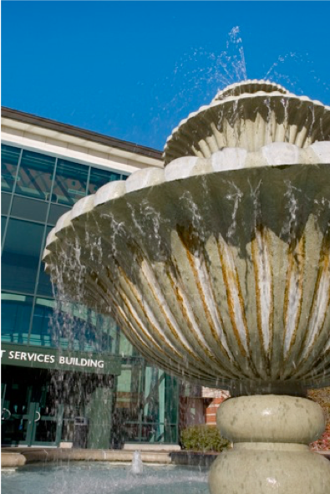

Slide 5


Slide 6
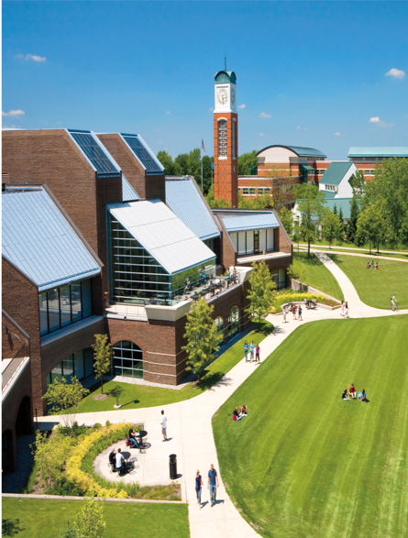

Slide 7
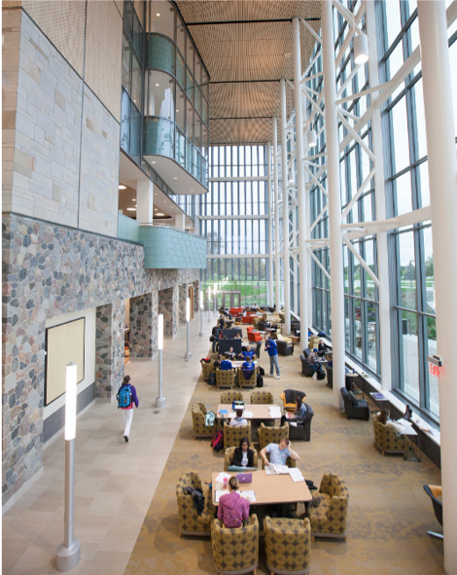

Slide 8
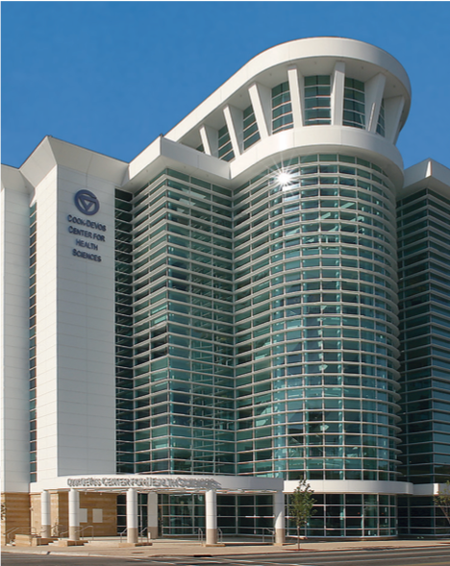

Slide 9
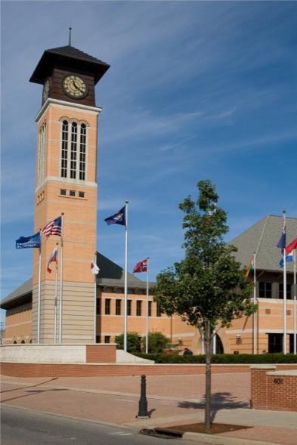

Slide 10
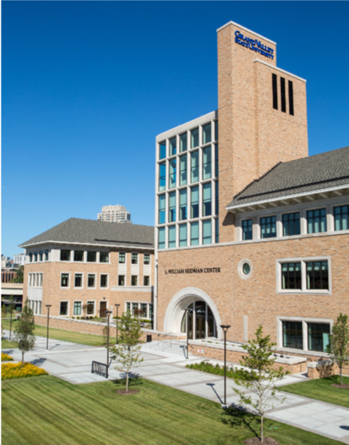

Slide 11


Slide 12


