Slide 1
Seidman New Faculty Orientation
August 12, 2024

Slide 2

Seidman Strategy
2021-26 Strategic Plan Aligns with Reach Higher 2025
4 main strategic priorities
  Learner Success
  Develop Distinctive & Relevant Curriculum
  Multi-Dimensional Approaches to Learning
  Societal Impact

Slide 3

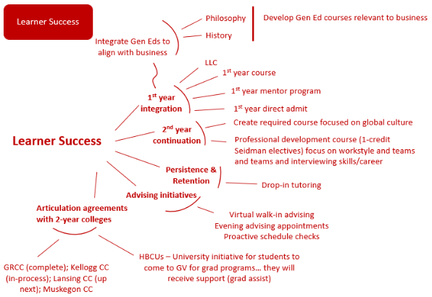
Learner Success
Jaideep Motwani (MGT) – Unit Head Lead

Slide 4

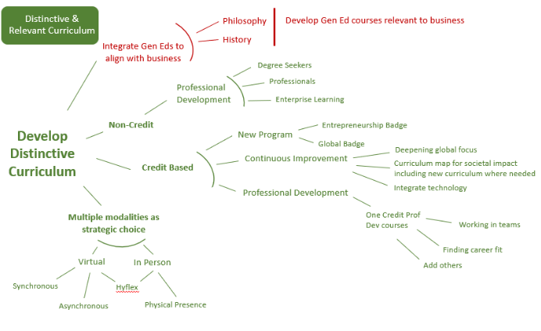
Distinctive & Relevant Curriculum
Richard Schneible (ACC) – Unit Head Lead

Slide 5

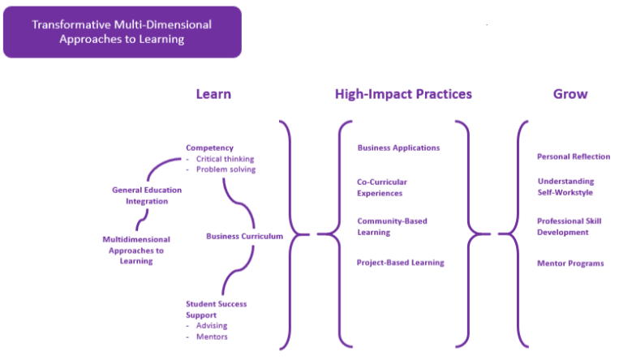
Multi-Dimensional Approaches to Learning
Mark Kubik (MKT) – Unit Head Lead

Slide 6

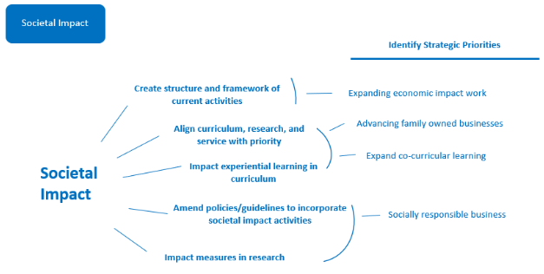
Societal Impact
Dan Giedeman (ECO) – Unit Head Lead

