Slide 1
Panopto Please

Slide 2
Panopto
Captures Video and Voice
Can Video the instructor or capture computer screen

Slide 3
Software is available from GVSU e-learning site

Slide 4
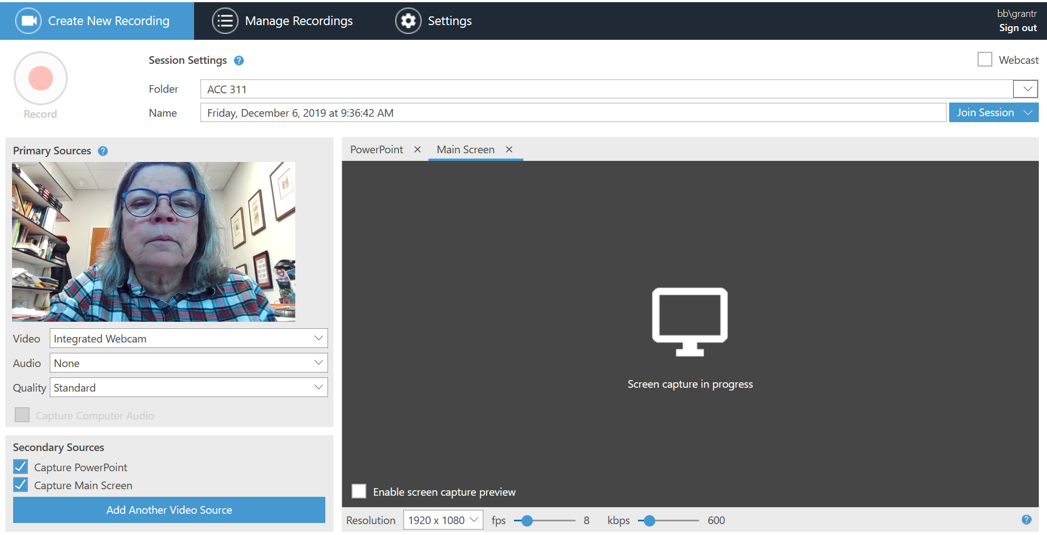

Slide 5
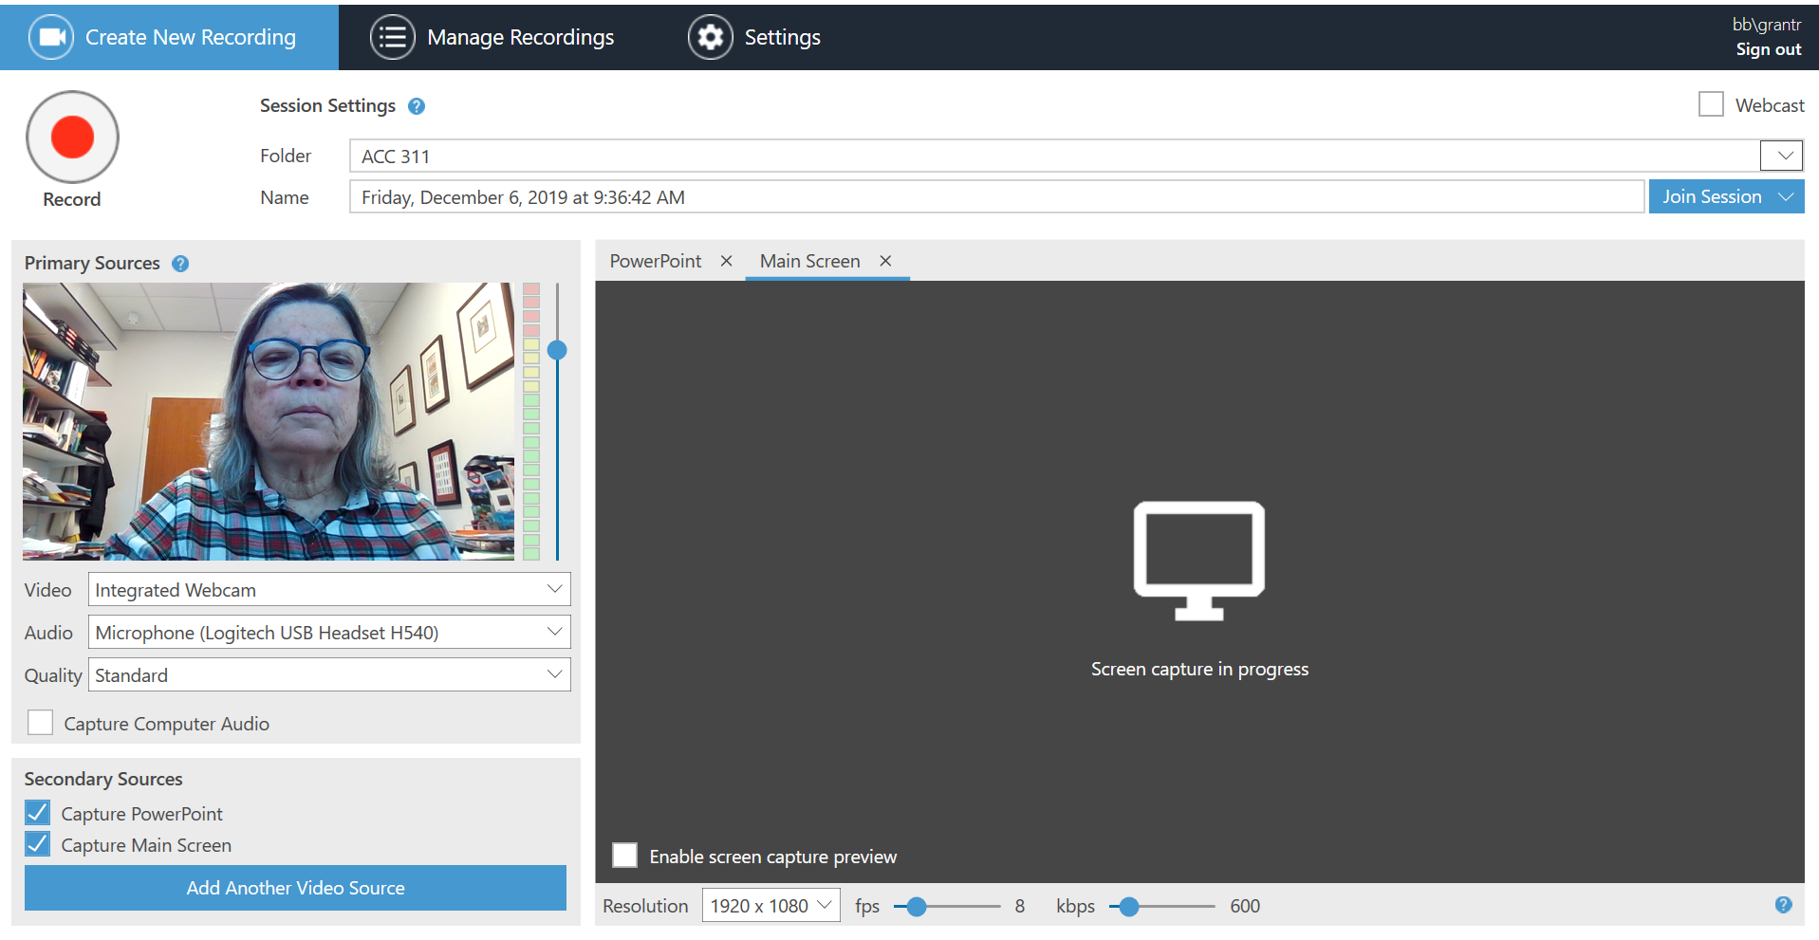

Slide 6
What is it good for?
Lightboard is great for illustrating the big picture
Panopto is good for drilling down to fine details
This Photo by Unknown Author is licensed under CC BY-SA

Slide 7
Panopto is an easy way to keep on schedule during the Polar Vortex or just add extra explanations for students

