Slide 1

Seidman CIR Summary
Fall 2021

Slide 2
Strategic Management
Creating the Seidman Strategic Plan
  Ensure alignment with GVSU Strategic Plan
  Listening Sessions with students, alumni, advisory boards, and faculty/staff
  Work sessions with the Dean’s Advisory Council and at College Wide Meetings
Implementing the Seidman Strategic Plan
  Visual persistence in the Dean’s Suite Conf. Room where the Seidman Leadership Team meets and deliberates
  Seidman leadership references the plan with decisions
  Guides college project identification and priorities

Slide 3
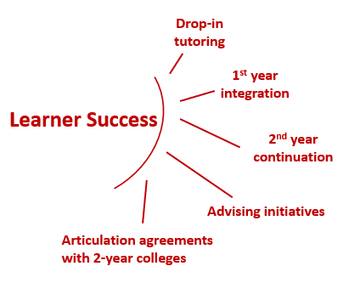
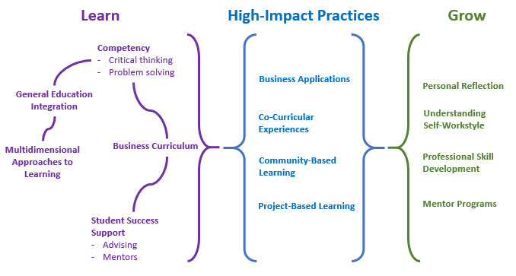
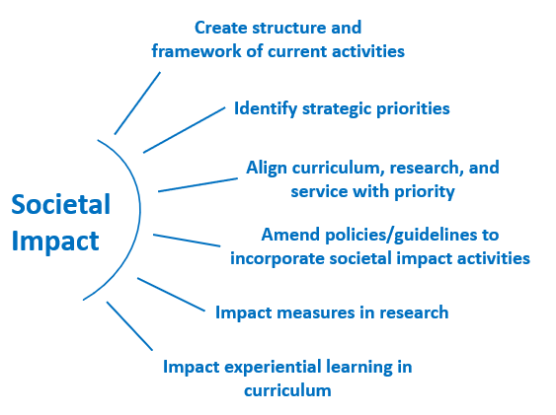
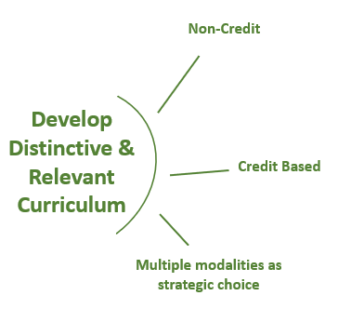
Strategic Management – Strategic Priorities
Multi-Dimensional Approaches

Slide 4
Learner Success
Curriculum Changes
  Program Re-designs – Professional MBA, MST with stackable badges
  Program Expansions – EMBA II, custom business training (e.g. Spectrum, Meijer), Seidman NXT non-credit training
  Pilots – allow us to try changes with a limited audience first
    Ex: Ethics pilot in 2019-20 as a 380 course will be offered in fall ‘22 as ECO 440 (a regular class not requiring overrides) allowing 2-3 weeks more and deeper ethics coverage; COVID slowed down additional pilot offerings
    Ex: First Year Experience – will offer a new iteration in fall ’22
    Ex: New CIS Excel class evolved from the old CIS 150 class
  Moving forward – working on international competencies now
  Share examples from your Unit and courses you teach
Technology Implementation
  Software – Mashme.io, Bluescape (SCB 2001 designed around this), Panopto, classroom capture
  Hardware – Digital Studio lightboard
  Support – Kevin Barrons and the Modality Students
  Consistency – common Blackboard and syllabus templates

Slide 5
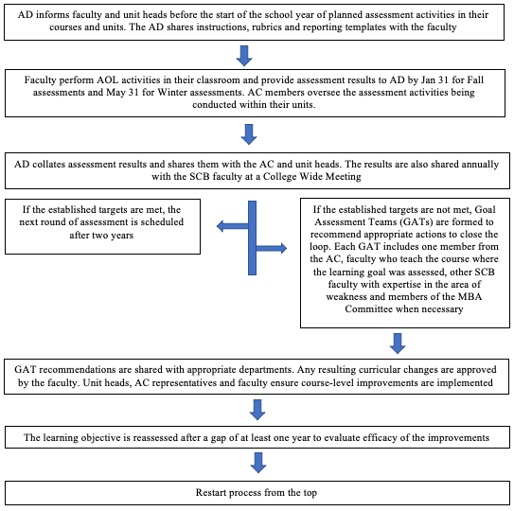
Learner Success – AoL Process

Slide 6
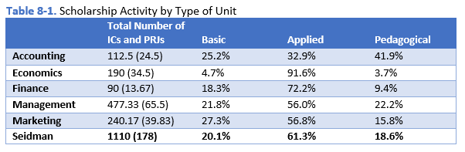
Thought Leadership
Impact of scholarship on Seidman’s intended audiences remains strong.
The culture around scholarship has strengthened.
Faculty sufficiency and qualifications are stable with the greatest challenge being sufficient faculty resources.

Slide 7
Thought Leadership
Seidman’s total student enrollment growth has far outpaced that of GVSU as a whole over the past 10 years.
Note the contrast below between the growth in student enrollments and majors with changes in faculty resources.

Slide 8
Thought Leadership
Seidman Outreach Centers Contribute to Societal Impact
  Small Business Development Center (SBDC) – front line COVID-19 economic recovery role; first three months of COVID, SBDC served 3x’s as many clients as in a typical year
  Van Andel Global Trade Center (VAGTC) – manages the Free Trade Zone in Muskegon along Lake Michigan; celebrated 20th anniversary and awarded the President’s “E” Award for Export Service in 2019; has served nearly 10,000 businesses
  The Richard and Helen DeVos Center for Entrepreneurship & Innovation (CEI) – Michigan Veterans Entrepreneurship Lab (MVE-LAB) initiated in 2019 helps veterans and their families start or strengthen their businesses; LendGR pivoted to help connect Seidman students with COVID-impacted businesses to complete impactful projects
  Koeze Business Ethics Initiative (KBEI) – responded to community need with a COVID inspired webinar series
  Family Owned Business Institute (FOBI) – continued to sponsor faculty research grants and is part of the leading members group of the STEP Project

Slide 9
Questions to Reflect On Prior to the Visit…
How has your work over the last 5 years contributed to the College’s strategic priorities?
How have you used outcomes of Assurance of Learning (AoL) in your classes to improve student learning and student success?

