Slide 1
Personal Statements for Professional Schools
Featuring
Julie Amon-Mattox
Alexis Schewe
Notes:
Welcome to the Personal Statements for Professional Schools workshop presented by Julie Amon-Mattox and Alexis Schewe. This workshop is divided into three parts – 1) Pre-Planning, 2) Ready to Write and 3) Do’s and Don’ts.
This is designed to be a working session, so please feel free to pause this tutorial as needed so you can work on the writing prompts.
Let’s get started.

Slide 2
Personal Statements for Professional Schools Part I Pre-Planning
Notes:
In the first section we will begin to brainstorm the content you want to include in the written sections of your application.

Slide 3
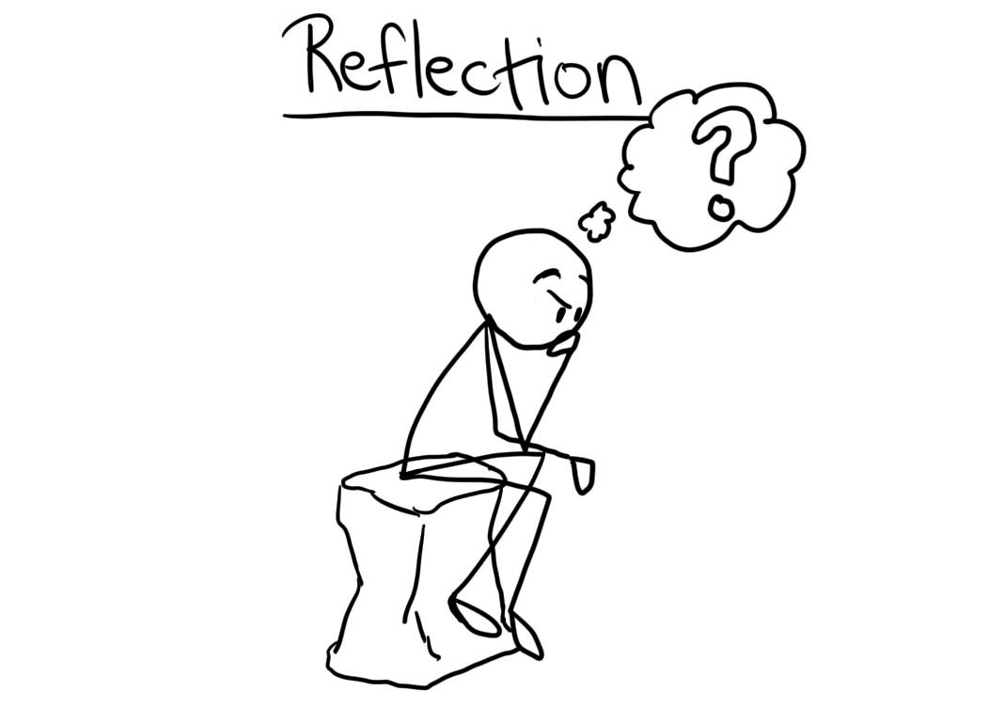
Reduce Redundancies
Maximize Space
Notes:
As you begin to write your personal statement, it is a good time to reflect on all of your accomplishments that you want to highlight in your application materials. By taking some time to brainstorm the content, you can be strategic about where you will place information on your application. This allows you to maximize your application space and avoid redundancies.

Slide 4
Work & Experience Section
Clinical (Shadowing & Interacting)
Community Service (Domestic & Abroad)
Employment
Citizenship
Leadership
Social Justice
& Advocacy
Research & Intellectual Curiosity
Hobbies
Teamwork
Publications, Honors & Award
Clubs & Organizations
Educating Others
How did each of your experiences challenge, change, and inform your understanding of your professional area?
Notes:
Your professional school application will have a section for you to detail work and co-curricular involvements. If you have been tracking your experiences from the beginning then this portion will be easy. If not, now is the time to create a list of your involvements. On the screen are some broad areas to reflect on. It is not a comprehensive list, but it’s a good starting point.
Begin recording all of your involvements in the above areas. As you do so recall what you did during the activity, but most importantly think about how these challenged you and changed your view of medicine, dentistry, optometry, etc. On the actual application you will need to log contact information, hours and dates of involvement. Record this information as you go for ease during the live application process.
A few reminders on experiences –
1. Professional Schools like to see quality over quantity so make sure your application demonstrates some longevity and not a lot of activity hopping
2. Recognize that you have likely done A LOT of great things up to this point, but not everything has to appear on the application. By reflecting on your involvements as a whole you can be selective and highlight activities that show breadth and depth.
3. Note: if you are applying through AMCAS to an allopathic school you will have the opportunity to highlight 3 of your activities as the most meaningful and will receive additional character space to elaborate on those activities.
4. You will want to familiarize yourself with the application guidelines for your professional area. In the resource section at the end of this tutorial you will find links to all of the professional centralized applications systems.

Slide 5
Core Competencies
Notes:
Now that you have a fresh memory of your activities and experiences, you can use this information to show how you have developed proficiency in the various core competencies. On the screen you will see the list of AAMC’s core competencies. These standards have been endorsed by the American Association of Medical Colleges as the expectations of all applicants accepted to medical school. However, these are applicable to all regardless of professional area.
Your reflection and assessment of the core competencies can be done in a four-step process. Which will be demonstrated on the next slides.

Slide 6
Ranking your Proficiency
Resilience & Adaptability (Step 1)
Demonstrates tolerance of stressful or changing environments or situations and adapts effectively to them; is persistent, even under difficult situations; recovers from setbacks.
(Step 2) Ranking – choose 1 that best describes your proficiency
Planning: Preparing to gain experience or exploring options
Progressing: Currently gaining experience, somewhat familiar
Demonstrating: Experienced significant familiarity
Notes:
Step 1: Become familiar with the competencies and definitions. For this example we will be using one of the intrapersonal competencies – Resilience & Adaptability which is defined as “demonstrates tolerance of stressful or changing environments or situations and adapts effectively to them; is persistent, even under difficult situations, recovers from setbacks.”
Step 2. Choose from the following ranking that best describes your current level of proficiency – planning, progressing, or demonstrating.

Slide 7
Step 3 Deeper Reflection
If you chose “Progressing” or “Demonstrating” answer the following
How I demonstrated this competency?
Why it’s important and what this says about me?
What I learned or how I grew from this experience?
How this prepared me or influenced my interest in my professional area?
What are my plans to continue developing this competency?
Step 4 Planning
If you chose “Planning” create a plan to start working on this competency
Notes:
Step 3. If you selected Progressing or Demonstrating use your list of work and experiences from the previous activity and your life experiences to answer the following…
• Describe the knowledge or skills you gained from the experience that demonstrates how you developed this competency
• Reflect on what you think the experience says about you as a unique individual and why its important
• Explain why the experience allowed you to grow as a person
• Describe ways in which you believe your experience influenced your pursuit of a career in your professional area
• Finally draft a strategy for continuing to build on your experience in this area.
Step 4: If you initially selected planning, then spend some time thinking about ways you can further develop this competency – include next steps, a timeline, and who can be a resource for you in the process

Slide 8
Anatomy of an Applicant
Notes:
You should continue to do this 4-step process with all of the core competencies. By doing so you will deepen the reflection you have started with your work and activities at the beginning of this tutorial, and also begin incorporating significant life events into your narrative. An additional benefit of this process is the ability to easily identify any significant gaps in your experiences that you may wish to rectify before the applying to professional schools.
AAMC has created an easy to use workbook called the “Anatomy of an Applicant” and a link to the document is provided on the screen. This document includes fillable assessment guides for each of the core competencies.
Be sure to save your work as you go through this pre-planning phase. These materials will be extremely useful when you complete your primary and secondary applications and prepare for interviews.

Slide 9
Personal Characteristics
Compassion
Respect
Maturity
Competence
Social Responsibility
Empathy
Effective Communication
Self-Awareness
Honesty
Professional Responsibility
Link to more personal values
Notes:
At this point in your pre-planning you should have a well defined list of activities and experiences, and a good understanding of how these experiences have developed your professional competency.
The final step in our pre-planning phase will be to select three personal characteristics or values that you feel best portray you and your aspirations to become a physician, dentist, optometrist, pharmacist, veterinarian, chiropractor or podiatrist. On the screen are some examples as well as a link to more suggestions. You may find that you easily gravitate to three values, or you may need to review your competency rankings and work/activities for some inspiration.
(Used with permission from Michigan State University College of Human Medicine)

Slide 10
Notes:
Thank you for taking the time to complete the pre-planning portion of the personal statement workshop. By doing these activities you should be very well prepared to move into the next phase which will be drafting your personal statement.
Please advance to the next tutorial.

Slide 11
References & Resources
Allopathic (AMCAS Application Information)
Osteopathic (AACOMAS Application Information)
Chiropractic (ChiroCAS Application Information, click Instructions and FAQs on the left)
Dental (ADEA Supporting Information)
Optometry (OptomCAS Application Information)
Pharmacy (PharmCAS Application Information)
Podiatry (AACPMAS Application Information)
Veterinary (VMCAS Application Information)
Pre-Professional Program Website
https://www.gvsu.edu/clasadvising/pre-professional-programs-14.htm
Notes:
A copy of this PowerPoint can be found on the Pre-Professional Program website

Slide 12
References & Resources
Anatomy of an Applicant - https://students-residents.aamc.org/applying-medical-school/preparing-med-school/anatomy-applicant/
Personal Values List - https://scottjeffrey.com/core-values-list/#A_List_of_Over_200_Personal_Values
Pre-Professional Program Website
https://www.gvsu.edu/clasadvising/pre-professional-programs-14.htm

