Slide 1
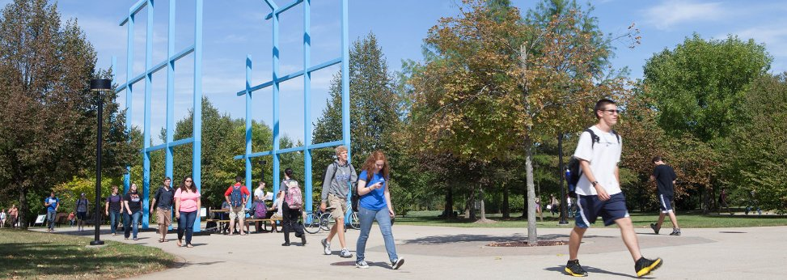
Mentoring Students with Autism Spectrum Disorders in Research (and Life)!
Jamie Owen-DeSchryver, Ph.D.
Responsible Conduct of Research Workshop
Saturday, February 24, 2018

Slide 2
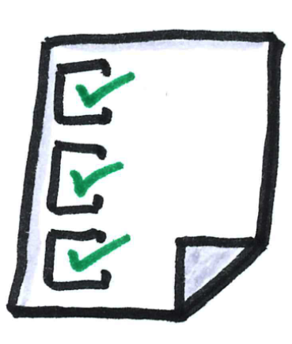
Agenda
Students with ASD in College
Characteristics
ASD and the Brain
Strategies and Supports
Resources

Slide 3
Students with ASD in College

Slide 4
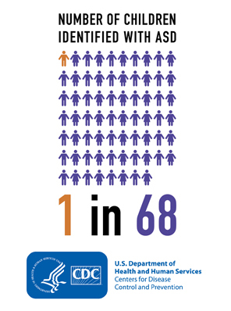

Slide 6
How does this affect us?
Improved identification and supports for K-12 students with ASD
Increasing numbers of students with ASD
Increasing numbers of young adults with
diagnosed ASD are coming to college

Slide 7
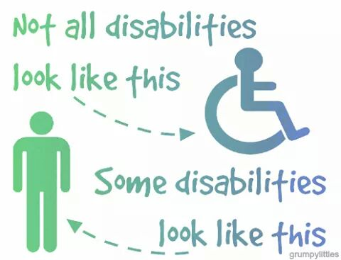

Slide 8
“Because students with ASD appear normal and may have obvious talents and abilities, faculty and other students may easily become frustrated by behaviors inherent to the disability. This can lead to social ostracism and ultimately adversely affect learning”
Camarena & Sarigiani, 2009, p. 117

Slide 9
Disclosure of ASD
Has the diagnosis, discloses
Has the diagnosis, does not disclose
Does not have the formal diagnosis, may not be aware

Slide 10
What we can do…
Increase awareness
Use ASD-friendly supports and strategies
Connect with resources

Slide 11
Characteristics of ASD

Slide 12
DSM IV (1994-2013)
PERVASIVE DEVELOPMENTAL DISORDERS
Autistic Disorder
Asperger
PDD-NOS
Rett’s Disorder
CDD
DSM-5 (May 2013)
Autism Spectrum Disorder

Slide 13
The Range of ASD is Broad
Cognitive Ability
Communication Skills
Social Competency
Social Interest
Sensory Experience
Motor Skills
Flexibility
Fascinations

Slide 14
Autism Spectrum Disorder (ASD) DSM-5 Definition (2013)
Deficits in social communication and social interaction across multiple contexts
Restricted, repetitive patterns of behavior, interests, or activities

Slide 15
Social-Communication Differences
DSM-5 Criteria
Persistent deficits in social communication and social interaction across multiple contexts, as manifested by the following:
Deficits in social-emotional reciprocity
Deficits in nonverbal communication
Deficits in developing, maintaining, and understanding relationships
What you might see in college students with ASD
Difficulty reading social cues
Unusual eye-gaze
Awkward interactions; Difficult conversation
Domination of classroom/lab discussion without awareness of cues from others to stop
Difficulty understanding another person’s perspective or opinion
Problems with social thinking

Slide 16
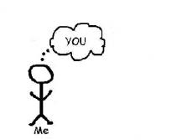
Social Thinking
Social thinking is what we do when we interact with people: we think about them. How we think about people affects how we behave, which affects how others respond to us, which affects our own emotions.
Most of us have developed our social thinking skills from birth by observing and acquiring social information and learning how to respond to people. However for some individuals, this process does not come naturally.
Garcia-Winner, 2016
www.socialthinking.com

Slide 17
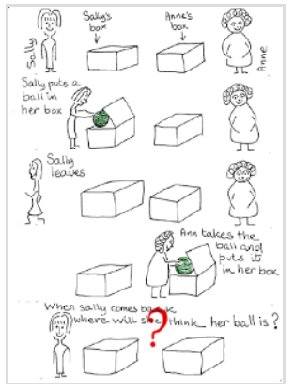
Social Thinking: Theory of Mind & Mindblindness

Slide 18
Social Thinking: Theory of Mind & Mindblindness

Slide 19
Social Awareness and Emotional Contagion
Yawning is contagious. A tendency to catch other people's yawns may depend on a social awareness of others.
Yawning (Senju et al., 2007; Helt et al, 2010)
Notes:
Video - 2:58-4:34

Slide 20
Restricted, Repetitive Patterns of Behavior
DSM-5 Criteria
Restricted, repetitive patterns or behavior, interests or activities
Stereotyped or repetitive motor movements, use of objects or speech
Insistence on sameness, inflexible adherence to routines or ritualized patterns of verbal or nonverbal behavior
Restricted, fixated interests that are abnormal in intensity or focus
Hyper or hypo reactivity to sensory input or unusual interest in sensory aspects of the environment
What you might see in college students with ASD
Highly-focused on specific topics or interest areas
Anxiety or stress with changes or unexpected situations
Unusual repetitive behaviors, like pacing
Strong reaction to noise, lights or sounds in the environment

Slide 21
Other Possible Challenges
Low motivation for classes outside interest areas
Misinterpreting sarcasm, innuendo
Group work
Misunderstanding assignments
Concrete or literal thinking
Susceptible to manipulation

Slide 22
In addition, there are MANY positives about ASD…

Slide 23
Uniqueness and Strengths
Advanced knowledge in particular subjects areas
Diligence in gathering and organizing information on a topic of interest
Advanced vocabulary
Creative thinking and original approaches to solving problems
Highly logical
Exceptional memory
Attention to detail
Speak their mind; honest

Slide 24
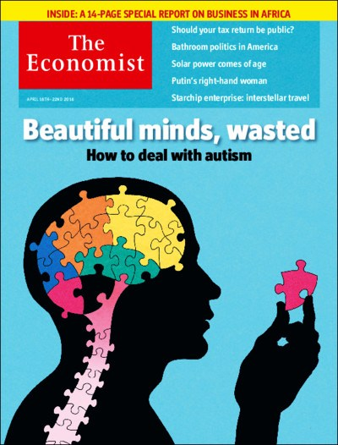
Employers who hire autistic staff are usually glad they did. Many have strengths that make them well suited to some jobs. They are unusually good at focusing, for example. When asked what he most enjoys about his job, Mr Schindler says: “Solving software-engineering problems.” His favorite hobby? “Solving software-engineering problems.”
Notes:
http://www.economist.com/news/briefing/21696928-children-rich-world-are-far-more-likely-be-diagnosed-autism-past-why/tw/te/bl/ed/spectrumshift

Slide 25
Study confirms that College Students with ASD are more likely to be STEM Majors
Notes:
https://www.sri.com/newsroom/press-release/autistic-students-choose-science-majors
https://link.springer.com/article/10.1007%2Fs10803-012-1700-z

Slide 26
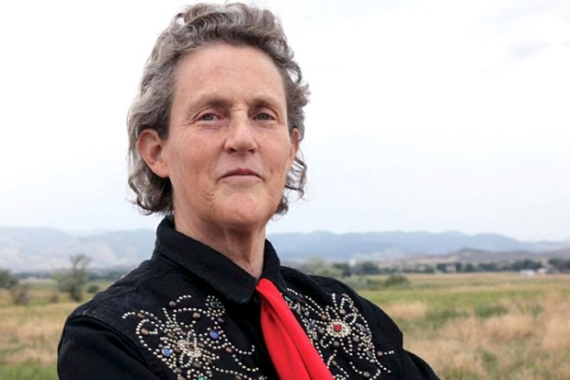
What would happen if the autism gene was eliminated from the gene pool? You would have a bunch of people standing around in a cave, chatting and socializing and not getting anything done”
-- Temple Grandin

Slide 28
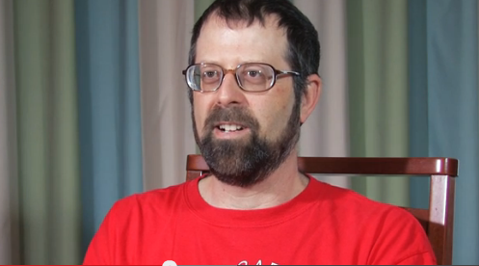
Stephen Shore, Ed.D.
Notes:
0:47-1:50 2:49

Slide 29
ASD and the Brain

Slide 30
Processing Differences
An individual with autism is like a Mac in a PC-dominated environment. It is hard-wired differently. Not incorrectly – just differently.
-- Ellen Notbohm

Slide 31
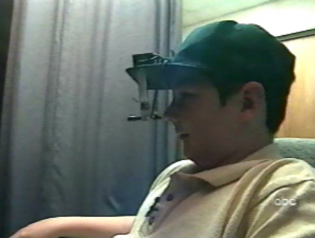
Autism is a Neurobiological Disorder

Slide 32
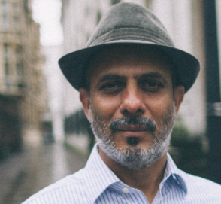
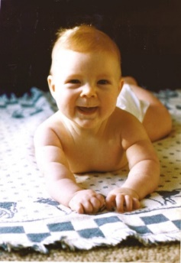
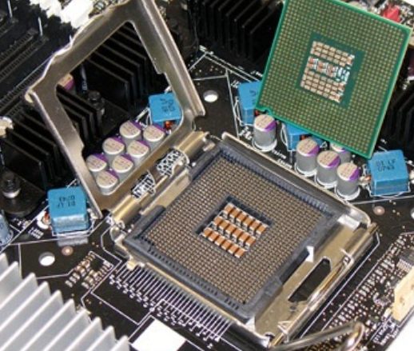
The way that one’s brain is hardwired makes a certain pathway more likely
Experts on people
Experts on things

Slide 33
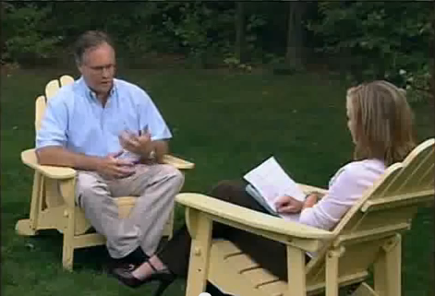
John Elder Robison
Notes:
0:14-1:29 (or 2:50)

Slide 34
Strategies & Supports

Slide 35
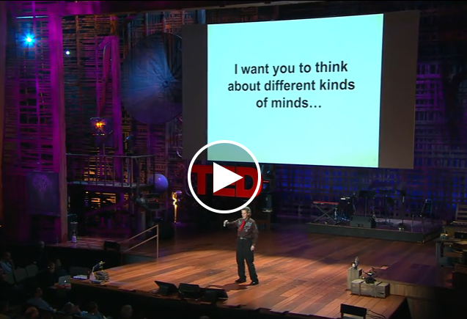
Temple Grandin, Ph.D.
Notes:
12:35-15:35

Slide 36
“Work by Nicholas Gelbar, Isaac Smith and Brian Reichow (2014) offers faculty members suggestions for helping students on the spectrum. As much as possible, use concrete language in both lectures and the syllabus. Break tasks down into more steps, provide greater organizational support, and realize that group work and public speaking may offer particular challenges for students who struggle socially and who do not thrive in environments demanding rapid transitions. In other words, when working with students whose disability makes flexibility extremely difficult, faculty members must be the flexible ones. They must also take responsibility for educating themselves about neurodiversity, and if that seems too hard, they can do one last thing. They can defer to autistic students who do understand their own needs, and they can give students the support they ask for.”
-Inside Higher Ed (2016)
Notes:
https://www.insidehighered.com/views/2016/09/13/making-college-work-students-autism-essay

Slide 37
Verbal Language
Student may have sophisticated and impressive vocabulary and excellent rote memory but may have difficulty with high-level thinking and comprehension skills. They can give the impression that they understand, when in reality they may be repeating what they have heard or read.
Many individuals with ASD/Asperger are visual learners. Written descriptions, pictures and graphs may be helpful to them.
Notes:
http://www.umassd.edu/dss/resources/facultystaff/howtoteachandaccommodate/howtoteachautismspectrum/

Slide 38
Take Away
Make words concrete
Write it down, Write it down, Write it down
Use visuals

Slide 39
In focus groups, college students with autism told story after story about metaphorical or abstract language leading to confusion, as well as loud, active classrooms challenging their abilities to focus on learning. For many, the frustrations became too great, leading to stress and anxiety. However, when students felt their social needs were met - in particular when faculty members proved willing to modify their teaching style - students had much more positive experiences.
-Inside Higher Ed (2016)
Notes:
https://www.insidehighered.com/views/2016/09/13/making-college-work-students-autism-essay

Slide 40
Take Away
Watch your language!
Use concrete language
Avoid idiomatic references

Slide 41
Central Coherence
ASD may come from a cognitive style that diverges from the “big picture” way of perceiving, making sense of, and remembering, toward a more detail-centered way of processing. Individuals with ASD do not process overarching ideas but instead accumulate knowledge in a piece-meal way. The weak central coherence perspective suggests that college students with ASD would have difficulty with activities requiring inference, synthesis, determination of significance, and argument. On the other hand, students with ASD may excel at activities requiring accumulation of fact or data, analysis of pieces, and accuracy with detail.
Gobbo and Shmulsky (2014)
Notes:
Gobbo and Shmulsky (2014)
http://dsq-sds.org/article/view/5053/4412

Slide 42
Writing and Researching
Student may be able to state facts and details, but be greatly challenged by papers or projects requiring taking another's point of view, synthesizing information to arrive at a larger concept, comparing and contrasting to arrive at the "big picture,“ or using analogies, similes, or metaphors.
Notes:
http://www.umassd.edu/dss/resources/facultystaff/howtoteachandaccommodate/howtoteachautismspectrum/

Slide 43
Take Away
Support writing and research
Help the student understand and describe the big picture
Keep directions simple and declarative
Ask students to repeat directions in their own words to check comprehension

Slide 44
Attribution Theory Applied to Mentoring
Every day we must guess how people will act, often from small shreds of evidence.
We do this through a form of social cognition called attribution.
As we observe others, we make inferences about them. We attribute people’s behavior to various causes.
Whether we are right or wrong about the causes of their behavior, our conclusions affect how we act.

Slide 45
How do our attributions change how we behave as mentors?
This student is not progressing on his research because he’s disorganized and spends too much time talking about X and not enough time doing the work
This student has ASD and it’s possible he needs additional supports to make progress because of some of these characteristics

Slide 46
Take Away
Strategies for Mentoring
Be direct when offering feedback, directions, discussion
Model appropriate behavior
Be patient, accepting, and inclusive
Avoid taking seemingly rude behavior personally

Slide 47
Take Away
Supporting Group Work
Avoid having students self-select into groups. Try to place the student with others who you believe will be understanding and accepting
When the student must be in a group, clarify your expectations, both academic and behavioral, to individuals within the group
Be the mediator if any conflicts arise
If a conflict occurs, explain to the student what effect they had on others, why the conflict arose, and how to be successful in a group setting (e.g. time spent talking, equal work from individuals, hearing everyone’s opinion)

Slide 48
Take Away
Rules and Guidelines
Help identify rules and guidelines for interactions
Personal space
Time/boundaries

Slide 49
Be Concrete
Student arrives at your office at 1:40. "We have 20 minutes to work together. At 2:00, I'm going to ask you to take my suggestions home and start making changes to your paper. Come to my office Thursday afternoon at 3:00 and show me what work you have done on the paper."

Slide 50
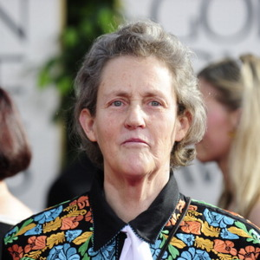
A good rule identified by Temple Grandin: “You simply cannot tell other people they are stupid, even if they really are stupid.” — Temple Grandin

Slide 51
Resources at GVSU

Slide 52
Autism Spectrum Disorder Supports at GVSU
Disability Support Resources (DSR)
Kathleen VanderVeen - vandervk@gvsu.edu
Shontaye Witcher - witchesh@gvsu.edu
Jason Osborne - osborjas@gvsu.edu
Psychology Department/Autism Education Center
Amy Matthews – matthewa@gvsu.edu
Jamie Owen-DeSchryver – owendesj@gvsu.edu

Slide 53
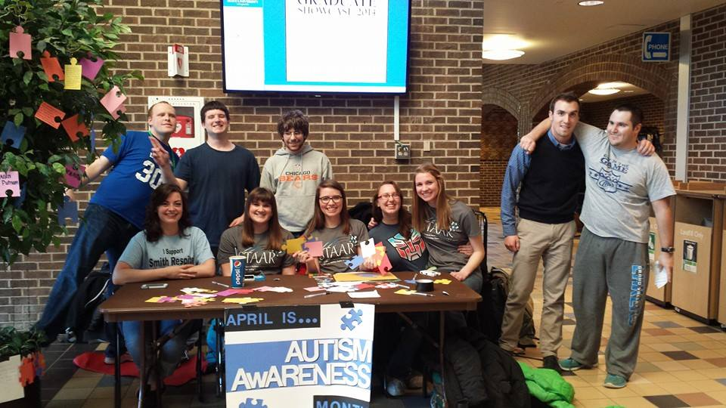
Campus Links
Social community
Peer mentoring
Regular check ins
Social activities

Slide 54
Video
Understanding Asperger Syndrome: A College Professor's Guide
http://www.youtube.com/watch?v=233-3jtEZck

Slide 55
Questions? Jamie Owen-DeSchryver owendesj@gvsu.edu

