Slide 1
Graduate Assistantship Orientation
2021-22 Academic Year

Slide 2
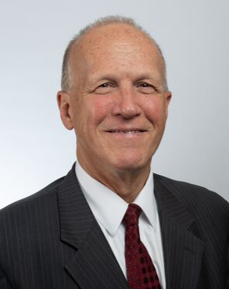
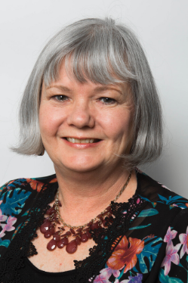
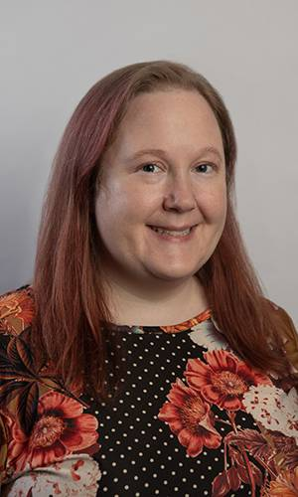
Welcome!
The Graduate School
Jeffrey Potteiger, PhD, FACSM
Associate Vice-Provost for the Graduate School
Irene Fountain
Assistant to the Associate Vice-Provost
Jennifer Palm
Assistant to the Graduate School
Kassie Nguyen Graduate Assistant (1st year)
Maggie Scannell Graduate Assistant (2nd year)
Long Ho
Undergraduate Student Assistant
Sarah Spencer
Undergraduate Student Assistant

Slide 3
Your Safety and Health Lakers Together
GVSU Covid Dashboard
Current Students

Slide 4
Today’s Orientation
GA Benefits & Responsibilities
The GA Experience
Do’s & Don’ts: Policies & Procedures
University Policies

Slide 5
What is a Graduate Assistantship?
Financial support in exchange for contractual work experience that supports your graduate education
Experience (research, teaching, application) that complements your program of study
Initial steps towards a chosen career or discovery of possible career paths, including doctoral studies
An opportunity to build technical and professional skills and gain valuable experience

Slide 6
What are the benefits of a GVSU GA?
Tuition Remission Varies by Appointment Length
Full-Time 10-mos = 21 cr hr (9 cr hrs in Fall; 9 cr hrs in Winter; 3 cr hr in summer)
Full-time 12-mos = 24 cr hr (9 cr hrs in Fall; 9 cr hrs in Winter; 6 cr hrs in summer)
Full-time, 9-mon AY = 18 cr hr (9 cr hrs in Fall; 9 cr hrs in Winter)
Half-time, 9-mos AY = 9 cr hr (4.5 cr hrs in Fall; 4.5 cr hrs in Winter)
Tuition waivers are not applicable to UG courses (< 500 number)

Slide 7
What are the benefits of a GA?
Stipend
$2,000 per semester for half-time appointments
$4,000 per semester for full-time appointments
$4,000 for summer semester for those with 12-mos appointments
Free parking
(no payment for student sticker)
Health care access
www.gvsu.edu/campushealth

Slide 8
What are the responsibilities of a GA?
To provide skills and services to faculty/units/offices to enhance teaching, scholarship, service or other outcomes of the unit to which assigned…
Half-time appointments = 10 clock hours/wk
Full time appointments = 20 clock hours/wk
No requirement to work over university breaks (i.e., any time classes are not in session)
Unless supervisor specifies otherwise, as pre-arranged with the GA

Slide 9
Essential information for GAs
Pay periods listed on Student Employment website
1st full paycheck - 10-Month GAs Aug. 31 - 9-Month GAs Sept. 14
Benefits of direct deposit (earlier, more secure)
For any appt > 9 mos, paychecks are scheduled through breaks
Length of employment - standard
Aug. 30, 2021 through April 29, 2022
GAs on extended contracts have different start/end dates.
Vacation
Tax requirements
Federal and Michigan (I-9 & W-4 forms)
GAs must file a city tax form if working in GR, Muskegon, Detroit, regardless of residence
Tuition waiver is taxable income if assignment is not research or teaching
GAs do not receive vacation other than university breaks and holidays

Slide 10
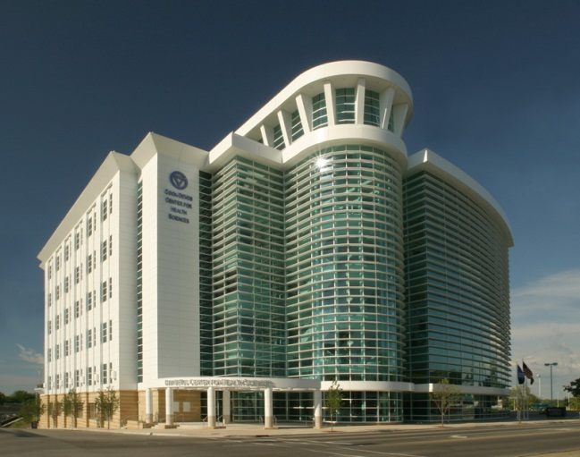
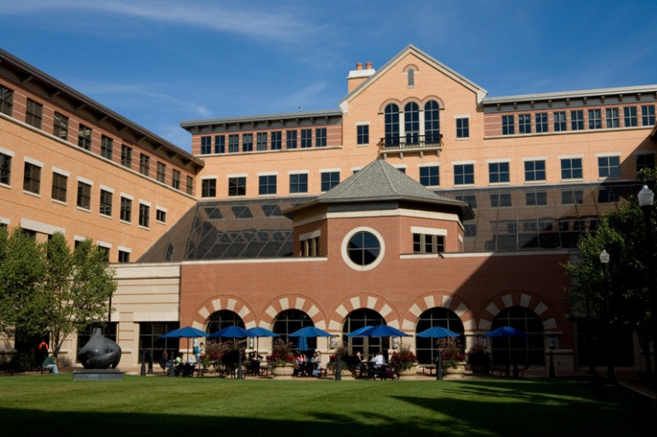
Questions at this point?

Slide 11
Today’s Orientation
GA Benefits & Responsibilities
The GA Experience
Do’s & Don’ts: Policies & Procedures
University Policies

Slide 12
The GA Experience…
Importance of going through orientation
Participate in unit orientation
Meet & greet staff/faculty
Prevents confusion and provides for a good start
Gain information regarding your job responsibilities and assignments
Learn your rights and what’s expected of you in the position
Ask questions…
What have previous GA experiences been like?
Could this GA position be renewed?
How are complaints & grievances resolved?
How will I be evaluated – methodology & frequency?

Slide 13
Task Assignment & Completion
Tasks assigned to GAs should challenge you to levels of success that can be reached by building new and better skills…
Respect timelines and deadlines and comply with them
What if this is not the case for you?
Seek challenge and take the initiative to talk to your supervisor
Don’t settle for the minimum as the ‘standard of excellence’
A GA is a learning experience, not just a job, so seize the opportunity
Demonstrate progress toward independence of decision-making

Slide 14
Supervision and Feedback
Some GA positions require more supervision, others less. Generally, the level of supervision provided during your GA changes, depending on outcomes.
As your skills/outcomes improve, supervision may be less necessary
You should seek the level of supervision you need for success over the course of your GA (early, middle, late)
Supervision should be available to you if you need it; if not, take the initiative to ask for it
All supervisors should provide you feedback (formal and informal) on a regular basis.
Weekly meetings as needed
Seek opportunities to provide your supervisor feedback
Without feedback, how do GAs and supervisors improve?
Primary Supervision should be given by Professional Staff or Faculty Member

Slide 15
Evaluation
Every GA should undergo some form of evaluation process (formal or informal) before ending the appointment
Process could be formative, focusing on strengths and things to improve; could be done regularly, at mid-point and/or conclusion
Process could be summative (more formal; “here’s how you did…”)
Could be structured evaluation with GA knowing the areas assessed
GAs should evaluate their supervisors by providing honest, open comments and suggestions for improvement of the GA experience
Graduate School has an online evaluation for completion at the end of the semester/academic year

Slide 16
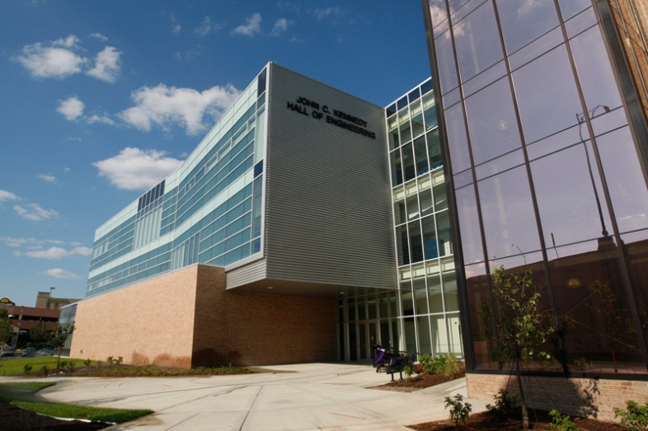
Questions at this point?

Slide 17
Today’s Orientation
GA Benefits & Responsibilities
The GA Experience
Do’s & Don’ts: Policies & Procedures
University Policies

Slide 18
GA Policies & Procedures
Forms that need to be completed to be paid
I-9
Requires original documentation for proof
Everyone should file at least 3 days prior to employment start date
W-4 (how much withholding tax you prefer)
Grand Rapids W-4 confuses students when asked…”what percentage of your work will occur in Grand Rapids?”
100% if your work is on a downtown campus (Health Campus or Pew Campus)
Stipend payment
Direct Deposit
Sign up for direct deposit online through myBanner
Enter bank information on “Employee” tab
GAs without direct deposit will automatically be issued a pay card. Each pay day their stipend payment will be ‘loaded’ onto the card.

Slide 19
Tuition
Students are responsible for tuition that the GA tuition waiver does not cover
For example, ½ time GA must pay for any credits beyond 4.5 credit hours
Tuition must be paid before the tuition deadline or automatic course drops will occur
Be aware!.. Banner may take some time to show your payments
If students pay their tuition before the waiver is applied, it may take several weeks for your refund to be processed
If a credit card is used, a refund will be credited to your account by the next billing cycle (~ 2-4 wks)

Slide 20
Access your Student Account via Banner log-in
Follow the path:
Student → Student Accounts → Student Account Information
Click on the corresponding semester statement
You will then be directed to view your student account statement
Overview of Student Account Statements

Slide 21
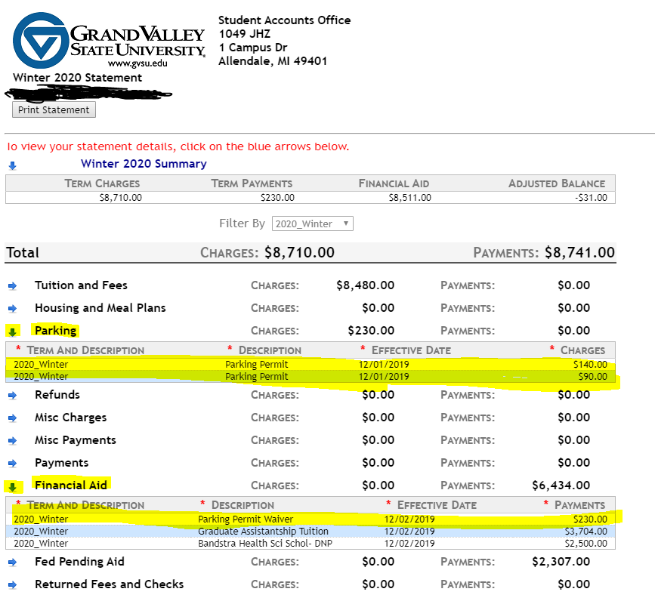
Student Account Statement

Slide 22
GA work assignments should correspond with the job description
Some deviation may be necessary depending on the needs of the hiring unit
Supervisors are responsible for requesting a computer/email login for their GAs
GAs are not expected to use their personal or student email addresses
GAs may not be used in place of clerical staff - assignment should enhance the GA’s academic experience
Routine filing, copying, answering phones, are not to be regular duties
GAs may work remotely with supervisor approval.
The GA and supervisor should create a plan for tracking work hours to ensure assignments are completed.
Work Assignment

Slide 23
Class attendance is the first priority for all GAs
Break and lunch schedules should be discussed with the supervisor
With supervisor approval, GAs may work fewer hours during any given week to accommodate exam schedules, academic matters, and urgent personal matters
Work Schedule
Lunch breaks (> 30 min) are not considered part of work hours
Short breaks (< 15 min) are typically counted towards work hours
GAs are not expected to work when they have a class
Supervisors and GAs should discuss work arrangements once the GA’s class schedule is finalized, to determine what days and hours the student will work
Arrangements to make up missed hours should be agreed upon by the GA and the supervisor

Slide 24
Additional On-Campus Employment
GAs may not exceed 20 hours per week of employment at GVSU.
GAs may not have any other employment at GVSU during the GA appointment without approval from the Graduate School.
GAs who are approved for additional work should not exceed 25 hours per week in total (GA hours + additional work hours <= 25 hrs.)
GAs who are seeking or are offered additional work should:
Ask the hiring supervisor to contact the Graduate School for approval and to confirm the number of work hours requested.
Ask their academic advisor or graduate program director to provide a statement of support for the additional employment to the Graduate School to ensure the GA’s academic success and work/life balance.
International students should consult with the Padnos International Center before accepting an additional on-campus job.

Slide 25
Vacation & Time Off
GAs with AY appointments are expected to work when classes are in session. GAs do not work:
Dress Code & Appearance
Units may determine their own dress code for GAs
GAs should dress according to their department culture and nature of their work… e.g., in an office setting, business casual is expected
GAs whose positions require physical activity may dress for conditions
For special events, GAs should generally dress in more formal business attire
However, hiring units may require their GA to work during such breaks if they have a substantial need and if the GA is informed of this expectation at the time of hiring
During fall break, winter break, spring break or between winter and Sp/Sum semesters
Wednesday before Thanksgiving
Martin Luther King Day

Slide 26
Termination and Cancellation of Appointment
Circumstances may occur that require a GA to resign
Whenever possible, two weeks’ notice should be given to the supervisor
Assignments should be completed to the best of the GA’s ability prior to departure
The stipend will be discontinued at completion of the GA’s last day of employment
Tuition will be pro-rated and the GA will be billed for the portion of the semester tuition that remains after resignation

Slide 27
Termination and Cancellation of Appointment
If a supervisor wishes to terminate a GA for cause (e.g., the student was unable to satisfactorily perform the duties of the assistantship), the hiring unit must do the following:
Create a performance improvement plan
Allow an opportunity for improvement
Notify the student of termination in writing and provide a copy of the termination notice to the Graduate School

Slide 28
GA complaints should be addressed locally, by the supervisor’s office or unit, whenever possible
At times, it may be necessary for a GA to file an appeal related to their position
GA-related disputes or concerns should be directed to the appointing officer who may intervene or refer the issue to the appropriate university office
Unresolved complaints may be appealed to the Graduate School
Complaints may include, but are not limited to issues such as job expectations not outlined in the position description, arbitrary or capricious behavior of the supervisor, or termination of the GA
GA Complaint Process

Slide 29
Do…
Ask questions when needed
Become informed of unit/office cultures
Communicate professionally
Take initiative – go ‘above and beyond’
Seek out opportunities to build skills and abilities
Ask what else you could do to help
Follow GVSU policies and procedures
Be professional in your job
Get to know your supervisor
Fulfill your contract hours
Don’t…
Do the bare minimum to get by, make sure to exceed expectations
Ignore rules and procedures in your office, unit, classroom, laboratory
Skip on your contract hours; a GA is not a scholarship
Be discourteous or disrespectful to the University Community or dress inappropriately
Contact the GS regarding any questions about tuition, payroll, paperwork, or policies
Enjoy the experience!
Compare your GA experience directly with others as there may be differences in assignments, responsibilities, supervision, etc.

Slide 30
Questions at this point?

Slide 31
Today’s Orientation
GA Benefits & Responsibilities
The GA Experience
Do’s & Don’ts: Policies & Procedures
University Policies

Slide 32
University Policies
Graduate Assistants are expected to adhere to all university policies as representatives of the GVSU community

Slide 33
Commitment to Inclusion & Equity and Equal Opportunity/Affirmative Action Policy
All members of the community are expected to conduct themselves in a manner that does not infringe upon the rights of others
University encourages diversity and provides equal opportunity in education, employment, all of its programs, and the use of its facilities
Members of the university community, including students, employees, faculty, staff, administrators, Board members, consultants, vendors, others engaged to do business with the University, candidates for employment or admissions, and visitors or guests have the right to be free from acts of harassment and discrimination, including sexual misconduct, as defined by the policy

Slide 34
Anti-Harassment Policy
Harassment is unprofessional conduct that could reasonably be understood as:
1
2
3
Having the purpose or effect of unreasonably interfering with an individual's work performance or access to educational activities and programs
Otherwise adversely affecting an individual's employment opportunities or access to educational activities and programs
Having the purpose or effect of creating an intimidating, hostile, or offensive environment

Slide 35
Anti-Harassment Policy
Any person who violates the University's Anti-Harassment Policy may be subject to a range of sanctions which could include, but is not limited to, dismissal, according to due process, from University employment
Harassment about age, color, disability, familial status, height, marital status, national origin, political affiliation, race, religion, veteran status, or weight is a violation of university policy
Violators may also be subject to civil action or criminal prosecution because harassment and other discriminatory behavior may violate state or federal laws

Slide 36
Confidentiality, Data & Security Policy
Individuals with authorized access to GVSU’s computer resources, information system, records or files are given access to use the University’s data or files solely for the business of the University. Specifically, individuals should:
.
Access data solely in order to perform his or her job responsibilities
Not seek personal benefit or permit others to benefit from any data that has come to them through their work assignments
Not release University data other than what is required in completion of job responsibilities
Not exhibit or divulge the content of any record, file or information system to any person except as it is related to the completion of their job responsibilities

Slide 37
Confidentiality, Data & Security Policy
Individuals are not permitted to operate or request others to operate any University data equipment for personal business, to make unauthorized copies of University software or related documentation, or use such equipment for any reason not specifically required by the individual’s job description

Slide 38
Title IX Compliance
Title IX states no person in the United States shall, on the basis of sex, be excluded from participation in, be denied the benefits of, or be subjected to discrimination under any GVSU educational programming or activity
All GAs will get an email to complete Title IX training. This is required of all employees. The email comes from getinclusive.com and is facilitated by the Title IX coordinator in the Division of Inclusion and Equity

Slide 39
FERPA pertains to everyone who works at GVSU and we are bound by professional ethics to safeguard the integrity and confidentiality of student information
Use a specific “need to know” approach when accessing student records: there must be a legitimate university-related educational or administrative interest and a need to review an education record in order to fulfill one’s professional responsibility
The information may not be disclosed to anyone who does not need this information to do their job at the university
Family Education Rights and Privacy Act of 1974 (FERPA)

Slide 40
Americans with Disabilities Act (ADA)
GVSU promotes the inclusion of individuals with disabilities as part of our commitment to creating a diverse, intercultural community
GVSU complies with the Americans with Disabilities Act as amended by the ADA Amendment Act (2008) and other applicable federal and state laws that prohibit discrimination on the basis of disability
GVSU will provide reasonable accommodations to qualified individuals with disabilities upon request
ADA act recognizes and protects the civil rights of people with disabilities
ADA covers a wide range of disability, from physical conditions affecting mobility, stamina, sight, hearing, and speech to conditions such as emotional illness and learning disorders

Slide 41
A complete list of University Policies can be found by searching for “University Policies” on the GVSU home page or by going directly to this website:
https://www.gvsu.edu/policies

Slide 42
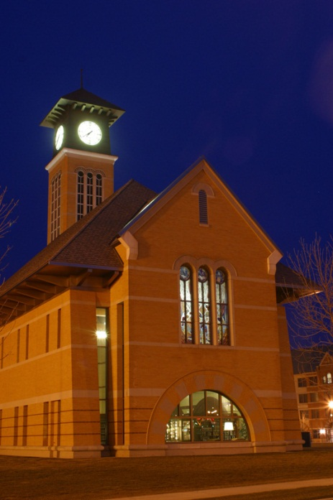
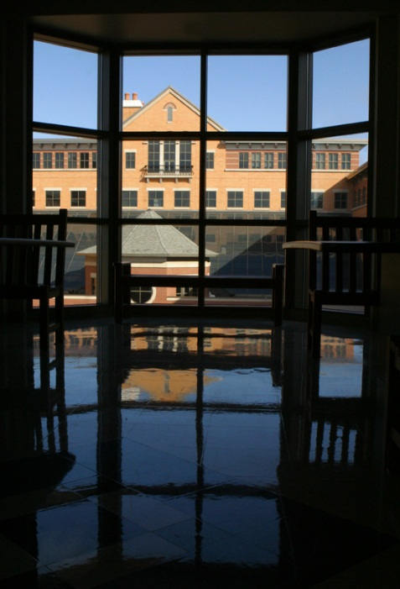
Questions?

Slide 43
Best Wishes for a Great Experience as a Graduate Assistant at GVSU!

