Slide 1
Social Media For Employment
A Guide to Understanding and Accessing
Resources For Career Success
Tom Brown
Vice President - Talent Acquisition Scouting
Fifth Third Bank

Slide 2
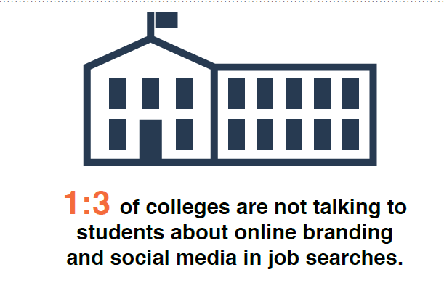

Slide 3
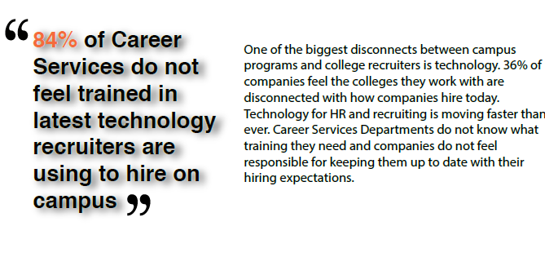

Slide 4
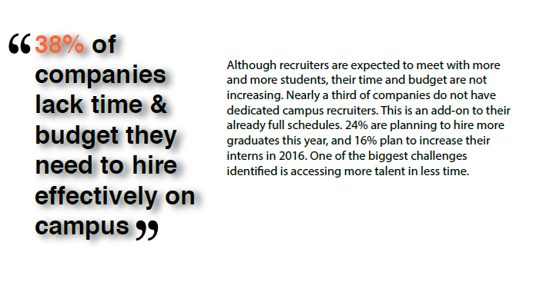

Slide 5
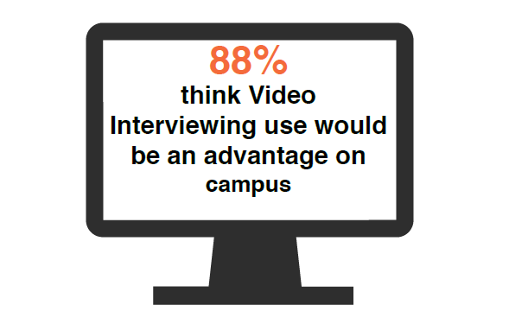

Slide 6
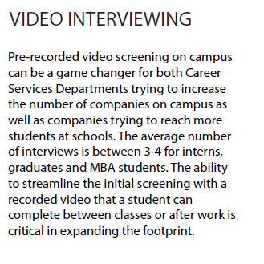
http://grow.hirevue.com/introducing-hirevue-insights

Slide 7
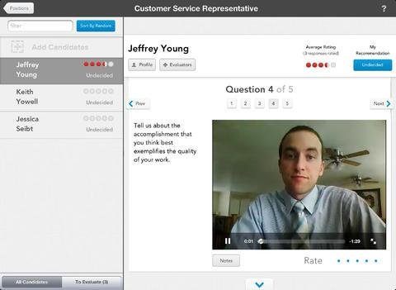

Slide 9
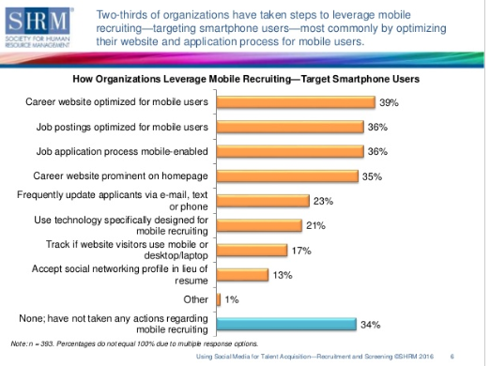

Slide 10
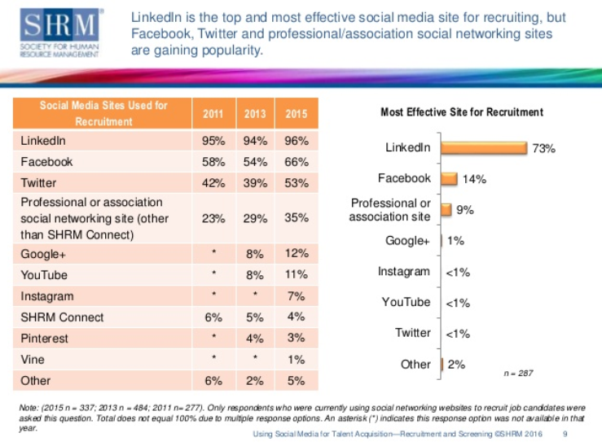

Slide 11
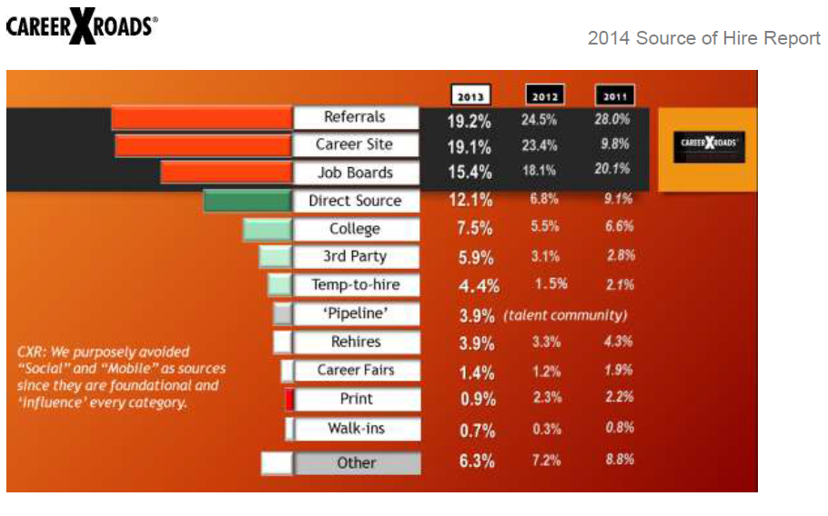

Slide 12
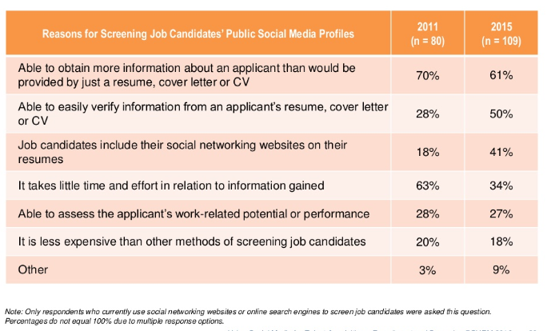

Slide 13
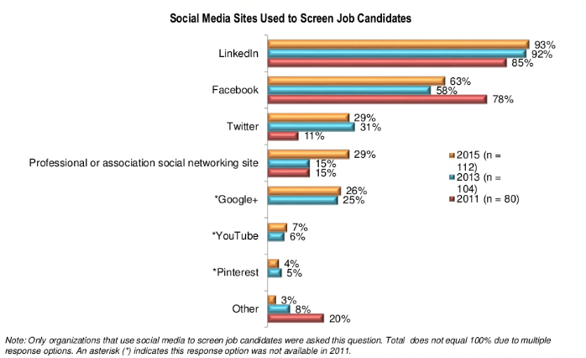

Slide 15
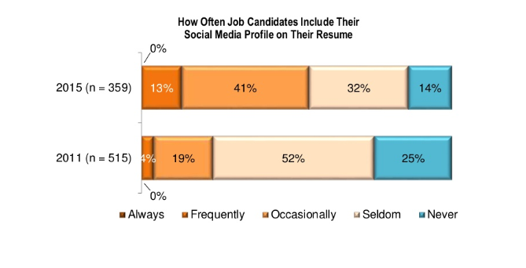

Slide 17
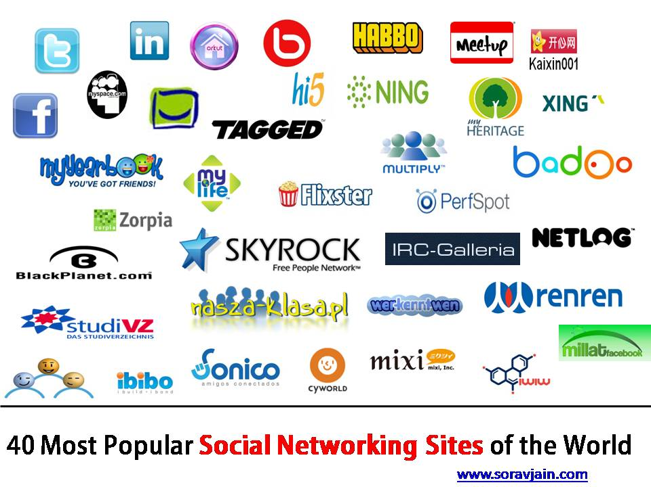
Which Social Media Sites Work when it comes to employment?

Slide 18
What has become the #1 Employment Site in America?

Slide 19
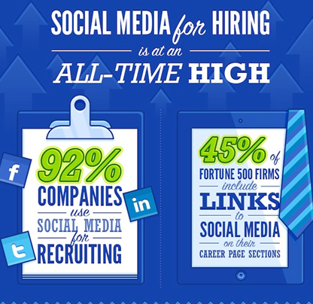

Slide 20
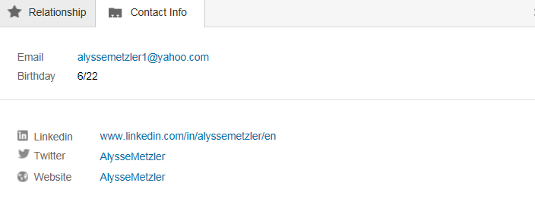
To Twitter or Not to Twitter

Slide 21
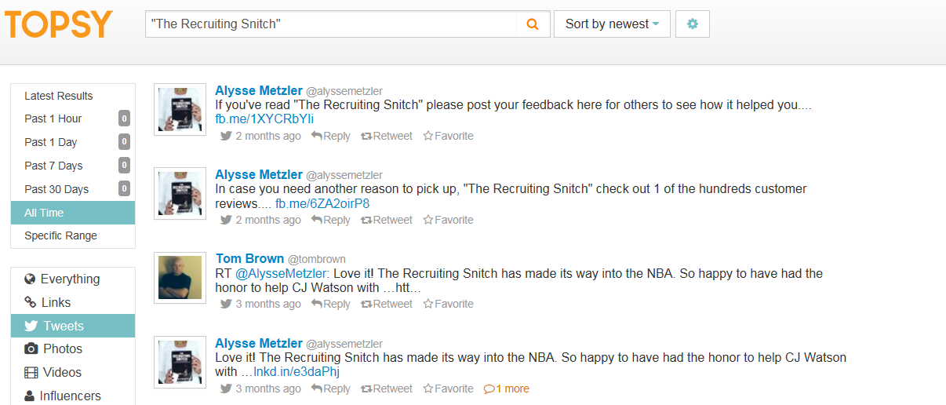

Slide 22
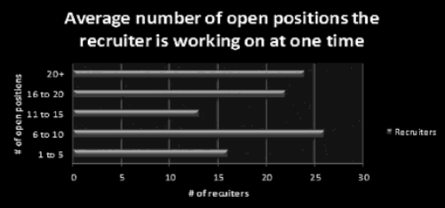
Not only does Alysse provide her own knowledge and advice but she has the opinions of 101 other recruiters in the United States to support her.

Slide 24
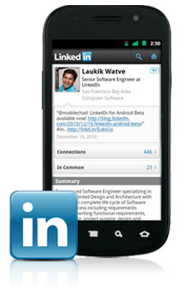
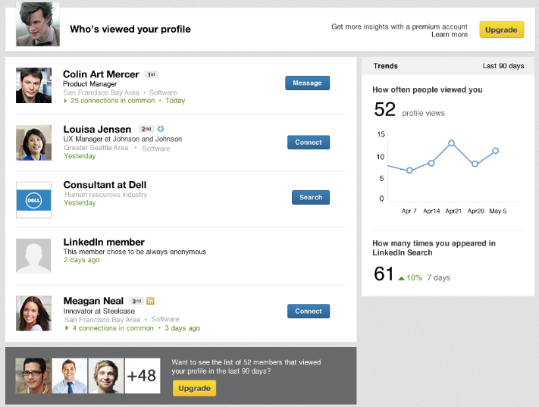
LinkedIn
Sobre o LinkedIn
À propos de Linkedln
Über LinkedIn
Acerca de LinkedIn
Informazioni su LinkedIn

Slide 25
Where Can LinkedIn Get You?

Slide 26
Get To Their Groups

Slide 27
Measure & manage your social reputation.
http://mashable.com/
http://flavors.me/alishainthebiz
http://vimeo.com/21228618
https://about.me/#itstombrown

Slide 28
What are hiring managers looking for on social media? The research suggests that hiring managers are using social media to get a glimpse at the candidate’s behavior and personality outside of the interview, and are most interested in professional presentation and how the candidate would fit with the company culture.
Search Yourself - The easiest way for employers to research your online personality is a simple search on Google and other sites.
Read Your Privacy Settings - Social media sites change their privacy settings often, and occasionally this leads to a change in your personal settings. It’s good practice to check in on the privacy settings for all of your accounts regularly.
Showcase Your Talent - This is your opportunity to provide evidence that you are as exceptional as your resume says by posting awards and accolades you’ve received, volunteer activities, accomplishments you’re excited about, etc. Employers often search social media to learn more about your qualifications or to see that you are well-rounded, so be sure to put that information front and center.
Keep Tabs - Just because you’re being careful with what you put online doesn’t mean your friends are necessarily so cautious. Pay attention to what others are posting on your profile and what you’re tagged in to protect your online image.

Slide 29
Get Connected
Stay Connected

Slide 30
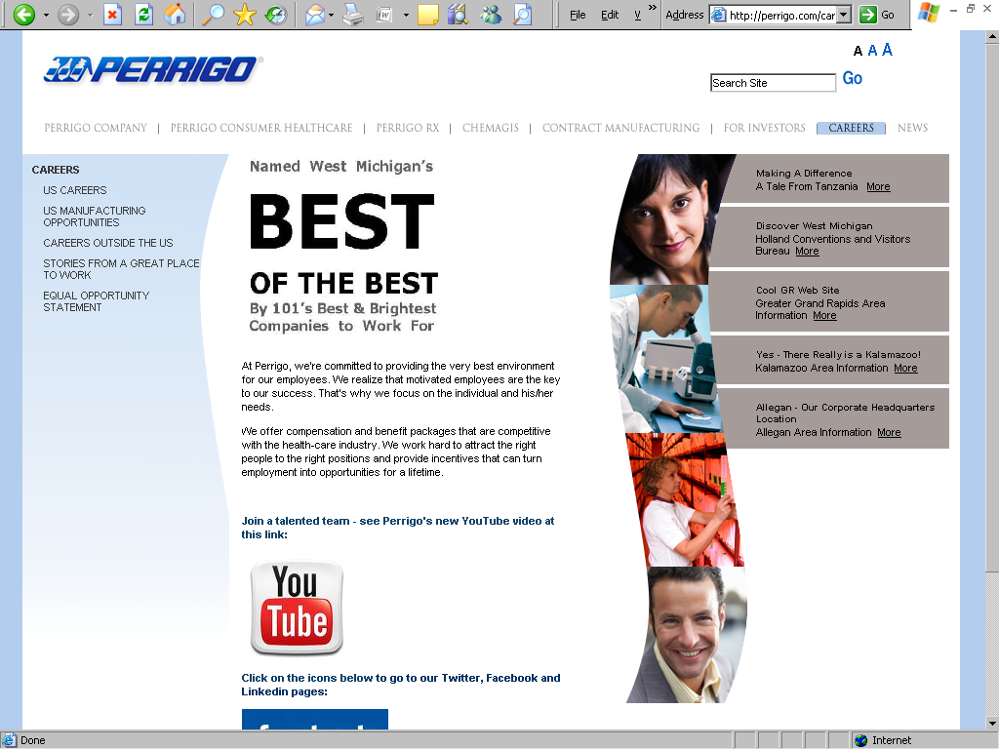
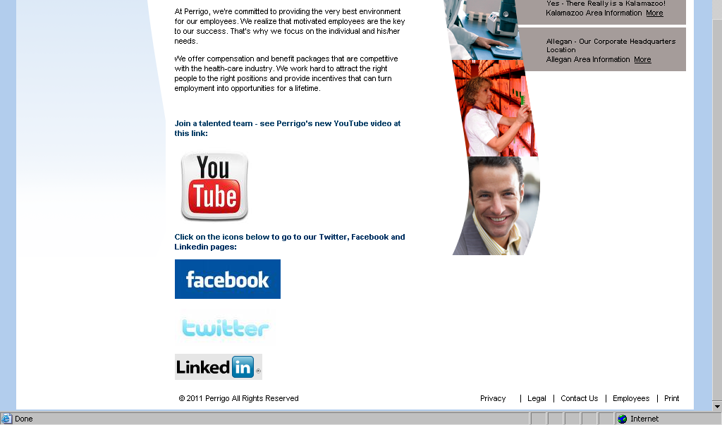

Slide 31
