Slide 1
Beyond Being An Ally: Balancing Professionalism & Activism
February 7, 2015

Slide 2
Professional Background
GVSU MPA 2003 – G.A. for Johnson Center
Catholic Charities of West Michigan
American Cancer Society
Urban Institute for Contemporary Arts (UICA)
GVSU Adjunct Professor
The Right Place

Slide 3
Community Work
Elliott Larsen Civil Rights Act
Marriage Equality
OutPro (Grand Rapids Area Chamber of Commerce)
Our LGBT Fund (Grand Rapids Community Foundation)
Experience Grand Rapids
GVSU LGBT Alumni Chapter

Slide 4
Why Do I Do All This LGBT Work?
Impacts me personally and professionally
Sharpens the focus of my community efforts
The time is now

Slide 5
Why Do I Do All This LGBT Work?
53% LGBT hide who they are at work
80% non-LGBT say personal lives come up weekly or daily
81% non-LGBT say people should not have to hide who they are
> 50% non-LGBT not comfortable hearing LGBTs talk about dating
25% LGBT say coworkers seem uncomfortable
63% LGBT report hearing jokes at work
Source: HRC The Cost of the Closet and Rewards of Inclusion

Slide 6
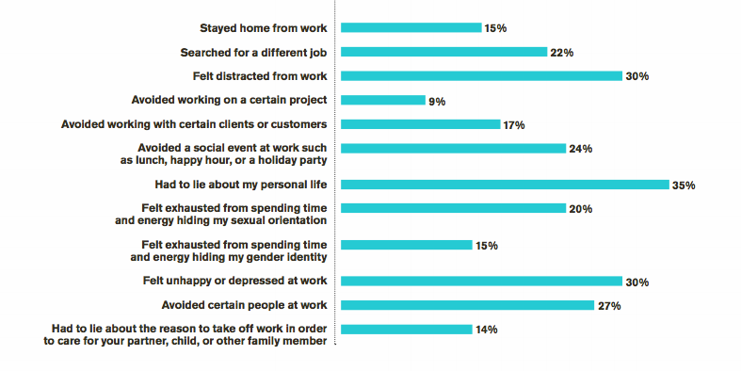
The Impact

Slide 7
Definitions
Diversity: The “mix” -- Age, gender, race/ethnicity, beliefs, sexual orientation, gender identity, socio-economic status, abilities, etc.
Inclusion: Making the “mix” work.
Equity: Access to opportunities that produce positive outcomes regardless of identity, place, economic status, etc.

Slide 8
The Vision for Change
Equity
(Results)
Diversity
(People)
Inclusion
(Orgs)

Slide 9
Why is Equity Important?
Employee attraction and retention
Avoid “group think”
Creativity, innovation, problem-solving
Globally competitive
Company reputation in the community
Represent diversity of customers – you can serve them better

Slide 10
Recognizing Diversity, Inclusion & Equity in The Workplace
Look at diversity of their workforce
Do they have diverse leadership?
Do they have inclusive employment policies?
Do they have employee resource groups?
How are they involved in the community?
HRC Corporate Equality Index

Slide 11
How I Balance Activism & Professionalism
Have a reputation for being good at what I do
Ask for forgiveness rather than permission
Balance what I have with what I’m willing to risk
Do not alienate people
Be patient. Real change takes time.
Mix community work with professional work
Know when to leave it alone

Slide 12
Allies Make A Difference
Get Involved!
Critical mass
Contribute unique talents and resources
Educate others outside LGBT community
Make others feel comfortable
Be intolerant of degrading jokes
Challenge those who use offensive terms

Slide 13
Questions?

