Slide 1
PSIZE
your influence
Notes:
1. Upsizing Your influence
Today I will show you how to have more impact on your students, Build more meaningful relationships, and rally your advisees to a better future.
When you upsize your influence you are not just advising students, but you are changing lives and that is a lot of fun and a really cool goal.
So, lets get started

Slide 2
think different
Notes:
2. Think Differently
I will challenge you to think differently about what is possible for you as an academic advisor
You will come to understand that you control the influence you have on yourself and on others
By taking control over 3 controllable’s you will not only enhance your success but the success of your students

Slide 3
Manager
Notify
Inform
Discuss
Prescribe
Suggest
Recommend
Advocate
Endorse

Slide 4
Manager
Leader
Notify
Pressure
Direct
Inform
Discuss
Sway
Affect
Prescribe
Suggest
Impact
Guide
Recommend
Adjust
Advocate
Endorse
Develop
Change

Slide 5
POSITIVE
ATTITUDE
Notes:
11. #1 Positive Attitude
Our mindset when we approach and respond to people and events
A positive attitude with regards to others is:
Accepting: nonjudgmental, non-comparing
Curious: open to new people, situations and things
Patient: listening

Slide 6
Influence has less to do with position than it does with disposition.
Notes:
13. Influence has less to do with position than it does with disposition
Your disposition is important because it influences the way students think and feel
Think of a person whose attitude you admire. What effect do they have on you?

Slide 7
CURIOUS
POSITIVE ATTITUDE
Congruent
Ethical
Trustworthy
ACCEPTING
ENTHUSIASTIC

Slide 8
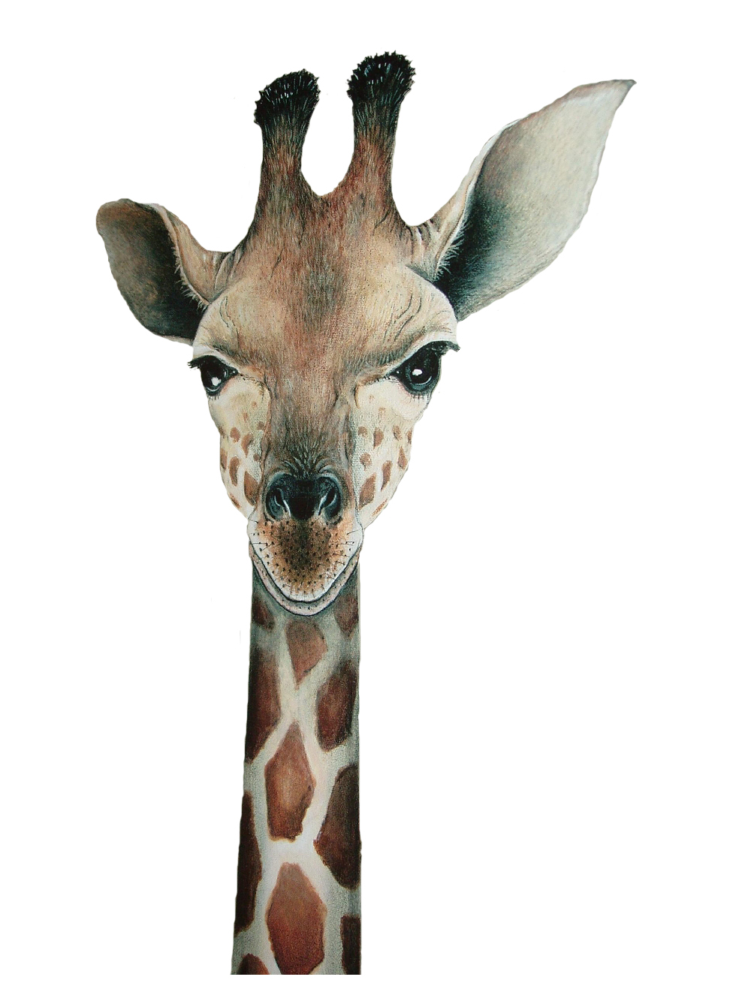
CHECK UP FROM
THE NECK UP
REFLECT
REFRAME
REENTER
Notes:
18. Check up from the neck up
REFLECT: What is one negative attitude you posses that is influencing others right now?
REFRAME: How can you reframe your thinking?
REENTER: How can you change your behavior?

Slide 9
What are your top three greatest personal strengths?
Notes:
19. What are your top three greatest personal strengths?
Handout exercise:
Write down three personal strengths
Turn to your partner and learn theirs
What were some of your partners strengths?
Raise your hand if you included self-control on your list?

Slide 10
SELF-CONTROL
Notes:
21. #2 Self-control: The ability to control your emotions and desires or the expression of them in your behavior
Studies on the role of self-control are among the most sited research in psychology literature
Some of their findings

Slide 11
THE
leading predictor
of positive outcomes
IN LIFE
Notes:
22. THE leading predictor of positive outcomes in life
Good self-control correlated with individual success, regardless of how they defined success:
Happy family life, good friends, meaningful career, financial security, freedom to pursue your passion
Alternatively, poor self-control correlated with just about every kind of personal and social problem.
Compulsive spending, violence, under achievement in school, Procrastination at work, unhealthy diet

Slide 12
STABLE
SELF-CONTROL
Congruent
Ethical
Trustworthy
PATIENT
PRESENT

Slide 13
Small victories build your self-control muscle
Notes:
23. Self-control is a vital strength and key to influence
Managers in the workplace who scored high in self-control were rated more influential by direct reports, peers and supervisors.
Better at forming and maintaining relationships
Better at empathizing with others
More emotionally stable

Slide 14
PERSONAL
INTEGRITY
Notes:
27. #3 Integrity: The state of being complete, unified
Integrity as a state of being
A “closeness of fit” between who you are and what you do

Slide 15
Integrity gives you credibility.
Credibility gives you influence.
Notes:
30. Integrity gives you credibility. Credibility gives you influence
Facilitates high standards in others
Walking the walk
Provides a model of self-control
Integrity is a hard won battle
Builds trust that you will act in good faith toward others
True to principles

Slide 16
ETHICAL
PERSONAL INTEGRITY
Congruent
Ethical
Trustworthy
CONGRUENT
TRUSTWORTHY

Slide 17
5% better
EXPAND WHAT YOU BELIEVE IS POSSIBLE
DICTATE YOUR OWN ATTITUDE
BUILD YOUR SELF-CONTROL MUSCLE
EXHIBIT YOUR OWN PERSONAL INTEGRITY

Slide 18
PSIZE
your influence
And you can
change the world

