Slide 1




Health Forum of Northern Michigan
Housing and Health in northern Michigan
Tuesday, April 5, 2022
Hosted by: Sponsored by:

Slide 2
      Welcome: Jean Nagelkerk, Special Assistant to the Provost
      Grand Valley State University
      Jason Slade, Vice President, Strategic Initiatives
            Northwestern Michigan College
            RURAL HEALTH AWARDS
      Moderator: Dave Mengebier, President & CEO
      Grand Traverse Regional Community Foundation
Panel: David K. Klee, MD
Munson Medical Center Family Practice
Jaclyn E. Sylvain, DO
Munson Medical Center Family Practice Resident
Ryan Hannon, Community Engagement Officer
Goodwill Northern Michigan
Becca Binder, Executive Director
Northwest Michigan Supportive Housing
Yarrow Brown, Executive Director
Housing North
A
G
N
E
D
A
Health Forum of Northern Michigan
Housing and Health in Northern Michigan

Slide 3
2022 Rural Health Awards
Rural Health Care Organization
Rural Health Practitioner

Slide 4
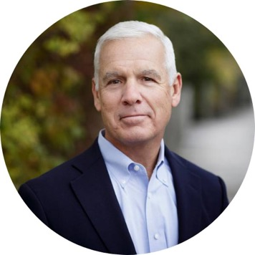
David Mengebier
President and CEO
Grand Traverse Regional Community Foundation

Slide 5

David K. Klee, MD
Munson Medical Center Family Practice

Slide 6

The Housing Crisis
David Klee MD, FAAFP

Slide 7

Notes:
Houses come in many different sizes and shapes . Some of them are grand structures such as this one others are more modest. But all of them give us a place to call home.

Slide 8
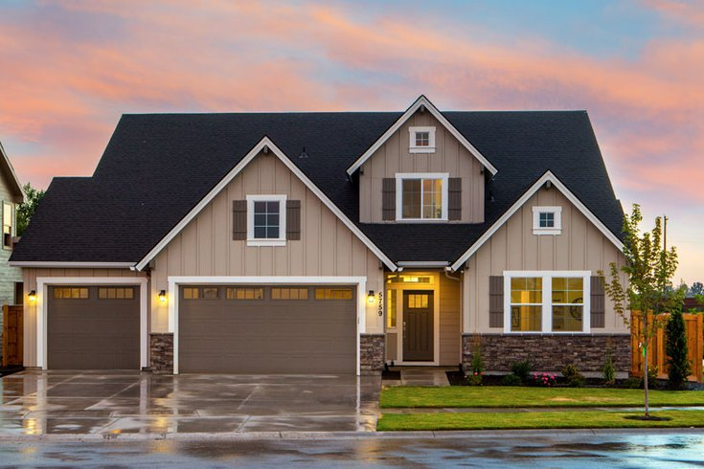
Notes:
Our homes are physical signs of our security and protection

Slide 9
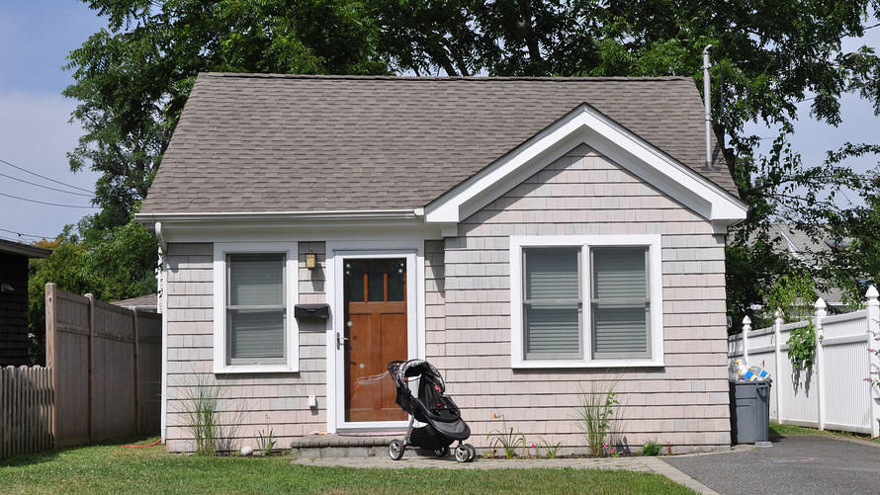
Notes:
They represent a place where we are safe, comfortable and can relax

Slide 10
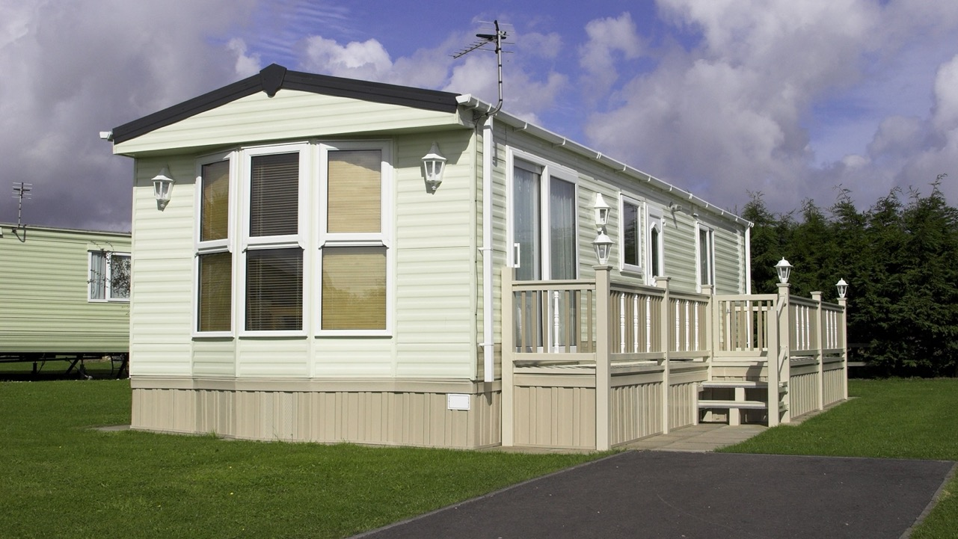
Notes:
Our homes are places where we seek shelter from not only the weather but all of the things the world throws at us

Slide 11
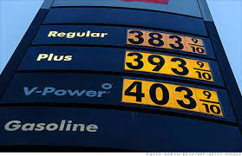



Notes:
Sometimes the world isn’t kind- like when a pandemic hits
Gas prices are sky rocketing
But it is not just gas prices, utility prices, cost of food and day care prices are through the roof
Financial advisors counsel us that we should save up 3 months worth of income for a rainy day (and for many it is rainy right now)
Unfortunately, many of us don’t have that luxury and are living pay check to pay check

Slide 12


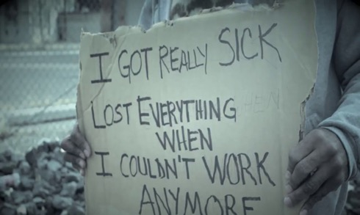

Notes:
Add into these escalating costs complicating problems like worsening mental health that we have seen for many people throughout the pandemic. More now than ever with the covid pandemic people are getting sick and not being able to work.
Others lost their jobs due to cutbacks from the crashing economy with some of those jobs not planning on ever restarting.
With lack of income coming in and high expenses going out Eventually the money runs out

Slide 13
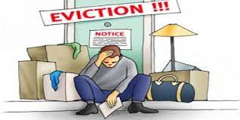
Notes:
which leads inevitably to eviction
Then enters a barrage of emotions: Overwhelming hopelessness, anger, fear, sadness and anxiety
But there is no time to process these emotions
Now it is a fight for survival

Slide 14
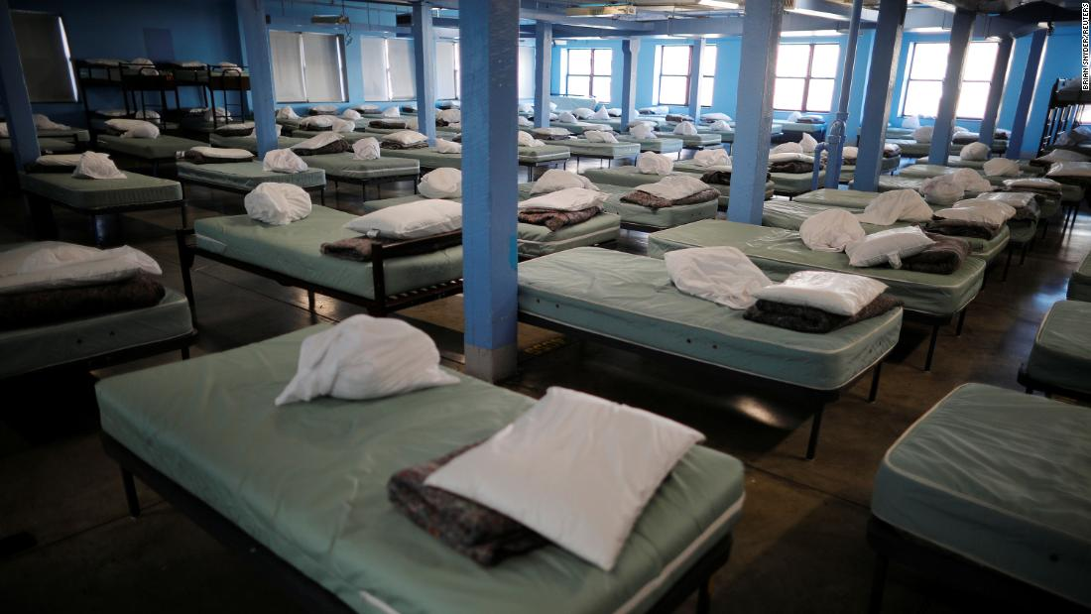
Notes:
Your housing options look quite a bit different

Slide 15
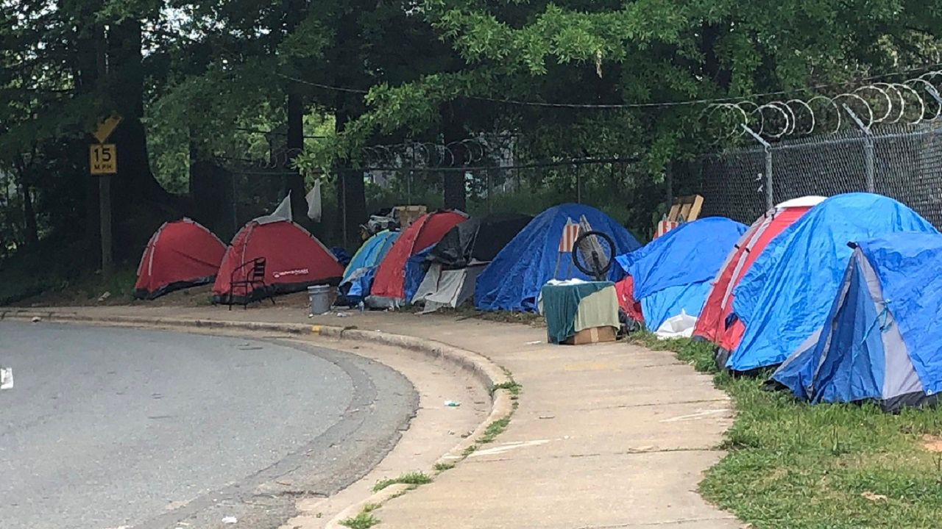
Notes:
Your security and protection are gone

Slide 16
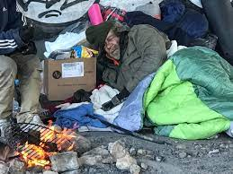
Notes:
Your ability to rest, relax and rejuvenate is replaced with your ongoing attempts to survive

Slide 17
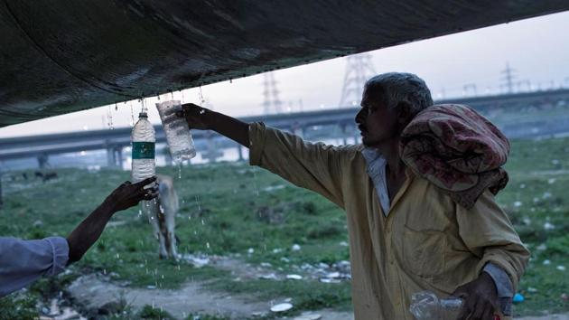
Notes:
Basic human needs like a clean water supply are difficult to obtain. Everybody needs water. With lack of clean, running water part of your day has to be trying to find enough water to survive.

Slide 18
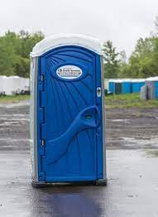
Notes:
Your new bathroom facility is not the master bath remodel that you were dreaming about.

Slide 19
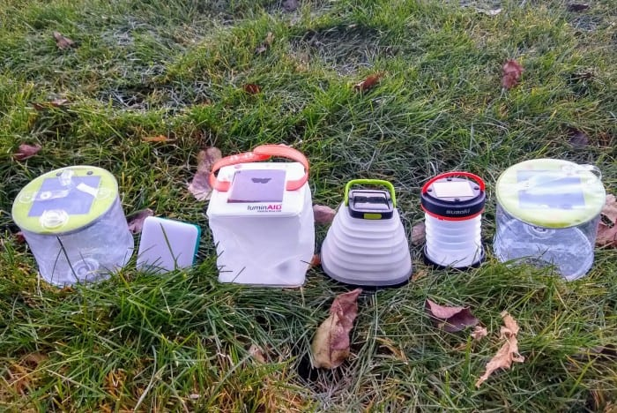
Notes:
Remember your tent does not have electricity so all those devices you have become dependent upon like your phone and coffee maker are useless
I have had patients tell me they have had to sneak up to the outside of buildings to try to charge their phones as night
Without a phone or an address, it is hard to arrange reliable contact with people

Slide 20
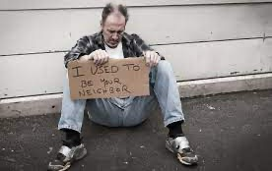
Notes:
When you are homeless you need to fight for basic life necessities- food and water, shelter and adequate clothing
This would be a struggle for any of us and it could be any of us
It can happen to you, your loved ones, or your neighbor

Slide 21
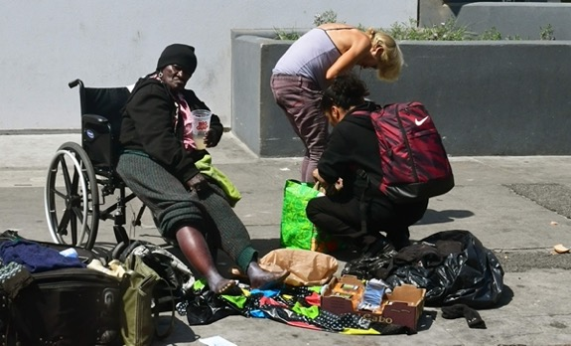
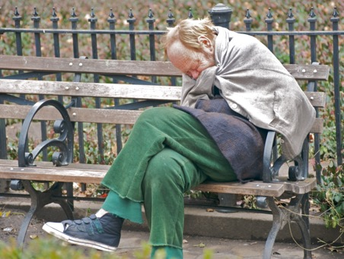
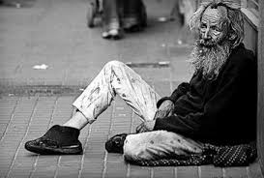
Notes:
Now imagine if you are not the posterchild for health
Battling homelessness and physical or mental illness can be a massive struggle
Living on the street accelerates the aging process rapidly

Slide 22
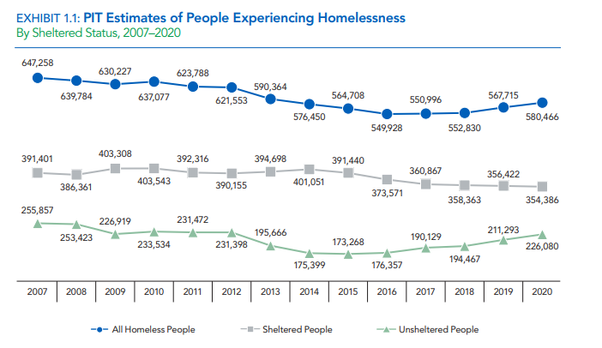
Homelessness in the US
Point-in-Time Counts: Single night estimates of both sheltered and unsheltered homeless populations.
Last week of January each year
Continuums of Care (CoC)
The U. S. Department of Housing and Urban Development. Office of Community Planning and Development. https://www.huduser.gov/portal/sites/default/files/pdf/2020-AHAR-Part-1.pdf The 2020 Annual Homeless Assessment Report (AHAR) to Congress.
Notes:
The extent of the problem of homelessness is staggering
In the US alone over ½ million people are homeless and we have not made much progress in this in the past 15 years with us seeing an upkick in the sheltered and unsheltered populations over the past 3 years
-Unduplicated single night estimates of both sheltered and unsheltered homeless populations. The one-night counts are conducted by CoCs nationwide and occur during the last week in January of each year.
-Continuums of Care (CoC) are local planning bodies responsible for coordinating the full range of homelessness services in a geographic area, which may cover a city, county, metropolitan area, or an entire state.
-While increases were reported among both sheltered and unsheltered populations, the sizable increase in the number of unsheltered people with chronic patterns of homelessness (21%) was the key driver.
-The number of individuals with chronic patterns of homelessness increased by fifteen percent between 2019 and 2020.
CoC MI-512 Grand Traverse, Antrim, Leelanau Counties (includes Kalkaska and Benzie)
CUE YOURSELF TO LOOK AT THE CAMERA

Slide 23
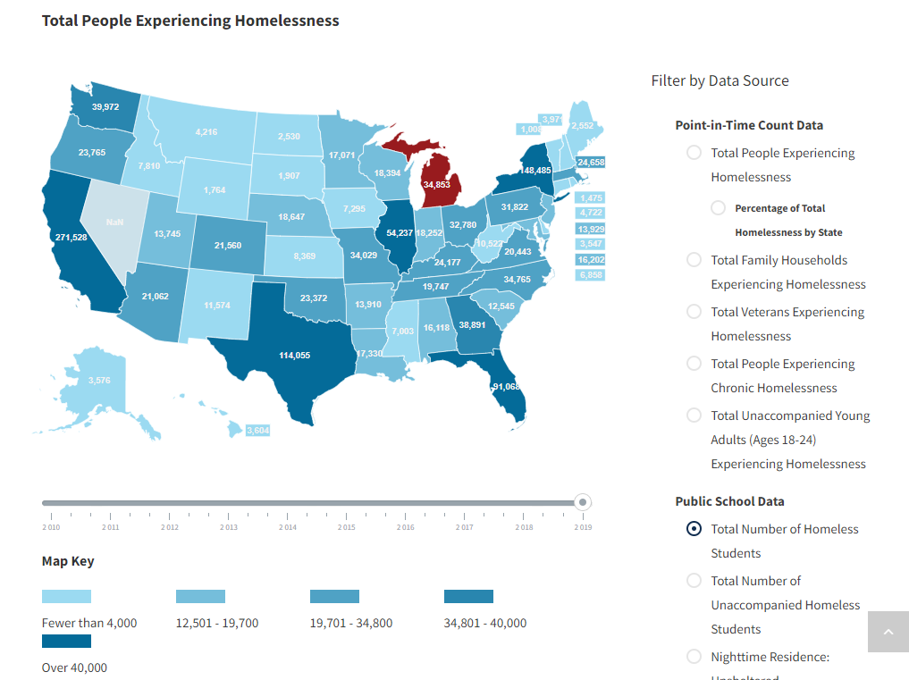
Notes:
The US Department of Housing and Urban Development reported that in 2020 8,638 people experienced homelessness in Michigan on any given night
Over 1000 were family households
Over 600 were veterans
Over 1100 were chronically homeless
This even effects our kids. During the 2019-2020 school year there were nearly 35,000 students in Michigan alone that experienced homelessness during the school year

Slide 24
Homelessness in Northern Michigan
275 open cases in the 5-county region
  Per Homeless Management Information System (HIMS) database
  2022 PIT data will come out in May 2022
  2021 – unknown due to pandemic
  211 people in 2020
Notes:
With our current best data In our Northern Michigan 5 county region we now have nearly 300 people who are homeless
That means we have 12 full elementary classrooms worth of people that do not have a place to lay their head down at night
Many of these people end up sleeping at Safe Harbor or Good Will Inn during the winter though others are sleeping in their tents or vehicles even during the winter. I took care of a woman this winter whose landlord died and the new landlord raised the rent so high that even though she and her husband were working in fast food restaurants they could not pay the rent and had to move out. They were living in a tent- even when the temperatures were 10 below zero which made it even harder for her to get better when she contracted covid.
Data from Ryan Hannon – Goodwill Northern Michigan Community Engagement Officer
PIT count: Official numbers do not come out until May from 2022
CoC MI-512 Grand Traverse, Antrim, Leelanau Counties (includes Kalkaska and Benzie)
235 sheltered
HIMS: 275 open cases in the 5-county region (including sheltered and nonsheltered)
Nonsheltered varies nightly (roughly 20 people stay – campers/rough sleepers (business entrances), which does not include people in cars – cars (roughly 20))

Slide 25
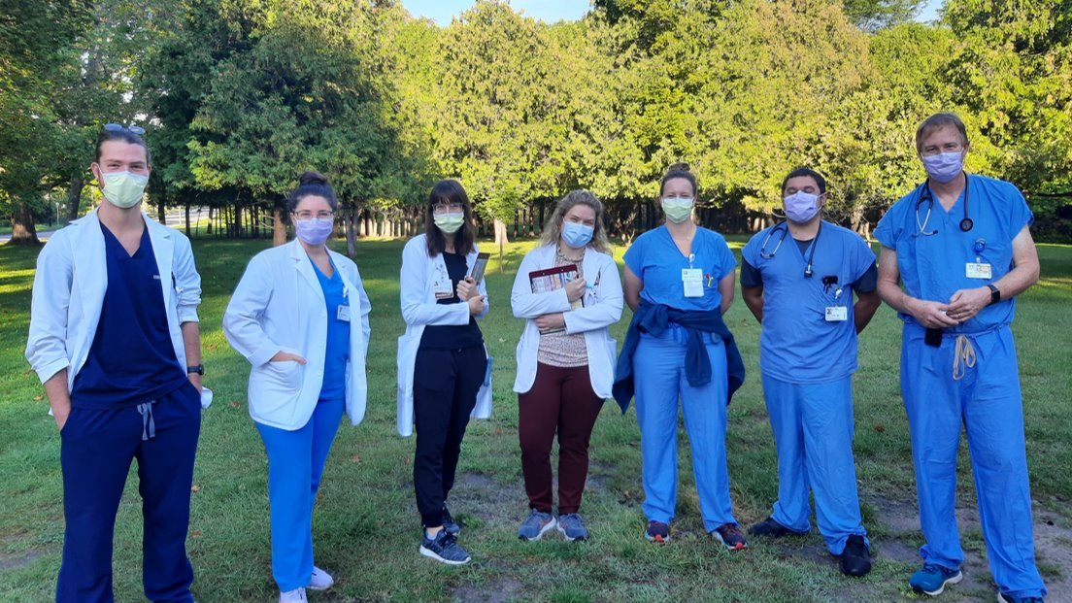
Notes:
We know that being homeless puts people at increased risk of illness and reduces your life expectancy by about 30 years
Just being homeless independently increases your risk of dying between 5 and 10 fold
For the past two years our team of family physicians from Munson Family Practice have joined others in caring for our homeless patients in their own environment.

Slide 26
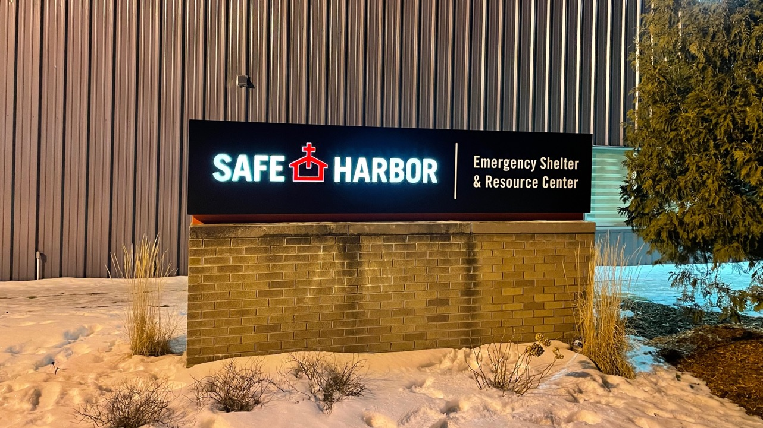
Notes:
Sometimes this is in one of our shelters
We have been seeing patients at Safe Harbor and Good Will Inn
We have also seen patients on Friday mornings at Central Methodist Church where they offer a free breakfast to people in need Monday to Friday

Slide 27

Notes:
Othertimes, it means we bring our medical services to the woods
Here we are visiting “The Pines” a homeless camp
The camp is located right next to the hospital bringing a stark contrast between the state of the art medicine being done in Munson Medical Center to the frontier medicine being done at the camp site. Our resident teams travel yearly to Kenya to provide care for our African friends. Many of the same problems that we see in Kenya due to lack of adequate food and shelter we encounter here in the Traverse City woods.

Slide 28

Notes:
Being able to see our homeless patients in their own environment has been wonderful for the patients and educational for our residents.
Developing trust with patients is paramount to any effective relationship.
Often our homeless patients have been marginalized and lost trust in the system.
This outreach is working to build the trust with not only individuals but our homeless community

Slide 29
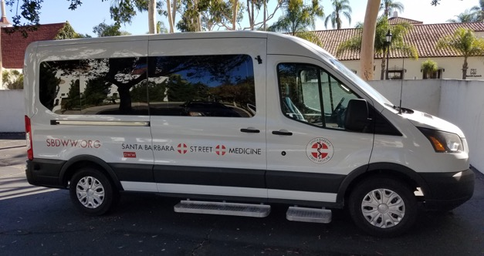
Future State
Notes:
We are excited about the recent addition of a mobile medical unit which will greatly expand the services we can offer to the homeless in our region
This will allow us to provide additional in the field services to homeless patients in more remote areas

Slide 30
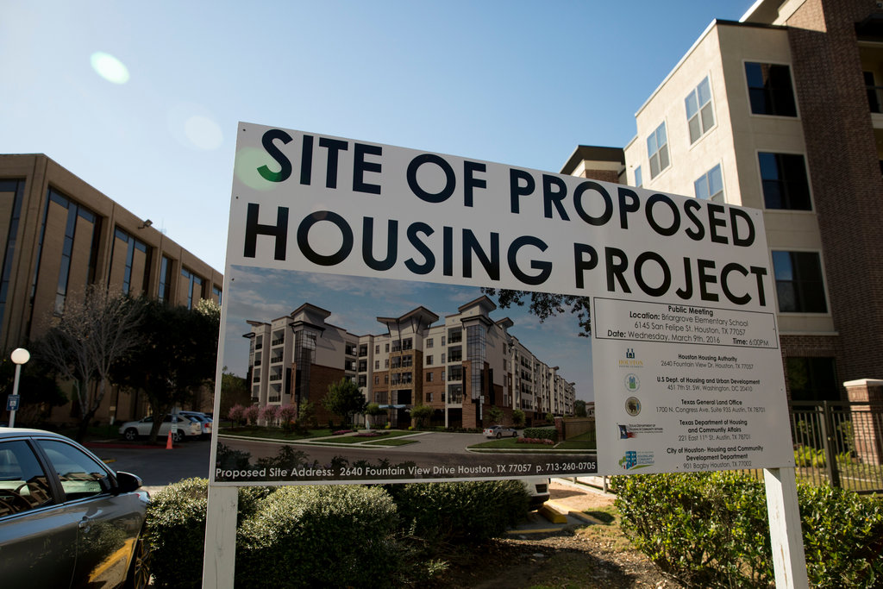
Notes:
The best fix for homelessness is homes
Unfortunately, affordable housing is scarce
Results of recent survey conducted by the CHIR of nearly 1000 residents of NW Michigan and nearly 200 providers was released in January
60% of providers and 45% of residents surveyed identified safe and affordable housing as the top factor for a thriving community.
1/3 of providers and 40% of residents identified lack of safe and affordable housing as the top issue, out of 35 issues, impacting their patients/clients.
With such an important problem identified it is worrisome that over ½ of providers surveyed responded that there was a lack of housing resources in their communities
It is estimated that we need an additional 4000 affordable housing units in our area to provide enough housing to meet the needs of our working poor, low and no income neighbors.

Slide 31

Notes:
In our community the Median Value of Owner Occupied Homes $165,000
Whereas the Median Household Income* $55,000
Nearly ¼ of homeowners spend at least 35% of their income on housing, exceeding the recommending max of 28%
Lack of affordable housing next to employment opportunities means our teachers, hospital workers, city employees can’t find affordable housing here and so are moving to other communities
There are many signs up around town looking for workers, but people can’t afford to work and live in the same community
Today we are blessed to hear from several panelist that will teach us more on the effects of homelessness. How homelessness effects our health and our health systems. What being homeless does to our self-confidence and self worth. Finally, our panelist will address what is being done at a local and state level to improve our access to affordable housing and will let us know how you can contribute to helping end homelessness. Thank you.

Slide 32

Jaclyn E. Sylvain, DO
Munson Medical Center Family Practice Resident

Slide 33
Homelessness and Health Outcomes
Jaclyn Sylvain, DO

Slide 34
My Connection
Medical school
Founding executive board member of Spartan Street Medicine (SSM)
Student run informal medical clinic at drop-in center (JIMHO) in Lansing, MI
Collaboration with Projects for Assistance in Transition to Homelessness (PATH) during "street runs"
Residency
Collaboration with Traverse Health Clinic, Munson Family Practice Center, Thomas Judd Care Center, and Goodwill Northern Michigan Street Outreach team
Notes:
Justice in Mental Health Organization (JIMHO)
OMT Tables
Oversight by Attending physicians
Hepatitis A outbreak – spearheaded vaccination drive at JIMHO with donated vaccinations from health department

Slide 35
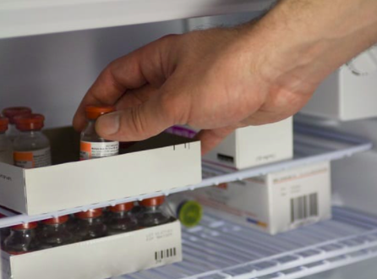
Notes:
Before we delve into the statistics, I wanted to share some personal experiences from working in this field.
Let’s start with a patient with Diabetes, who requires insulin for their care.
According to the product labels from all three U.S. insulin manufacturers, it is recommended that insulin be stored in a refrigerator at approximately 36°F to 46°F. If you are using ice, avoid freezing the insulin. Do not use insulin that has been frozen.
Now, what do you do if you are living in an unsheltered location and need to take your insulin to survive/decrease vascular complications, prevent further damage for your heart, eyes, kidneys, nerves?
One patient established care with me a few weeks ago – Their blood sugar was >400 on their CGM at all times – could not take his insulin because they were living in their car and could not take their insulin if it was frozen.

Slide 36
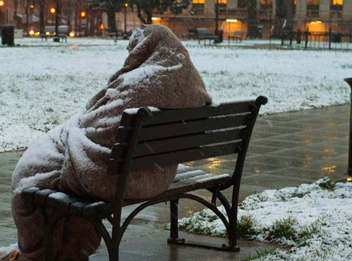

Slide 37
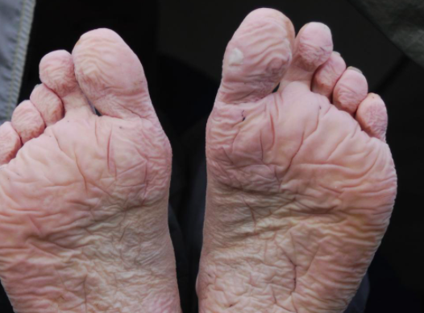
Notes:
People experiencing extreme poverty and homelessness often suffer from foot problems caused by ill-fitting or worn out shoes, wet shoes, shelter showers shared by hundreds and often teeming with contagious skin diseases, abscesses and infections, long hours spent selling papers and standing in lines and, finally, the need to walk miles every day for survival, often shouldering a heavy pack.

Slide 38


Slide 39
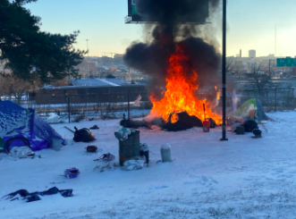

Slide 40
Health Outcomes
Decreased life expectancy
Increased risk of violence and sexual violence
Accidental injury and trauma
Increased morbidity
Mental illness and suicide
Substance use disorders
Mortality
National Health Care for the Homeless Council. February 2019. https://nhchc.org/wp-content/uploads/2019/08/homelessness-and-health.pdf Homelessness & Health: What's the Connection?
Patterson, A. A., & Holden, R. R. (2012). Psychache and suicide ideation among men who are homeless: A test of Shneidmans model. Suicide & Life-Threatening Behavior, 42(2), 147.
²Morrison DS. Homelessness as an independent risk factor for mortality: results from a retrospective cohort study. Int J Epidemiol. 2009 Jun;38(3):877-83. doi: 10.1093/ije/dyp160. Epub 2009 Mar 21. PMID: 19304988.
Notes:
Homelessness public health crisi
1) Life expectancy is 48 – average US for general population is 78. Thirty years off your life
2) Morbidity – Increased rates of DM, HTN, HIV, hepatitis C, depression and substance use disorders
Incidence of chronic disease increased (roughly 2x, but HIV and Hep C and substance use disorders is even more disproportionate)
Morbidity
DM (18 vs 9)
HTN 50 % vs 29%
HIV 20% vs 1%
Hepatitis C 36% vs 1%
Depression 49 % vs 8%
Substance Use disorders 58% vs 16%
-Break this down – Inability to have access to healthy food options – focus on cheap/durable/does not require cooking = processed/sugary foods
Violence
For the years 1999 through 2005, the National Coalition for the Homeless has documented 472 acts of violence against homeless people by housed people, including 169 murders of homeless people and 303 incidents of non-lethal violence in 165 cities from 42 states and Puerto Rico
Sexual Violence
2) Morbidity – Increased rates of DM, HTN, HIV, hepatitis C, depression and substance use disorders
Incidence of chronic disease increased (roughly 2x, but HIV and Hep C and substance use disorders is even more disproportionate)
Morbidity
DM (18 vs 9)
HTN 50 % vs 29%
HIV 20% vs 1%
Hepatitis C 36% vs 1%
Depression 49 % vs 8%
Substance Use disorders 58% vs 16%
-Break this down – Inability to have access to healthy food options – focus on cheap/durable/does not require cooking = processed/sugary foods
Suicide
-2012 study found suicide rates 10 times higher for homeless cohort.
More than half had thoughts of suicide or have attempted suicide.
In Washington DC area
10x greater than the general population
50% of people have had SI or attempted suicide
In comparison to the general population, a 2012 study found suicide rates to be 10 times higher for a homeless cohort, and other research has indicated a higher suicide rate among people experiencing homelessness than the general population.10 In fact, more than half of people experiencing homelessness have had thoughts of suicide or have attempted suicide.11 According to a 2017 study, more than 40 percent of homeless teens struggle with depression, which is 12 percentage points higher than their housed peers. School-age children and youth who are homeless are three times more likely to attempt suicide than students who live at home with a parent or guardian (20 percent versus six percent housed). 12 Additionally, research has found that LGBTQ youth experiencing homelessness are twice as likely to commit suicide compared to heterosexual youth who are homeless, according to the National Coalition for the Homeless. Research has shown that individuals experiencing homelessness have greater morbidity and mortality rates than the general population and experience more co-morbidities than their housed counterparts. 13 When compared to non-homeless populations, individuals experiencing homelessness face a multitude of complex health and social issues that are often integrated with past, present, and daily trauma that impact these individuals’ prioritization and decision-making efforts.
1) Systematic review and meta-analysis, studies published between Jan 1, 2005, and Oct 1, 2015. Included USA, Australia, Sweden Canada, and the UK.
-Did not look at causes of mortality
-In high-income countries, All-cause mortality 3-11 times higher than in housed counterparts¹
Independent risk factor²
-The USA contributed 698 datapoints, Australia contributed 460, Sweden contributed 309, Canada contributed 257, and the UK contributed 234.
2)Independent risk factor even after you adjust for socioeconomic factors and morbidity.
-Based on retrospective 5-year cohort study in Greater Glasgow area in the UK.
-Looked at homeless adults and age and sex-matched random sample of nnon-homeless population.
Over 5 years of observation, 1.7% of the general population and 7.2% of the homeless cohort died.
Among patients who had been hospitalized for drug-related conditions, the homeless cohort experienced a 7-fold increase in risk of death from drugs compared with the general population.
3)
-Studies from the 1980s showed common causes of death to be from substance use disorders and unintentional injuries.
-Studies from the 1990s revealed HIV/AIDS, when combined, to be a leading cause of death.
-2000s cohort of 28,000 adults seen at Boston Health Care for the Homless Program from 2003-2008 – 1302 deaths occurred during that time. Drug overdose (n = 219), cancer (n = 206), and heart disease (n = 203) were the major causes of death. Drug overdose accounted for one-third of deaths among adults younger than 45 years. Opioids were implicated in 81% of overdose deaths. Compared with Massachusetts adults, mortality disparities were most pronounced among younger individuals, with rates about 9-fold higher in 25- to 44-year-olds and 4.5-fold higher in 45- to 64-year-olds
-More recently, unintentional overdose was shown to have replaced HIV/AIDS as a leading cause of death in the homeless population.
-Another study was a prospective study over a 10 year period, In this 10-year cohort study of 445 unsheltered homeless adults, the age-standardized all-cause mortality rate was almost 3-fold larger than that for a cohort of homeless adults primarily sleeping in shelters and nearly 10-fold larger than that for the adult population of Massachusetts; both represented significant differences. Common causes of death were cancer and heart disease.
2000s mortality data
Methods: We assessed all-cause and cause-specific mortality rates in a cohort of 28 033 adults 18 years or older who were seen at Boston Health Care for the Homeless Program from January 1, 2003, through December 31, 2008. Deaths were identified through probabilistic linkage to the Massachusetts death occurrence files. We compared mortality rates in this cohort with rates in the 2003-2008 Massachusetts population and a 1988-1993 cohort of homeless adults in Boston using standardized rate ratios with 95% confidence intervals.
Results: A total of 1302 deaths occurred during 90 450 person-years of observation. Drug overdose (n = 219), cancer (n = 206), and heart disease (n = 203) were the major causes of death. Drug overdose accounted for one-third of deaths among adults younger than 45 years. Opioids were implicated in 81% of overdose deaths. Mortality rates were higher among whites than nonwhites. Compared with Massachusetts adults, mortality disparities were most pronounced among younger individuals, with rates about 9-fold higher in 25- to 44-year-olds and 4.5-fold higher in 45- to 64-year-olds. In comparison with 1988-1993 rates, reductions in deaths from human immunodeficiency virus (HIV) were offset by 3- and 2-fold increases in deaths owing to drug overdose and psychoactive substance use disorders, resulting in no significant difference in overall mortality.
Conclusions: The all-cause mortality rate among homeless adults in Boston remains high and unchanged since 1988 to 1993 despite a major interim expansion in clinical services. Drug overdose has replaced HIV as the emerging epidemic. Interventions to reduce mortality in this population should include behavioral health integration into primary medical care, public health initiatives to prevent and reverse drug overdose, and social policy measures to end homelessness.
Extra
Retrospective 5-year study of two fixed cohorts, homeless adults and an age- and sex-matched random sample of the local non-homeless population in Greater Glasgow National Health Service Board area for comparison.
Over 5 years of observation, 1.7% (209/12 451) of the general population and 7.2% (457/6323) of the homeless cohort died. The hazard ratio of all-cause mortality in homeless compared with nonhomeless cohorts was 4.4 (95% CI: 3.8–5.2).
After adjustment for age, sex and previous hospitalization, homelessness was associated with an all-cause mortality hazard ratio of 1.6 (95% CI: 1.3–1.9).
Higher rates of death among non-Hispanic white individuals compared with non-Hispanic black individuals and persons of color have been consistently observed in previous studies of homeless persons, and the causes for this phenomenon are likelymultifactorial. Similarly, studies have shown that homeless men have higher rates of death than homeless women. Non-Hispanic white individuals and men, on average, have more economic resources than non-Hispanic black individuals and women and are less likely to have experienced adverse social and economic effects due to bias or discrimination.27 Thus, non-Hispanic white individuals and men may, on average, have reached a higher threshold of comorbidities at the time that they become homeless comparedwith non-Hispanic black individuals and persons of color. Men, whether or not they are homeless, are at a higher risk of death at an earlier age than women because of risk-taking behaviors related to the male sex. However, more research with empirical data needs to be conducted to fully understand these disparities among the unsheltered homeless.

Slide 41
Homelessness and the Healthcare System
Cost
Underuse of primary care
Implicit bias
Patient “dumping”
Housing First
*Wadhera, R. K., Khatana, S., Choi, E., Jiang, G., Shen, C., Yeh, R. W., & Joynt Maddox, K. E. (2020). Disparities in Care and Mortality Among Homeless Adults Hospitalized for Cardiovascular Conditions. JAMA internal medicine, 180(3), 357–366. https://doi.org/10.1001/jamainternmed.2019.6010
**Health Research & Educational Trust. (2017, August). Social determinants of health series: Housing and the role of hospitals. Chicago, IL: Health Research & Educational Trust. Accessed at www.aha.org/housing
***National Coalition for the Homeless. (2014, April). Policy Briefing Paper: Discrimination and Economic Profiling among the Homeless of Washington, DC. Washington, DC. Accessed at https://nationalhomeless.org/publication/view/discrimination-economic-profiling-2014/
Notes:
CUT OUT WORDS
Cost – Retrospective cross-sectional study
-Homeless individuals are five times more likely than non-homeless individuals to be admitted to inpatient hospital units. They also stay in the hospital for up to four days longer, at a cost of $2,000 to $4,000 a day.**
5x more likely be admitted to inpatient hospital units
Stay up to four days longer ($2,000 to $4,000 a day)²
2) Discrimination:
-Study and surveys performed in Washington DC in 2014
2014 National Coalition for the Homeless Policy Briefing Paper
Patients feel judged, unwanted. “Frequent flyers” “here for their sandwich”
CALL AND MAKE THE APPOINTMENT OR PICK UP THE RX (GET TREATED DIFFERENTLY)
49.7% reported discrimination by medical services³
Acute myocardial infarction – less likely to undergo coronary angiography, PCI and CABG, resulting in higher mortality rates¹
Received less procedural care for cardiac arrest or stroke¹
3) Acute MI: Homeless individuals with acute myocardial infarction – less likely to undergo coronary angiography, PCI and CABG compared with non-homeless adults, resulting in higher mortality rates¹
-In this cross-sectional study of 24 890 hospitalizations for cardiovascular conditions among homeless adults and 1 827 900 hospitalizations for cardiovascular conditions among nonhomeless adults in New York, Massachusetts, and Florida between 2010 and 2015, homeless individuals hospitalized with acute myocardial infarction were significantly less likely to undergo coronary angiography, percutaneous coronary intervention, and coronary artery bypass graft surgery compared with nonhomeless adults and had higher mortality rates for ST-elevation myocardial infarction.
-Homeless persons hospitalized for cardiac arrest or stroke also received less procedural care and had higher mortality rates.
EXTRA
-This retrospective cross-sectional study included all hospitalizations for cardiovascular conditions among homeless adults (n = 24 890) and nonhomeless adults (n = 1 827 900) 18 years or older in New York, Massachusetts, and Florida from January 1, 2010, to September 30, 2015. Statistical analysis was performed from February 6 to July 16, 2019.

Slide 42

Notes:
Housing is healthcare
Replaced treatment first - required psychiatric treatment and sobriety before housing
Housing First: permanent housing is priority
Includes ongoing support with community engagement and case management
Reduction in non-routine healthcare services
Fewer ED visits, fewer hospitalizations, less time spent hospitalized
Improved housing stability
More days housed, more likely to be housed at 18-24 months
-Housing First – placement to permanent housing is priority. #1 Priority
Contrast to the ‘Treatment First’ model, which provides temporary accommodation alongside services to address health needs, particularly substance use.
-Conditional on adherence to treatment for mental health and problematic substance use
HF is not contingent on compliance with health treatment or substance abstinence.
-HF includes ongoing support, through Intensive Case Management or Assertive Community Treatment approaches.
-European Study
Four randomised controlled trials on rapid access to non-abstinence-continengent, permanent housing vs "treatment as usual approach"
-found results above.
-with unclear short-term impact on health and well-being outcomes. For mental health, quality of life and substance use, no clear differences were seen when compared with TAU.
EXTRA
European study: We included four randomised controlled trials of interventions providing rapid access to non-abstinence-contingent, permanent housing. The impact of HF on most short-term health outcomes was imprecisely estimated, with varying effect directions. No clear difference in substance use was seen. Intervention groups experienced fewer emergency department visits (incidence rate ratio (IRR)=0.63; 95% CI 0.48 to 0.82), fewer hospitalisations (IRR=0.76; 95% CI 0.70 to 0.83) and less time spent hospitalised (standardised mean difference (SMD)=−0.14; 95% CI −0.41 to 0.14) than control groups. In all studies intervention participants spent more days housed (SMD=1.24; 95% CI 0.86 to 1.62) and were more likely to be housed at 18–24 months (risk ratio=2.46; 95% CI 1.58 to 3.84).
Our systematic review found that HF resulted in large improvements in housing stability; with unclear short-term impact on health and well-being outcomes. For mental health, quality of life and substance use, no clear differences were seen when compared with TAU. HF participants showed a clear reduction in non-routine use of healthcare services, over TAU. This may be an indicator of improvements in health.

Slide 43

Ryan Hannon
Community Engagement Officer
Goodwill Northern Michigan

Slide 44

The People of Homelessness
Ryan Hannon @TweetOutreach

Slide 45

Engagement Activity
Say hello to each other.
“Hello my name is ______.”
“What’s yours?”

Slide 46
Talking with People
People might say:
I want to be out here
Freedom
I am a survivor
I can drink or drug anytime
I’m tough
What’s really going on:
Preserve dignity
Shelter isn’t working for me
Still homeless & no way out
I can’t stop using
I’m scared

Slide 47
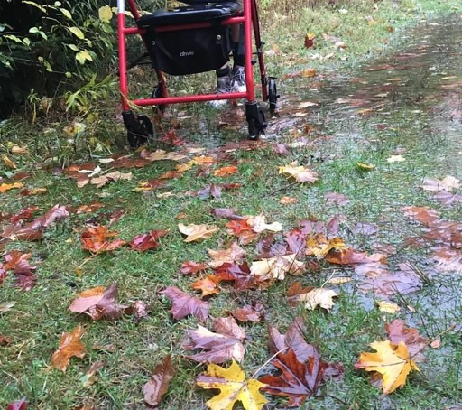
Anthony’s Journey
Eviction
Squatting
Breaking in
Jail
Shelter
Streets
Shelter
Housing

Slide 48

Homelessness is Really Bad for Your Health.
In the Grand Traverse Region:
–12 deaths in 2021
–3 deaths in 2022
Heart issues
Cancer
Diabetes
Wound Care
Hypothermia
COVID-19
Constant state of fight or flight

Slide 49

Dignity
Respect
Listen
Do what you say
Be on time
Presence
Explain Process
Choice
Consistent Theme:
Trauma and Loss of Trust
Want to gain trust?
Don’t try this.
Eater.com

Slide 50


Homeless Population – Not Homogeneous
“Funnel” Of Homeless Services
Intake & Assessment – Acuity Determined
General Housing Help
Housing First
Rapid Re-housing

Slide 51
What Can You Do?
Say “Hello”
Spread the word/sphere of influence
Housing opportunities
Housing Advocacy: Local, State, Nationwide
Hospitals providing housing
Welcome Home Basket drive
Volunteer
Donate

Slide 52

Hospitals Providing Housing
Affordable Housing Investment: A Guide for Nonprofit Hospitals and Health Systems from the Urban Institute
Some nonprofit hospitals and health systems that have a mission-orientation to improve their communities’ health have the opportunity to provide strategic support for and investment in housing development.
Housing costs are increasing, and the share of rent-burdened tenants has doubled since 1960s (JCHS 2018).
A minimum-wage worker today cannot afford to rent a two-bedroom apartment anywhere in the country (NLIHC 2018).
Local governments, nonprofit developers, and community development organizations struggle to secure the funding needed to meet the growing housing needs of moderate- and low-income families.

Slide 53

Becca Binder
Executive Director
Northwest Michigan Supportive Housing

Slide 54

Northwest Michigan
Supportive housing
Mission: to provide permanent supportive housing to individuals and families experiencing homelessness who struggle with mental illness

Slide 55

The Cost of homelessness
$35,578
Poor Health Outcomes
High Utilization of Emergency Services
Significant Obstacle to Achieving Wellness
NMSH savings
to the community =
$21,278/year per person
$14,300
Community
cost per year
for one
individual
experiencing
homelessness
NMSH cost per year to house and support one individual

Slide 56
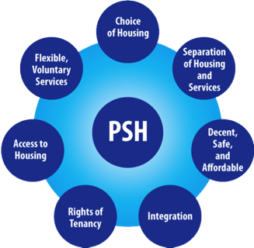
What is PSH?
Housing First
Harm Reduction Model
Crisis Plans
Honest Monthly Budget
Meaningful Daily Activities
PSH IS NOT?
Crisis Response
Enabling
One size fits all
Time-limited
Counseling

Slide 57
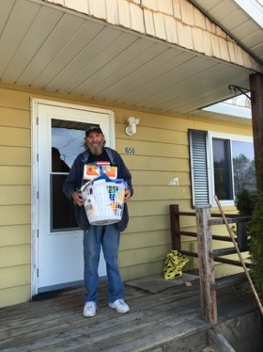
NMSH’s Model
Tenant/Landlord Payments
Paid Utilities
Landlord/Tenant Liaison
Lease Holder
Scattered Site Rentals

Slide 58
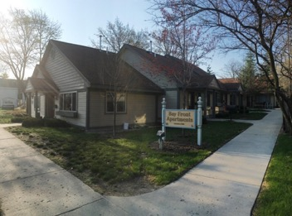
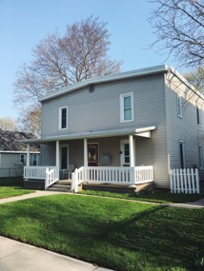
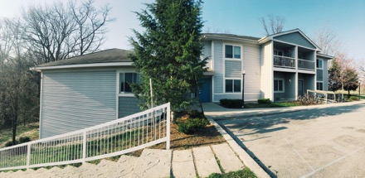
NMSH Properties
2 fourplexes
1 single family home
1 single family condo
11-unit apartment complex
7-unit apartment complex
NMSH leases with approx. 35 private landlords

Slide 59





Questions?
Becca Binder, Executive Director
  becca@nmshousing.org
  231-929-1309
  nmshousing.org
  Thank you to our partners!

Slide 60

Yarrow Brown
Executive Director
Housing North

Slide 61

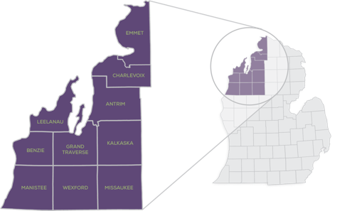



AWARENESS
Outreach, messaging, & communications tools to communities, developers, & other partners.
ADVOCACY
Identify and influence policy that impacts development opportunities in rural Michigan.
CAPACITY & RESOURCES
Work with partners to develop new tools & funding options for housing.
Founding Partners

Slide 62
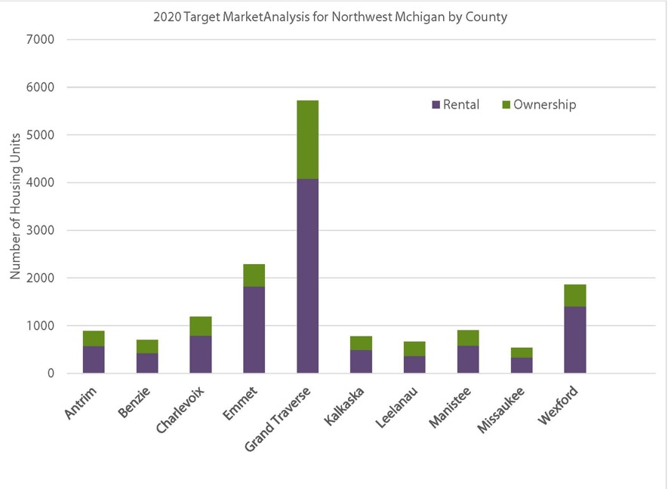
The 2020 Northwest Michigan
Target Market Analysis studied the
demand for housing through 2025
In the 10 counties in NW Michigan. The study showed the potential for demand from current residents moving within the community as well as those who would move here from outside the community.
The study found that the market could support 15,000 additional units through 2025.
10,880 in rental units
4660 in homeownership units
These could be newly constructed homes or apartments or the repair or conversion of existing homes or buildings.

Slide 63
BARRIERS
Construction costs
Infrastructure
Labor shortage
Taxes
Zoning that restricts the type or amount of homes that can be built
Public opposition
Grant requirements designed for urban areas
SOLUTIONS
Grants, low interest loans, financial partnerships
Land donations
Tax incentives
Zoning changes for more diverse housing options
Build public support and understanding
Legislative or policy change to create more tools and revenue
We know we need more housing. Why not just build it?
Grants
Land donations
Tax incentives
Zoning changes for more diverse housing options
Public support
Notes:
Introduce the “Campaign” umbrella
What is it for? WHO is it for?

Slide 64
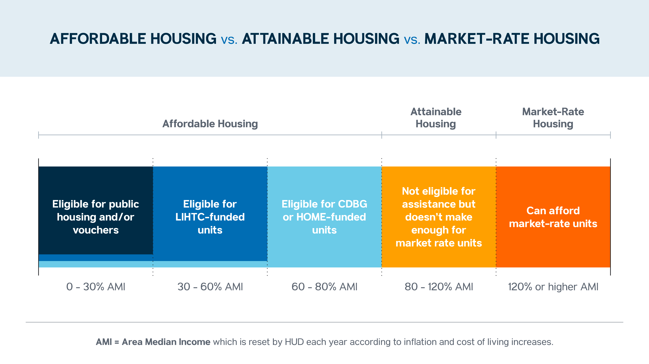

Slide 65
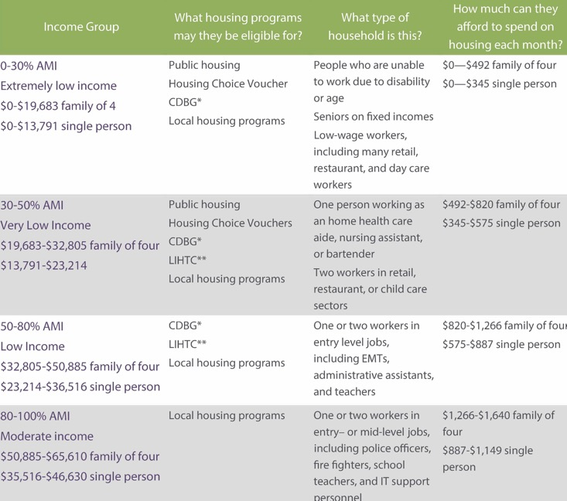
What is affordable?
And at what income level?
30% of your income spent on housing is considered affordable

Slide 66
Communications/Advocacy
Creating Housing Ready Communities
Advocating for zoning changes
Helping remove barriers to housing

Slide 67

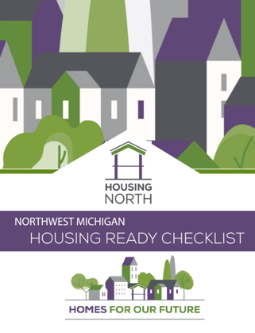
Housing Ready Communities
Since 2020 #12 Units of Government and more than 30 organizations and local businesses have supported this program
Encourage housing ready checklist to be filled out in each community
Develop housing task force for meeting housing goals (at least one per County)
Develop a strategy for a Housing Ready Program Coordinator/Director (3 years)

Slide 68
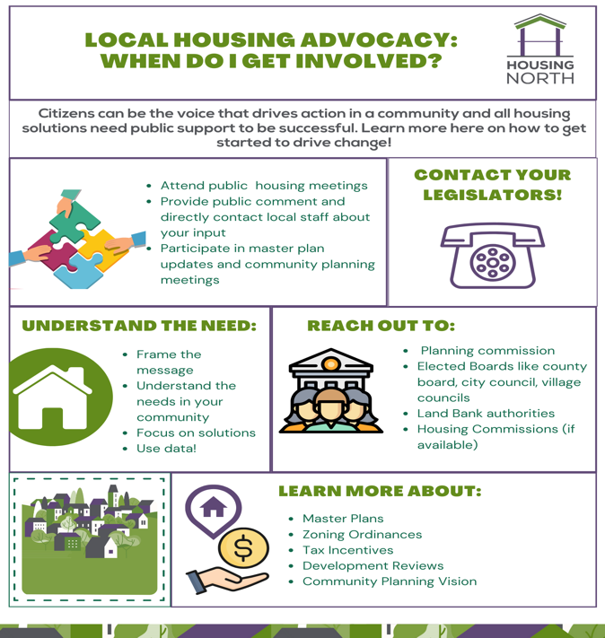
Get informed- review the Communications Toolkit and Housing Ready Checklist
  Was this adopted in your community?
  If not, ask for your PC to consider it.
Join your local Housing Action Committee or and attend your local planning commission meetings
  Is housing on the agenda? Are they updating their master plan? Is the timing right to advocate for changes?
Become a property manager or landlord to help with year round housing

Slide 69
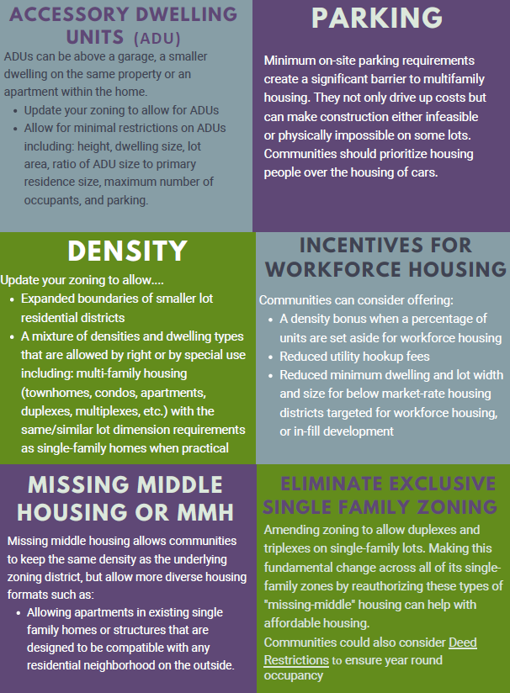
Suggestions for zoning changes to make your communities more ‘Housing ready’

Slide 70




Policy Initiatives
Housing North has developed a state legislative advocacy policy designed to give communities more tools for incentivizing housing development and spurring housing growth.
In 2020, we began working with a group of similarly committed regional and statewide organizations dedicated to changing state policies to grow housing development options.
Notes:
Housing Michigan Coalition
Make workforce rentals more affordable
Incentivize long-term rentals (vs use of property as a short-term rental)
AFCI Increase housing credit allocations
Create additional opportunities for access to credits for rural communities
Increase access for hard-to-serve communities like rural, Native American, high poverty, and high-cost areas
Develop a new and innovative tax structure for property owners seeking to provide long-term (greater than one month) rental housing for the workforce

Slide 71
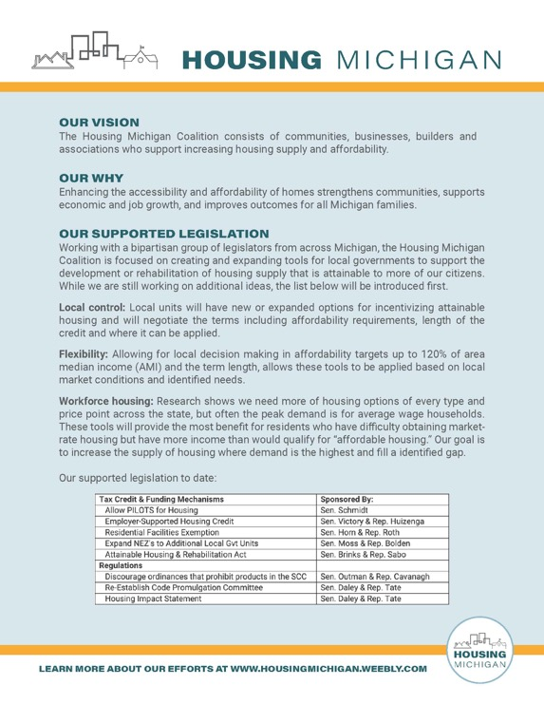

Sign up for the Housing Michigan Coalition
We’ve created a simple sign-up to get updates & calls to action.
Sign up here!
Or type in https://www.surveymonkey.com/r/MIHousingCoalition
Notes:
Working with a bi-partisan group of legislators from across Michigan, we are focused on creating and expanding tools for local governments to support the development or rehabilitation of housing supply that is attainable to more of our citizens. There are multiple reasons for the housing gap.
There is NO Silver Bullet.
We need changes in policy, attitudes, and incentive on multiple fronts.

Slide 72
Capacity
….bringing technical support and new tools/resources for housing
Housing Ready Program
Public Private partnerships
Facilitating/Coordinating projects

Slide 73










CHARLEVOIX & EMMET COUNTY
HOUSING READY PROGRAM
Housing Ready Program
With Housing North is a coordinating agency to support and manage a Housing Ready staff in Charlevoix and Emmet Counties
build capacity locally
identify key development opportunities
initiate and coordinate development
leverage local resources
spur new housing investment.
Offering a shared local approach and buy-in funding from:
Commitment from Resort Township

Slide 74
Projects in Development
Land Bank and TIF Workforce Housing Program
Housing Ready Master Plan and Zoning Amendments
Supporting Housing Advocacy Teams within local communities
Pursuing 4% and 9% Low Income Housing Tax Credits (LIHTC)

Slide 75
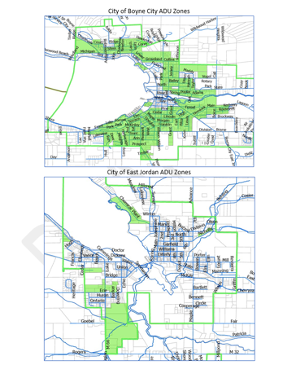
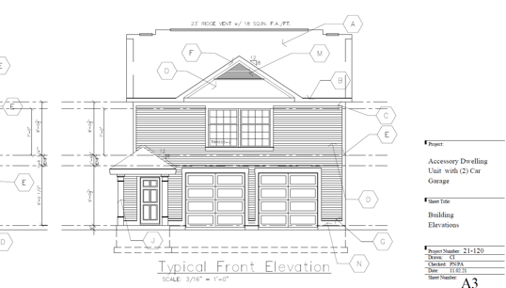
Projects in Development
Accessory Dwelling Unit
Program

Slide 76
Thank you!
Yarrow Brown, Executive Director
yarrow@housingnorth.org
Steve Schnell, Charlevoix County Housing Ready Program Director
steve@housingnorth.org
Andrea Jacob, Emmet County Housing Ready Program Director
andrea@housingnorth.org
Data available at:
www.housingnorth.org

Slide 77
Questions

Slide 78



Health Forum of Northern Michigan
Slides of today’s event will be posted to:
www.gvsu.edu/hfnorthernmich
We hope to see you next fall!
Watch your e-mail for further announcements.
Presented by:
Sponsored by:
Sponsored by:

