Slide 1
Coaching for the Implementation of EBPs
Coach Training Modules
Statewide Autism
Resources and Training

Slide 2
Training Modules Description
This module is a part of a series of modules available to coach leaders to utilize for training of building coaches. Trainers should be Level 1 START Trainers and approved for the content which they are presenting. Modules can be combined, separated, and the order of slides changed or removed based on the needs of the audience, but trainers are asked to ensure fidelity of information in all presentations.

Slide 3
Coaches Module
(List Name of County) Counties
(Name of Module)
(Date)

Slide 4

INTRODUCTIONS
Notes:
Key Concepts:
It is important to know who is in the audience in order to adjust examples and frame answers to participant questions. If the audience is too large to have participants introduce themselves, have participants raise their hand to represent their particular group or perspective.
Considerations:
Application:

Slide 5
Who Is Here Today
Administrative Support
Coach Leaders from (Insert County Here)
Coach Leaders from (Insert County Here)

Slide 6
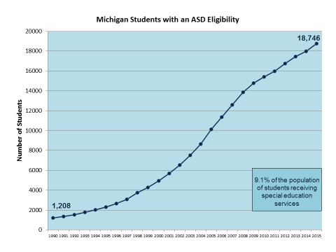
Michigan Students with ASD Eligibility
Notes:
Increase of only 29 from 2013

Slide 7

Number of Michigan Students with ASD by Age

Slide 8
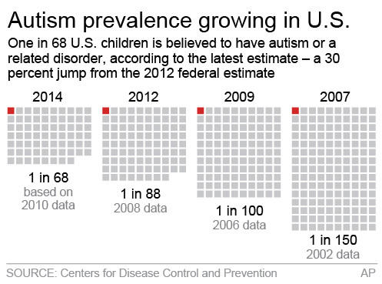
Autism Prevalence Growing in U.S.

Slide 9
Latest CDC Report
If 1 in 68 children have an autism spectrum disorder…
The average elementary building will have 3-5 children with ASD
The average middle school building will have 7-9 students
The average high school will have about 14-15 students

Slide 10


Numbers of Students with ASD
(Name of County) County – (# of Students with ASD)
(Name of County) County – (# of Students with ASD)
Picture of County
Picture of County

Slide 11
Purpose of Today
Understand Your Role as a Coach in the Implementation of Peer to Peer Support Programs

Slide 12
Before You Leave Today…
Your Coach Leaders will meet with you and your team
Action Plans will Be Developed

Slide 13
Action Plan

Slide 14
Before We Meet on (Next Date of Coaching Meeting)
Complete Steps on Action Plan
Coach Leaders will meet with your team to determine if support in needed to complete action plan

Slide 15

(Next Date of Coaching Meeting)
Report out on Action Plan
Share with Group where your team is in the Implementation of the Peer to Peer Support Program

Slide 16
Why a Coaching Model?
Improve Capacity for ALL Staff to Educate Students with ASD
Improve resource allocation / efficiency
Move from Crisis to Frontloading

Slide 17
Why a Coaching Model? (continued)
Too many students (low vs. high incidence)
  Can’t adequately meet the needs / use #’s as a reason
  Can’t do anything effectively
  Always in crisis / no time for proactive strategies
  No time for collaboration to improve services IN the classroom / build capacity

Slide 18
START
Statewide Autism Resources and Training
WELCOMES
COACH
DAN FIFE

Slide 19
Decisions…
Clarkston High School
27 Years
Notes:
After 3 years in College coaching, gone all of the time, 2 babies, making $13,000. I felt if I was going to stay in College coaching, I was going to have to move.
Also I thought I was going to have a hard time being a good Dad.
So I got into the golf business back in Clarkston. It didn’t take long for me to realize how much I missed Coaching. The High School job opened up and I was able to get the Head job.
Started my 27th year in Clarkston
Better have an understanding WIFE!
The gym is like your other home. Sweep, clean, others schools.

Slide 20
The back story of a successful team…
Parents
Coaches
Opportunity
Notes:
Presentation:
( PARENTS / Off-season Individuals…. On season / TEAMS are made)
Last fall I had to meet with out Board of Education / Athletics
College program at the High School level 365
Preseason conditioning & Post – Cross-Fit.com
Weight room
JV Assistant – Cunningham
3 Man Work outs Gun Coach Eric Chambers
Open gyms
Academics
Summer
* We do as much or more for our players than when I was in college coaching
* Jack Roberts – media Guides Who are they? What are they doing?
H.S. Coaches involvement New Committee
Preseason Dead period
AAU
Junior high / be involved with lower grades

Slide 21
Sizing up the environment….
What’s already positive in the environment?
What changes need to be made?
Notes:
Our Program
Clarkston is Great situation
One high school town
7th grade
2 8th grade teams
Drugs, alcohol, tobacco, internet
Parent issues
Varsity letter
1. Strong relationship with A.D., Principal, Superintendent, Athletic Secretary, Coaches, teachers, and custodian.
2. Ability to hire coaches at all levels that will coach your system
3. Access to gym – Season, off season, summer, week-ends, Holidays
4. Develop Junior program (Explain McGrath) (no names, my players: 11 weeks / 3 weeks of stations, 8 weeks of game)
BACKBONE
5. Ability to hire Assistants

Slide 22
A player called me, “Old School”
What makes a good team?
Standards, expectations, persistence!
Notes:
OLD SCHOOL (Player called me)
1. Encourage to play other sports (football)
2. Playing Athletics is a 365 day commitment
3. As a Clarkston Basketball player
4. Wear a tie on game days or Dress Appropriately
5. Open gyms – if you’re not there, I want to know why
6. On time means at least 30 minutes early
7. No cell phones during practice
8. If you’re hurt, you’re hurt
9. Twisted ankles can be played on – Walk, you can play
10 99% I want WIN more than they do
11. Video games are not a Varsity sport

Slide 23
Philosophy
Keep it simple… don’t over analyze
Scout / Know Match-ups and Defense
Put team in position of being successful!
Notes:
Philosophy
1. KISS: Keep it simple / don’t over-coach, analyze
2. Stop the other team from scoring / earn every basket
3. Scout – Match-ups and defense
4. Film – Time is limited – I always feel doing vs. watching
5. Stats – Media – Parents * My eyes are my stats
6. Put kids in position to be successful

Slide 24
Playing SMART
Create YOUR role on the team
Know what YOU can do
Work on expanding / don’t try to do what you CANNOT do
Notes:
PLAYING SMART:
Create your role on the team
Know what you can do
Work on expanding, but don’t try to do what you CAN’T do
If you don’t want to shoot, DON’T

Slide 25
Team Building
Pizza Parties!
Notes:
Friday: PIZZA PARTIES

Slide 26
Must Coach your Personality
You must know the X’s and O’s of the game…however
Teams who compete the hardest are the most successful
Notes:
Must Coach YOUR PERSONALITY
Coaches Confident:
It is mandatory you know & more importantly understand the X & O’s of the game. But the teams who compete the hardest and play the smartest are usually the most successful.
You have to figure out HOW the successful programs get their kids to believe and trust in you.

Slide 27
Every good coach must know…
If the team doesn’t think you care about them, you don’t have a chance!
Notes:
I do know if kids don’t think you care about them, you don’t have a chance.

Slide 28
It’s About EXPECTATIONS
Clear
Direct
Supportive
Notes:
We all say the same things: EXPECTATIONS

Slide 29

Ideas About Being a Coach
3 ideas about being a coach:
TRANSLATION
3 ideas about being a START coach:

Slide 30
Who are Building Coaches?
Primarily assigned to ONE building
EXAMPLES:
  Special Ed Teacher
  Gen Ed Teacher
  Provider of Speech and Language
  Principal
Notes:
30

Slide 31
WHAT IS THEIR JOB?
Meet monthly with building team
  School Improvement Team
  Tiered / Academic – Behavior Support Teams
  Special Ed / ASD Support Teams
Develop goals for building capacity
  USAPT
  POC
Follow up on action items
Provide Implementation Support
Problem Solve in Crisis
Report to Coach Leader

Slide 32
Coaching:
You’ve heard these ideas before!
  Sage on the stage vs. guide at the side
  An idea discovered is better than an idea delivered
How this philosophy is implemented determines whether coaching is effective

Slide 33
Coaching Strategies
Direct coaching strategies:
  Focused around individual students/staff
  Focused on strategies
  Emphasis on rapport
Indirect coaching strategies:
  Focused on teams
  Focused on systems
  Emphasis on meeting mechanics

