Slide 1

Did you know…
Students favorite picture of self
about me…
Presentation by NAME
With help from NAME(S)
DATE
Notes:
Self-advocacy presentation for Elementary through High School—I will need to change it and add information about ME.
I can change pictures of me, or add pictures of kids my age I can downloaded on the computer.

Slide 2
What I LIKE?
What I LIKE?
(Like most kids do…)
Notes:
This is where people get to know ME better. I can add a few or a lot of pictures, I can add videos too if I have some or find some.
I can add more slides about what I like, if I want to.
Ideas some students use for things they might like:
- Food and drinks I like;
- Friends and family I like to hang out with;
- Places I’ve been or like to go;
- My interests or hobbies;
Doing fun things.
Other things not listed here.

Slide 3
Here is a fun video of me
Here is a fun video of me doing….
Notes:
I can add a video of something fun I did!

Slide 4
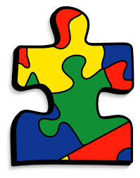
Another thing about me
Another thing about me….
I have AUTISM…
OR
I am on the SPECTRUM…
Notes:
I can add an “I have autism” statement to let people know I have autism.
I can change the picture if I want to, or not have a picture, or put my picture here.
I can say “I have autism”, or “I am on the spectrum”, or “I am on the autism spectrum”, or “I have autism spectrum disorder”…or whatever I use to describe my autism.

Slide 5
Autism…
Autism…
My BRAIN is made differently.
I think and learn DIFFERENTLY than you do.
You can’t SEE my autism by the way I look.
I was BORN with it, and will always have it.
It is NOT something you catch (like a cold!)
Notes:
This is some information about autism to help people understand it better.
I can add that it is a disability if I want to, or say I have different “abilities”.
I can add more information, or take it out. It is important to write down what autism means to help my friends understand it better.
I can use my own words to describe my disability: autism, the spectrum, the autism spectrum, autism spectrum disorder, or anything else.

Slide 6
Autism continued…
Autism…
Some things are EASY for me, some are HARD.
Everybody with autism has their OWN kind of autism.
I work VERY hard to keep learning.
I am NOT dumb, it just takes me longer to think of the answer sometimes.
Notes:
This is more information about autism.
It can be changed if I want.
I can add information too.
I can use my own words to describe my autism: autism, the spectrum, the autism spectrum, autism spectrum disorder, or anything else that helps describe me.

Slide 7
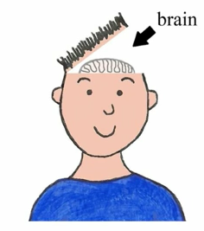
How we all are different
Autism…
How WE all are different
Differences OUTSIDE the body | Differences INSIDE body
Hair colors | How brains think and are made
Eye colors | Kinds of blood
Colors of skin | Feelings
Notes:
This gives examples of how autism is different for everyone.
It gives information about how everyone is different outside and inside their bodies.
I can use my own words to describe my disability: autism, the spectrum, the autism spectrum, autism spectrum disorder, or anything else.

Slide 8
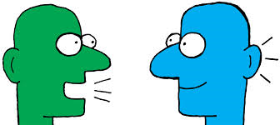
Communicating
Autism
Autism makes it really hard to communicate….
….and understand what people mean, say, and do with their words or body language
Whaaaaat??
Notes:
This is a picture of how some people feel who have autism, when other people are talking to them, and the person with autism doesn’t understand what the other person is saying.
They may be talking too fast.
They may be saying lots of words I can’t keep up with and understand.
They may be not be clear and using sarcasm, innuendos, metaphors, or other ways of talking I don’t understand.
I can use my own words to describe my autism: disability, other abilities, autism, the spectrum, the autism spectrum, autism spectrum disorder, or anything else.

Slide 9
What’s really hard for me
What’s really hard for me…
Changing subjects about things I like to talk about
Talking softly and not getting in your space
When things don’t follow the rules…and I tell you so
Understanding the meaning of how words are used
Paying attention and staying focused…
Notes:
These are things that are hard for some people with autism.
I can add things that are hard for ME if they are not on here.
I need to add things that are hard for me in school or other places.

Slide 10

Downside of ASD
The downside of autism
Since you can’t see my brain and how it works, some people don’t understand why I say or do certain things…sometimes they don’t get me.
Notes:
Autism is hard sometimes.
This is something I can change if I want to, or take it off.
I can use my own words to describe my disability: autism, the spectrum, the autism spectrum, autism spectrum disorder, or anything else.

Slide 11
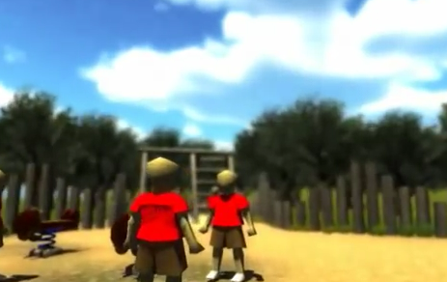
Some kids have sensory issues…lights, sounds, smells, and touch bother them…
Check out this video game that makes it feel like you have autism…
https://www.youtube.com/watch?v=DwS-qm8hUxc
Notes:
THIS SLIDE CAN BE REMOVED IF IT DOES NOT FIT WITH OR WORK FOR MY PRESENTATION!!!
This is a video that helps other people see what some people with autism feel like with a lot of sights, sounds, smells, or touches.
Too much sensory stuff can be a lot to deal with.
For some people it makes them scream, cover their ears, or even run away.

Slide 12
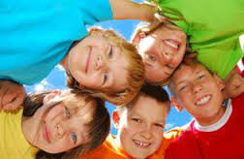
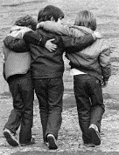
Friends
I want to hang out and have friends, just like you…
Please be patient and it’s ok to tell me:
“Hey, could you stop talking, please?”
“Do you mind talking about something else?”
“You are standing too close, could you back up a step or two?”
“Do you mind lowering your voice, it’s really loud?”
This will help me understand what you are thinking…I don’t always get your body language…
Notes:
Friends are important to most people.
People with autism usually want friends too.
I can change this slide to point out what may help me with things that are hard for me, and help my friends know how to talk to or help me.

Slide 13
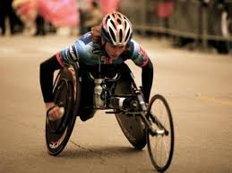

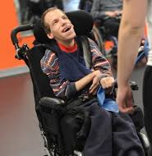
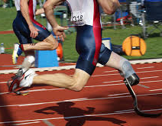
Would it be right to make fun of or laugh at these people?
NO, it would not!
You can see their disability…but you can’t see mine…
Notes:
Even if you cannot see someone’s disability, it is never ok to laugh at them.

Slide 14
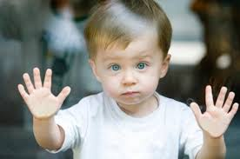
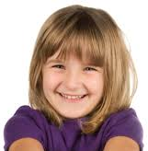
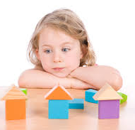
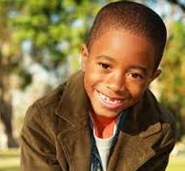
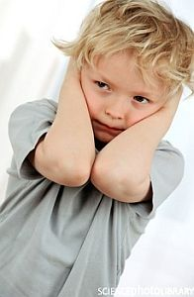
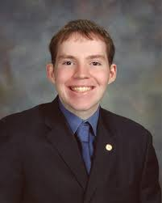
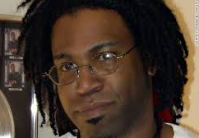
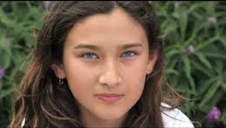
All of these people, including me, have autism!
Child
Notes:
These are examples of other people with autism—that look just like other people without autism.
I can use my own words to describe my disability: autism, the spectrum, the autism spectrum, autism spectrum disorder, or anything else.

Slide 15
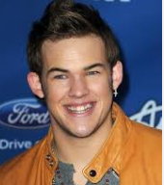
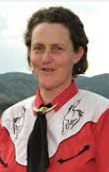
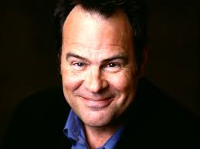
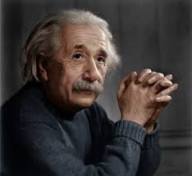
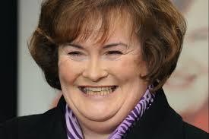
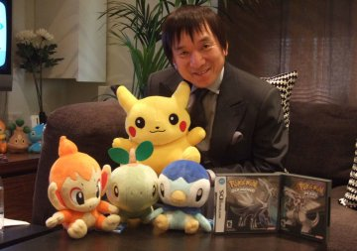
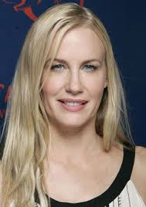
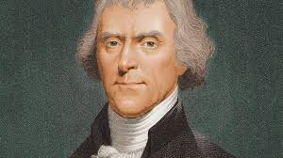
*Even famous people have autism…
These famous people from history are thought to have autism…
Dan Akroyd
Move Actor and Comedian
Temple Grandin
Professor at Colorado State University, Public Speaker on Autism
James Durbin
Singer & Star of American Idol
Albert Einstein
Scientist
Thomas Jefferson
U.S. President
Susan Boyle
Singer
Satoshi Tajiri
Pokémon Founder
Daryl Hannah
Actress
*From Autism Speaks & Huffington Post February 2016
Notes:
These are a few famous people who have autism
I can add to or change these people if I want to
I can use my own words to describe my disability: autism, the spectrum, the autism spectrum, autism spectrum disorder, or anything else.

Slide 16
Thank you for listening… and thank you to all my friends who help me, include me, and accept me for who I am!
Add Picture of self
Any questions?
Notes:
I can add a picture of me here, or have no picture at all!

Slide 17
Resources
The following are additional resources that may be helpful for some in creating their self-advocacy presentation.
Anti-bullying video From Ohio Center for Autism and Low Incidence (OCALI): video of bullying scenarios and how peers can assist students with and without disabilities who may be bulled: http://www.ocali.org/project/bullying_and_individuals_with_special_needs/page/anti_bullying_webcasts

