Slide 1

The Michigan Merit Curriculum (MMC), Personal Curriculums (PC) and Certificates of Completion (COC):
Addressing the Needs of Students with ASD

Slide 2

The Problem
Too many IEP Course of Study decisions defaulting to Certificate of Completion for students with ASD
Lack of Theory of Mind
Restricted Interests
Need for Predictability
Communication Deficits
Social Interaction Differences

Slide 3
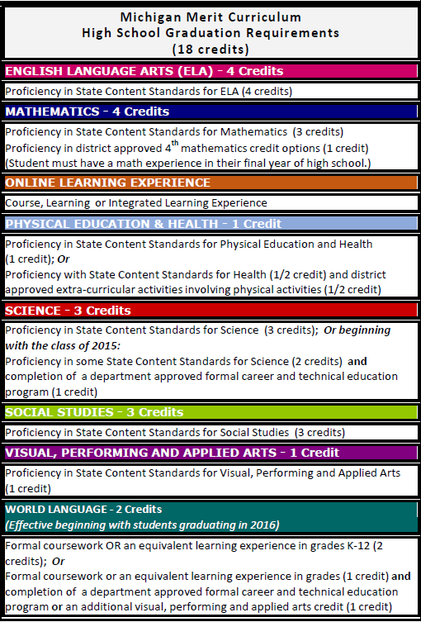

Michigan Merit Curriculum
Students entering 8th grade in 2006.
Notes:
Looking at left column of handout
Changes and flexibility include….
CTE options to meet WL and 3rd science
VPAA to meet 2nd WL

Slide 4
MMC Statute
MMC sets the floor (core requirements) for a diploma.
A request can be made to modify default requirements through a “personal curriculum”

Slide 5
What is a Personal Curriculum?
1 of 6 Flexible Learning Options
“A personal curriculum (PC) is a tool… that allows specific modifications to be made to certain requirements of the Michigan Merit Curriculum (MMC) in order to individualize the rigor and relevance of the educational experience… the personal curriculum is intended to help make the MMC accessible to all students while maintaining the academic rigor required to uphold the integrity of the high school diploma.”
^{Personal Curriculum FAQ 2009}

Slide 6
Reasons Allowed to Modify
Go beyond requirements (additional courses in core content area or rigor up)
Modify the math requirement
Modify credit requirements for students with IEP
Modify credit requirements for an out of state or non-public school transfer student
Two potential options for PC modifications
  Content expectations
  Credit requirements

Slide 7

PC Modifications Guidance (page 9) for General Education Students
Modifications Not Allowed
Allowable Modifications
English / Lang Arts
Science
World Languages
Civics / Government
Online Learning Experiences

Slide 8
Students with IEPs
(k) If the parent or legal guardian of a pupil requests as part of the pupil's personal curriculum a modification of the Michigan merit standard requirements that would not otherwise be allowed under this section and demonstrates that the modification is necessary because the pupil is a child with a disability, the school district or public school academy may allow that additional modification to the extent necessary because of the pupil's disability if the group under subdivision (a) determines that the modification is consistent with both the pupil's educational development plan under subsection (11) and the pupil's individualized education program.

Slide 9


Slide 10
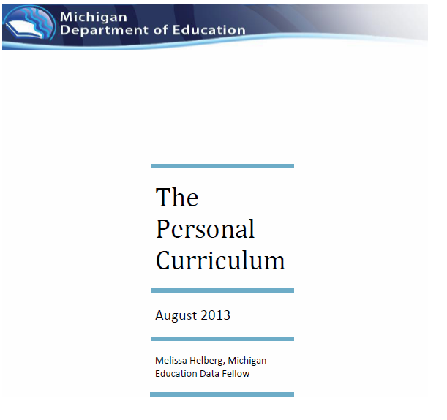
U of M Research Study
Implementation of Personal Curriculum
Requested by Special Education Advisory Committee (SEAC) due to # of calls from parents of students with disabilities regarding PC process / implementation
Results of the study:
  Primary users were students without disabilities to rigor up or to modify Algebra II
  Students with disabilities under-utilized PC

Slide 11
OCR Investigation Report Corrective Action
(Parent challenge to Course of Study (COS) Determination)
Consider whether students with IEPs would benefit from a PC BEFORE determining that the COS should lead to a certificate.
If at any time it is determined that a student with a disability would not benefit from a PC, the determination is to be documented in the student’s educational file and communicated to the student’s parent/guardian within 15 school days from that determination.
Conduct a review of all students with disabilities placed on certificate tracks to ensure that they are not being denied an equal opportunity to participate in the diploma track, including:
  Consideration of the nature and severity of the student’s disability
  Documentation of the reasons why the student is not being considered for a diploma.
  Documentation of any services and modifications, such as PCs, to ensure the student is being given an equal opportunity to earn a diploma.
  Provide training to all district secondary school administrators, counselors, psychologists and teachers regarding PC development for students with disabilities.

Slide 12
OCR Primary Message
Districts must afford students with disabilities an equal opportunity to participate in diploma track and to graduate with a district diploma
    Does not equate to right to a diploma
    Does require an “individualized consideration as to whether students with disabilities would benefit from a personal curriculum before determining whether they would be placed on a certificate track”

Slide 13

Joint Final Report and Recommendations
Basic and Plus Diploma Options
Certificate Options
  Performance
  Academic Achievement
  Participation
Provide Notice of Course of Study (COS) Discussion at IEP
Prepare for IEP COS Discussion (DATA)
Consider PC PRIOR to Certificate

Slide 14
PC Process
Can be requested by parent / LG, student, or school personnel
Reviewed for consistency with policy
PC Team Developed
  Student & Parent / LG
  Counselor / Designee OR Teacher currently teaching pupil or w/ content expertise or principal determines has relevant qualifications
  School psych (for students with an IEP)
PC Team Develops Written Agreement
Parent / LG Quarterly Communication re: Progress

Slide 15
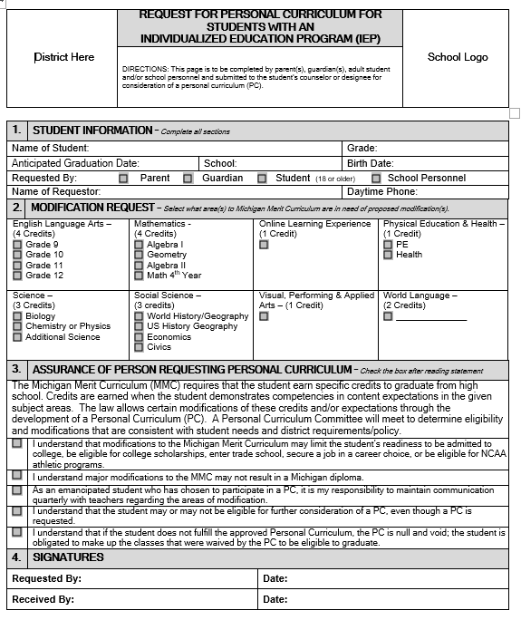
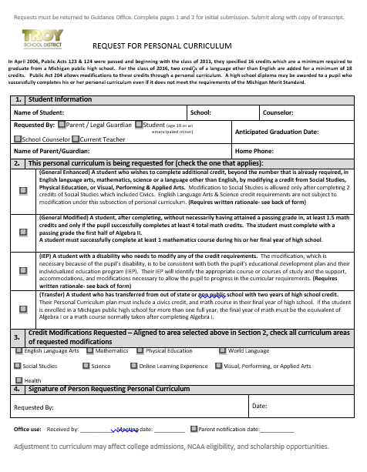
EXAMPLE FORMS
not required / not model

Slide 16
PC Written Agreement
Align with EDP (career pathway) and IEP secondary transition goals
Include as much of MMC as practicable while maintaining the legislative intent of increased rigor for all students
Include measurable goals and method of evaluation that goals are met
Identifies credits to be earned and modifications to existing content expectations

Slide 17

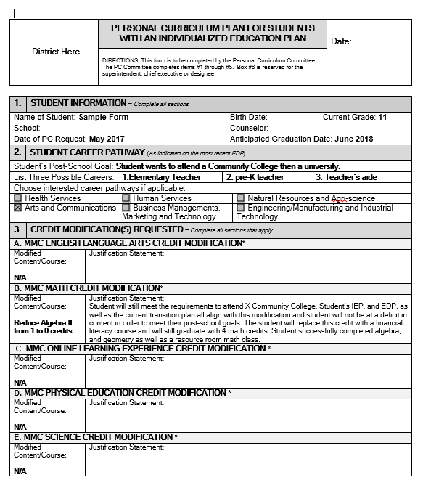

Slide 18
Responsibilities
LEA / Board
IEP Team
Annual Notice re: PC
Content Mastery Criteria & Proficiency
Allowable Modifications
What Constitutes Credit
Determine secondary transition goals aligned with EDP
Determine COS based on those goals
CANNOT:
  Grant PC
  Create alt graduation options
  Grant or guarantee credit
  Include curriculum modifications below MMC and/or PC requirements

Slide 19
Resources on MMC and PC
MDE MMC Website
MDE PC Website
  PC Parent and Educator Guide
  PC Additional Resources
  PC FAQ
  PC Focus on a Student with an IEP
Kent ISD PC Website
Oakland Schools PC Website

Slide 20
Schedule Your Own Training
Michigan Department of Education
Rashell Bowerman
  Instructional Intervention Consultant
  Curriculum and Instruction Unit
  Office of Education Improvement & Innovation
(517)335-3062
Bowermanr1@michigan.gov

