Slide 1
Self-Management
Lindsey Harr-Smith
START: Autism Education & Intervention Specialist;
Autism Consultant: Livingston ESA
harrsmil@howellschools.com
Gina Sanderson
Autism Consultant: Lenawee ISD
START Consultant
gina.sanderson@lisd.us

Slide 2
Webinar Considerations
Guided Notes
Pause, Break, Time Stamp, Revisit
Resources: Steve Buckmann:
Don’t Forget About Self-Management
Immediate Development and Implementation

Slide 3
Self-Management Webinar Framework
The Why: Evidence Based Practice and Research
The How: Implementing a Self-Management System
Target Areas with 3-5 Examples:
Independence and Routines
Self Awareness
Interruptions or Disruptions to Instruction
Time Management
Expectations
Engagement/Academics
Manage High Interests
Job/Vocational Tasks

Slide 4
Don't Forget About Self-Management Steve Buckmann
A primary goal of education is to assist individuals to become more independent in managing their own behavior. For most people, this is a gradual process which extends well into adulthood! For many individuals with autism spectrum disorders, moving towards increased independence is difficult without systematic, long term instruction.

Slide 5
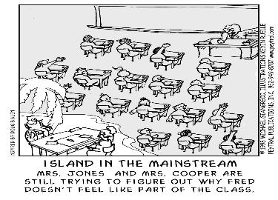
Don't Forget About Self-Management Steve Buckmann
Though support persons strive to assist individuals with autism spectrum disorders in reaching greater heights of independence and autonomy, many of our efforts actually result in teaching individuals to be heavily reliant on outside influences and controls.

Slide 6
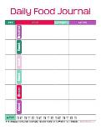
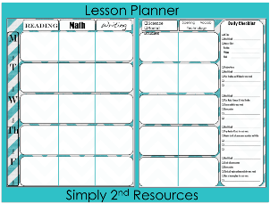
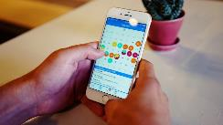
We ALL Need and Use Self-Management

Slide 7
Goals for all Students -NRC
Independence
Socialization Skills
Employment
Critically important focus of instruction for individuals with ASD

Slide 8
We ALL Need Self-Management
I need a Self-Management Plan Here…Here…Here…Here…Here to execute the plan!

Slide 9
What are Self-Management Systems?
a procedure in which people are taught to discriminate their own target behavior and record the occurrences or absence of that target behavior
a highly effective yet significantly underutilized evidence-based practice
one of only two of the 24 evidence-based practices (EBP) identified by the National Professional Development Center (NPDC) that crosses every domain and age level.

Slide 10
Evidence-Based Decision Making

Slide 11
Links and Resources for Self-Management
NATIONAL CLEARINGHOUSE ON AUTISM EVIDENCE & PRACTICE (NCAEP) www.ncaep.fpg.unc.edu
AFFIRM MODULES https://afirm.fpg.unc.edu/afirm-modules
ASSOCIATION FOR SCIENCE IN AUTISM TREATMENT (ASAT) www.asatonline.org
NATIONAL STANDARDS PROJECT https://www.nationalautismcenter.org/national-standards-project/
AUTISM INTERNET MODULES (AIM) www.autisminternetmodules.org

Slide 12
Don't Forget About Self-Management Steve Buckmann
Self- management is a useful technique to assist individuals with disabilities, including autism spectrum disorders, to achieve greater levels of independence in vocational, social, academic and recreational activities.

Slide 13
Why Self-Management?
How do we manage our behavior?
Recognize Unspoken Rules / Hidden Curriculum
Self-Regulation: Self-Monitoring / Self-Reflection by context
Understand the rules / norms
Discriminate between appropriate / inappropriate behavior

Slide 14
Life, Animated Quote
“He has no sense of “supposed tos” because he can’t read all those looks, expressions of favor or disfavor, the ripple in the crowd, borne within each passing moment that builds into life. That means he doesn’t know what you’re supposed to do in the library – as opposed to a playground – or what movies most eight-year olds are watching… Owen is driven, shaped, and guided by what bubbles up, often quite mysteriously, from within. There are plenty of self-directed urges in everyone. It’s just that our impulse instantly slams against our lightening-fast assessment of context. The atmospheric zone created by that collision is behavior”.

Slide 15
Why Self-Management?
Self-management strategies systematize these things so that individuals with ASD can learn the rules and norms needed in different contexts and environments.
Self-management is both a tool to teach other skills and an important skill in itself (self-determination)

Slide 16
Self-Management Achieves
Greater levels of independence and
awareness with:
vocational,
social,
academic and
recreational activities
IEP Goals and Objectives

Slide 17
Self-Management Interventions have EVIDENCE for…
Decreasing challenging behavior:
Disruptions/Interruptions
Off-task
Increasing typical behavior:
Initiate interactions
Social / Communication
Engagement in social and academic tasks

Slide 18
Benefits of Self-Management
Provides students with a sense of ownership for and control over their own behavior, which is inherently reinforcing and may also make it less likely that students will try to control the teacher’s behavior.
Provides consistent alignment with the philosophy of positive behavioral supports and interventions (PBIS) which calls for behavioral management techniques to be positive, preventative, educational, and empowering. “One of the best places to solve a problem is before it even happens” Dave Schoemer

Slide 19
Benefits of Self-Management
3. Provides opportunities for meaningful practice by measuring, graphing, evaluating and defining skills necessary in multiple parts of the curriculum.
4. Provides students and teachers with a proactive and positive way to avoid reactive punishment contingencies.
5. Increases the likelihood that appropriate behavior will last over time and generalize to various settings.

Slide 20
Self-Management
Independence is a PIVOTAL Skill
Alone it Reduces Behavior

Slide 21
Visual Supports
Research has shown that when some individuals are given the opportunity to learn with visual supports or cues they:
Complete more tasks by themselves therefore increasing their independence
Learn more rapidly
Demonstrate decreased levels of frustration and anxiety related to task completion
Adjust more readily to changes in their environments
(Koyama & Wang, 2011; Savner & Myles, 2000).

Slide 22
Goal of Education
Adults Independent in Managing Their Own Behavior

Slide 23
Self-Management System Components
Teaching students to:
(a) monitor behavior
(b) record performance, and
(c) obtain feedback / reinforcement
Implementation Steps:
Prepare the system
Teach student to use the system
Implement the system with adult support
Promote independence with the system

Slide 24
BEFORE “Prepare the System”
Too much of <behavior>
Not enough of <behavior>
Aberrant <behavior>

Slide 25
Steve Buckmann
Typically, instruction for individuals with autism spectrum disorders has focused on teaching ALL of the skills and behaviors needed in EACH instructional setting, since individuals with autism may experience difficulty generalizing behaviors and skills across settings. Unfortunately, this becomes an overwhelming prospect as well as an inefficient strategy. Instead, it would seem more logical and efficient to teach behaviors that have the potential to transfer across settings and to benefit the individual in multiple settings. Self-management is such a behavior.

Slide 26
How Do You Identify the Problem?
What is interfering with their academic progress, socialization, and/or independence?
Operationally define the “problem”- prioritize
Direct and indirect data gathering (observations, interviews, rating scales)
Self-Management Systems: ARE INDIVIDUALIZED

Slide 27
What Data?
Direct observation tools: on START website
Social Data
Engagement Data
Independent Data
Indirect data measures:
Interview/surveys/rating scales
FAST
Schedule Matrix tool- identify times in the day student is not independent, engaged, or social/appropriate
Team problem solving process: Meeting Mechanics

Slide 28
Implementing a Self-Management System
Step 1: PREPARE THE SYSTEM
Identify Behaviors to Increase / Decrease
B. Select recording/cueing system appropriate for the student (use interests)
Paper / Pencil
Clickers
Token Boards
C. Determine interval
Stopwatch / Timer / Clock
D. Decide how to give feedback / reinforcement
How often
Criterion
Adult accuracy checks

Slide 30
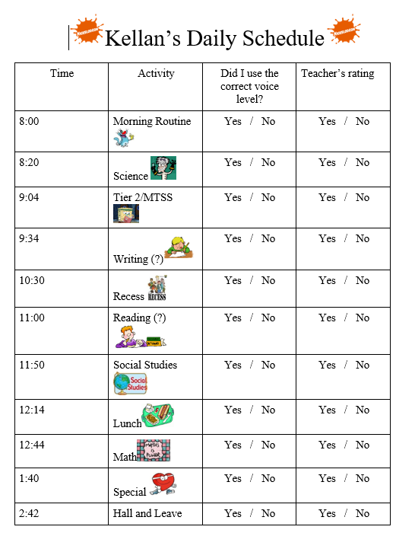

Slide 31
When at All Possible,
Develop the Self-Management WITH the Student
Individualized for the Student
Using Highly Preferred
Design
Use Student’s Language

Slide 32
Other Self-Management Considerations
How will the student use it?
Paper/Pencil
Technology
Peer to Peer Support

Slide 33
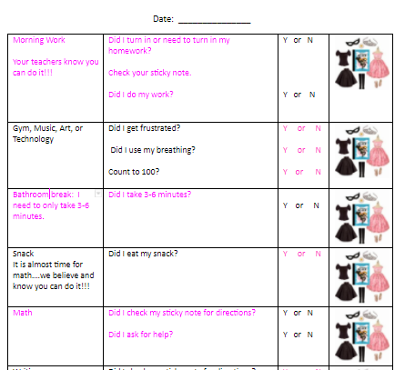
Individualized Examples

Slide 34
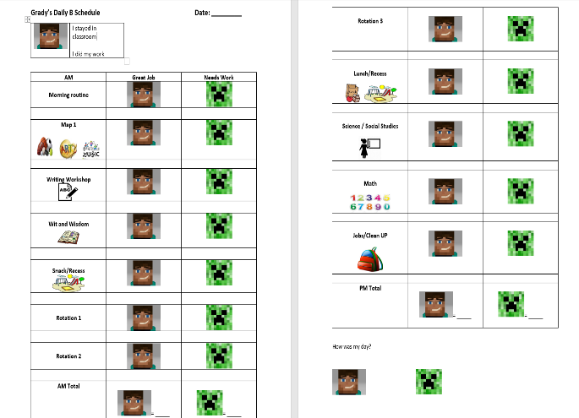

Slide 35
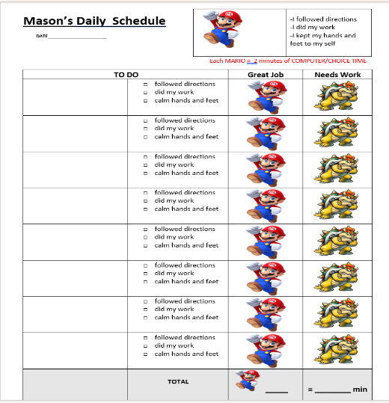

Slide 36
USE CAUTION INCENTIVIZING Contingent Reinforcement

Slide 37
Caution with Contingencies
Contingencies should not be initially used
The need for order and predictability may be reinforcing enough
Contingencies may inadvertently prevent success with the plan: Could create more behavior if use highly preferred/driven interest as contingent reward
Contingencies may lead to punishment
If you need contingencies, you must PLAN to avoid inadvertent use of punishment or reinforcing challenging behavior

Slide 38
Implementing a Self-Management System
Step 2: TEACH student to use the SYSTEM
Model Desired Behavior
Discriminate Behaviors (examples / non-examples)
Teach everyone else the System!
Give time: TEACH, TEACH, TEACH

Slide 39
Teaching the Visual Schedule Foundation for Self-Management
To Do | All Done
Math
Health
Social Studies
Lunch
English
Art
Science

Slide 40
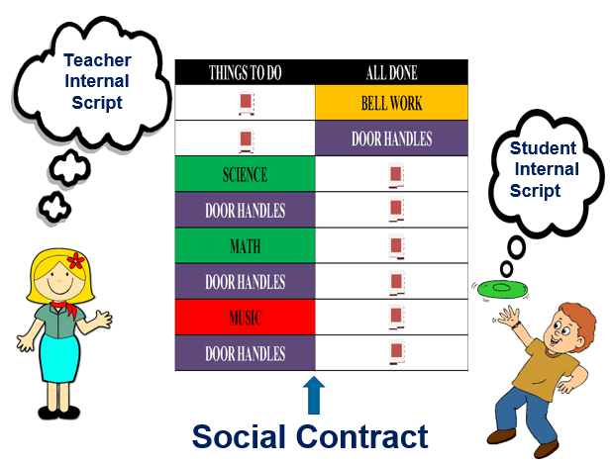

Slide 41
Implementing a Self-Management System
Step 3: IMPLEMENT with Adult Support
Provide materials / Teach student to independently gather materials
Provide cues / prompts to signal time to use the system
TEACH to self-record (prompt, reinforce, fade)
Reinforce

Slide 42
Prompting Procedures (NPDC EBP Brief: http://autismpdc.fpg.unc.edu/content/briefs; AIM Modules:http://www.autisminternetmodules.org/)
Instruction vs. Prompting:
First time given = instruction;
Every support after to elicit the response = prompt
Prompt = “help” to teach the correct response
Goal of prompt is to elicit correct response
Repeating instructions = verbal prompts
Multiple prompts encourages inattention / guessing
Use least intrusive prompt necessary to get the correct response

Slide 43
Types of Prompts
Physical Prompts: Most intrusive / restrictive type of prompt.
Full physical guidance to a partial physical prompt such as a light touch to encourage a response.
Verbal Prompts: Additional verbal instruction to perform the required action.
Visual Prompts:
Object Prompts: The object acts as a stimulus for the response.
Gestural Prompts: A point or other gesture to prompt the expected response.
Pictorial: A picture or other two dimensional representation (words, symbols, etc.) acts as a stimulus for the response.
Positional Prompts: Positioning the correct response in a way that the student is more likely choose it (often used in direct instruction situations).
Model Prompts: Demonstration of the behavior to be performed (i.e., showing how to perform the behavior/action).

Slide 44
Prompting Procedures
Levels of prompting (amount of assistance)
Most-to-Least Prompting
ERRORLESS LEARNING
For NEW Skills / Minimizes Errors
High risk of prompt dependency
Least-to-Most Prompting
Use for performance deficits and when learner begins to perform the skill
TIME DELAY: Give time enough to produce the response but not enough to allow error / produce behavior challenges
Reinstate prompts if learner regresses; doesn’t respond; begins to respond incorrectly, etc.
Fade prompts as quickly as possible
Avoid prompt dependency / Ensure independent responding
Fading Prompts:
Say softer
Use less force
Model PART and wait

Slide 45
Create Prompt Hierarchy
Visual
LEAST
Gesture
Intermediate
Model
Partial Physical
Controlling

Slide 46
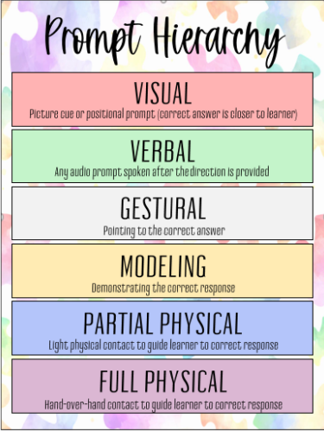

Slide 47
Implementing a Self-Management System
Step 4: Promote Independence with the System
Fluency / Accuracy with Implementation
Intermittent Checks
Increase Criterion
Increase Time
Increase Locations

Slide 48
Self-Management Can Support Challenges with:
Independence in Routines
Self Awareness
Interruptions/Disruptions to Instruction
Anxiety Reduction
Time
Organization
Expectations
Engagement/Academics
Manage High Interest Area
Socialization
Job/Vocational Tasks

Slide 49
Self-Management
Independence in Routines

Slide 50
Routine
A sequence of actions regularly followed…..
A sequence of instructions for performing a task….
A regular procedure, customary or prescribed…..
Routines Create a Practice Playground
To do or engage in frequently; make a habit of
To do repeatedly so as to become proficient
To work at

Slide 51
A Series of Routine Independence Questions
What routines are other students doing independently?
What routines is the target student not doing independently (i.e. requiring adult prompts) that the other students are doing independently?
Which of these tasks or routines, if addressed, would have the biggest impact?
Of these, what task or routines does the team want to target? Limit: INITIALLY NO MORE THAN 1
Who are the participants in the task or routine who may need to be included in the process?
What are the student’s interest areas?

Slide 52
Task Analysis Matrix for Routine Independence
Schedule | Expectations | Independence Level | Goal
Arrival | Independently: Get off the bus Walk into the building Go to locker Take off backpack Take off coat Take backpack to class Go to desk Complete morning board work | I VP GP PP FP | 3 level prompt hierarchy prompt fade: GP PP FP

Slide 53
Routine Independence Self-Management
Mini Schedules / Schedules within Schedules
Circle Time
Welcome Songs
Song 1
Song 2
Calendar
Weather
Check Schedule
Tasks | Done | Help
Get off the bus
Walk into the building
Go to Locker --Take off backpack --Take off coat Take backpack to class
Go to Desk
Complete Morning Board Work

Slide 54
Self-Management for Routine Independence
9th grader with ASD
Did not like having a paraprofessional walking with him between classes; ran away, hid, etc.
Used the self-management checklist to increase independence so paraprofessional wasn’t needed

Slide 56
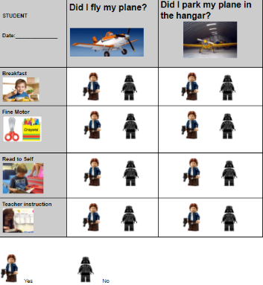
Independence with Transitioning and Routines

Slide 57
Independence with a Break Routine

Slide 58
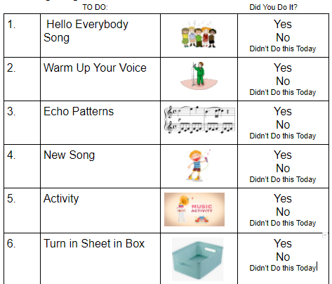
Specials (Music) Example

Slide 59
Self-Management
Self Awareness

Slide 60
A Series of Self Awareness Questions
What is the student doing that is causing a problem (e.g. swearing)?
Does the student have a recognition of what he/she is doing, how often, etc.?
What visual system can be developed to assist the student in monitoring the behavior?
Who are the participants in the task or routine who may need to be included in the process?
What are the student’s interest areas?
This will assist in the development of the system to promote engagement

Slide 61
Self-Management Systems Elementary
5th Grade Student
Work Completion Issues
Difficulty with Voice Tone
Perceived Verbal Aggression Toward Staff
Perceived Verbal Aggression Toward Students
Limited Support from Staff
Minimal Interactions with Peers

Slide 62
Teaching Tool

Slide 63
Sponge Bob, Squidward, and Plankton

Slide 75
Conclusions
Clear Success
Short Timeframe
Simple Concept
a. Social Script/Story
b. Monitoring Sheet
c. Data
Interests the student

Slide 76
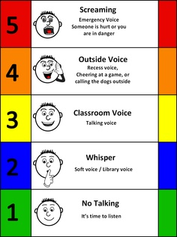
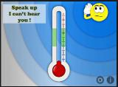
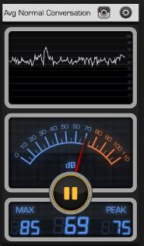
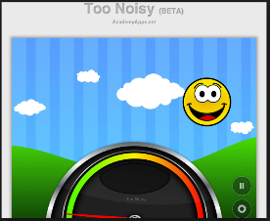
Awareness for Voice Volume
Voice Meter

Slide 77
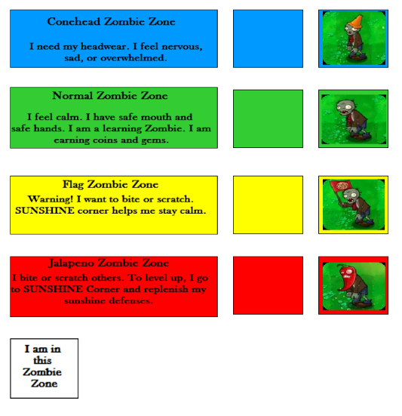

Slide 78
Self Awareness

Slide 79
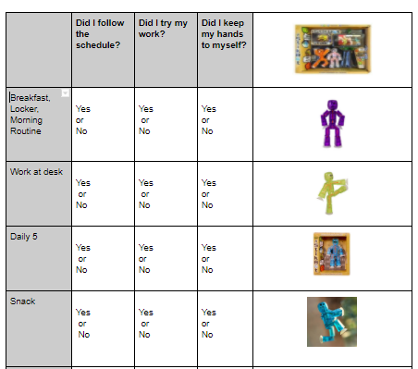
Self Awareness

Slide 80
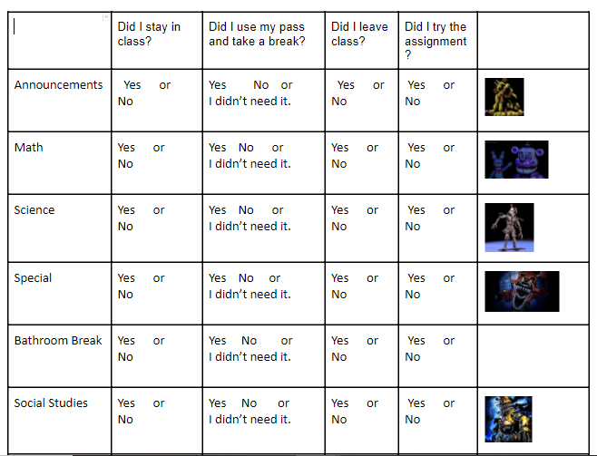
Self Awareness

Slide 81
GUESS WHAT?
Kids at middle / high school swear!!!
Beyond Not No, Where and When…Who!

Slide 82
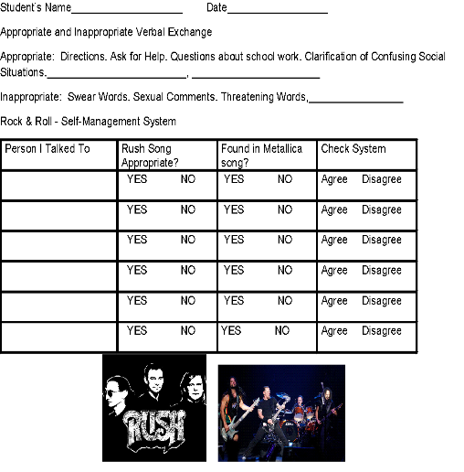

Slide 83
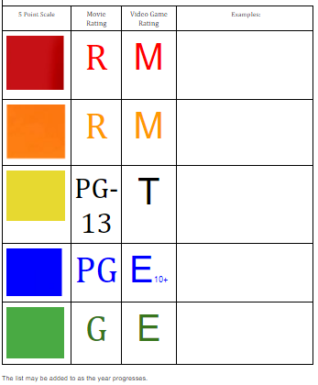
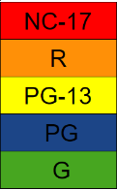
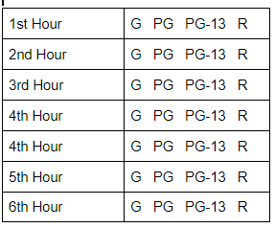
Teaching Tools
Self-Management

Slide 84
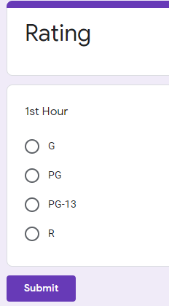
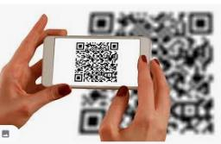
Self-Management Using Technology
Google Form
QR CODE

Slide 85
Social Awareness
Scripting
Repetitive Language
Bodily Noises
OTHERS?

Slide 87
Self-Management
Interruptions /
Disruptions to Instruction

Slide 88
A Series of Interruptions / Disruptions Questions
What is the target student doing that is interrupting instruction or disruptive compared to peers?
Collect Data:
Frequency or the duration of the disruption
Purpose or function of the disruption (e.g. get information (predict), derailment, talk about preferred interest (verbal fascination))
What strategy can be employed to put parameters (not eliminate) the interruption / disruption?
NOT NO, WHERE AND WHEN
Who are the participants in the task or routine who may need to be included in the process?
What are the student’s interest areas?
This will assist in the development of the system to promote engagement

Slide 89
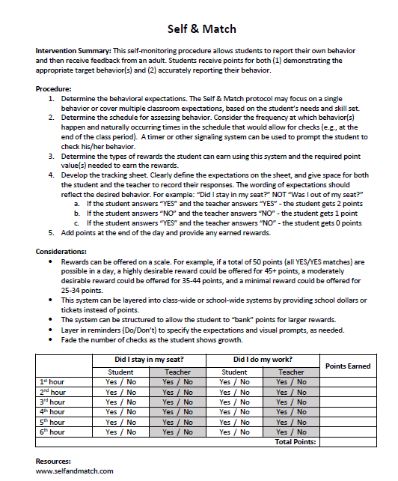

Slide 90
Room | SEWER A kid did something mean to me (tally in this box): | COWABUNGA! I did something nice for someone (tally in this box) | Data Collection
 |  |  | I got teacher’s attention in the right way (CHAMPS) Y N I followed directions the first time given Y N I brought everything I would need for class with me Y N I handled emotions appropriately Y N I made tallies & waited until right time to talk about it Y N
Mrs. Smith’s class
Mrs. Miller’s Class |  |  | I got teacher’s attention in the right way (CHAMPS) Y N I followed directions the first time given Y N I brought everything I would need for class with me Y N I handled emotions appropriately Y N I made tallies & waited until right time to talk about it Y N
Lunch & Recess |  |  | I got teacher’s attention in the right way (CHAMPS) Y N I followed directions the first time given Y N I brought everything I would need for class with me Y N I handled emotions appropriately Y N I made tallies & waited until right time to talk about it Y N

Slide 91
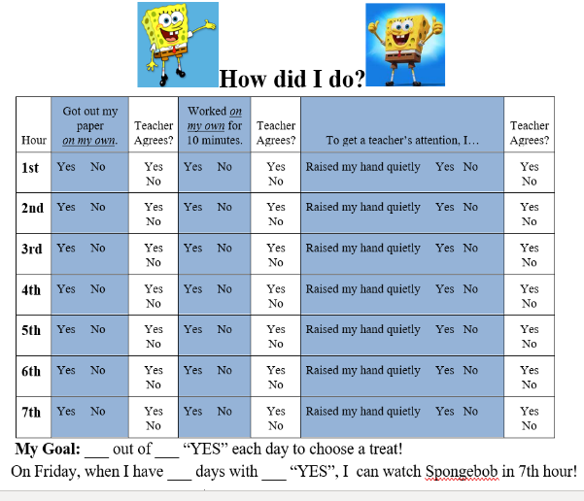

Slide 92
Self- Management
Anxiety Reduction

Slide 93
A Series of Anxiety Reduction Questions
Does the student have anxiety that he/she is responding to in a problematic manner?
What is creating anxiety for the student (FBA data)?
What antecedent strategies might you use to reduce the variables creating the anxiety?
What behavior does the student exhibit to reduce his/her anxiety?
What do other students do when they are anxious?
Will the strategies other students use, if taught to the target student, work to reduce his / her anxiety?
If no, what object or task can be paired with the student’s anxiety that help reduce it (e.g. allowable mistakes, de-escalation tasks)—Something to teach to….
Who are the participants in the task or routine who may need to be included in the process?
What are the student’s interest areas?
This will assist in the development of the system to promote engagement

Slide 94
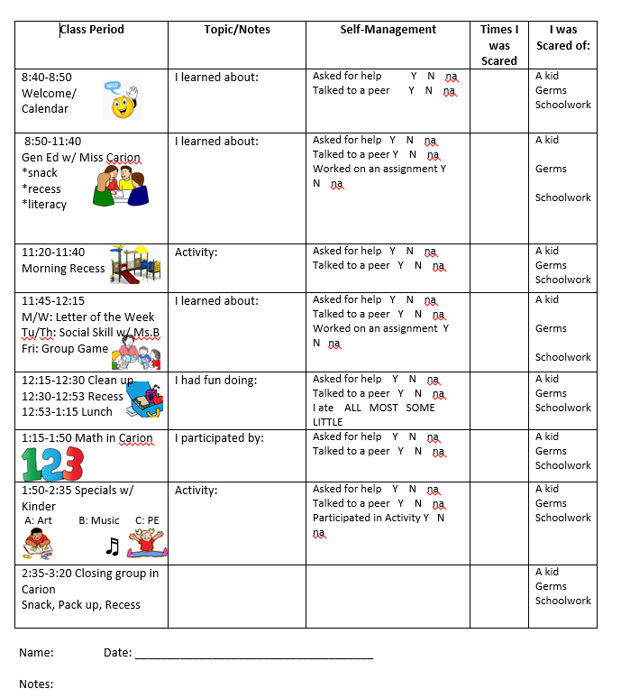

Slide 97
Self-Management
Time

Slide 98
A Series of Time Questions
Does the student have difficulty understanding or managing time increments (FBA DATA)?
What does the student do that indicates an issue with time management? EX: asking multiple times about the time something will occur or leaving the environment because in student’s mind, activity is over.
How can you visually organize the time management issue in a way the student can understand and take ownership over it.
Who are the participants in the task or routine who may need to be included in the process?
What are the student’s interest areas?
This will assist in the development of the system to promote engagement

Slide 102
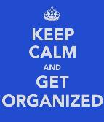
Self-Management
Organization

Slide 103
A Series of Organization Questions
What is the target student doing or not doing that suggests he/she is lacking organizational skills?
What are peers doing to keep themselves organized?
What visual system can be employed to impose organization on the student?
USE THE STUDENT’S NEED FOR RULES AND STRUCTURE IN DEVELOPING THIS SYSTEM
Who are the participants in the task or routine who may need to be included in the process?
What are the student’s interest areas?
This will assist in the development of the system to promote engagement

Slide 107
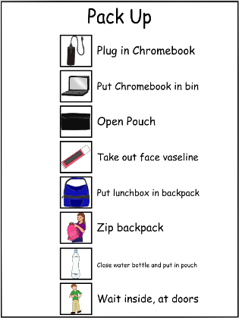

Slide 108
Self-Management
Expectations

Slide 109
A Series of Expectations Questions
What are the expectations in the environment that the student is not following?
Are the expectations clearly written (i.e. operationally defined), posted and have they been taught for all students? If not, do so.
What visual system can be designed to remind the student the expectations and allow him/her to monitor following them?
Who are the participants in the task or routine who may need to be included in the process?
What are the student’s interest areas?
This will assist in the development of the system to promote engagement

Slide 110
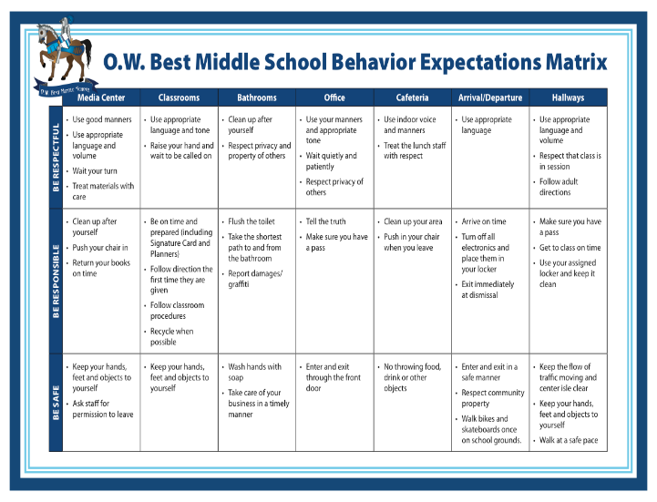

Slide 111
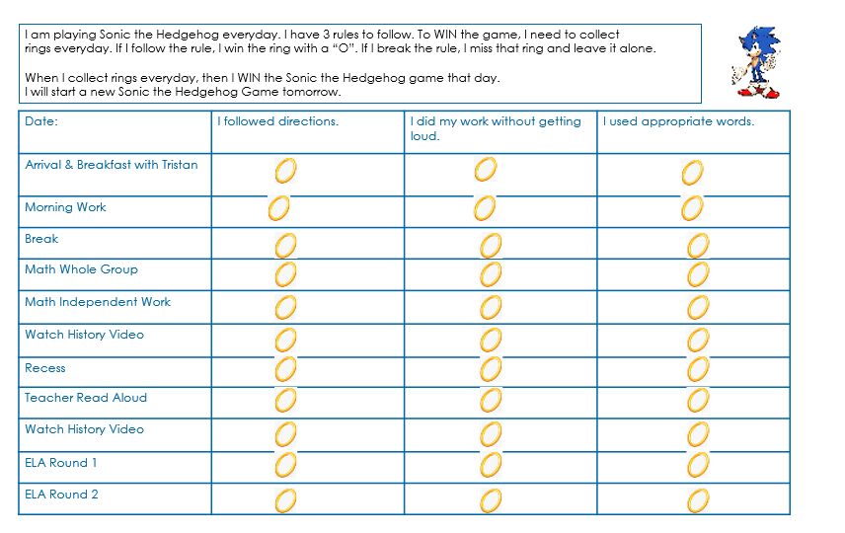

Slide 112
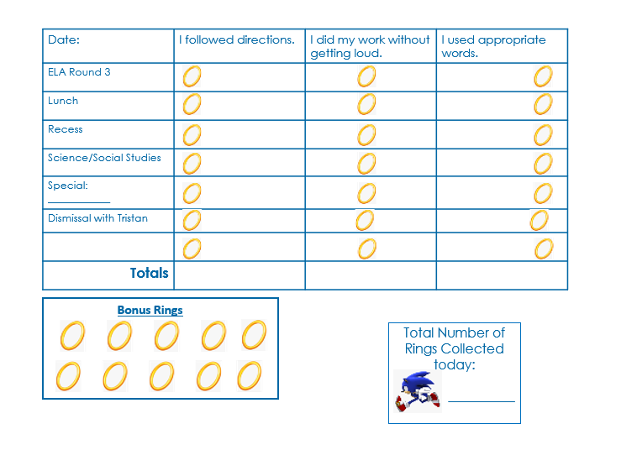

Slide 113
Will’s Weekly Data Collection—Number of Rings Collected for Sonic the Hedgehog Game Schedule for the
Week of: ____________________________________________________
60
55
50
45
40
35
30
25
20
15
10
5
Date: | Monday | Tuesday | Wednesday | Thursday | Friday

Slide 115
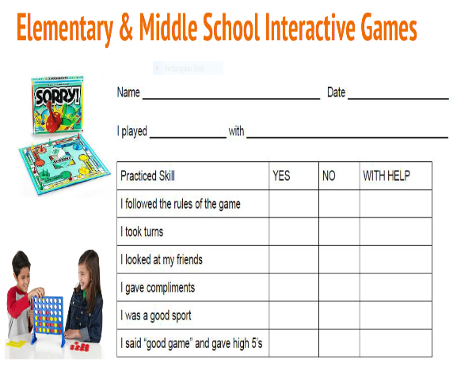

Slide 116
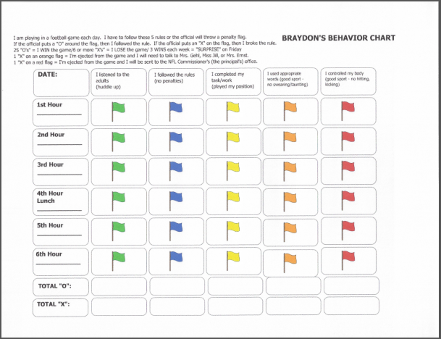

Slide 117
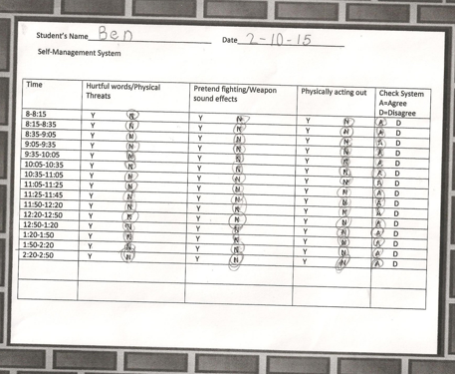

Slide 118
Self-Management
Engagement / Academics

Slide 119
Academics Questions
What is the student doing or not doing relative to academics (e.g. initiating tasks, completing work, turning work in)
Who are the participants in the task or routine who may need to be included in the process?
What are the student’s interest areas?
This will assist in the development of the system to promote engagement

Slide 120
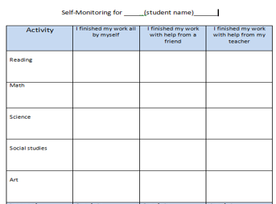

Slide 124
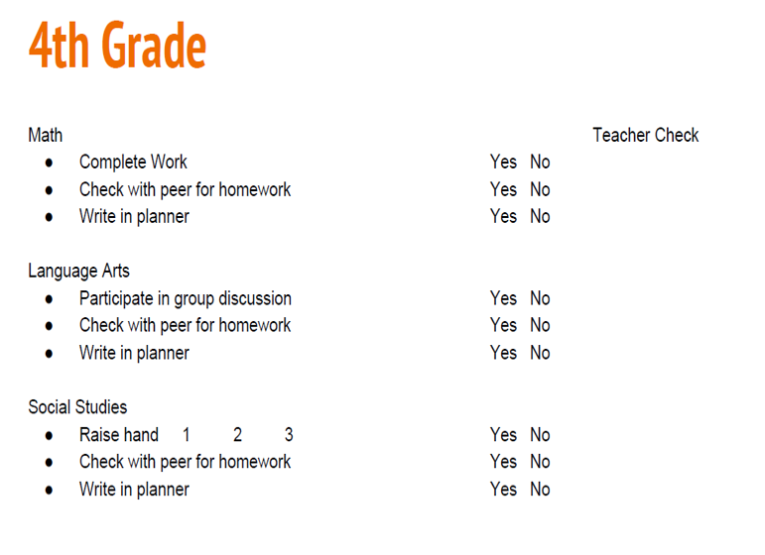

Slide 125
Self-Management for Academics & Behavior
4th grader in General education classroom
Completed this form every 15 minutes, classroom aide completed one also
Compared their answers
Student earned rewards for achieving stars AND for correctly checking boxes
Rules:
Raise hand
Answer 1 question
No bell noise

Slide 126
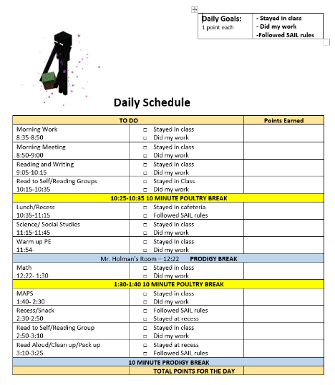

Slide 127
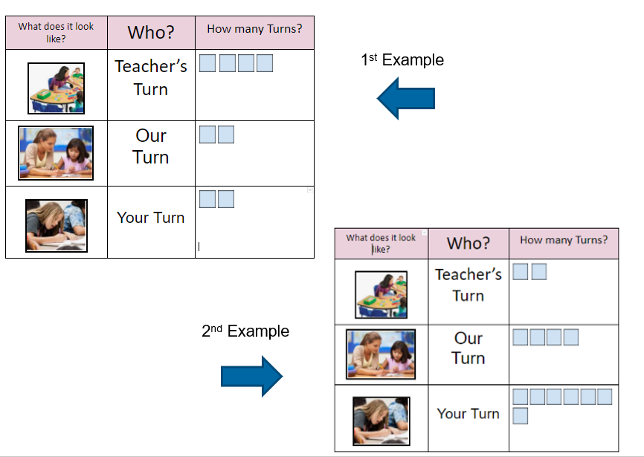

Slide 128
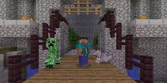
Self-Management
Manage High Interest Area

Slide 129
Ways to Address Preferred Interests
Not no, where & when
Build into the visual schedule
Flood in the environment
Use in teaching
Embed as part of the curriculum, visual system (creates motivation and engagement)
Find a home for it

Slide 130
A Series of Manage Intense Interests Area Questions
What is the student’s intense interest?
How is the student’s intense interest interfering with expectations in the educational environment (e.g. self-talk)?
Has the student been taught where and/or when he/she can engage in intense interest?
What visual system can be developed to assist the student in determining where and/or when he/she can engage in intense interest?
Does the visual system developed assist the student in monitoring his/her intense interest?
Who are the participants in the task or routine who may need to be included in the process?

Slide 131
Put it in the Schedule!

Slide 132
Micah’s Schedule
7:45 | Arrival | 5 min - Celine break | Did you talk about Celine? Yes NO
1st hour | English | Rm 57 | Yes NO
2nd hour | Math | Rm 60 | Yes NO
3rd hour | Art | Rm 101 | Yes NO
4th hour | Lunch | Cafeteria | Yes NO
5th hour | Office Help | 5 min- Celine break | Yes NO
6th hour | Science | Rm 80 | Yes NO
7th hour | Social Studies | Rm 90 | Yes NO

Slide 133
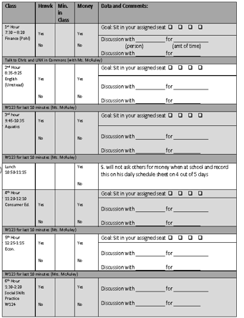

Slide 135
Self-Management
Socialization

Slide 136
A Series of Social Questions
What are other students doing socially?
What is the target student doing or not doing that the other students are doing or not doing?
Which of these behaviors, if changed, will have the biggest social impact on the student (i.e. pivotal skills)
Of these, what skill(s) does the team want to target?
Limit: NO MORE THAN 3
Who are the participants in the social situation who may need to be included in the process?
What are the student’s interest areas?
This will assist in the development of the system to promote engagement

Slide 137
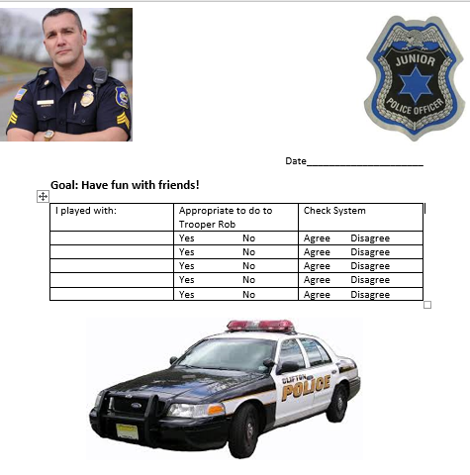

Slide 138
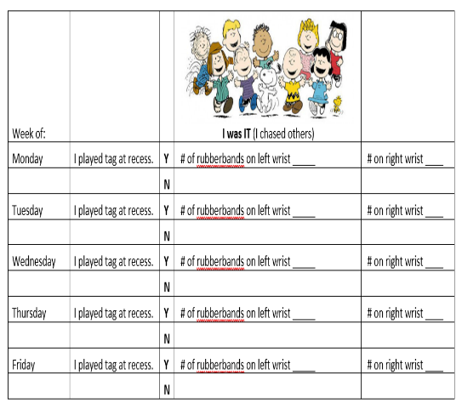

Slide 139
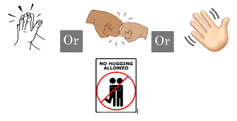
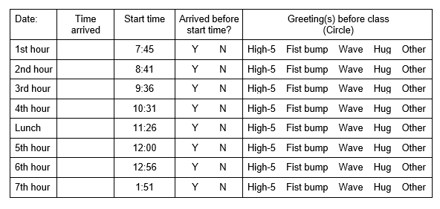

Slide 143
Self-Management
Job Task
Vocational Task

Slide 144
Job and Vocational Tasks Questions
What is the student doing or not doing that is causing a problem in the work environment (e.g. accurately completing job task)?
Does the student have a recognition of what he/she is doing or is not doing, how often, etc.?
What visual system can be developed to assist the student in monitoring the accuracy of the job task?
Who are the participants in the task or routine who may need to be included in the process?
What are the student’s interest areas?
This will assist in the development of the system to promote engagement

Slide 145
Self-Management Systems Return Merchandise

Slide 146
Vocational Self-Management System for Adults with ASD

Slide 147
Vocational Self-Management System for Adults with ASD

Slide 152
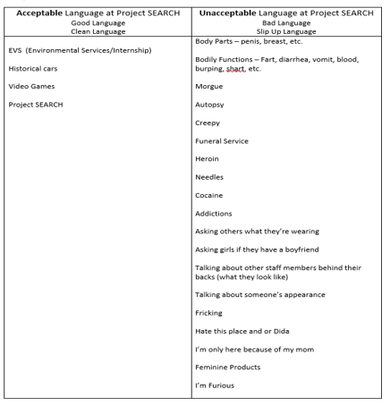
Teaching Tool

Slide 155
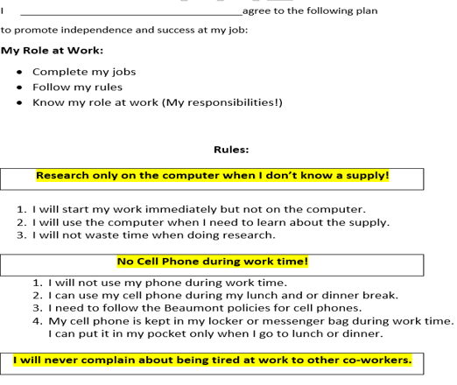

Slide 156
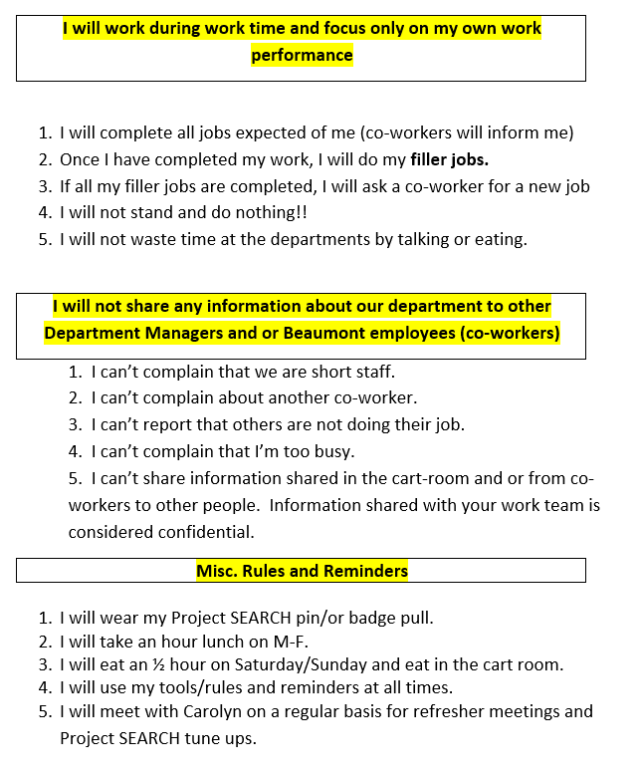

Slide 157
Bringing It All Together

Slide 159
Student’s Name. Student
Ownership of Schedule
Date for Data Collection and
Data Analysis Purposes. Is the
Self-Management System working
for Jana?

Slide 160
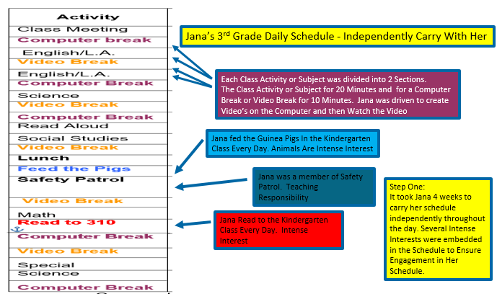

Slide 167
Components to the Plan
No Contingencies in this plan
Contingencies should not be initially used
The need for order and predictability may be reinforcing enough
Contingencies may inadvertently prevent success with the plan
Contingencies may lead to punishment
If you need contingencies, you must PLAN to avoid inadvertent use of punishment or reinforcing challenging behavior

Slide 169
The Jedi Code

Slide 170
The Jedi Code
A Jedi must exhibit responsibility, self discipline,
and public service.
Following the Jedi theme: one begins their Jedi Training as a Youngling, to an Initiate, to a Padawan, and will eventually reach the rank of Jedi Knight.

Slide 171
Journeys for Jedi Training
In order for a developing Jedi to reach a new level in their training (ex. Initiate to Padawan) a candidate must complete a certain number of missions on their journey.

Slide 172
Role of the Staff
Administration
Jedi Council Members
Teachers and Support Staff
Jedi Masters
Peers
Fellow Jedi Candidates

Slide 173
How a Journey Works
The candidate will be given an objective each week which corresponds with a journey in the Jedi Code.
Objectives are completed during their daily missions (classes).
If the candidate is successful with an objective, this means they have completed that mission and will be given a sticker badge to place on their weekly Jedi Training Board.
If the candidate fails to meet an objective, they will have another opportunity to earn a badge during the next mission.
The overall goal of the objectives are for the candidate to meet with more success than failure.

Slide 174
Journeys of the Jedi Code
Jedi Code
Responsibility
Public Service
Self-Discipline

Slide 175
Objectives for our Jedi Candidates
Responsibilities:
Follow their schedule
Complete assignments in class
Extensions given when appropriate
Complete school jobs on time

Slide 176
Objectives for our Jedi Candidate
Self-Discipline:
Actions do not distract other students
When asked to stop, ends a behavior independently
Ignores actions of others that are distracting or annoying
Operates in “stealth mode” in class, attempting to stay under the radar and not distract the Jedi master or peers
Use appropriate words to participate in conversations

Slide 177
Objectives for our Jedi Candidate
Public Service:
Participate in class discussions on topic
Raise hand
Contribute to the discussion
Say something positive within the class period

Slide 178
Assessing the Objective through Data Collection
After each successful mission, the Jedi Candidate will earn a badge from their Jedi Master to place on the weekly Jedi Training Board.
Each time a candidate earns the indicated number of badges, they move up one rank during a celebration ceremony.
Youngling (60 badges)
Initiate (180 badges)
Padawan (360 badges)
Jedi Knight (720 badges)

Slide 182
Takeaways!
Problem: Priority
Plan
Use Preferred to teach
Engagement
Teach to Independence
Data Collection
Send us your examples: emails

Slide 183
Final Self-Management
Did we meet the goals of the session? Yes No
Did you gain any information you can use? Yes No
What populations of students can self-management support? All Students with IEPs Students with ASD? Yes No

