Slide 1
Creating a Banner Archive
Holly Markel, Database Programmer/Analyst
Computing and Information Technology
June 22, 2018
markelh@hope.edu

Slide 2
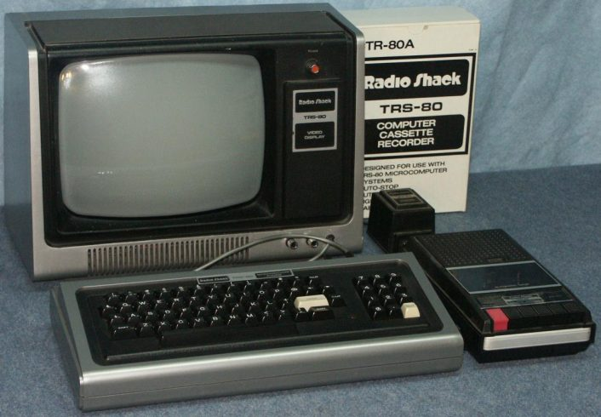
Who is this person and what is she doing here?!?
Holly Markel
Wrote my first computer programming at age of 8!

Slide 3
Who is this person and what is she doing here?!? (continued)
Holly Markel
Graduated from SVSU (a Colleague school)
3.5 years working in their Administrative Information Systems department
19 years working in Information Technology
13 years working in Databases/SQL
10 years working in student information systems
7 years working in data warehousing and ETL (Extract, Transform, and Load data)
3 years working for Hope College

Slide 4
A little about Hope College
Founded in 1866 in partnership with the Reformed Church in America
Four-year liberal arts college
Located in Holland, MI
Over 33,000 alumni

Slide 5
A little about Hope College’s Banner
We have been on Banner for 20 years
We use Banner for:
Finance, A/R, HR, Payroll, Student, Financial Aid
Transitioning from Banner Advancement to Blackbaud The Raiser’s Edge
Using Hobson’s Radius for Admissions
Currently around 3300 active students and 1000 Faculty/Staff
Banner 8 on Oracle 11 Windows
working on transitioning to Banner 9 on Oracle 12 Linux

Slide 6
A little about Hope College’s Data use
We have around 40 reporting users accessing Banner data directly
MS Access
Tableau
A few IT users using direct Oracle queries in Toad or SQL Developer
Our own home-grown reports through a web application
Many additional users go to this site
Around 350 database views in the Banner database
Around 50 materialized views that refresh nightly
Biggest materialized view takes around 8 hours to refresh right now!
133 columns across 45,000 records

Slide 7
SSIS – What is it?
SSIS: SQL Server Integration Services
An ETL service built for data integrations
Uses Visual Studio developer interface and debugging tool
The Visual Studio 2012 version SSIS developer tools are free
SSIS processes can be deployed and run in automation from a Microsoft SQL Server
Hope College has created 48 separate SSIS processes for data integrations that we have running

Slide 8
Why have an archive of Banner data?
Data as it was on the day of
Many tables don’t store historical changes
- OR - they don’t store them very well
Deleted records from source
Direct queries against Banner
Performance issues for others
Performance issues of the queries

Slide 9
How this design process went
Many changes throughout the process as we discovered things
Mantra –
BUILD IT IN!

Slide 10
Where do we start?
What area do we really want to target first?
STUDENT!!!
How do we go about doing that?
Tables
We started with about 25 tables (then later expanded to about 100 tables)
Get a list! Build it in!

Slide 11
What metadata do we need?
Wait!!! What’s metadata?

Slide 12
What metadata do we need? (continued)
Process data
How to run
Making the process dynamic
What ran
When it ran
How it went (were there errors? what did we get?)

Slide 13
What metadata do we need? (continued)
Row-level data
When we got it
How long was it in source
When did it change
Is this data current?
Has this data been deleted?
Are there errors in this row?

Slide 14
The Process – it seems so simple!
1. Get the list of tables
2. Log that the process started
3. Loop of actions for each table in the list:
Copy over the data we don’t already have
Mark the data that has changed (if any) as no longer current
Mark the data no longer there (if any) as deleted
Flag any errors
4. Log that the process ended

Slide 15
Copy over the data - For each new table …
First time load
Considerations first:
Destination tables – Who wants to do manual creation on all those tables?
Build it in to the process!
Don’t we need an index?
Build it in! Build that in, too! Use the source primary key, plus a unique identifier for the destination row
Build it in! Build the Unique Identifier for the destination row into the row-level metadata
The good news for new tables:
Don’t (yet) need to worry about marking records in new tables as old or deleted

Slide 16
Copy over the data - For each existing table…
Find the new records in source since last load
Insert them into the destination
Compare the previous data to what you just added
If a record has changed, mark the previous one (by insertion date) as old
Compare the ‘current’ (by flag) data in the destination to the source
Records in destination but not source? They’ve been deleted

Slide 17
What’s new?
How do I know what data is new?
Use the source system change data capture (CDC) dates, if possible (or create them in source)
GREAT! I CAN USE ACTIVITY DATES!!! They’re already there!
WHAT?!? I CAN’T USE ACTIVITY DATES???
Compare every piece of data in the source record to the destination (Uggh! Right?)
Hash!
SQL function: DBMS_CRYPTO.HASH( UTL_RAW.CAST_TO_RAW( *** ),3)
*** [full concatenated list of columns goes here – omit the ACTIVITY DATE field]
Better throw that in the row-level metadata, too… Build it in!

Slide 18
How do I know if I have the same record?
Source table PK
Some Banner tables have up to 9 fields on the Primary Key!
Gotta compare them all – Build it in!
Some Banner tables don’t have a Primary Key
Seriously?
Yes, seriously
Can we infer a potential primary key? We’ll need it for that index, anyways
Sometimes, so let’s capture it, but….
Better be safe than sorry
If an entire row is the same (by hash), we have it already
Otherwise, mark as deleted if not there in source exactly as-is

Slide 19
How do I compare source to destination (and still keep this a dynamic process)?
Dynamically created SQL statements
Join source to destination
This adds to the metadata we need to keep for the list of tables:
At run-time:
List of columns
Pull from the source system DBMS system table (Oracle: all_tab_columns) so that we don’t have to store the whole list for each table
SSIS has a maximum field length of 4000 characters – more on this later
Source Schema name | Source Table name | Destination Schema name | Destination Table name
Number Key fields | Key field names (9) | Last modified field (activity date) name | Has true source PK?
Is new table? | Last Load sequence | Last load time

Slide 20
Moving this to another database
Wasn’t part of the goal to move it somewhere else to keep Banner from having performance problems?
How do we keep our dynamic queries with our source-destination joins?
Oracle database links – Build it in!

Slide 21
Oracle database links
Uh-oh! Oracle database links have a 4000 byte maximum field length (no LOBs allowed)
Need to make some sort of special exception here for the tables with potential of these
Can we leave the LOB source fields out?
When are we ever going to do analytical reporting off of a field larger than 4000 characters?
What about when the total characters in the hash is over 4000?
- OR -
What about when the column list is more than 4000 (since we’re bringing that, too)?
Are there columns that are larger than we would report off of, but under 4000? Eliminate!
Are there columns we have never used that have been around for a long time? Eliminate!
Omit the Banner 9 system columns (Surrogate ID, Version, Data Origin, VPDI Code) from this elimination or Common Database Upgrades could make your Data Warehouse server’s brain explode

Slide 22
Flagging errors/warnings
What do we want to catch?
Duplicate records – more on this later!
PIDM = 0 (Integration gone wild)
Table load error
Do we include errored data in our analytics?
Flag on the error type code value for whether or not error is a data quality problem

Slide 23
Duplicate records are special snowflakes
Duplicated data versus true duplicates
Build it in! Put a character between each column in obtaining the hash
This will make the list of column names you can take shorter
Are both duplicates (if we have a true duplicate detected) an error? No
Only mark one of them
When checking for deletions, also need to check to see if records are still duplicates
Column A | Column B | Column C | Concatenated value
1 | 2 | 3 | 123
12 | (null) | 3 | 123

Slide 24
What if I just want current data?
Create views using the Is Current flag
Might as well do that dynamically at creation time
Build it in!

Slide 25
What happens when Banner adds a column?
Process will error
We want it to, so we can fix the destination table
Add the new columns to the destination table and re-run!
Make sure to also add these to the current records view

Slide 26
Logging
We’re already recording start and end time of the process
Row-level metadata captures the load a record came in on
Might as well capture:
Start and end time of each table – Build it in!
How many records in each load – Build it in!
Inserts
Updates
Deletions
Errors – both new and total currently present

Slide 27
What if the process fails while running?
Lots of thought went into this
SSIS’s default error handling allows to send an email – do that – Build it in!
Where do we want it to stop versus move on and keep going?
Before it gets to any tables (or after it’s done)? Fail and halt processing entirely
Table loop – skip on to the next table and error out the table
Table load statement – send full statement in email body text

Slide 28
Getting fancy (a.k.a. Oh crap, it’s RCRAPP)
Exception columns:
We had to build in some alternate logic to capture:
Data in RCRAPP tables
GORSDAV_VALUE field (ANYDATA data type)
A poorly-used keyword-tagging process in a comment field
Eliminate columns we don’t have room for that we aren’t planning on using
Truncation or substring where a field is too large but we still want it
We’ll need to add a yes/no field to capture if this truncated the source value – Build it in!
Add another error code for if this field is a ‘Yes’
Type conversion, if the field can be converted

Slide 29
How do we use this stuff?
Say I want to do some analysis on the set of currently enrolled students…
Use the Is Current views! Just like live Banner data
Say I want to look at the data we pulled from our IPEDS date last year…
Use the start and end dates on rows as book-ends
IPEDS date is between the record’s Start Date and End Date
We’ve built some dimensional model tables off of data in our archive:
Dimensions | Person | Term | Major
Facts | Student Major – Single Relationship | Student Major - Flattened | Term-level Academics

Slide 30
Future plans…
More dimensional tables
Future potential data:
Student Activities
Course-level information
Employee/Faculty information
High Schools | Degrees | Student Attributes
Test Scores | Address information (?) | Admissions Details

Slide 31
What’s everyone else doing?
Group discussion time!

Slide 32
Thank you!
I hope you found this informative
If you have any questions, now is the time to ask!
For more information, please feel free to email me:
markelh@hope.edu
For a copy of this presentation
For a copy of our SSIS package and metadata table creation scripts

Slide 33
Primary Keys (that aren’t really Primary Keys)
What to include in our destination table index
Key values
Hash
Unique identifier field
Metadata fields that will be queried (Is Current flag, Last load, error flag)
Do we make our destination table indices a primary key?
Oracle doesn’t allow nullable fields in a PK
Inferred keys – Tables without a source PK
SPRIDEN – PIDM, ID, Change indicator
None of these are unique!
Change indicator is nullable
Change indicator can’t be in the database PK
Build it in – put nullable fields at the end of the list and drop off the last field if PK creation fails

