Slide 1
Using Email for Appreciative Advising
Danielle Leek, Associate Professor
Grand Valley State University

Slide 2
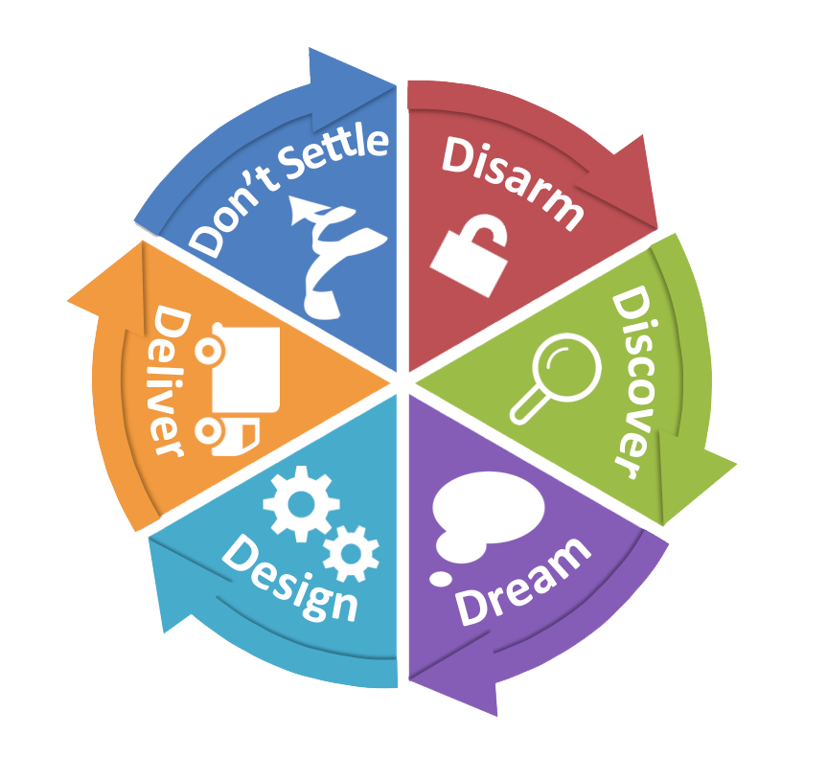
Six Phases of Appreciative Advising

Slide 3
Disarm.
Make a positive first impression with the student, build rapport, and create a safe, welcoming space.
Discover.
Ask positive open-ended questions that reveal students' strengths, skills, and abilities.
Dream. Inquire about hopes and dreams for the future.
Design.
Co-create a plan for making their dreams a reality.
Deliver.
The student delivers on the plan created during the design phase and the adviser encourages and support students.
Don’t Settle. Advisers and students need to set their own internal bars of expectations high.

Slide 4

Electronic Crisis
Im-personality
Counter-productivity
Ir-responsibility

Slide 5

Disarm.
Welcome
Office Hours
Invite questions/visits
Share

Slide 6
Discover.
“We may exhibit an admirable command of content, and possess a dazzling variety of pedagogical skills, but without knowing what’s going on in our students, that knowledge may be presented and that skill exercised in a vacuum of misunderstanding.”
–Stephen D. Brookfield, The Skillful Teacher (2006)

Slide 7

Dream.
Research Opportunities
Study Abroad
Lectures
Theatre
Student Organizations
Alternative Breaks

Slide 8
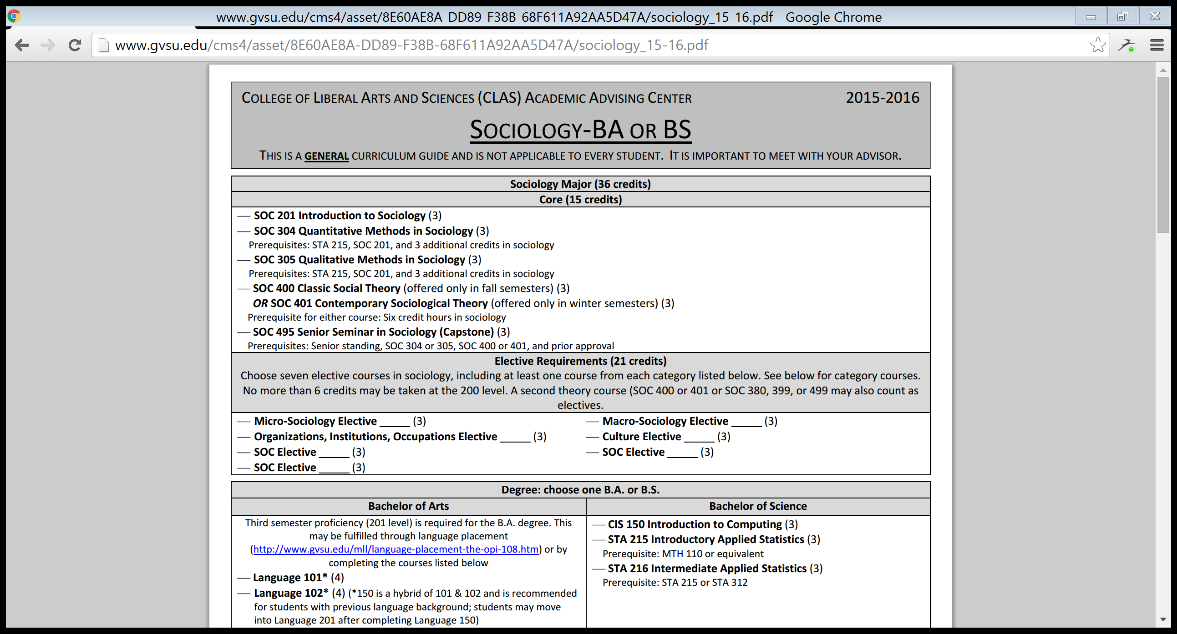
Design.

Slide 9

Deliver.

Slide 10
Don’t Settle.
Follow-up on meetings
Check in on students’ progress
Expect students to follow-through

Slide 11
Appreciate advising.
It makes school a better place.
Semester start
DISARM
October
DISCOVER
April
DON’T SETTLE
November
DREAM
January
DESIGN
March
DELIVER

