Slide 1
Interfacing with Students with Autism Spectrum Disorder: A Campus collaboration
Supporting Students with an Autism Spectrum Disorder Diagnosis

Slide 2
Disability Support Resources
4015 James H Zumberge hall
331-2490
Kathleen M. VanderVeen, Assistant Vice President for Inclusion Planning
Shontaye Witcher, Interim Director, Disability Support Resources
Jason Osborne, Senior Program Advisor
Leijhi Koval, Program Advisor
Jeff Sykes, Assistive Technology Coordinator
Dori Runyon, Office Coordinator
Etonia Todd, Testing Coordinator
Sandra Harrier, Testing Coordinator Assistant
Aaron Breting, Van Scheduling Coordinator
Liz Chase, Graduate Assistant-CSAL
Brittania Schreurs, Graduate Assistant-CSAL

Slide 3
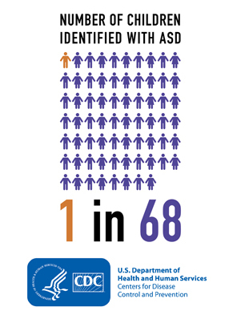

Slide 4
What is Autism Spectrum Disorder (ASD)?
Autism Spectrum disorder and autism are both general terms for a group of complex disorders of brain development
According to the National Institute of Mental Health (2015) Autism Spectrum Disorder is described by:
persistent deficits in social communication and social interaction across multiple contexts
restricted, repetitive patterns of behavior, interests, or activities
symptoms must be present in the early developmental period (typically recognized in the first two years of life)
symptoms cause clinically significant impairment in social, occupational, or other important areas of current functioning
www.nimh.nih.gov

Slide 5
“Because students with ASD appear ‘normal’ and may have obvious talents and abilities, faculty and other students may easily become frustrated by behaviors inherent to the disability. This can lead to social ostracism and ultimately adversely affect learning.”
(Camarena & Sarigiani, 2009, p. 177)

Slide 6

Students with ASD in College
Academic rigor rises
Transition issues
New college social environment
No filters during class time

Slide 7
While students with ASD arrive at college with many favorable qualities, certain skill sets are typically underdeveloped and therefore negatively impact the transition into and persistence though college as well as their post-college placement in the workforce.

Slide 8
Six domains
Six domains represent some of the most prevalent areas of concern as students transition into and strive to find success in college and beyond:
Executive Functioning
Academic Skills
Self-Care
Social Competence
Self-Advocacy
Career Preparation
http://www.rit.edu/~w-ssp/documents/ASDinHigherEdGuide.pdf

Slide 9
Executive Functioning
    Refers to brain functions that activate, organize, integrate and manage other functions.
    Enables individuals to account for short and long term consequences of their actions and to plan for those results.
Deficits
    Difficulty with independent living and self-directed learning required for college success.
    Struggle to carry out actions such as planning and prioritizing which is necessary to initiate and complete academic work.

Slide 10
Academic Skills
    Refers to strategies and techniques that enable successful learning and academic progress, test preparation, note-taking, textbook reading, library/research skills, writing competency, and working within one’s learning style.
Deficits
    Struggle with a rigidity (stick with the familiar).
    Unable to be flexible with learning methods, various teaching styles or diverse academic disciplines.

Slide 11
Self-Care
  Refers to maintaining one’s personal wellness, including sleep, hygiene, exercise, nutrition, sensory integration, stress management, medication management and budgeting.
Deficits
  Taking responsibility for one’s health.
  Need time to develop independence.
  Struggle to maintain consistent hygiene, sleep patterns, and management of medications that are necessary for conditions such as attention deficit disorders, anxiety, and depression.
  Problems with sensory integration (e.g., fire alarms, crowded dining halls, constant socialization, etc.)
  Can become overwhelmed and may resort to familiar self-soothing tendencies, such as rocking or pacing. These tendencies could be perceived as socially inappropriate, leading students with ASD to become increasingly isolated from peers.

Slide 12
Social Competence
  Refers to the ability to relate to others by responding to verbal and nonverbal communication.
Deficits
  Inability to get along with others and build relationships.
  Challenges with initiating conversations and reading of social cues.
  Tend to interpret communication literally, making it difficult to understand sarcasm, as well as social and classroom norms.
  Possess excellent vocabulary and can appear highly articulate, however, others misinterpret social difficulties as disrespect or indifference.

Slide 13
Self-Advocacy
  Refers to knowing and communicating one’s needs while understanding corresponding rights, responsibilities and resources (Brinckerhoff, L.C., 1994).
Deficits
  Inability to anticipate challenges and access to resources.
  Difficulty developing and practicing self-advocacy skills.
  Struggle requesting accommodations and accessing support services.
  Planning, personal flexibility, responsibility, and social communication, make it hard for students with ASD to recognize how and when to ask for help.

Slide 14
Career Preparation
  Refers to vocational exploration, the job search and application processes, as well as gaining appropriate work experience.
  Skills of networking, resume-writing, interviewing, and navigating the social world of work.
  The importance of career development during the college years cannot be underestimated given that securing fulfilling employment is one of the ultimate goals of higher education.
Deficits
  Students may struggle to transfer knowledge and skills to employment settings.
  Social interaction can undermine chances of success in an interview, where candidate fit is often based on “soft-skills” rather than measurable skills or educational background.
  Indirect social context of work can be confusing and sensory integration issues make it difficult to function in work environments without appropriate accommodations and supportive management.

Slide 15
What are we seeing in Advising Sessions and in the classroom?
Sending emails that are not carefully worded
Difficulties with time management and organization
Needs extra clarification before beginning tasks/assignments
Struggles during group projects, class participation, and other activities
Talkative at the beginning, during and after class
Avoid giving professors their memos if registered with DSR
Intrusive parental involvement
Requires constant 1 on 1 support
Avoids eye contact, difficulty responding to social cues
Behavioral issues or unusual behavior such as rocking, tapping or pacing in advising sessions and classroom
Interruptions and gives unrelated answers to questions
Difficulties initiating communication
Easily frustrated with other students, advisors, professors and environment

Slide 16
Resources for GVSU students
Disability Support Resources – accommodations and academic support
Housing and Residence Life – Living Learning Center (LLC) Committee with other LLC’s on campus
Counseling Center – personal counseling
Campus Links mentors (red and blue groups)
Psychology Department – social skills class (Campus Links participants)
Dean of Students – classroom behavior management
Student Academic Success Center/Tutoring
Advising Centers
Career Center
Library Knowledge Market

Slide 17
Solutions for the classroom
If student is registered with DSR, distribution of memo with detailed disability verbiage for ASD
Treat students as you would any other student if memo does not specify otherwise
Behavioral Contract in agreement with the student
Learning skills/tutoring assistance
Think outside the box
Contact Disability Support Resources or the advisor who is listed on the DSR memo with any questions

Slide 18
Solutions for the Advising Centers
Do not assume that the student is registered with the DSR office
Be patient
Redirect student conversation when discussing advising topic-student may want to talk to you about non related matters ie, typewriters, trains, Russian Military History, Anime
Give clear, literal directions
Avoid using metaphors/open ended questions
If there are any tasks given to the student, recap at the end of the appointment
Affect may not show that attention is being paid in advising session, ask student to repeat
Faculty may contact you on tips for managing behaviors in the classroom-refer to DSR or FTLC

Slide 19
Education for Campus Community
Faculty Staff Training (new and ongoing)
Disability Awareness Month Events
Speakers
Student Panels/Organizations
Campus Links Open House
Faculty Teaching Learning Center (FTLC)
Teach IN
Individual Consultation with faculty by DSR staff
Freshman Orientation
Laker Visitation Days
Resource Fairs

Slide 20
DSR staff involvement
Program advising on satellite campuses
Program advising in North C
Mid and end of semester transcript review outreach
Assistive Technology
Study skills/learning skills assessment
Weekly case review
Involvement in Advisory Council, Behavioral Meetings, and Housing Appeal Committees
ADA Compliance
ADA Advisory Committee
Testing Task Force
Internship assistance for DSR students

Slide 21
Resources
http://www.gvsu.edu/dsr
http://www.autism-society.org
www.gvsu.edu/integrativelearning
http://www.gvsu.edu/library/knowledge-market-17.htm
http://www.gvsu.edu/speechlab
http://www.johnrobison.com/about-john.php

Slide 22
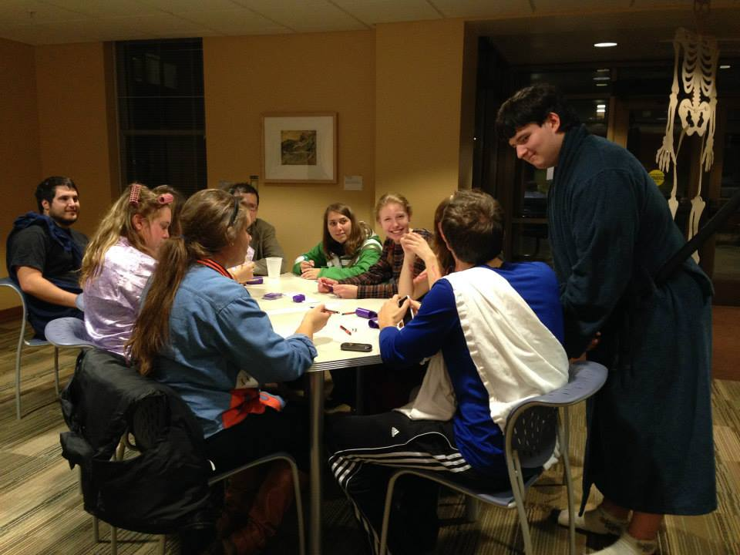
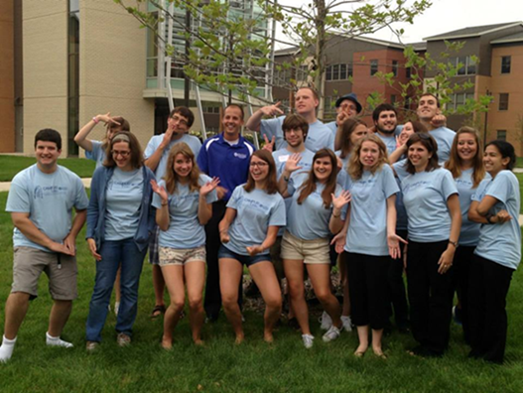
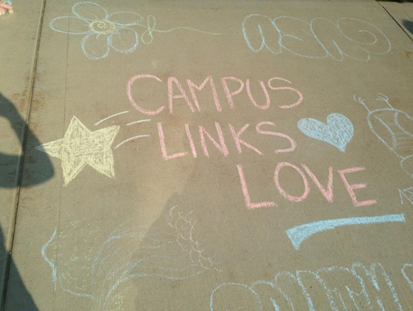
Questions?

