Slide 1
Hands-On Activities for Struggling Students
By EduCalc Learning
2023 Math In Action
Grand Valley State University
© EduCalc Learning 2023

Slide 2
Dr. Honora Wall, Ed.D. Curriculum & Instruction
honora@educalclearning.com
www.educalclearning.com
https://rss.com/podcasts/dyscalculia/
18+ year teacher
Author
Researcher

Slide 3
Today’s goal:
Activities that work in any setting, for any student, at any level.

Slide 4
“I’ve tried everything, why isn’t anything working?”
Math struggles come from:
Low numeracy;
Weak foundation;
ELL students;
Dyscalculia, the math learning disability.

Slide 5
“Give the pupils something to do, not something to learn; and the doing is of such a nature as to demand thinking; learning naturally results.”
– John Dewey

Slide 6
Using unusual activities…
… increases engagement,
… helps form memories,
… increases metacognition, and
…. helps students at all levels, with and without learning disabilities.
Research shows that art, music, projects, and explorative activities work!

Slide 7
“We only think when confronted with a problem.”
– John Dewey

Slide 8
Numeracy Games
1. Number Hangman
2. Operation!

Slide 9
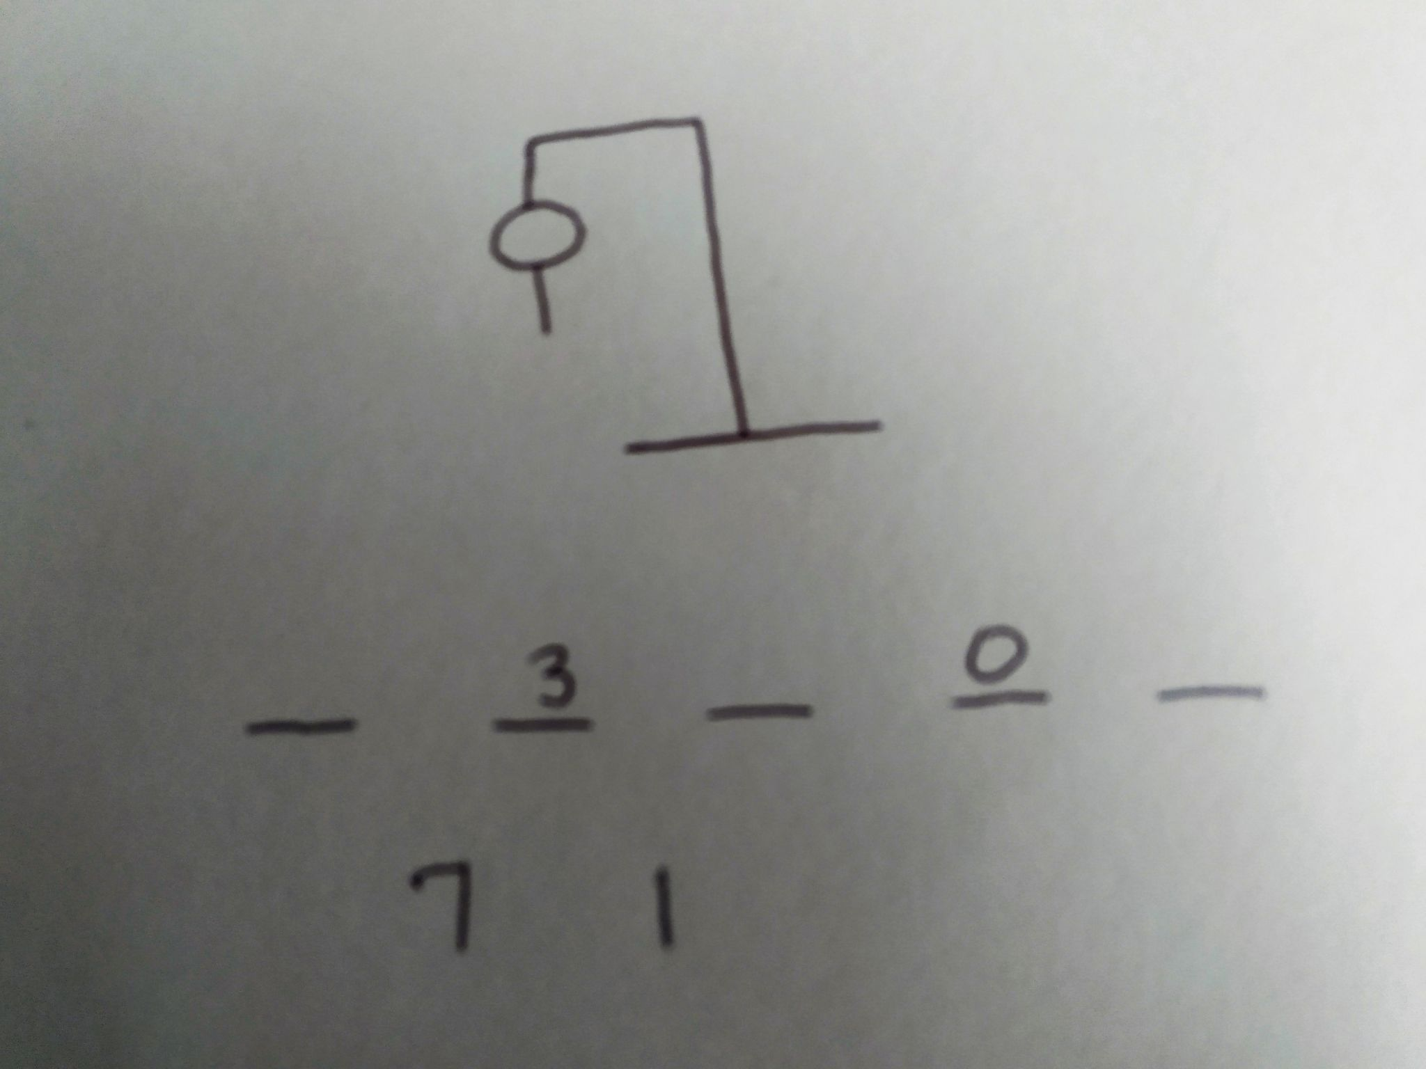
Number Hangman
Choose 3 to 5 numbers (0 to 9).
Write down your sequence!
Have students guess the numbers.
Track the sequences used and the incorrect guesses.

Slide 10
Using Number Hangman:
For lower grades, do not repeat numbers.
6th grade and up can repeat numbers.
Save sequences and use for class or homework.
Write sequences in order G to L.
Use one sequence and make all possible combinations.
Use one sequence and add, subtract, multiply, divide.

Slide 11
Using Number Hangman:
Works great as a center or small group activity.
Fills time around fire drills, assemblies, end of lesson.
Let students run the game!

Slide 12
Operation!
Put students into teams or with partners.
Choose up to 5 numbers for adding/subtracting games, 3 for multiplying/ dividing games.
Use dice, cards, online spinners, or have students say random numbers (use numbers less than 20).

Slide 13
Operation!
Team 1 combines the numbers
(add, subtract, multiply, or divide).
Team 1 gives just the answer to Team 2.
Team 2 guesses the operation!

Slide 14
12

Slide 15
Using Operation!
This game is complex– give students time to solve problems.
The game is more difficult with extra numbers or changing signs.
Subtraction and division is more difficult, because order matters.

Slide 16
“Art is the most effective mode of communications that exists.”
– John Dewey

Slide 17
Art Projects
3. Sierpinski’s Triangle
4. Pascal’s Triangle
5. Mondrian Art

Slide 18
Sierpinski’s Triangle

Slide 19
Sierpinski’s Triangle
Draw an equilateral triangle with one vertex pointed up.
Mark the midpoint of each side.
Draw a downward-pointing triangle.
Continue making triangles in the blank spaces.

Slide 20
Using Sierpinski’s Triangle:
Have students draw free hand or with a ruler.
Older students can use the midpoint formula.
Discuss patterns, fractals, and increasing smaller amounts.
Work with your art teacher.

Slide 21
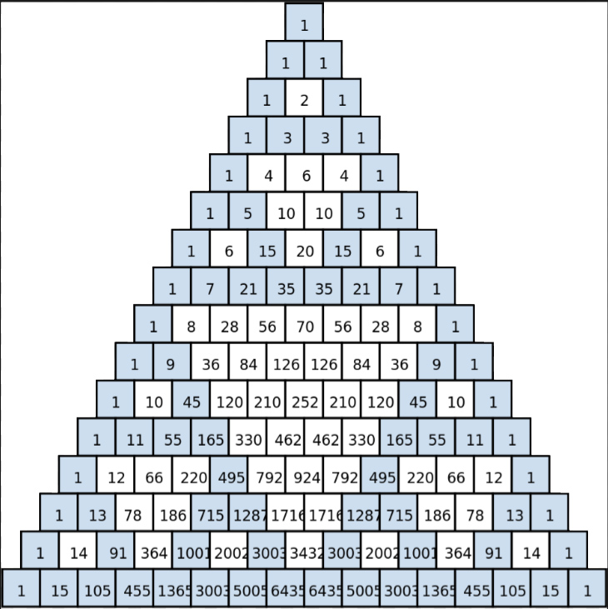
Pascal’s Triangle:
This shows
Binomial Expansion,
an important
concept in
higher level math.

Slide 22
Pascal’s
Triangle:
Covering the
Even numbers
Creates the
Same pattern.

Slide 23
Using Pascal’s Triangle:
Ties together math and art.
Gives struggling students access to math.
Expands the conversation: Math is more than numeracy.

Slide 24
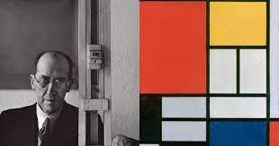
Mondrian-inspired Art
Piet Mondrian
Dutch painter
“De Stijl” movement

Slide 25
Mondrian-inspired Art
Draw 3-4 horizontal lines.
Draw 3-5 vertical lines.
Draw 3 diagonal lines.
Draw 2-4 circles.
Color!

Slide 27
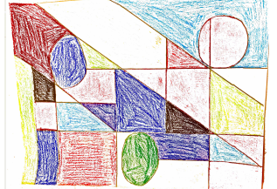
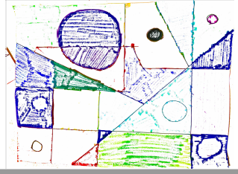
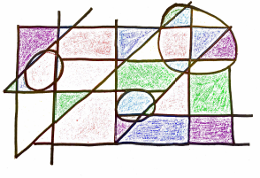
Student work

Slide 28
Struggling students rarely have their work displayed. Be sure to post the projects!

Slide 29
Be messy. Struggling students need to be right, be included, and be successful, without being perfect.
High-achieving students need to see this also.

Slide 30
“Education is a social process.”
– John Dewey

Slide 31
Movement reinforces memory and recall and increases oxygen to the brain.
Movement can be:
Out of seat;
Raising hands;
On the playground.

Slide 32
Movement Activities
6. Back It Up
7. To the Left
8. Who Can…

Slide 33
Back It Up!
Start at 0.
Add 2 every time you step forward.
After ten steps, stop
Back it up: Subtract 2 when you step back.

Slide 34
Any “backwards” math is more difficult to do, just like walking backwards or saying the alphabet backwards.
Backward Math:
Subtraction,
Division,
Roots,
Factoring.

Slide 35
Using Back It Up!
Addition and subtraction,
Multiplication and division,
Allow number lines, times tables lists, etc.

Slide 36
Make up numbers or have a deck of cards or sets of dice to play with.
Card and dice games increase number sense, illustrate inequalities, and support probability.

Slide 37
Think of a card.
Write down the color, suit, and number.
Aces = 1
Face cards = 11

Slide 38
To the Left
Odd numbers to the left, even to the right.
Prime numbers to the left, composite to the right (the Ace should stay in the middle).
Less than 3 to the left, greater than 3 to the right (3 should stay in the middle).

Slide 39
Using To the Left
Students can see if they are right or wrong.
Students can change groups quickly.
Removes embarrassment of being wrong.
Stores memory in multiple places.

Slide 40
Who Can….
Use cards, dice, or random numbers.
Ask questions, have students group together.

Slide 41
Who Can….
Who can add to 12?
Who can subtract to a number less than 8?
Who can multiply to a number greater than 15?
Who can add to a prime number?

Slide 42
Using Who Can….
Students work together.
They practice being right and being wrong.
Removes embarrassment of being wrong.
Stores memory in multiple places.

Slide 43
Using Unique Activities:
Using one activity in multiple ways is a true real-world experience for students.
Using activities where everyone can win gives struggling students space to succeed!

Slide 44
Thank you for being here today!
Session evaluation:
https://www.gvsu.edu/mathinaction/math-in-action-program-2023-16.htm
“Hands-On Activities for Struggling Students”
Notes:
30 minutes

Slide 45
Let’s continue the conversation…
Dr. Honora Wall, Ed.D.
honora@educalclearning.com
www.educalclearning.com
https://educalclearning.thinkific.com/
https://rss.com/podcasts/dyscalculia/

Slide 46
References
Brigham, F.J. Scruggs, T.E., and Mastropieri, M. A. (2011). Science Education and Students with Learning Disabilities, Learning Disabilities Research & Practice. 26(4), 223–232.
Elster, A. and Ward, P. (2007). Learning math through the arts, Mathematics and Culture, M. Emmer, Ed., Springer, New York, NY, USA.
Lai, Y., Zhu, X., Chen, Y., and Li, Y. (2015). Effects of mathematics anxiety and mathematical metacogntiion on word problem solving in children with and without mathematical learning difficulties, PLOS ONE.
Oppenheimer, F. (1968). A rationale for a science museum, Curator: The Museum Journal. 11(3), 206–209.
Thuneberg, H., Salmi, H., & Fenyvesi, K. (2017). Hands-on math and art exhibition promoting science attitudes and educational plans. Education Research International.

